Slide 1
Flow recording

Slide 2

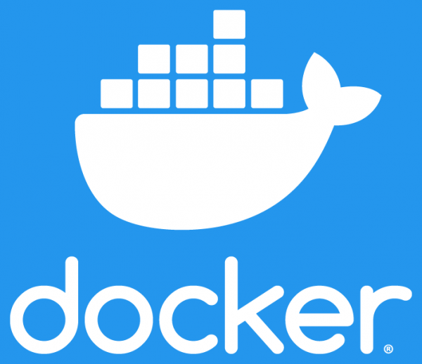

Components used
Minikube (v1.16.0)
Creates local kubernetes cluster
Docker (v20.10.5)
Used as vm driver for minikube
Open vSwitch (v2.14.0)
SDN compatible virtual network switch

Slide 3
Pods Created
Analyser
This is a service that accepts as input a file containing the list of names we want to record requests to
Analyses incoming traffic from a given port
When the domain of the packet exists in the predefined list, specific info about the packet gets forwarded to the logger pod
Logger
This is a service that listens for info packaged as a json from the analyser pod
Data are recorded to data.log file inside the pod
Data are accessible both inside and outside of the cluster with the provided client application

Slide 4
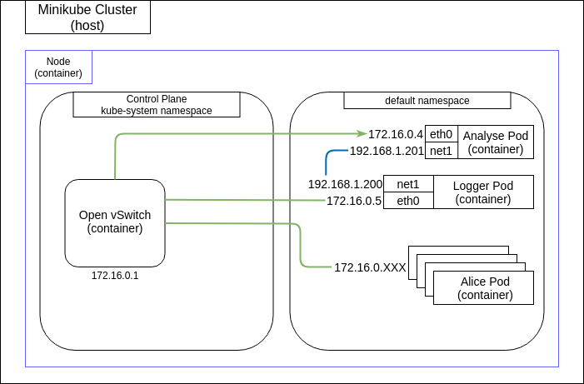
Cluster initial state
Kubernetes creates automatic rules for each newly created pod
By default they can communicate with each other
Traffic is mirrored through analyser port (eth0 interface)
Analyser and logger pod communicate through a secondary network

Slide 5
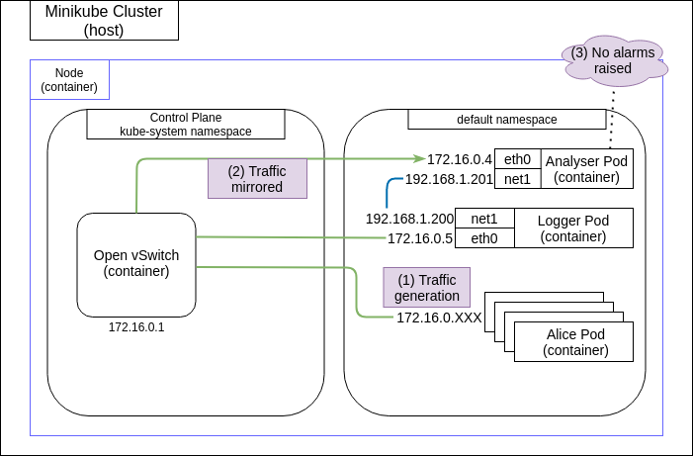
Normal operation
Requests pass through analyser pod and are analysed
Requests are checked against a predefined list provided by the user
Non-listed domain requests are not logged

Slide 6
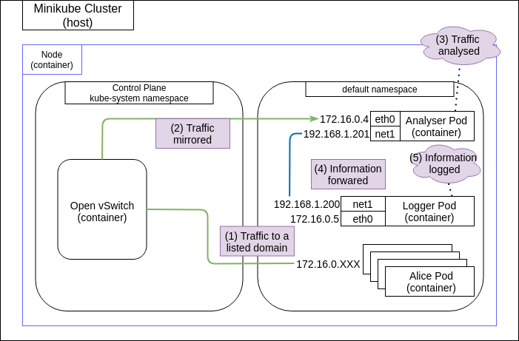
Domain Detection
When a domain exists in the predefined list, packet information get forwarded to the logger pod
Logger pod stores the provided information to the data.log file
Data.log file is accessible both inside and outside of the cluster

Slide 7
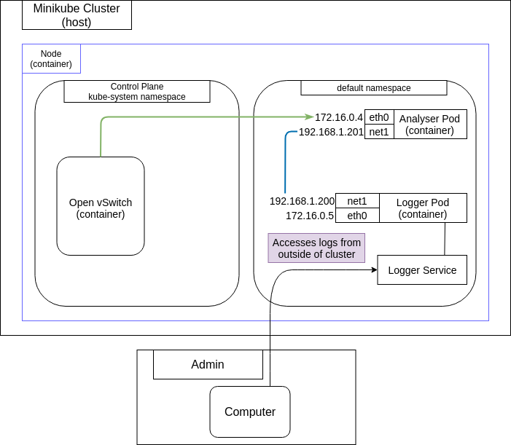
Accessing log
A kubernetes service is created in order for logger port to be accessible from outside the cluster
The administrator is able to access the data with a request on that service

