Slide 1
Forward malicious traffic to honeypot

Slide 2
Components used
Minikube (v1.16.0)
Creates local kubernetes cluster
Docker (v20.10.5)
Used as vm driver for minikube (all machines in the cluster are using docker)
Open vSwitch (v2.14.0)
SDN compatible virtual network switch

Slide 3
Pods Created
DGA detector
This service uses a machine learning model that detects requests to domains created by domain generation algorithms
When a malicious request arrives from the bridge, the offending IP is forwarded to the Flow controller
Flow controller
This service listens for requests from DGA detector
It forwards the request to the OVS controller service
OVS controller
This service runs on the same pod with the Open vSwitch bridge
It listens for commands from Flow controller
It applies the received commands to the Open vSwitch bridge
Honeypot
Receives malicious tcp traffic on port 80 and responds back to the malicious pod.

Slide 4
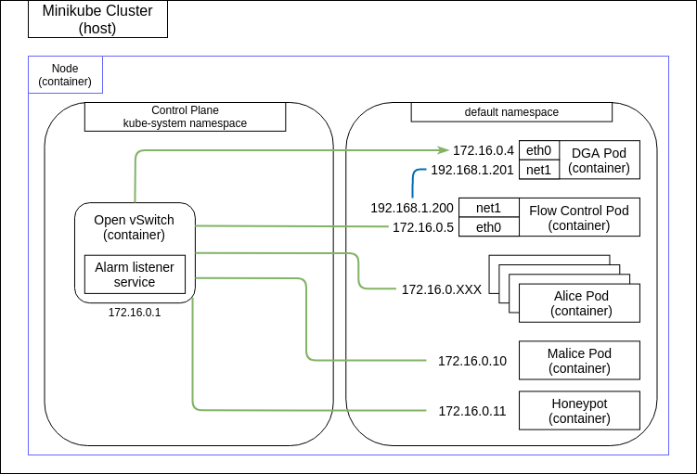
Cluster initial state
Kubernetes creates automatic rules for each newly created pod
By default they can communicate with each other
Traffic is mirrored through dga port connected to the ovs bridge
Dga and flow-controller after mirroring talk with a secondary network
Malicious tcp requests are forwarded to honeypot

Slide 5
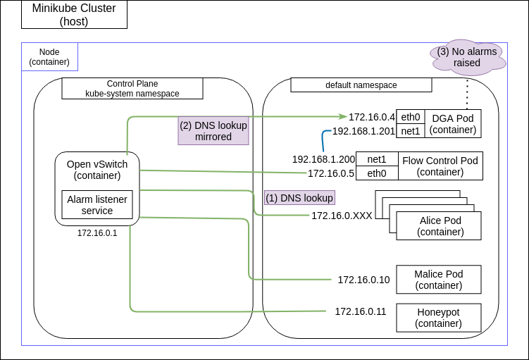
Forward malicious traffic to honeypot [1/4]
Requests pass through dga pod and are analysed
Requests are analysed with the help of a machine learning model running on a python script
Non-malicious requests are allowed

Slide 6
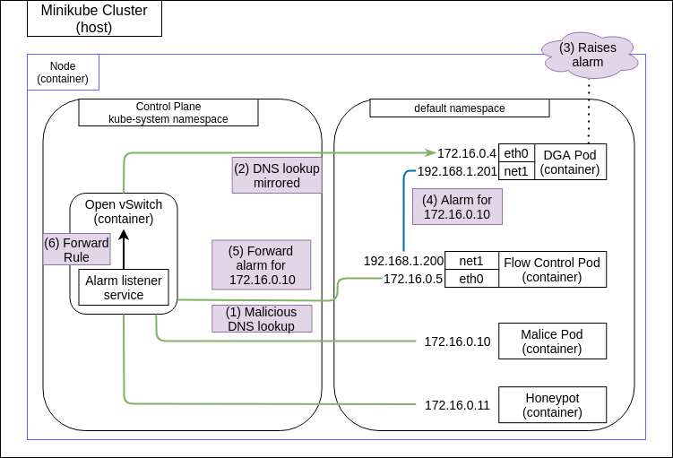
Forward malicious traffic to honeypot [2/4]
When a malicious request is detected, source pod ip is registered
Dga pod reports that ip to flow-control pod
Flow control pod forwards that ip to antrea-agent

Slide 7
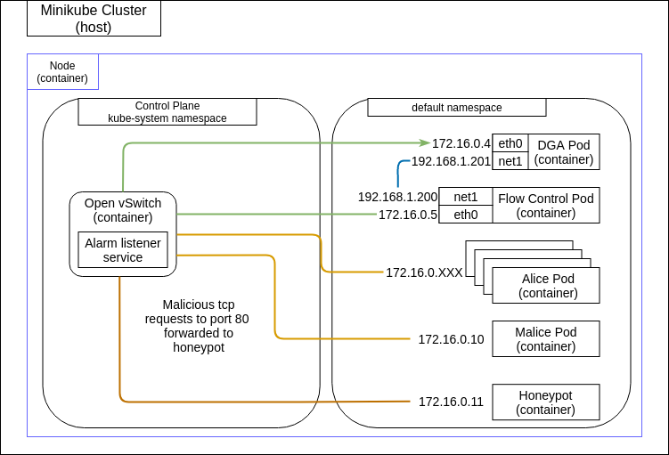
Forward malicious traffic to honeypot [3/4]
OVS controller service drops all requests on malicious ip using one rule
os.system('ovs-ofctl add-flow br-int table=70,ip,nw_dst='216.218.185.162',priority=300,actions=drop')

Slide 8
Forward malicious traffic to honeypot [3/4]
OVS controller service only forwards tcp connections to port 80 on malicious ip to honeypod using two rules
os.system('ovs-ofctl add-flow br-int table=70,tcp,tcp_dst=80,nw_dst='216.218.185.162',actions=mod_nw_dst:'172.16.0.11',mod_dl_dst:'f2:ce:e5:7f:81:8f',goto_table:71')
os.system('ovs-ofctl add-flow br-int table=10,ip,dl_src='f2:ce:e5:7f:81:8f',nw_src='172.16.0.11',actions=mod_nw_src:'216.218.185.162',goto_table:29')

