Slide 1
Block/Unblock traffic

Slide 2
Components used
Minikube (v1.16.0)
Creates local kubernetes cluster
Docker (v20.10.5)
Used as vm driver for minikube (all machines in the cluster are using docker)
Open vSwitch (v2.14.0)
SDN compatible virtual network switch

Slide 3
Pods created
Flow controller
This is a service running inside each own pod
It listens for a json file as input
The file contains commands (currently block/unblock) and arguments (the IP)
Forwards the json file to the OVS controller service
OVS controller
This service runs on the same pod with the Open vSwitch bridge
It listens for commands from Flow controller
It applies the received commands to the Open vSwitch bridge

Slide 4
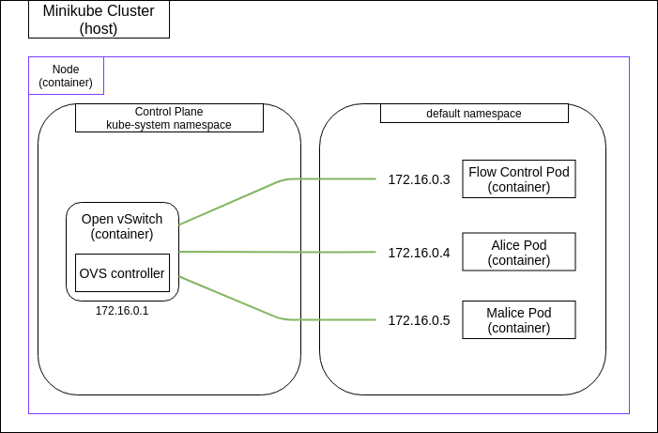
Cluster initial state [1/2]
Kubernetes creates automatic rules for each newly created pod
By default they can communicate with each other
Flow controller forwards all incoming json files to OVS controller

Slide 5
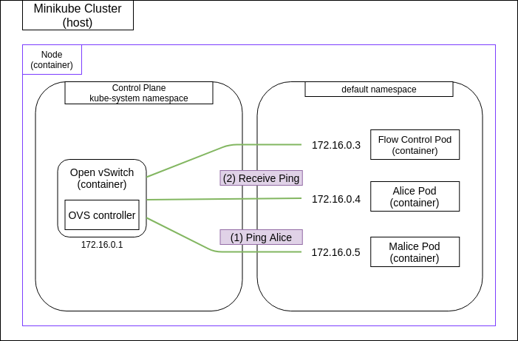
Cluster initial state [2/2]
At any given moment, pods are able to communicate with each other and with the outside world

Slide 6
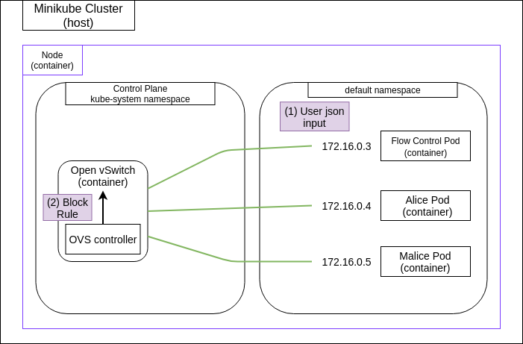
Blocking traffic [1/2]
By adding a new rule to the Open vSwitch, no traffic leaves the malice Pod:
ovs-ofctl add-flow br-int ip,nw_src=172.16.0.4,actions=drop
This adds a new OpenFlow rule at the switch.
When a packet matches the ip address the switch drops it.
The reverse action is to match that rule and delete it:
ovs-ofctl del-flows --strict br-int ip,nw_src=172.16.0.4

Slide 7
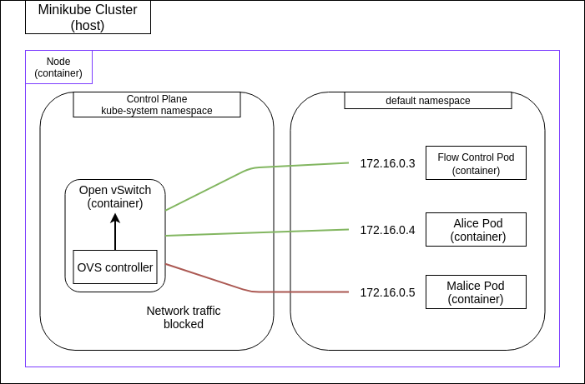
Blocking traffic [2/2]
By adding a new rule to the Open vSwitch no traffic leaves the malice Pod
Note that the port connecting the switch with the container is not deleted. It just drops all packages
If we remove the rule, the communication is restored

