Slide 1
Multi Node scalable DGA detection

Slide 2
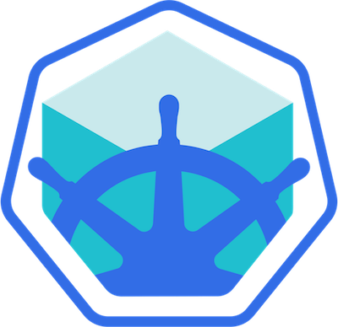
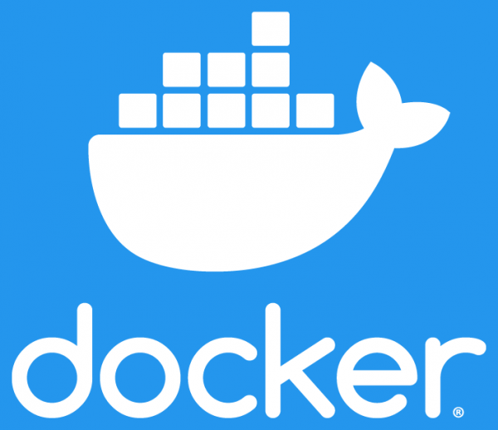
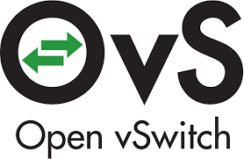
Components used
Minikube (v1.16.0)
Creates local kubernetes cluster
Docker (v20.10.5)
Used as vm driver for minikube
Open vSwitch (v2.14.0)
SDN compatible virtual network switch

Slide 3
Pods Created [1/2]
DGA detector
This service uses a machine learning model that detects requests to domains created by domain generation algorithms
When a malicious request arrives from the bridge, the offending IP address(es) is forwarded to the Flow client
Each node contains an instance of DGA pod
Flow Client
This service listens for TCP requests from DGA detector pod
Each TCP request contains the resolved malicious IP address
The malicious IP address(es) is packaged along with the `block` command as a JSON
The package is forwarded through a TCP connection to the flow server pod
Each node contains an instance of the Flow Client

Slide 4
Pods Created [2/2]
Flow Server
Runs a service that accepts TCP connections from flow clients in all nodes
The service is connected to all OVS controllers through a TCP connections
A package is received by the service from a flow client. The flow client could be in any possible node in the cluster
The package is broadcasted in all OVS controllers
Pod is deployed only on master node
OVS Controller
Runs a service that accepts TCP connections from Flow Server
Runs on the same pod as the Open vSwitch bridge
Applies the received package on the OVS bridge
Each node contains an instance of the OVS Controller

Slide 5
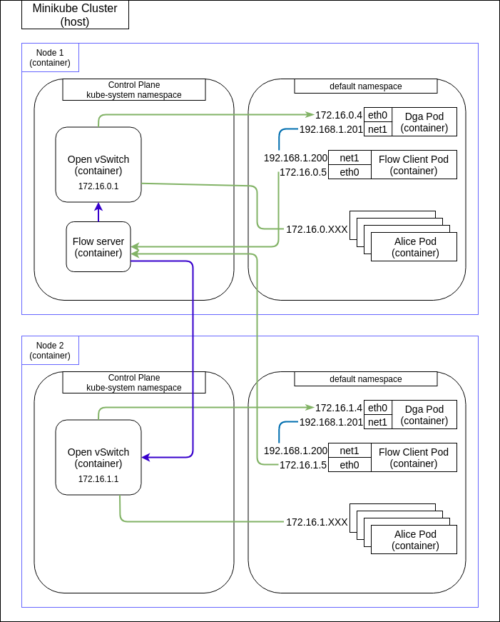
Cluster initial state
Kubernetes creates automatic rules for each newly created pod
By default they can communicate with each other
By default node to node communication is possible
Traffic is mirrored through DGA OVS port connected to the OVS bridge
After mirroring DGA and flow client communicate using a secondary network

Slide 6
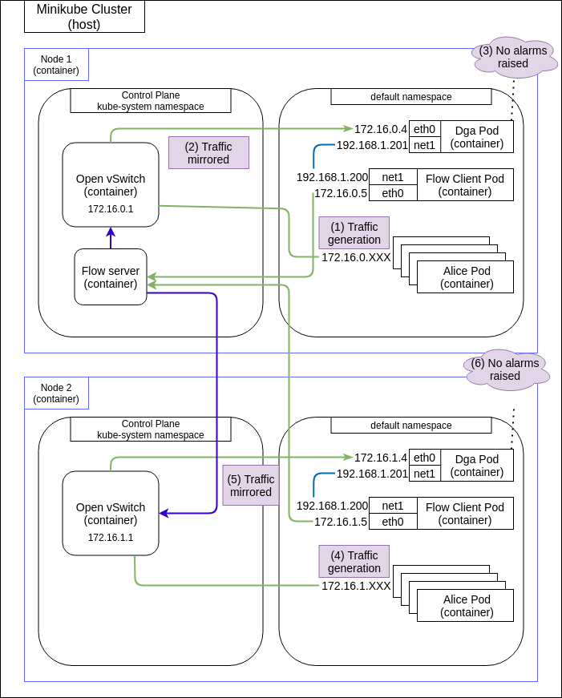
Normal operation
DNS Requests pass through dga pod and are analysed with the help of a machine learning model running on a python script
Each nodes traffic is forwarded to the corresponding DGA pod
Non-malicious DNS requests are allowed

Slide 7
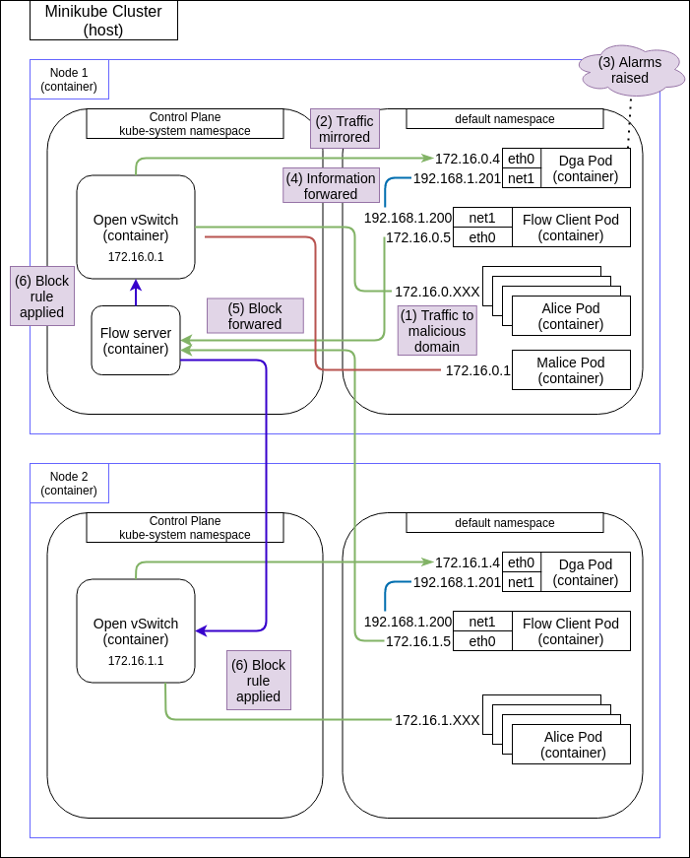
DGA detection [1/2]
When a malicious request is detected, the resolved IP address(es) of the domain is registered
Dga pod reports that IP address(es) to flow client pod through a TCP connection
Flow control pod generates an OVS command with that IP address(es), and sends it to Flow server pod on master node through a TCP connection

Slide 8
DGA detection [2/2]
Flow server pod on master node receives the IP address(es)
Flow server broadcasts the IP address(es) to all connected OVS controllers
OVS controllers in each node apply the block command on the OVS bridge in each node. Command applied is:
ovs-ofctl add-flow br-int ip,nw_src=<malicious IP>, actions=drop

Slide 9
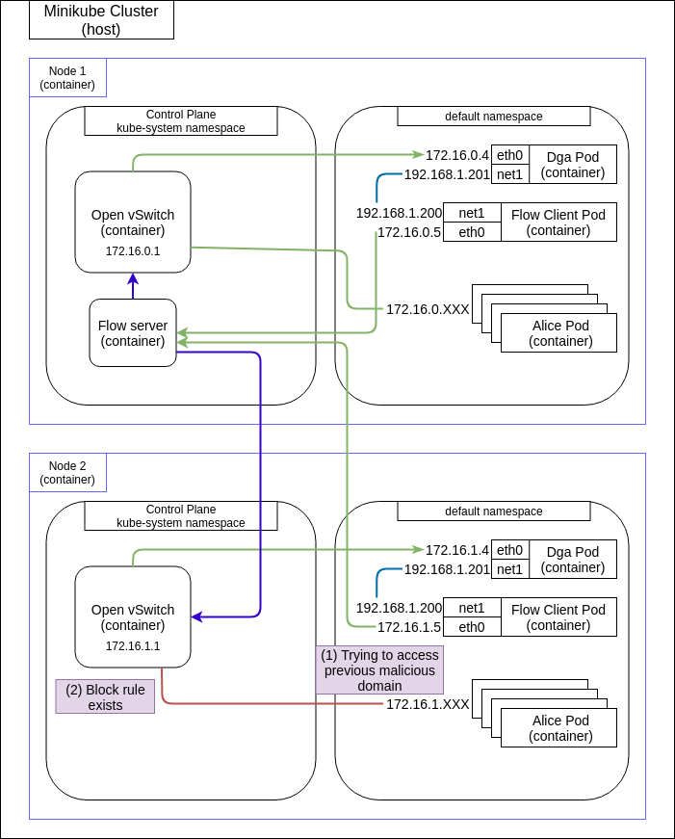
Blocked domain state
Each time a pod from Node 2 try to access a malicious IP address(es) previously accessed on Node 1, their request is dropped
Each block rule is applied universally to all Nodes

