Slide 1
Image Colorization
Computer Vision Project
Submitted By
Harsh Parashar | Prateek Singhal | Amit Panwar
M22AIE210 | M22AIE215 | M22AIE202

Slide 2
Project Objective
Create a model for transforming grayscale pictures into vibrant and realistic colored pictures
Treat colorization as a classification task and utilize class-rebalancing during training.
Due to resource constraints, train the system on a minimal dataset of ~14k color images to achieve comparable color prediction quality.
Develop an end-to-end API and web application to use the model as a SaaS offering.

Slide 3
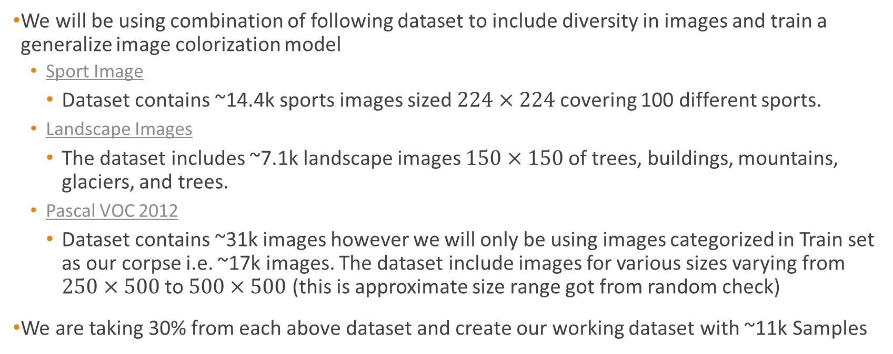
Dataset
We will be using combination of following dataset to include diversity in images and train a generalize image colorization model
Sport Image
Dataset contains ~14.4k sports images sized $224×224$covering 100 different sports.
Landscape Images
The dataset includes ~7.1k landscape images $150×150$of trees, buildings, mountains, glaciers, and trees.
Pascal VOC 2012
Dataset contains ~31k images however we will only be using images categorized in Train set as our corpse i.e. ~17k images. The dataset include images for various sizes varying from $250×500$ to $500×500$ (this is approximate size range got from random check)
We are taking 30% from each above dataset and create our working dataset with ~11k Samples

Slide 4
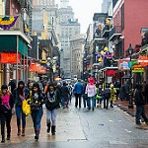
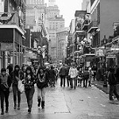
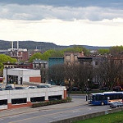
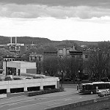
Data Preprocessing
Convert the colored images to grayscale
Normalize grayscale images and colored images between 0 and 1 for easier processing.
Resize images to 256 X256.
Shuffle the dataset to remove any inherent order.
Split dataset into training, validation, and test sets (70%, 10% and 20% respectively).

Slide 5
Model Architecture

Slide 6


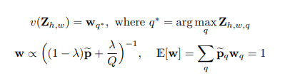

Convergence Approach
L2 Loss function: It is Euclidian distance between predicted and the ground truth (but this is not robust as it may cause desaturated results due to averaging)
Class Rebalance: It helps in rebalancing the ab (color gamut) values which helps in getting vibrant images
Class Probabilities to Point Probabilities: It helps in getting better accuracies in the color of objects

Slide 7
Evaluation Metrics
Semantic interpretability (VGG classification): This is achieved by feeding our fake colorized images to a VGG network that was trained to predict ImageNet classes from real color photos.
Raw accuracy (AuC): It is computed the percentage of predicted pixel colors within a threshold L2 distance of the ground truth in ab color space
Perceptual realism (AMT): This is a real vs. fake two-alternative forced choice experiment on Amazon Mechanical Turk (AMT).

Slide 8
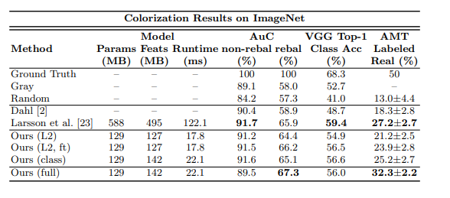
Colorization Result on ImageNet

Slide 9
Project Plan

Slide 10
Thank You!

