Slide 1
BECHLOR OF COMPUTER APPLICATIONS
ONLINE MOBILE PURCHASING & DISTRIBUTING SYSTEM
A Complete Multi-Tier Smartphone E-Commerce, Inventory Control & Distribution Management Platform
PROJECT NO.: 28 | 5th Semester BCA | Academic Year 2026-27
SUBMITTED BY (PROJECT TEAM):
1. PATANJALI PATEL (2024015667)
2. KEYUSH PATEL (2024015657)
3. PRIYANSHU PATEL (2024015671)
BECHLOR OF COMPUTER APPLICATIONS
Veer Narmad South Gujarat University, Surat Dolat Usha Institute of Applied Science and Dhiru Sarla Institute of Management & Commerce, Valsad

Slide 2
PROJECT CONTEXT & MOTIVATION
Introduction & Problem Statement
Challenges in Traditional Smartphone Distribution
• Fragmented Supply Chain: Lack of direct automated coordination between smartphone manufacturers, regional distributors, and end retail consumers.
• Inventory Inaccuracies & Phantom Stocks: Over-selling during flash demand spikes due to delayed inventory synchronization across warehouse depots.
• Manual Tax & Billing Bottlenecks: Prone to human errors in calculating 18% GST (CGST 9% + SGST 9%) and generating compliant tax invoices.
• Opaque Shipment Tracking: Customers lack real-time milestone visibility into dispatch, transit hub movements, and delivery verification.
Proposed Online Mobile Distribution Platform
• Unified 3-Tier Web Architecture: Centralized platform connecting Customers, Suppliers, and Super Admins with role-based access control.
• 15-Minute Concurrency Stock Reservation: Automated temporary stock lock (P1.3.3) during checkout prevents phantom stockouts and race conditions.
• Automated GST Compliance Engine: Instant calculation of taxable value, CGST/SGST breakdown, and print-ready tax invoices (HSN 85171300).
• 7-Stage Consignment Tracking Timeline: End-to-end milestone tracking from order confirmation to OTP-verified doorstep delivery.
3 ACTORS
Customer, Supplier, Admin
100% REAL-TIME
Stock Sync Across Warehouses
AUTOMATED GST
HSN 85171300 Invoicing
7-STAGE FULFILLMENT
Consignment Milestone Tracker
ONLINE MOBILE PURCHASING & DISTRIBUTING SYSTEM
Slide 2 of 17

Slide 3
PROJECT SCOPE & TARGETS
Project Objectives & Key System Goals
01
02
03
Online Mobile Storefront
Provide customers with a responsive e-commerce portal to browse flagship smartphones by brand, price, RAM, camera, and storage.
Supplier Distribution Portal
Enable verified mobile distributors to manage product listings, track consigned batches, and fulfill regional dispatches.
Concurrency Stock Locking
Implement a 15-minute stock reservation mechanism (P1.3.3) to prevent double-booking during flash demand and concurrent checkouts.
04
05
06
Automated GST Tax Invoicing
Auto-generate formal GST tax invoices with 18% tax breakdown (CGST 9% + SGST 9%) and print-ready receipts under DFD P1.4.3.
End-to-End Tracking Timeline
Provide 7-stage fulfillment tracking with AWB consignment numbers, carrier updates, and OTP-verified delivery milestones (DFD P1.5).
Administrative Governance
Empower administrators with real-time supply chain analytics, revenue reports, low-stock threshold audits, and RBAC control.
ONLINE MOBILE PURCHASING & DISTRIBUTING SYSTEM
Slide 3 of 17

Slide 4
REQUIREMENT ENGINEERING
Requirement Analysis & Stakeholder Capabilities
CUSTOMER PORTAL
Retail Smartphone Buyers
SUPPLIER PORTAL
Regional Mobile Distributors
ADMINISTRATOR PORTAL
Central Operations Management
• Account Management: Self-registration, profile maintenance, delivery address book.
• Catalog Discovery: Multi-attribute search, filter by brand, RAM, storage, 5G.
• Cart & Checkout: Add items to cart, select delivery mode, secure payment.
• Invoices & Tracking: Download GST tax invoice, view live 7-stage delivery timeline.
• Vendor Profile: Onboarding, company info, GSTIN credentials verification.
• Inventory Control: Add mobile devices, update batch prices, monitor stock.
• Low-Stock Alerts: Automated restock threshold warnings when stock <= 5 units.
• Dispatch Fulfillment: Process allocated orders, assign carrier & tracking IDs.
• Central Dashboard: Real-time KPIs: Revenue, order counts, customer metrics.
• Catalog & Stock Audit: Oversee all smartphone inventories across supplier depots.
• Order & Payment Oversight: Monitor payment transactions, refunds, and order states.
• Analytics & Reporting: Monthly revenue breakdown, brand sales trends, user logs.
ONLINE MOBILE PURCHASING & DISTRIBUTING SYSTEM
Slide 4 of 17

Slide 5
FUNCTIONAL ARCHITECTURE
System Modules Overview (Processes P1.1 to P1.5)
P1.1
D1: USER
P1.2
D2: PROD
P1.3
D3: ORDE
P1.4
D4: BILL
P1.5
D5: FULF
User & Supplier Management
Product & Inventory Control
Order Processing Engine
Billing & Payment Gateway
Fulfillment & Distribution
• Customer self-registration and credential authentication
• Role-Based Access Control (RBAC) for 3 actor groups
• Supplier business verification & GSTIN registration
• Encrypted password hashing (BCRYPT) & secure sessions
• Smartphone specifications cataloging (5G, RAM, CPU)
• Supplier stock allotment and batch inventory entries
• Automated low-stock threshold triggers (minimum <= 5)
• Audit trail for stock adjustments & restock records
• Shopping cart management and dynamic price calculation
• Order detail and shipping address validation (P1.3.1)
• Subtotal and 18% GST tax computation (P1.3.2)
• 15-minute concurrency stock reservation hold (P1.3.3)
• Customer payment method selection (Card, UPI, NetBank)
• Mock Bank Gateway token generation & HMAC signature auth
• Transaction verification callback & order status commit
• Automated GST tax invoice generation (INV-YYYY-XXXX)
• Warehouse packaging and IMEI barcode assignment
• Carrier dispatch integration (Ekart / Blue Dart Air)
• Unique tracking ID & AWB consignment generation
• 7-stage delivery milestone tracking with OTP handoff
ONLINE MOBILE PURCHASING & DISTRIBUTING SYSTEM
Slide 5 of 17

Slide 6
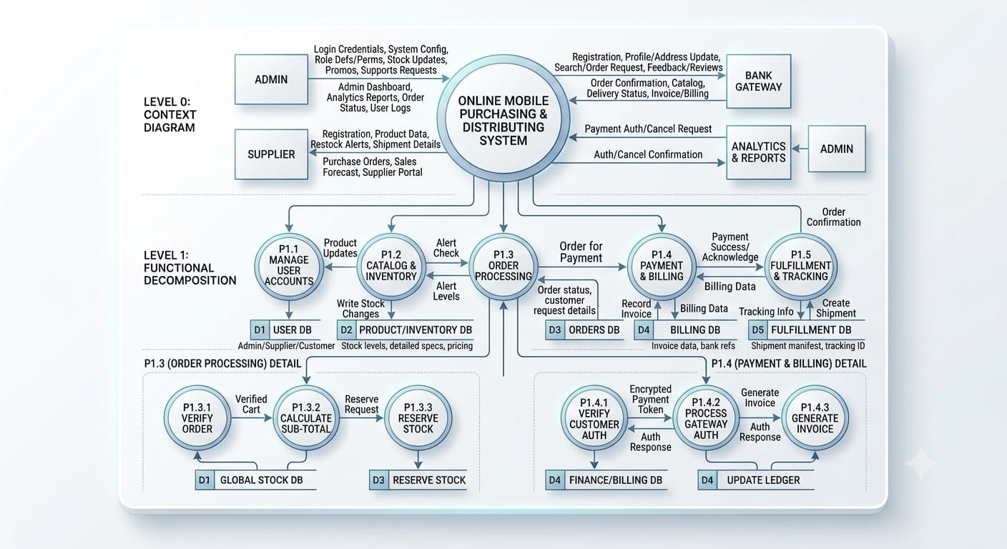
DATA FLOW ARCHITECTURE
Project Data Flow Diagram (Authoritative Architecture)
DFD Entities & Flow
4 External Entities: Customer, Supplier, Administrator, and Bank Gateway.
5 Core Processes: P1.1 Manage Users, P1.2 Manage Products, P1.3 Process Orders, P1.4 Billing, P1.5 Manage Fulfillment.
5 Relational Stores: D1: USER DB, D2: PRODUCT DB, D3: ORDERS DB, D4: BILLING DB, D5: FULFILLMENT DB.
P1.3 Subprocesses: P1.3.1 Verify Details, P1.3.2 Calc Subtotal, P1.3.3 Reserve Stock.
P1.4 Subprocesses: P1.4.1 Customer Auth, P1.4.2 Gateway Auth, P1.4.3 Generate Invoice.
ONLINE MOBILE PURCHASING & DISTRIBUTING SYSTEM
Slide 6 of 17

Slide 7
DETAILED PROCESS MODELING
Subprocess Decomposition: Order Processing & Billing
Process 1.3: Order Processing Sub-Pipeline
P1.3.1 Verify Order Details
• Validates customer delivery address, phone, and PIN code.
• Checks product active state, stock availability, and supplier link.
• Ensures shipping address is complete and contact number is 10-digit valid.
P1.3.2 Calculate Sub-Total & Tax
• Calculates individual line-item totals based on unit price & quantity.
• Applies standard 18% GST (9% CGST + 9% SGST) compliant with HSN 85171300.
• Applies shipping charge rules (free delivery over threshold) and discount promo codes.
P1.3.3 Reserve Stock (Concurrency Control)
• Places a temporary 15-minute reservation lock in stock_reservations table.
• Decrements available stock to prevent race conditions during high-demand checkout.
• Auto-releases reserved stock if payment is abandoned or fails within TTL window.
Process 1.4: Billing & Payment Sub-Pipeline
P1.4.1 Customer Payment Auth
• Customer selects payment mode: Credit Card, Debit Card, UPI, or Net Banking.
• System encapsulates order total and payment intent into a secure payment token.
• Prepares signed payload for transmission to Mock Bank Gateway.
P1.4.2 Process Gateway Auth (HMAC Token)
• Verifies tamper-proof HMAC-SHA256 signature against mock gateway secret key.
• Simulates bank authorization, OTP validation, and payment settlement.
• Captures gateway response code, authorization ID, and updates payment record.
P1.4.3 Generate Tax Invoice & Commit Stock
• On payment SUCCESS: Commits order status to PAID and marks stock COMMITTED.
• Creates official invoice record in D4 (INV-YYYY-XXXX) with sequential numbering.
• Generates print-ready GST tax invoice with full tax bifurcation for customer download.
ONLINE MOBILE PURCHASING & DISTRIBUTING SYSTEM
Slide 7 of 17

Slide 8
TECHNICAL ARCHITECTURE
5-Tier Enterprise Software Architecture
TIER 1: CLIENT PRESENTATION — Customer Browser | Supplier Terminal | Administrator Management Console
• Cross-browser responsive rendering across Mobile, Tablet, Laptop, and Desktop screens • Async AJAX interaction for real-time cart counters, stock checks, and status polling
TIER 2: UI/UX & STYLING FRAMEWORK — HTML5 | CSS3 | Bootstrap 5.3 | Font Awesome 6.5 | Vanilla JS
• Clean, modern e-commerce visual hierarchy with responsive grid and utility components • Interactive Chart.js visual analytics dashboard for revenue and inventory monitoring
TIER 3: APPLICATION & CONTROLLER LAYER — Modular PHP 8.2 | Session Management | RBAC Guards | Security Filters
• Strict Role-Based Access Control guards (require_login, require_admin, require_supplier) • Prepared SQL statements preventing SQL injection, XSS output sanitization, CSRF tokens
TIER 4: BUSINESS SERVICES ENGINE — Stock Reservation Engine (P1.3.3) | GST Billing Engine | Fulfillment Tracker
• 15-minute TTL stock reservation preventing race conditions and flash-sale overselling • Automated 18% GST (CGST 9% + SGST 9%) tax calculation and invoice PDF/Print generator • Mock Bank Gateway authorization with HMAC-SHA256 signature validation
TIER 5: PERSISTENCE & DATA STORAGE — MySQL 8.4 Database | InnoDB Engine | UTF-8 Unicode | Mock Payment API
• Normalized 3NF relational schema across D1 (Users), D2 (Products), D3 (Orders), D4 (Billing), D5 (Fulfillment) • Foreign key constraints with ON DELETE CASCADE / RESTRICT for complete ACID integrity
ONLINE MOBILE PURCHASING & DISTRIBUTING SYSTEM
Slide 8 of 17

Slide 9
SYSTEM WORKFLOW
End-to-End Smartphone Order & Distribution Lifecycle
1
Step 1: Product Discovery: Customer registers / logs in, filters smartphones by brand/RAM/camera, views tech specs, and adds items to shopping cart.
2
Step 2: Cart Checkout & Stock Hold: Customer initiates checkout. System executes P1.3.3: reserves stock for 15 minutes, calculates 18% GST and shipping charges.
3
Step 3: Mock Gateway Payment: Customer selects payment method (Card / UPI / NetBanking). System invokes Mock Bank Gateway with signed HMAC token.
4
Step 4: Payment Branching Logic: SUCCESS: Order status -> PAID, stock deducted permanently, tax invoice generated (P1.4.3). FAILED: Stock released, user retries.
5
Step 5: Supplier Consignment Allotment: Assigned regional supplier receives order alert, prepares smartphone unit, inspects IMEI barcode, and packs in tamper-evident box.
6
Step 6: Carrier Handover & Tracking: Carrier (Ekart / Blue Dart) collects package, generates AWB tracking ID, and initiates transit through regional sorting hubs.
7
Step 7: Doorstep OTP Delivery: Customer tracks package across 7 live milestones. Delivery executive verifies OTP with customer and completes handover.
ONLINE MOBILE PURCHASING & DISTRIBUTING SYSTEM
Slide 9 of 17

Slide 10
DATABASE MODELING
Entity-Relationship Model (Core Relational Schema)
USERS
SUPPLIERS
PRODUCTS
ORDERS
user_id: INT (PK)
name: VARCHAR(100)
email: VARCHAR(150) (UQ)
password_hash: VARCHAR(255)
role: ENUM (ADM/CUST/SUP)
phone, address: TEXT/VARCHAR
supplier_id: INT (PK)
user_id: INT (FK -> users)
company_name: VARCHAR(150)
gst_number: VARCHAR(50)
approval_status: ENUM
rating: DECIMAL(3,2)
product_id: INT (PK)
supplier_id: INT (FK)
brand_id: INT (FK)
product_name: VARCHAR(200)
model, specs: VARCHAR
price, stock_qty: DEC/INT
order_id: INT (PK)
customer_id: INT (FK -> users)
order_number: VARCHAR(50) (UQ)
subtotal, tax: DECIMAL(10,2)
total_amount: DECIMAL(10,2)
order_status: ENUM (9 states)
ORDER_ITEMS
PAYMENTS
INVOICES
FULFILLMENTS
order_item_id: INT (PK)
order_id: INT (FK -> orders)
product_id: INT (FK -> prod)
supplier_id: INT (FK -> supp)
quantity: INT
price, subtotal: DECIMAL(10,2)
payment_id: INT (PK)
order_id: INT (FK -> orders)
customer_id: INT (FK -> users)
transaction_id: VARCHAR(100)
amount: DECIMAL(10,2)
payment_status: ENUM (PAID/...)
invoice_id: INT (PK)
invoice_number: VARCHAR(50) (UQ)
order_id: INT (FK -> orders)
payment_id: INT (FK -> pay)
tax_amount: DECIMAL(10,2)
billing_address: TEXT
fulfillment_id: INT (PK)
order_id: INT (FK -> orders)
shipment_id: VARCHAR(50) (UQ)
tracking_id: VARCHAR(50) (UQ)
carrier: VARCHAR(100)
shipment_status: ENUM (7 stages)
ONLINE MOBILE PURCHASING & DISTRIBUTING SYSTEM
Slide 10 of 17

Slide 11
DATABASE DESIGN
Database Data Stores Overview & Table Dictionary
DFD Data Store | Constituent Tables | Purpose & Architectural Scope
D1: USER DB | users, suppliers | User accounts, supplier credentials, RBAC roles, contact address books
D2: PRODUCT / INVENTORY DB | categories, brands, products, product_images, inventory_transactions | Smartphone models, technical specifications, brand categories, warehouse stock audits
D3: ORDERS DB | cart, cart_items, orders, order_items, stock_reservations | Shopping carts, customer checkout records, itemized line items, 15-min stock locks
D4: BILLING / FINANCE DB | payments, invoices, invoice_items | Mock gateway transaction logs, payment tokens, GST tax invoices (HSN 85171300)
D5: FULFILLMENT DB | fulfillments, shipment_events | Carrier dispatch records, tracking numbers, 7-stage milestone timestamps
Data Integrity, Key Constraints & Schema Highlights
• ACID Compliance & Foreign Keys: Every transactional table uses InnoDB storage engine with strict FOREIGN KEY constraints guaranteeing referential integrity across deletions.
• Optimistic Concurrency Control: stock_reservations table utilizes timestamp-based TTL expiry (expiry_time = NOW() + INTERVAL 15 MINUTE) to eliminate double-selling.
• Auditability & Traceability: inventory_transactions records every quantity change with transaction_type (INITIAL, RESTOCK, PURCHASE, RESERVATION_HOLD, DAMAGE_RETURN).
• Security & Privacy Measures: Passwords hashed with BCRYPT (cost factor 10); payment payloads signed via HMAC-SHA256 tokens; role guards enforce access boundaries.
ONLINE MOBILE PURCHASING & DISTRIBUTING SYSTEM
Slide 11 of 17

Slide 12
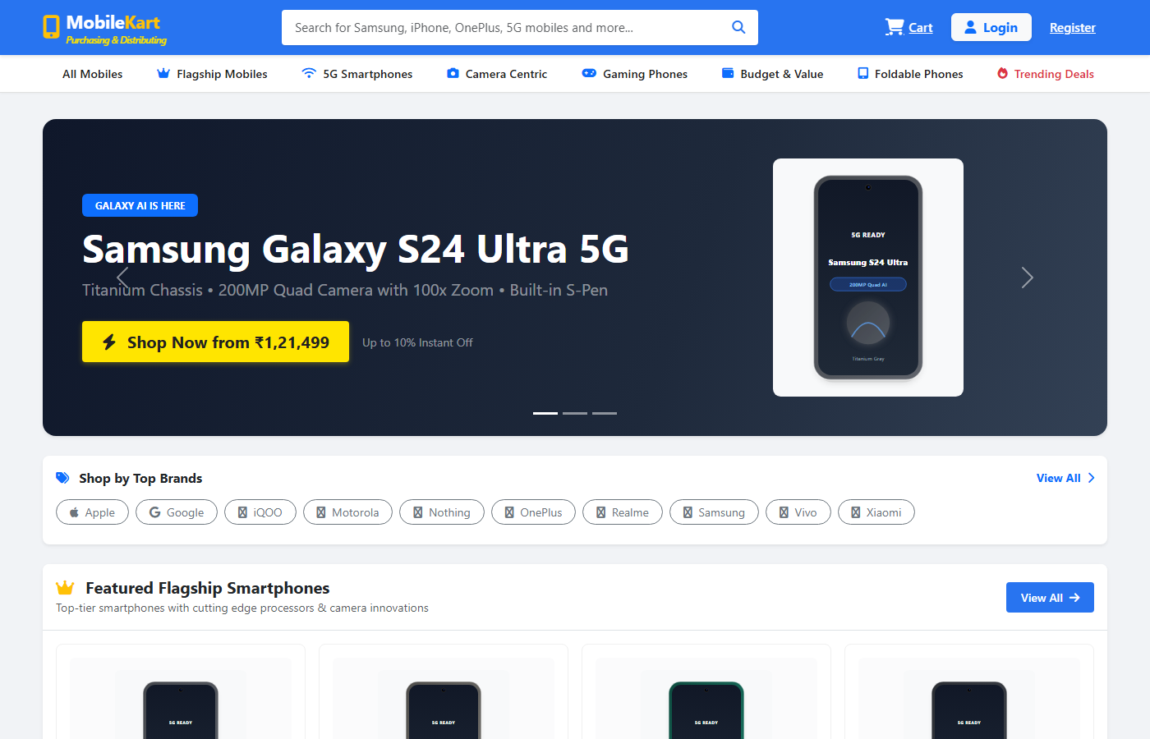
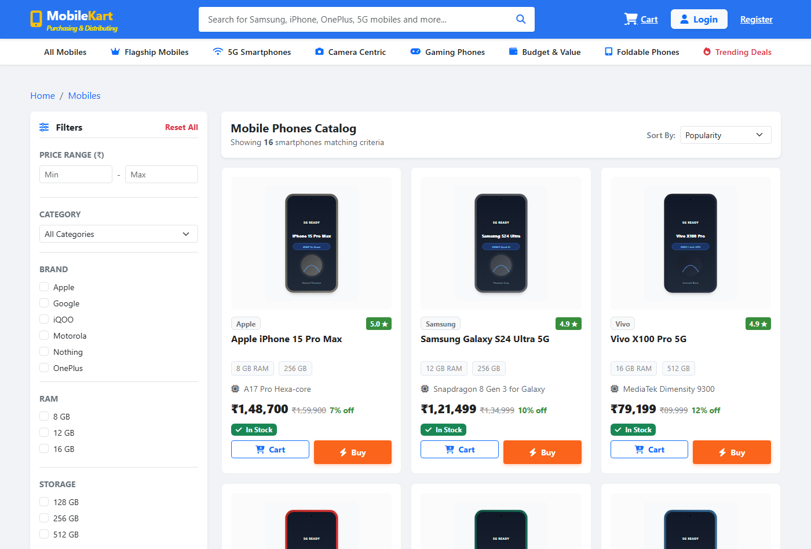
USER INTERFACE SHOWCASE
Storefront Homepage & Smartphone Catalog UI
https://localhost:8000/ - Online Mobile Purchasing System - Home
https://localhost:8000/ - Smartphone Catalog & Tech Filters
Storefront Homepage Features:
Hero slider banners, brand quick-links (Apple, Samsung, OnePlus, Google), trending smartphone carousels, and real-time live cart item counter in header.
Smartphone Catalog Filtering Engine:
Multi-criteria filtering: Brand selection, price slider, 5G network filter, RAM & storage capacity, with instant search results and responsive grid layout.
ONLINE MOBILE PURCHASING & DISTRIBUTING SYSTEM
Slide 12 of 17

Slide 13
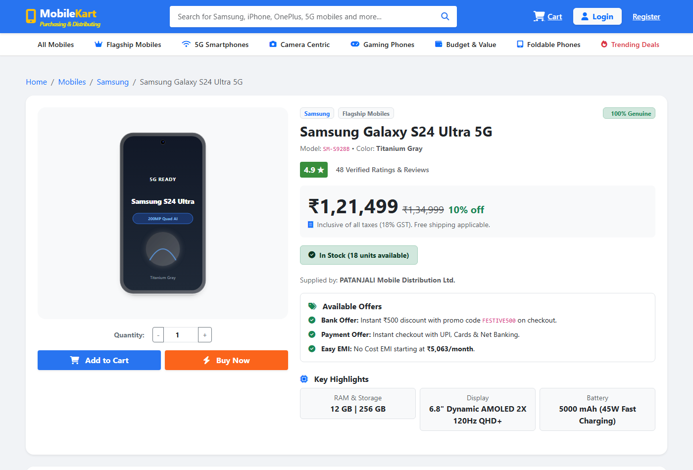
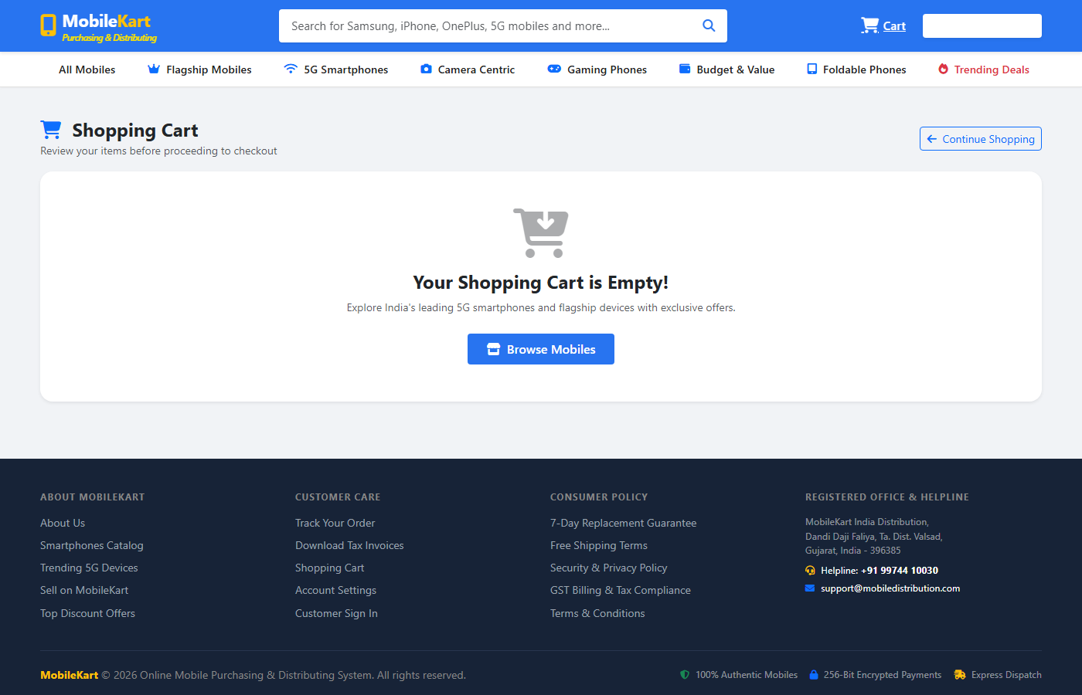
USER INTERFACE SHOWCASE
Product Specifications & Shopping Cart Management
https://localhost:8000/ - Product Specification - Samsung Galaxy S24 Ultra
https://localhost:8000/ - Shopping Cart & Dynamic Tax Computation
Detailed Hardware Specifications Display:
Complete spec sheet (Snapdragon 8 Gen 3, 200MP Quad Camera, 5000mAh Battery), dynamic stock status badge, and instant Add-to-Cart with stock verification.
Cart Management & Price Calculation:
Item quantity adjustment, subtotal computation, 18% GST (9% CGST + 9% SGST) breakdown, and seamless one-click transition to secure checkout.
ONLINE MOBILE PURCHASING & DISTRIBUTING SYSTEM
Slide 13 of 17

Slide 14
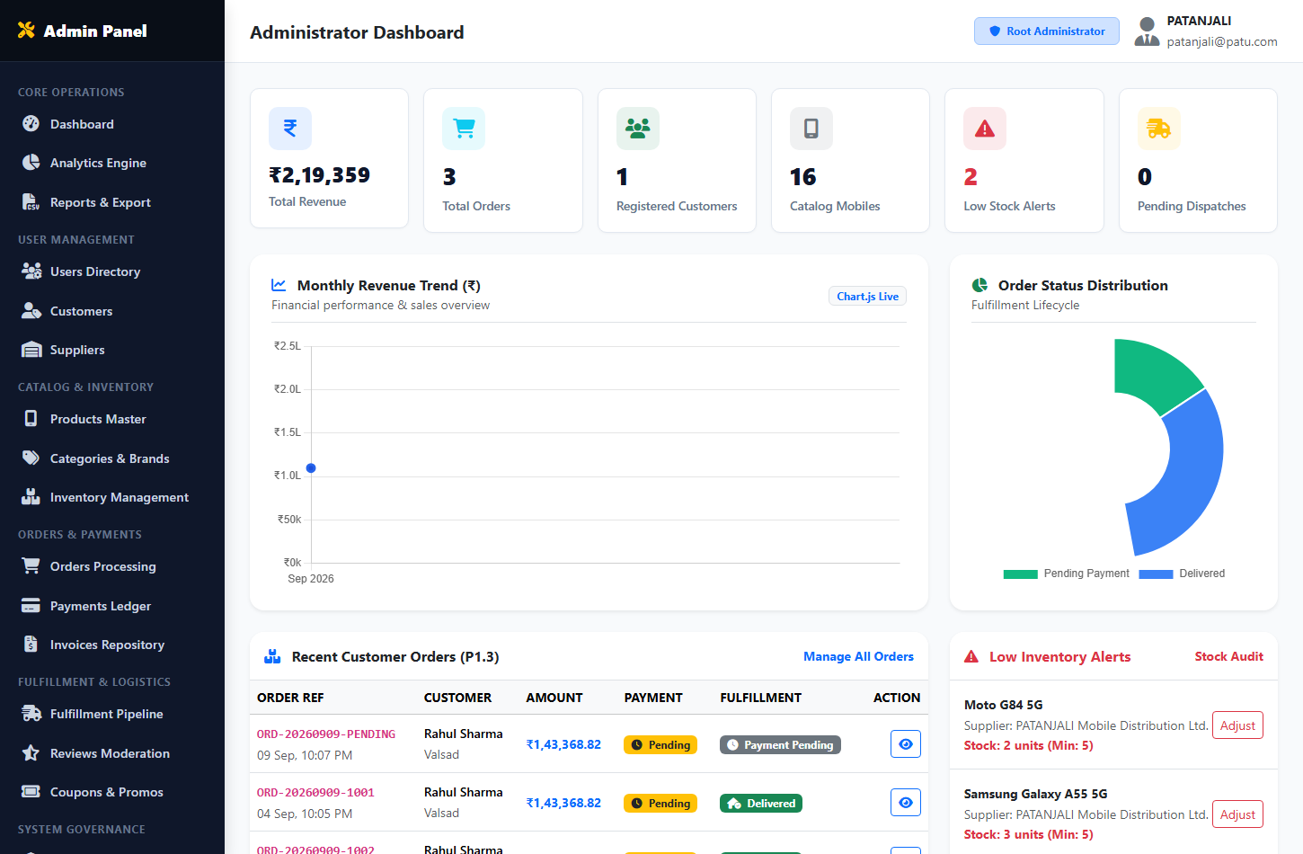
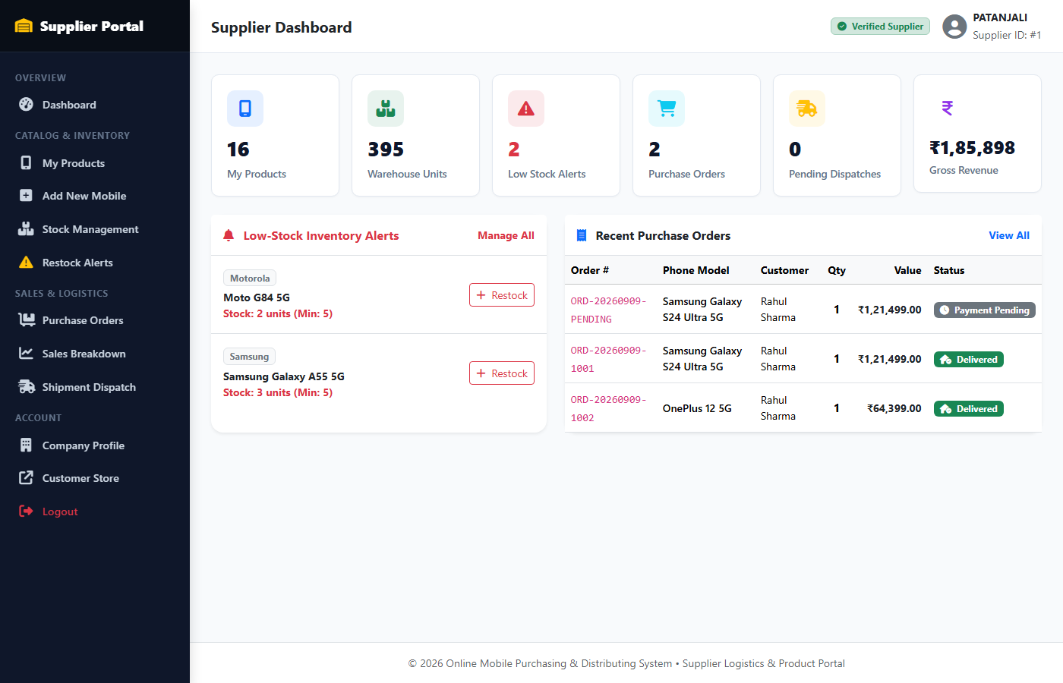
USER INTERFACE SHOWCASE
Administrative Dashboard & Supplier Portal UI
https://localhost:8000/ - Administrator Operations Dashboard
https://localhost:8000/ - Supplier Stock & Consignment Portal
Super Administrator Governance Features:
Central KPI cards (Total Revenue, Orders, Products, Customers), low-stock audit alerts, recent transactions table, and direct access to inventory & user management.
Supplier Operations & Dispatch Tools:
Supplier catalog management, smartphone restock submission, assigned order dispatch handling, and automated warehouse threshold monitoring.
ONLINE MOBILE PURCHASING & DISTRIBUTING SYSTEM
Slide 14 of 17

Slide 15
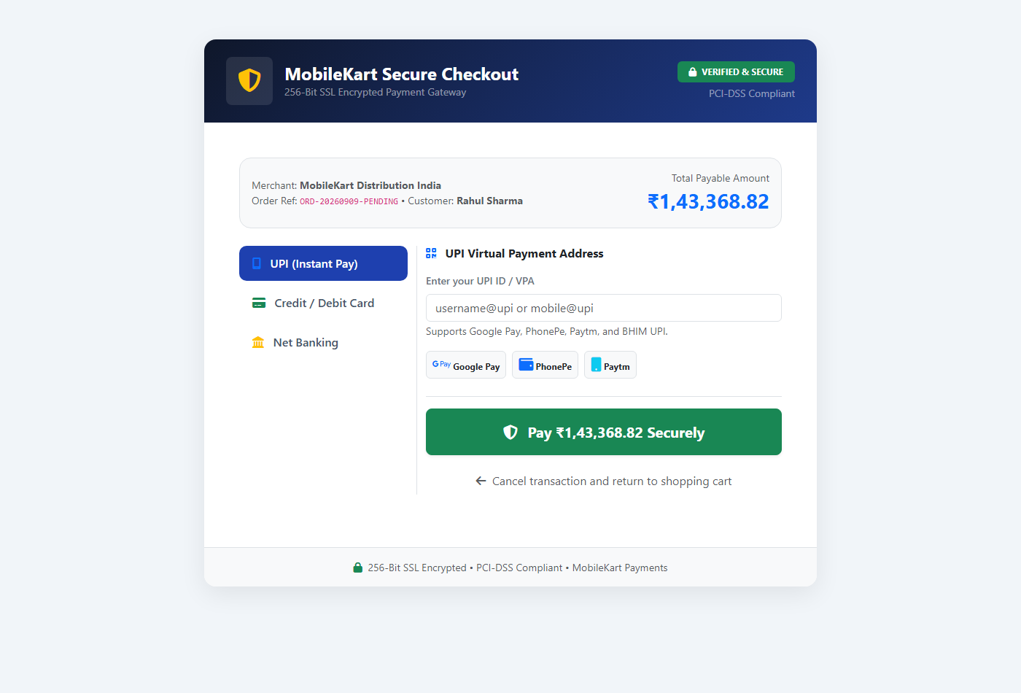
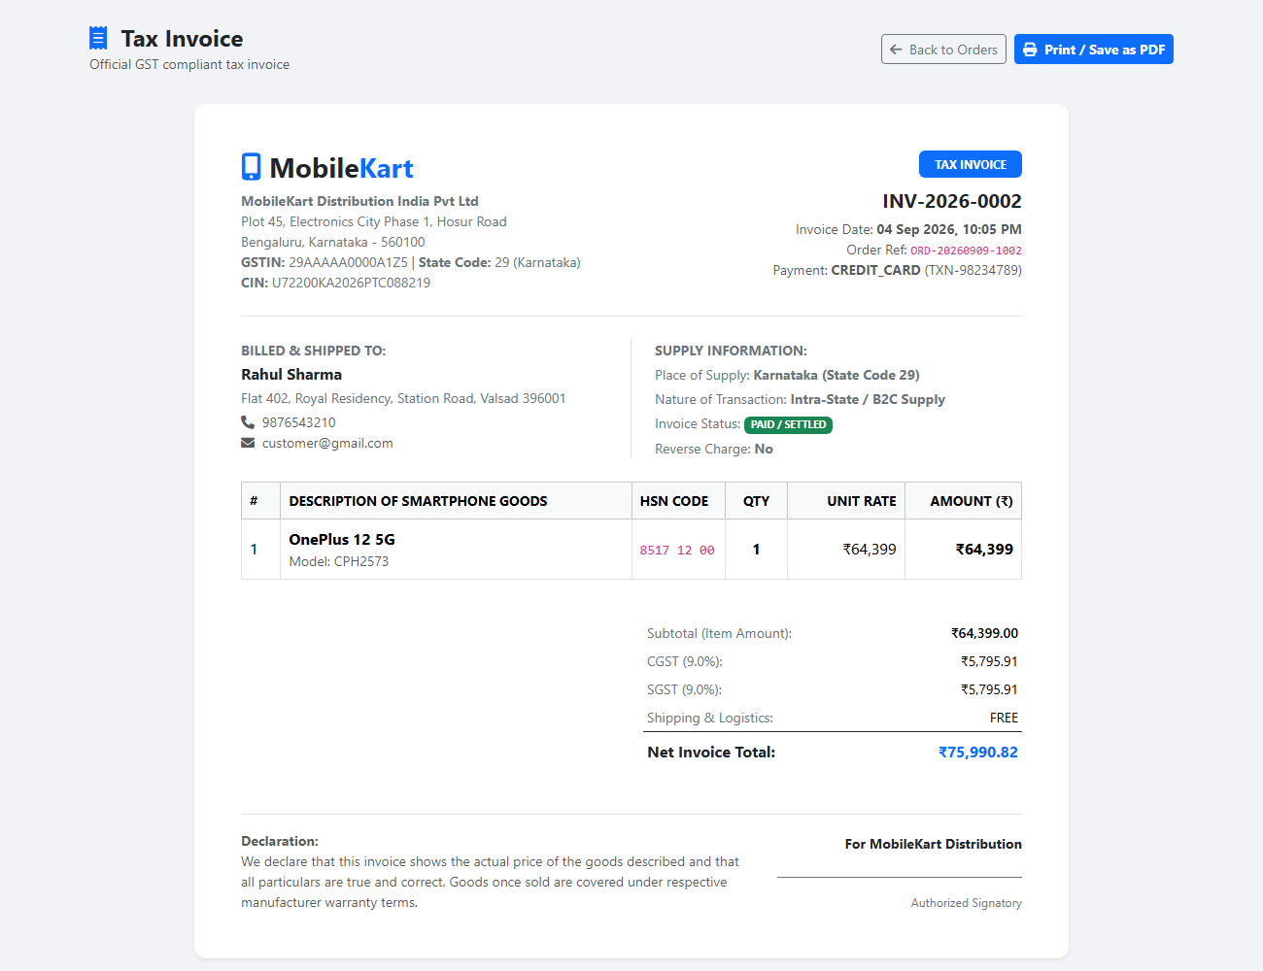
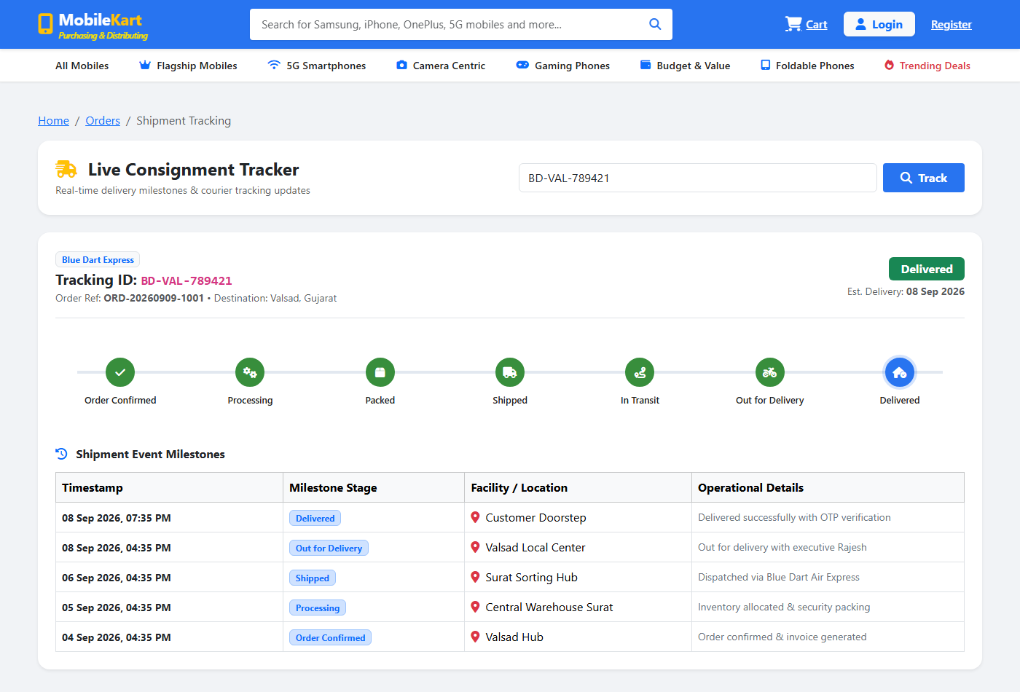
USER INTERFACE SHOWCASE
Mock Bank Gateway, GST Tax Invoice & Consignment Tracking
https://localhost:8000/ - Mock Bank Payment Gateway
https://localhost:8000/ - GST Tax Invoice - INV-2026
https://localhost:8000/ - Consignment Tracking Timeline
P1.4.2 Mock Bank Gateway:
Card/UPI validation, HMAC signature token verification, safe test mode.
P1.4.3 GST Tax Invoice:
HSN 85171300, CGST 9% + SGST 9%, print/PDF invoice generator.
P1.5 7-Stage Delivery Timeline:
Ordered -> Confirmed -> Packed -> Dispatched -> Out for Delivery -> OTP Handover.
ONLINE MOBILE PURCHASING & DISTRIBUTING SYSTEM
Slide 15 of 17

Slide 16
PROJECT EVALUATION
System Features, Practical Benefits & Future Roadmap
SALIENT FEATURES
BUSINESS & TECHNICAL BENEFITS
FUTURE ROADMAP & EXPANSION
• Multi-Role RBAC Architecture: Strict credential authentication for Customer, Supplier, and Super Admin.
• Multi-Attribute Filtering: Instant smartphone lookup by brand, RAM, 5G, price, and technical specs.
• 15-Minute Concurrency Lock: Temporary stock reservation during checkout prevents overselling.
• Automated GST Tax Invoicing: Auto-computes 18% GST (9% CGST + 9% SGST) under HSN 85171300.
• 7-Stage Consignment Tracking: Live milestone logs with AWB number and OTP delivery validation.
• Zero Inventory Discrepancy: Real-time stock synchronization eliminates phantom stockouts.
• Accelerated Order Turnaround: Automated invoice generation cuts administrative processing by 80%.
• Complete Tax Transparency: Standardized GST breakdown eliminates billing errors and audit issues.
• High Consumer Confidence: Transparent milestone tracking reduces customer support inquiries.
• Production-Ready Security: Prepared statements, XSS escaping, and HMAC token signing.
• Native Mobile Applications: Cross-platform mobile apps for Android & iOS using Flutter or React Native.
• Live GPS Courier Tracking: Interactive real-time driver tracking using Google Maps / Mapbox APIs.
• Production Payment Gateway: Integration with Razorpay / Cashfree / Stripe for real UPI & card payments.
• AI-Driven Recommendations: Collaborative filtering suggesting smartphones based on user preferences.
• Automated Warehousing: Integration with automated barcode scanners and IoT inventory lockers.
ONLINE MOBILE PURCHASING & DISTRIBUTING SYSTEM
Slide 16 of 17

Slide 17
PROJECT CONCLUSION & DEFENSE
Summary of Academic Project Achievements
ONLINE MOBILE PURCHASING & DISTRIBUTING SYSTEM
Key Project Achievements:
✓ Fully realized all Data Flow Diagram specifications (P1.1 to P1.5, D1 to D5).
✓ Implemented concurrency-safe 15-minute stock reservations to prevent overselling.
✓ Integrated complete GST-compliant invoicing engine (HSN 85171300, 18% CGST/SGST).
✓ Developed safe Mock Bank Gateway with cryptographic HMAC token verification.
✓ Engineered live 7-stage fulfillment tracking timeline from packing to OTP delivery.
✓ Constructed normalized relational MySQL schema with foreign key ACID integrity.
✓ Designed responsive, modern web UI adhering to contemporary e-commerce standards.
Thank You!

