Slide 1
Development of Thermal Energy Harvesting Power Supply with an Internal Startup Circuit for Pacemakers
Pre-Incubatee work report
Under the guidance of
Dr Kailash Chandra Ray
Professor-In-Charge(Incubation Centre, IIT Patna)
Submitted By : Yaman Parasher

Slide 2
Working of the Proposed System
Flow
From upper left to right followed by bottom
right to bottom left
Ring Oscillator
Comparator 1
Vcmp1
TEG(Vin)
`40-60mV
Cpst(Capacitor)
Vth or Vref of comparator
is in between 1.5-2.4V
This modified CP helps to achieve 2.5V in 8s
Charge upto Vpst
Modified Charge Pump
Sets when Vpst reaches 2.5V
Oscillator
Vpst 2.5V for SUBC comparator
Provide clock signal to SUBC counter
MUX
Steady State Boost Converter
Startup Boost Converter
o/p Voltage
Cout
Capacitor
o/p enable
Comparator 2
Control circuit in it provide clock phases for both itself and SSBC
Sets when Vout >Vth
Cout rises Vout till it reaches Vth of comparator 2

Slide 3
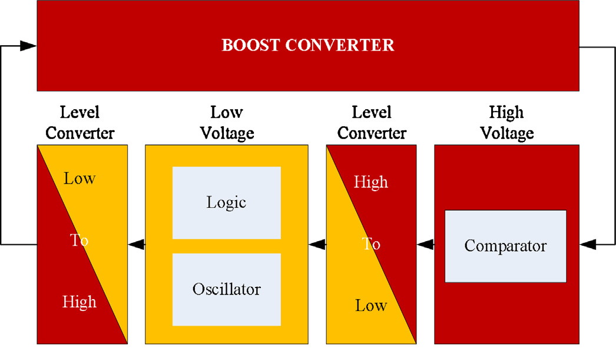
Systematic Design of Boost Converter associated with its Control Circuit

Slide 4
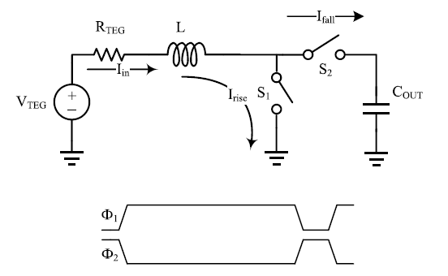
Basic architecture of Boost Converter
In low power application, we generally avoid diode for relevant switching ,due it high forward voltage loss associated with it.
Therefore in our proposed system, we employ low power MOS of P & T type to cope up with the switching losses.
Working
At the vey beginning, the switch S1 is closed with S2 open.
Due to this ,the potential at the input end will develop or accumulate energy in the inductor due to flow of current .
In the next stage, when switch S1 is open and S2 is close, there comes a back emf which will result in greater accumulation of voltage in the circuit which is equal to v(back emf) and the one provided by the input end V(in).This whole thing will make the capacitor charge up to more voltage level at subsequent stages of clock cycle ultimately leading to the increment in the voltage at the output end.

Slide 5
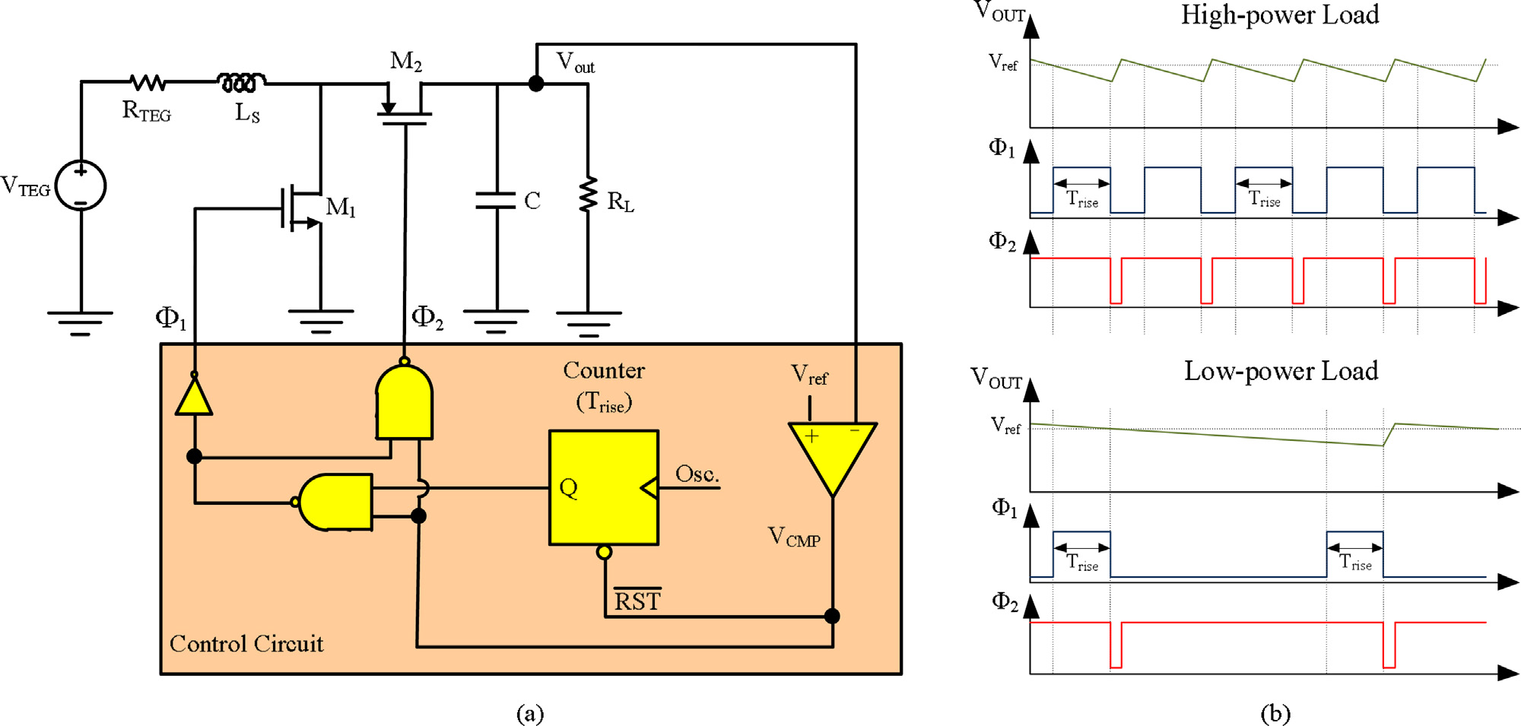
Boost Converter(CCT structure)
NAND gate truth table(for reference)
A | B | AB’
0 | 0 | 1
0 | 1 | 1
1 | 0 | 1
1 | 1 | 0
Vout Expected to be 1-3V(regulated) that makes power of nearly 130µW with Vout=2.6V
Corresponding waveform for high and low power loads
1.5Ώ
400µH
~40mV-60mV
400nF
Vref is taken to be somewhere between 2.5V
There has to be two level shifter, one from high to low(just after the comparator output) and the other one from low to high(just after the output of the decision circuit ,i.e. from the output of NOT and NAND gate giving switching power supply to both MOS above in the circuit.

Slide 6
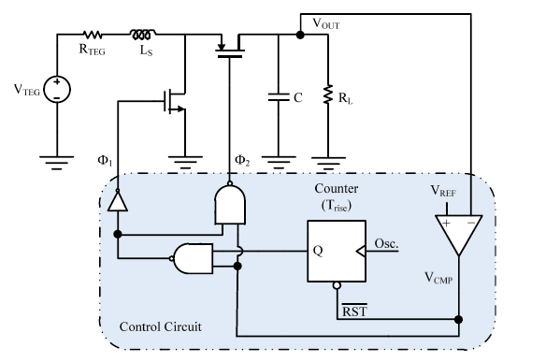
Case 1(When Vref > Vout)
A | B | AB’
0 | 0 | 1
0 | 1 | 1
1 | 0 | 1
1 | 1 | 0
Subcase 2 (When Counter gives logic‘0’)
In this case nmos act as open circuit ,while
pmos behave as a conducting wire
1.5Ώ
400µH
pmos
nmos
~40mV-60mV
400nF
0
0
=2.5V
Here Vref is taken as 2.5V
1
0
1
1
→nmos behave as open circuit at logic 0 and conducting at logic 1
→pmos behave as open circuit at logic 1 and conducting at logic 0

Slide 7
Case 1(When Vref > Vout)
NAND gate truth table(for reference)
A | B | AB’
0 | 0 | 1
0 | 1 | 1
1 | 0 | 1
1 | 1 | 0
Subcase 1 (When Counter gives logic‘1’)
In this case nmos act as close circuit or conducting ,while
pmos behave as a open circuit.
1.5Ώ
400µH
pmos
nmos
~40mV-60mV
400nF
1
1
=2.5V
Here Vref is taken as 2.5V
0
1
1
1
→nmos behave as open circuit at logic 0 and conducting at logic 1
→pmos behave as open circuit at logic 1 and conducting at logic 0

Slide 8
Analysis
ɸ₁ | ɸ₂ | Interpretation
1 | 1 | (M1 is closed, M2 is open) Accumulation of energy at inductor
0 | 0 | (M1 is open, M2 is closed) Transfer of energy from inductor to capacitor(charging of capacitor)
0 | 1 | (M1&M2 both remain open) Discharging of capacitor, building up potential at load

Slide 9
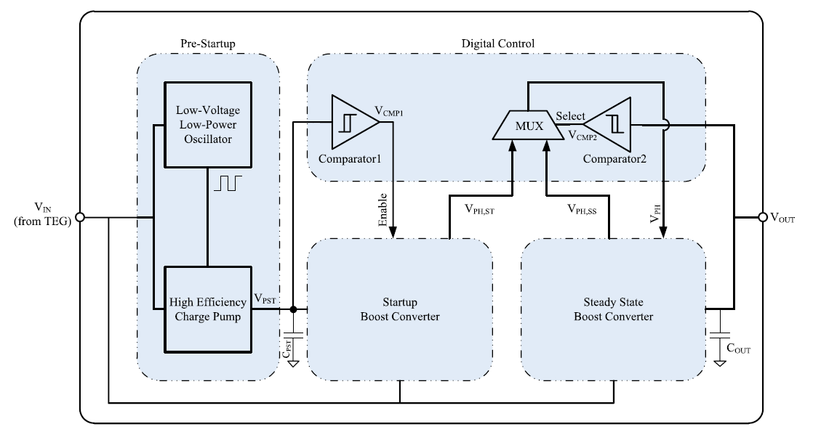
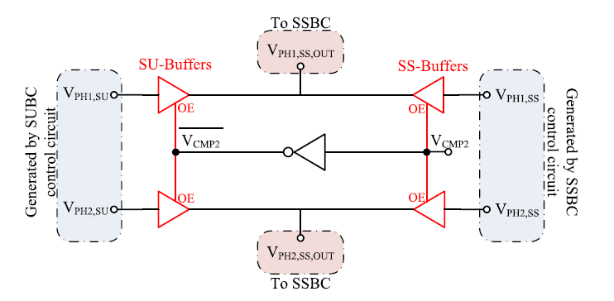
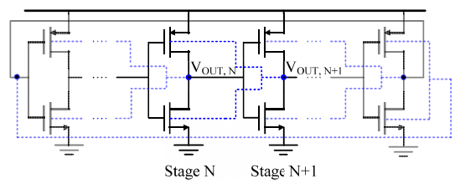
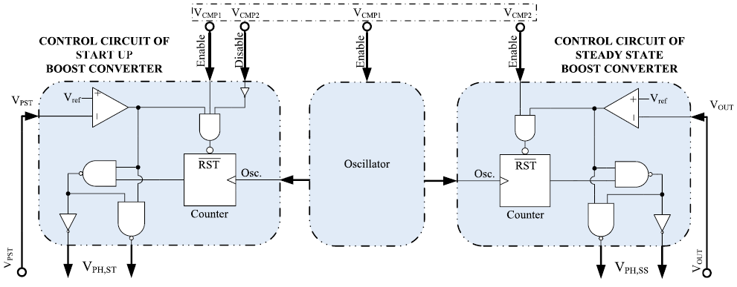
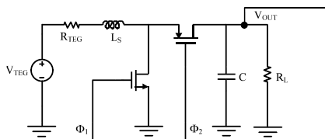
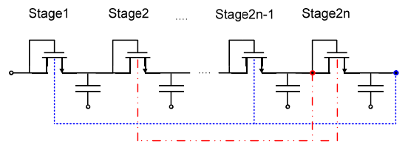
Proposed TE energy harvesting architecture
Preferably a ring oscillator due to low power consumption
Proposed ring oscillator
MUX
~40mV-60mV
Control circuit for both SUBC & SSBC
SUBC
SSBC
Helps in generating clock phases for SSBC and providing
Vout at the initial stage so that comparator 2 get set for function
Proposed charge pump
Cpst(Capacitor)
Same Boost converter

Slide 10
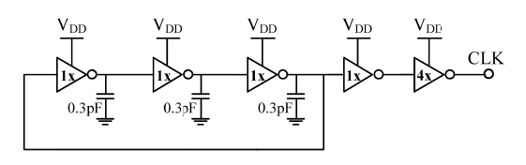
Ring Oscillator in the Proposed System
The output voltage of TEG is very low. To make the oscillator work with such a low voltage a ring oscillator is employed in the circuit .A general Ring
oscillator is made up of successive inverter based stages with its output buffer. A typical inverter is made by the combination of nmos and pmos. Thus in Order to make the oscillator work we need to reduce the MOS threshold voltage. The only way to do it is by Forward Body Biasing. In Forward Body biasing, the threshold voltage decreases by making the Vsb in the Nmos negative and positive in Pmos. It can be further explained by MOS threshold voltage equation.
Output Buffer(chain of inverters)
Ring Oscillator(3-stage)

Slide 11
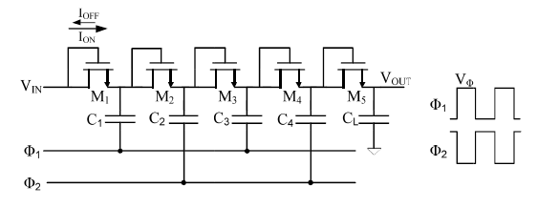
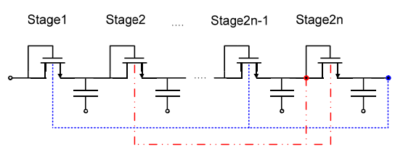
Charge Pump in the Proposed System
The output voltage of a conventional CP circuit after N stages is given by
Vout=Vin – Vth + N( Vph – Vth)
Where Vin is the input voltage, Vph is the clock amplitude and Vth is the threshold voltage of the MOS switches.
It could be clearly seen from the above equation that, in order to increase efficiency of Charge Pump, we need to minimize the threshold voltage.
It could be done by mainly by one process, which is the FBB(Forward Body Biasing) .
In the modified version, body voltage of MOS switches of the odd(even) stages is being connected to the output voltage of the last even(odd) stage. This process increases Vsb which will ultimately result in the reduction of threshold voltage of MOS that is the Vth.
Conventional Charge Pump Circuit
Modified Dickson Charge Pump

Slide 12
Control Circuit of proposed TE harvesting architecture
Note MUX is only used to provide clock phases at the initial stage to SSBC by SUBC, once SSBC gets the required Vout then it will generate phases for itself , thus eliminating need of SUBC
Vph1,SUBC
MUX
Vph2,SSBC
Towards
Analog circuit of SSBC
Towards
Analog circuit of Start Up Boost Converter
Vph2,SUBC
Vph2,SSBC
OE
Vcmp2

Slide 13
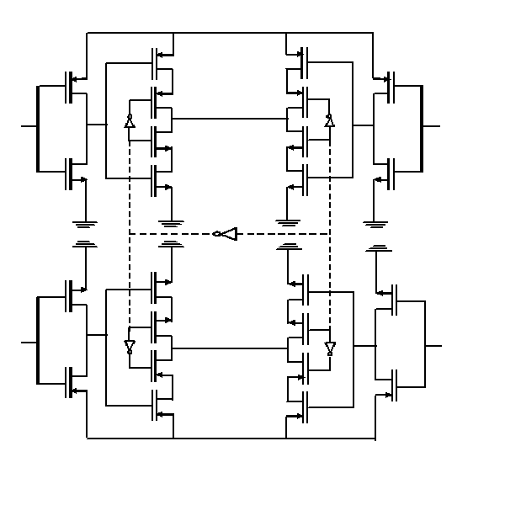
Schematic of MUX in Proposed System
Vph1,SSBC(OUT)
Steady State Tri State Buffer
Startup Tri State Buffer
Vph1,SUBC
Vph1,SSBC
OE
OE
A simple tristate is a simple buffer
,that has an input, output and a control (here OE).It provide output same as that of the input only when the control valve(OE) is set ‘HIGH’.
VCMP2
OE
OE
Vph2,SUBC
Vph2,SSBC
Startup Tri State Buffer
Steady State Tri State Buffer
Vph2,SSBC(OUT)

Slide 14
Case1(When Vcmp2 is Set)
Vph1,SSBC(OUT)
Steady State Tri State Buffer
Startup Tri State Buffer
Vph1,SUBC
Vph1
Vph1,SSBC
0
OE
OE
1
In this case, SSBC Tristate buffer will provide self generated clock phase to the output that will derive its circuit. Here in this case they wont need a SUBC to provide a clock phase
0
1
VCMP2
In this case,
SUBC Tristate buffer
won’t work
0
OE
1
OE
Vph2,SUBC
Vph2,SSBC
Vph2
Startup Tri State Buffer
Steady State Tri State Buffer
Vph2,SSBC(OUT)

Slide 15
Case1(When Vcmp2 is Reset)
Vph1,SSBC(OUT)
Steady State Tri State Buffer
Startup Tri State Buffer
Vph1,SUBC
Vph1,SUBC
Vph1,SSBC
1
OE
OE
In this case, SUBC Tristate buffer will provide clock phase to SSBC, that will drive its circuit.
0
In this case,
SUBC Tristate buffer
won’t work
1
0
VCMP2
1
OE
0
OE
Vph2,SUBC
Vph2,SUBC
Vph2,SSBC
Startup Tri State Buffer
Steady State Tri State Buffer
Vph2,SSBC(OUT)

Slide 16
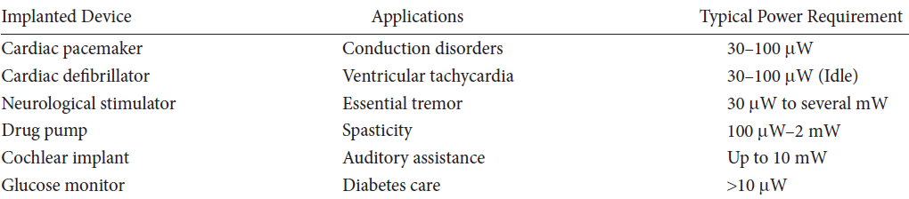
Potential Applications of our work

Slide 17
THERMOELECTRIC GENERATOR FOR BIOMEDICAL IMPLANT
Convert thermal energy into electricity
Heat Input
n-Type
p-Type
Heat rejected
Fig 2.1 Typical simplest thermoelectric generator

Slide 18
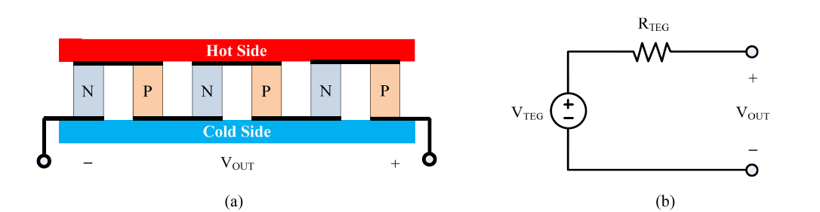
Thermo Electric Generator
Typical TEG
Equivalent Circuit of TEG

Slide 19
Thermoelectric Module
Heat absorbed(cold side)
P-Type
Positive(+)
n-Type
Electric Insulator(Ceramic)
Electrical Conductor(Copper)
Negative(-)
Heat rejected(hot side)

Slide 20
Points to Ponder in development of TEG
Typical power requirement for implantable medical devices range between 30 to 100µW.
Though device design and material of TEG can be optimized to increase device performance, the power output ultimately depends on the available temperature difference within the application.
This temperature differences are only readily available near the surface of the skin where the heat is emitted to the ambient environment.
The tissue near the skin surface can be modeled into three layers consisting of muscle, fat and epidermis(skin).
According to previous studies, temperature gradient of 1-5K is available in the fat layer, which may vary depending upon the body location, ambient environment and physical activities.
These conditions play a vital role in determining optimal thermoelectric device placement.
The temperature gradient is proportional to the fat thickness due to low thermal conductivity of fat.
That means –> An overweight person running without clothing will have the largest temperature gradient within the fat layer and as a result will provide the most power to a thermoelectric generator.

Slide 21
Abstract
A complete thermal energy harvesting power supply for implantable pacemakers is presented in this presentation The designed power supply includes an internal startup and does not need any external reference voltage. The startup circuit includes a prestart up charge pump (CP) and a startup boost converter. The prestart up CP consists of an ultralow-voltage oscillator followed by a high-efficiency modified Dickson. Forward body biasing is used to effectively reduce the MOS threshold voltages as well as the supply voltage in oscillator and CP. The steady-state circuit includes a high-efficiency boost converter that utilizes a modified maximum power point tracking scheme. The system is designed so that no failure occurs under overload conditions.
Thus ,in the presentation a comprehensive analysis of the working of Boost converter circuit is done.

