Slide 1

Designing of a highly reflective GeSn based resonant cavity structure in the SWIR region
Under the guidance of PROF. DR. GUO-EN CHANG
-YAMAN PARASHER

Slide 2
Introduction
Resonant cavity structure
Also known as Optical Cavity, mainly present in emitters like Lasers, LEDs etc
In simple terms
It is an arrangement of mirrors where optical radiation circulates within the structure back and forth to produce optical feedback to the gain element.
Primarily used to produce laser emission with much concentrated & high power.

Slide 3
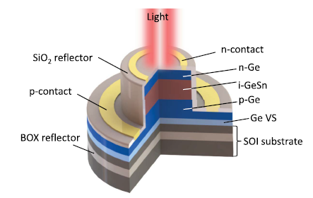
Past Work
This work was taken as inspiration .
The aim was to develop the simulation
Replica of this work in COMSOL.
Fig 1. GeSn p-i-n resonant cavity enhanced PDs
[Source: Bo-Jun Huang, Jun-Han Lin, H. H. Cheng,Guo-En Chang , “GeSn resonant-cavity-enhanced photodetectors on silicon-on-insulator platforms,”Optics Lettere 43(6), 1215-1218 (2018)]
Fig 2. Intensity Spectra of the given GeSn p-i-n resonant cavity enhanced PD

Slide 4
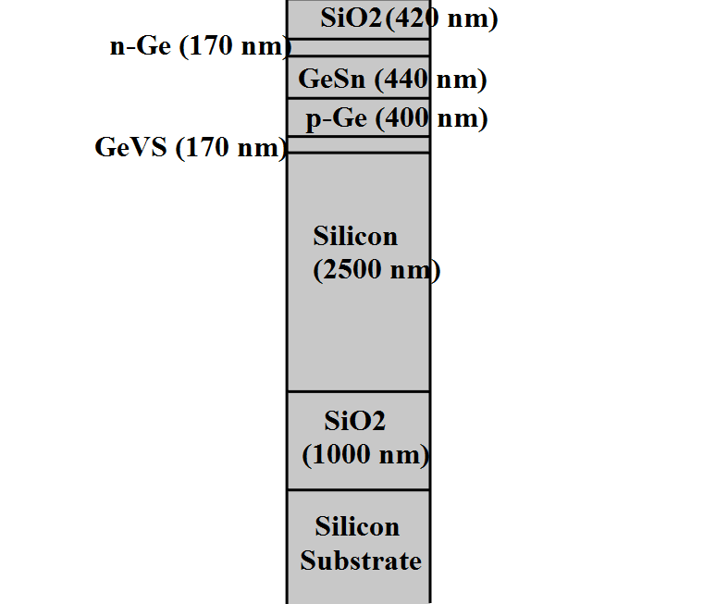
Simulation of Equivalent Resonant Cavity Structure in COMSOL
Equivalent 2D model of Bo-Jun’s work
Blue trend shows
the simulated
Spectra of the given 2D cavity structure
Fig 3. 2D schematic of GeSn p-i-n resonant cavity structure
Fig 3. Comparative analysis of Spectra of fabricated resonant cavity structure with that of simulated

Slide 5
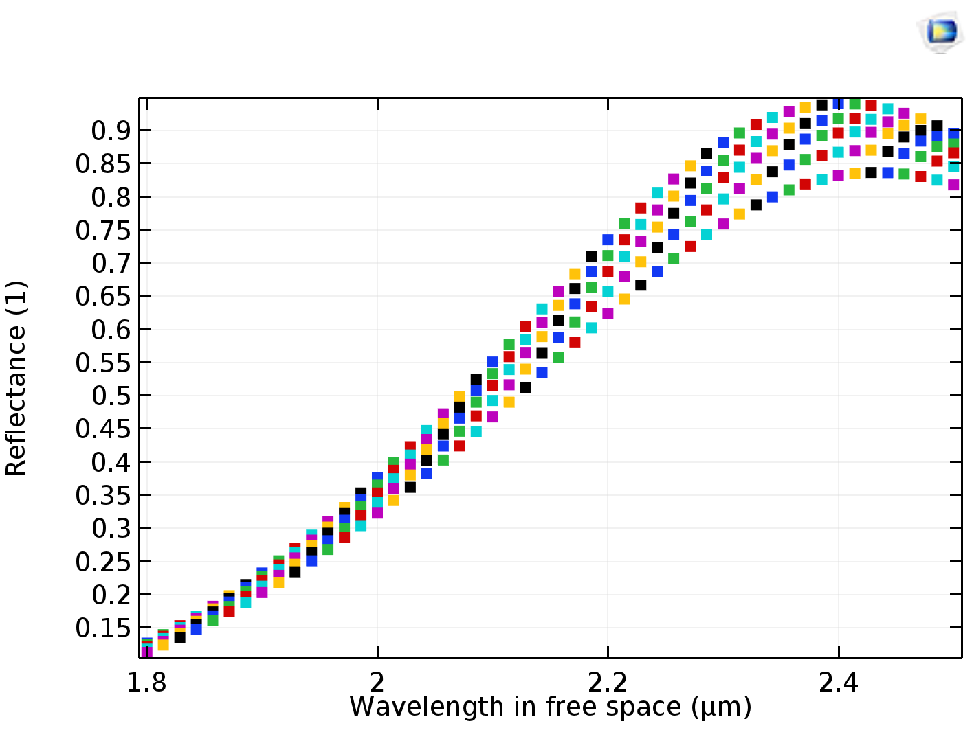
Reflection Spectra in terms of modeling parameter
Now, to further optimized the structure for better results
I added 8 DBR pairs(Si/SiO2) of optimal thickness further
on the top reflector (SiO2).
This whole setup is shown in the next slide.
Fig 5. Reflection Spectra in terms of thickness of top layer (SiO2) of the basic GeSn based resonant cavity structure

Slide 6
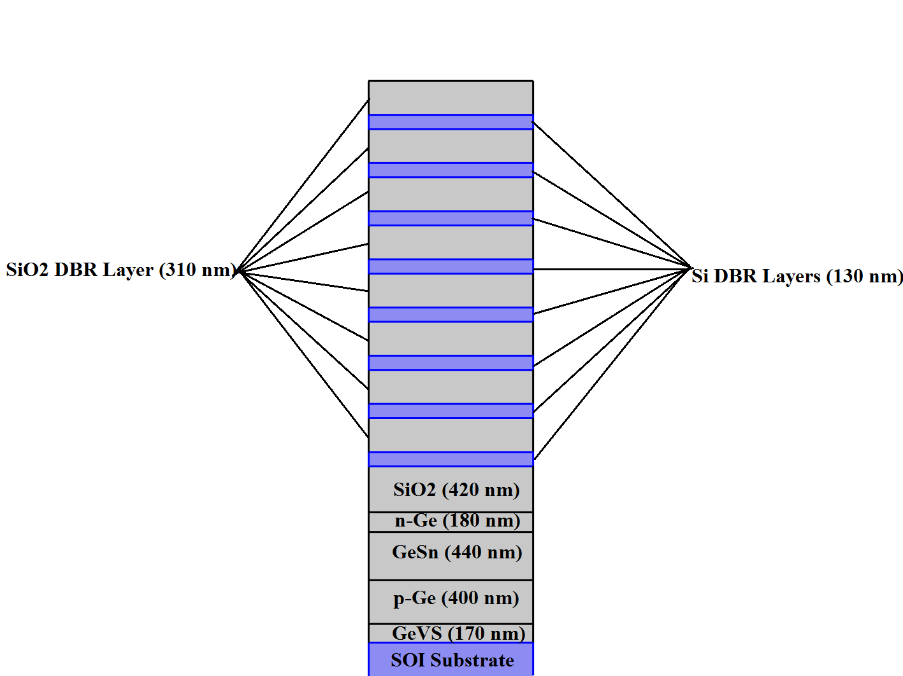
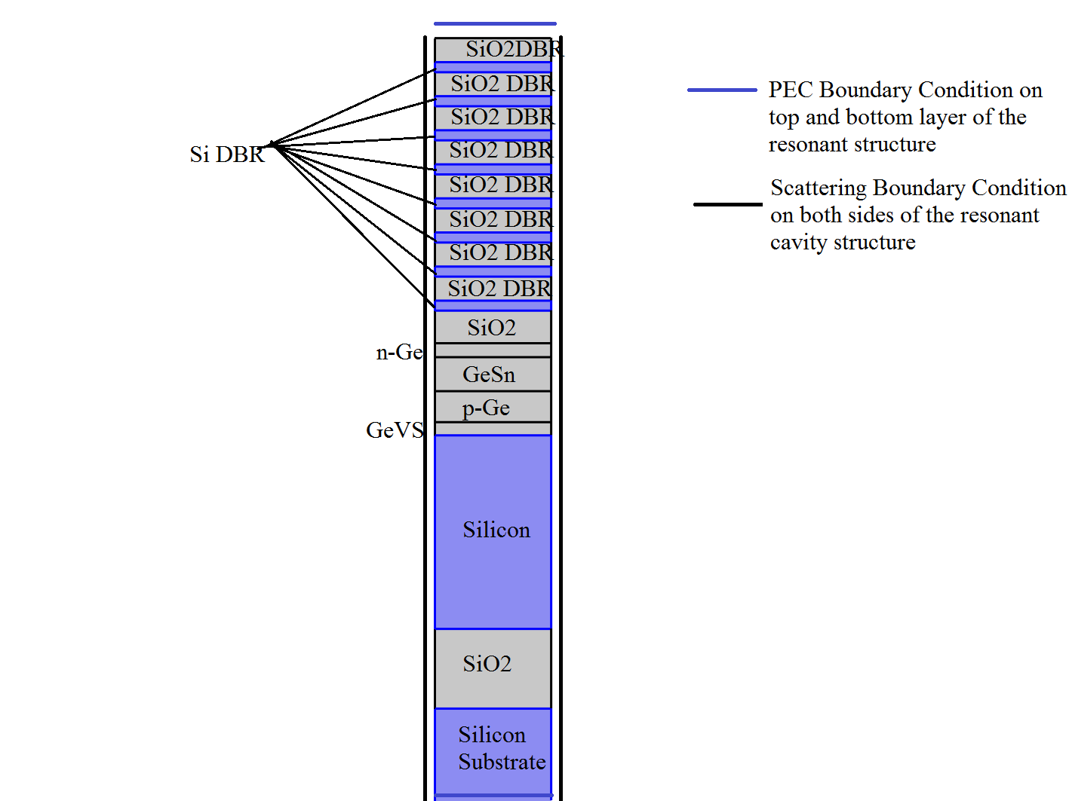
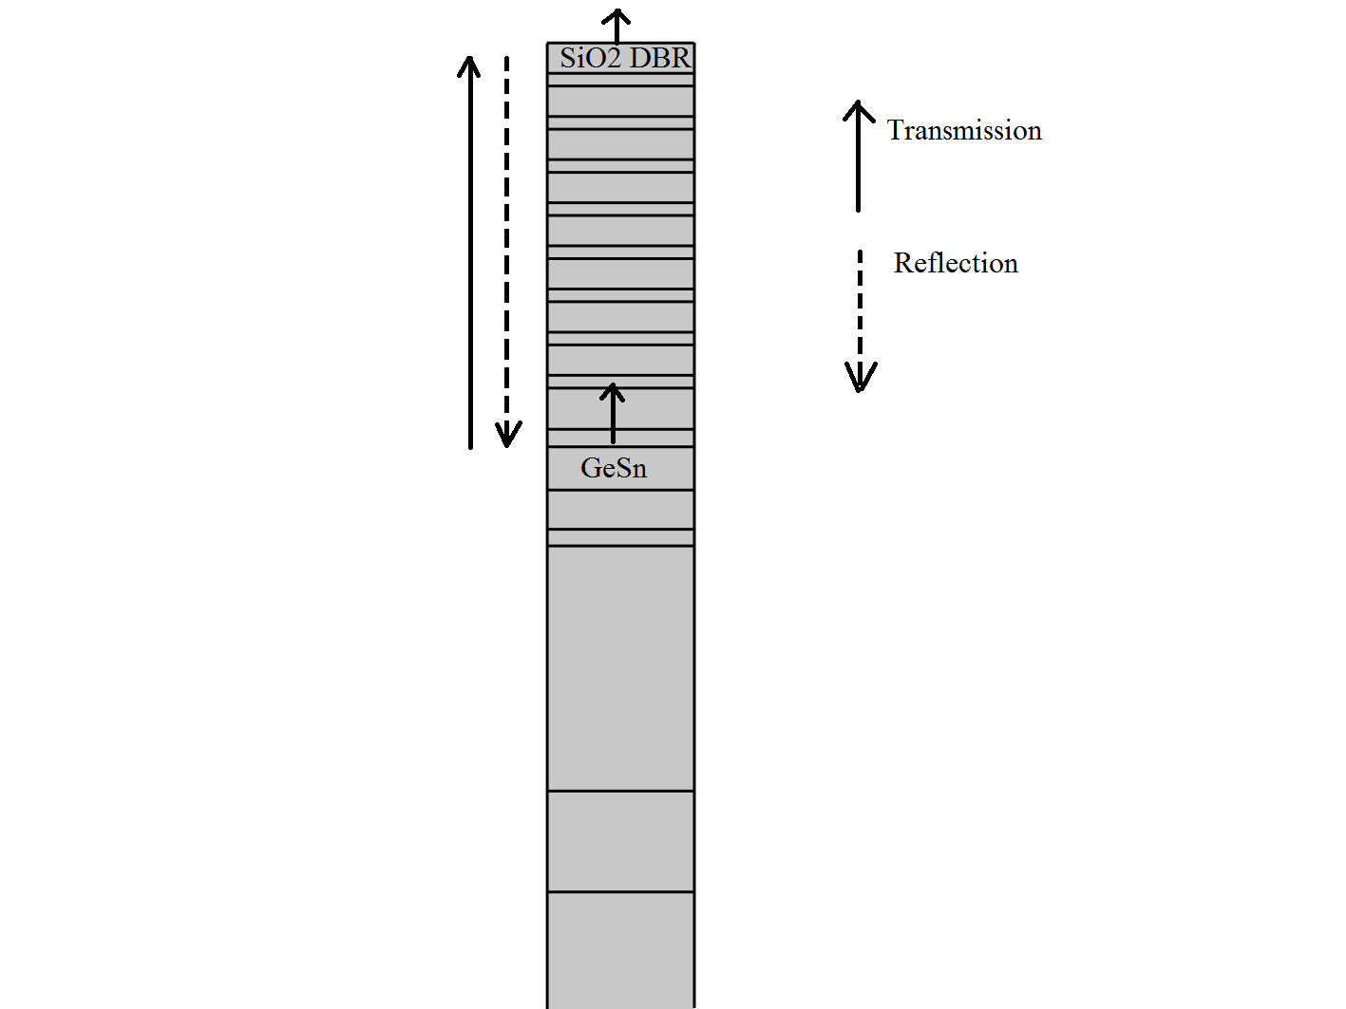
Designing of 8 DBR (Si/Si02) pairs resonant cavity structure
(a)
(b)
(c)
Fig 6. 2D schematic of GeSn p-i-n resonant cavity structure (a) with 8 DBR pairs (Si/SiO2) , (b) Boundary Conditions , (c) Reflection & Transmission direction

Slide 7
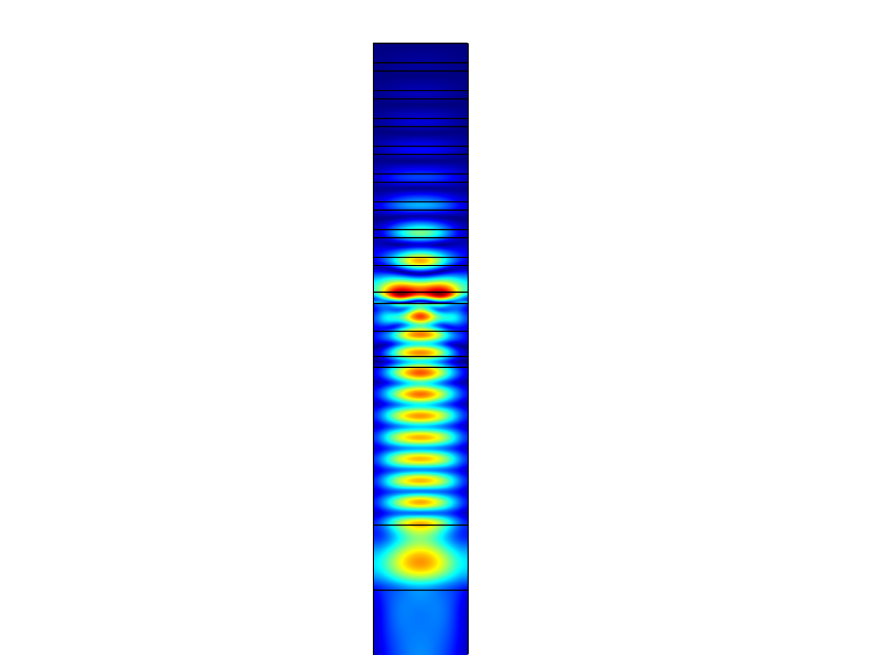
Simulation of 8 DBR resonant cavity structure
As you can see the blue trend of simulation
resembles exactly somewhat in similar way to Bo-Jun experimental work spectra.
Fig 7. Electric field Energy distribution inside 2D GeSn p-i-n resonant cavity structure with 8 DBR pairs (Si/SiO2)

Slide 8
Conclusion & Future Directions
Developed simulated model provide a basic architecture to simulate highly reflective resonant cavity structures for
RCLEDs (Resonant cavity Light Emitting Diodes)
VCSELs (Vertical Cavity Surface Emitting Lasers)
PDs (Photodetectors)
And other optoelectronics devices

Slide 9
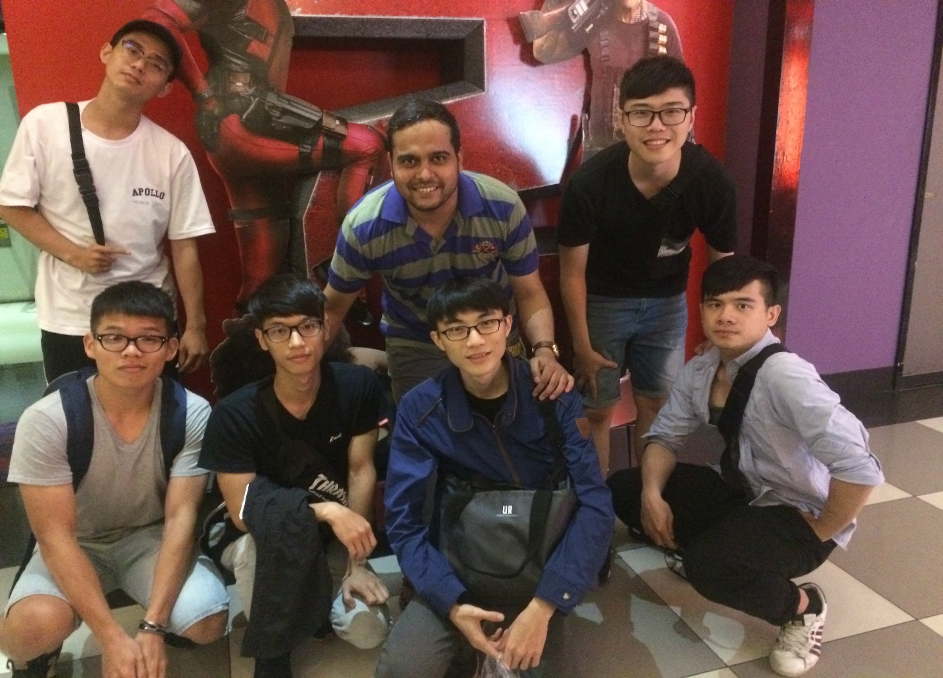
My friends!
Experience in Taiwan

Slide 10
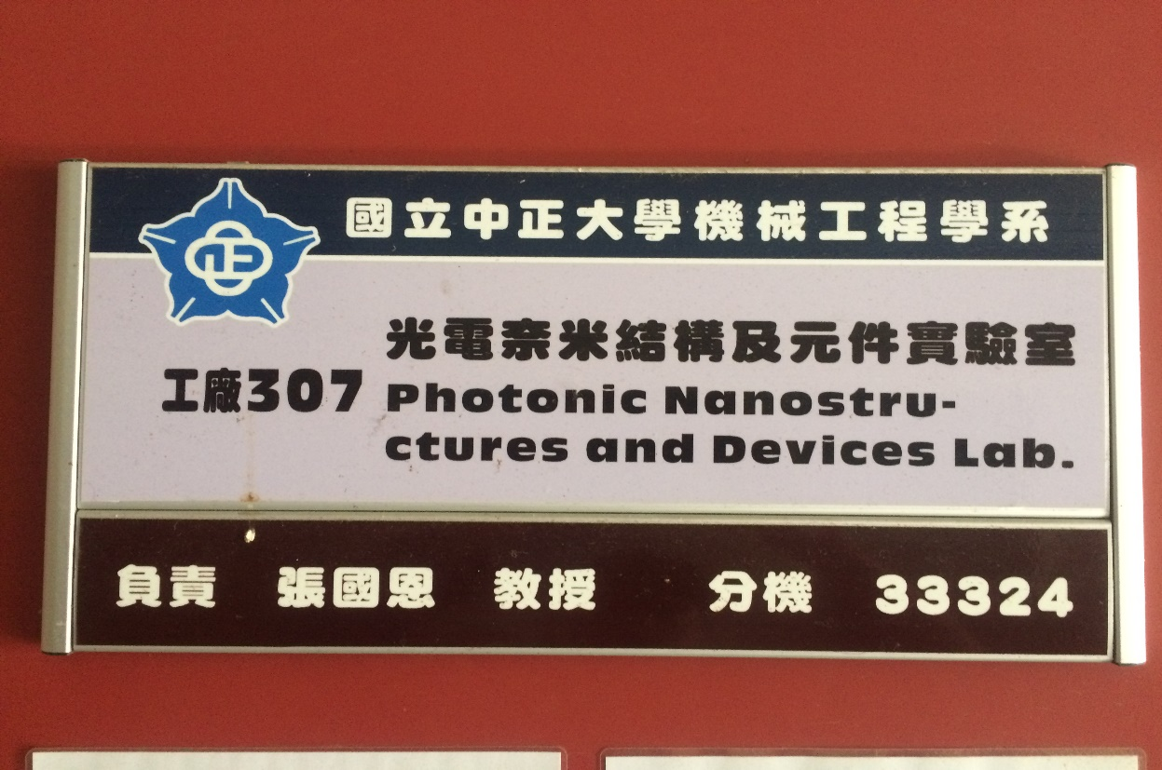
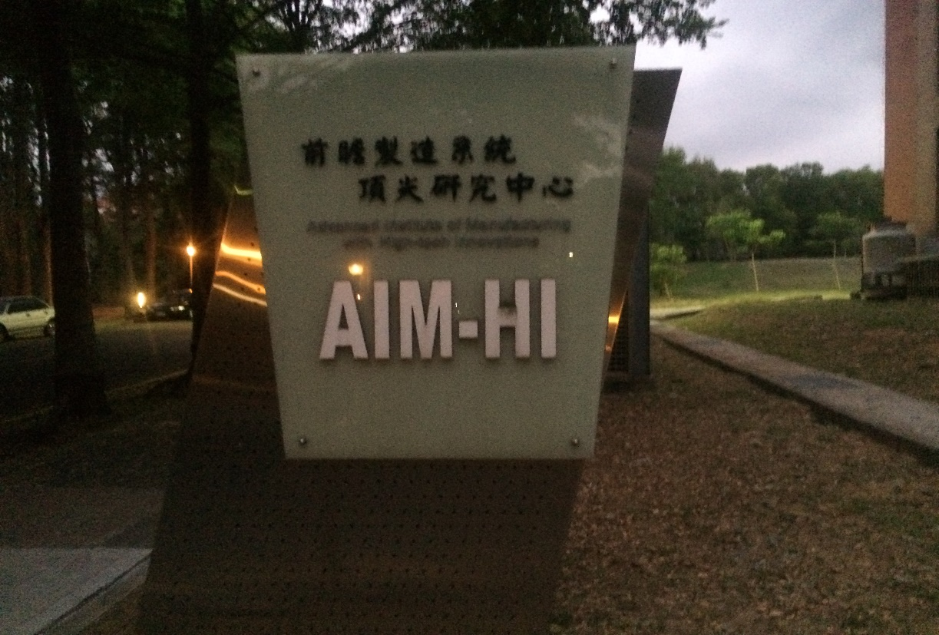
My home away from home!
Experience in Taiwan

Slide 11

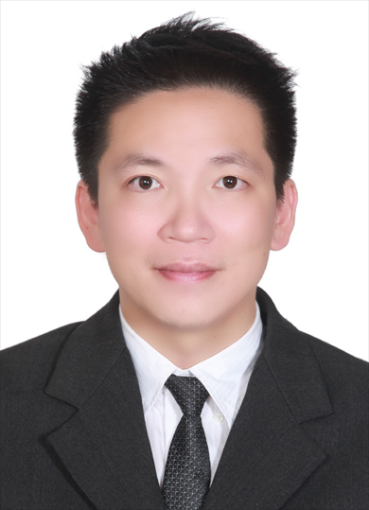
Sincere Thanks to !
Experience in Taiwan
Prof. Dr. Guo-En Chang and AIM-HI,CCU
Also I would like to thank my lab mates and Ms. Cindy Kuo
for helping me in any way possible throughout this internship period
Thank you Sir! ,Thank you very much for this opportunity.

