Slide 1
Working Title: Kinectzilla
Hog Jam / Ludem Dare

Slide 2
Game Idea
Good guy player versus Boss player
Boss player wants the entire world to be on FIRE!
The good guy (s) wants to save the world for good (aka the world should not be on fire).
Which side will be victorious when the world of good versus fire collide?

Slide 3
Features
Asymmetric Game Play
Kinect for Windows 2.0
Xbox Game Controllers
Unity 4.6

Slide 4
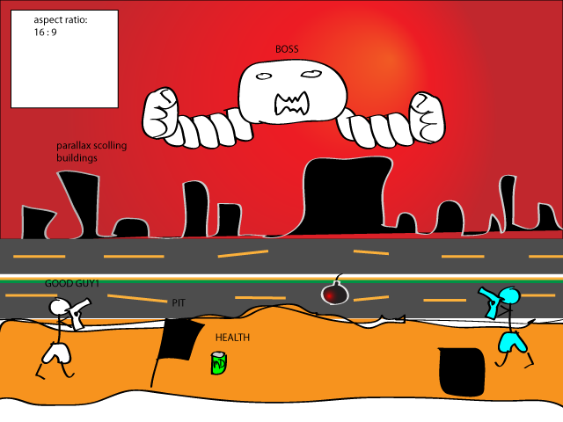
KinectZilla

Slide 5
The Controls - Boss
Boss Player will use the Kinect sensor to move in the game.
The Boss appears over head and uses his hands and head to move left and right
The boss smashes by making a smash gesture with his hands
The Boss opens his mouth wide to breathe fire
The Boss rears back to temporarily go into the background
The Boss opens hands to smack away bombs

Slide 6
The Controls – Good Guys
The Good Guys use their game controller to move in the game.
Left Joystick to move left and right
Right joystick to shoot Up left and right
A to jump
Right Trigger to toggle between bullets (infinite) and bombs (set number)

Slide 7
Team
Team:
Evie Powell - Designer / Programmer
Yori Kvitchko - Lead Programmer
Artist - Havilah Farnsworth
Jay Cheng - Programmer Intern 1
Nathan Zager - Programmer Intern 2
Tom Miller - Musician

Slide 8
Things to get from the Reactor
Cintiq Monitor
Keyboard / Mouse
Kinect 4 Windows
Xbox Controllers
Index Cards
DONE

Slide 9
Art asset list
Player (four different colors for different colored players)
4 frame run animation
jump state
4 frame idle animation
Background file (1920 x 1080)
Scrolling buildings
Health Pack
Life bars
Life bar boss
Death icon (player is dead and must hit start button to restart)
OR death state of the player
Font for game screens
Title Screen
UI box background
UI button background

Slide 10
Functional Design Doc
Gesture of smash move

Slide 11
Things to get from Home?
Moar Xbox Controllers?
Second Kinect 4 Windows?

