Slide 1
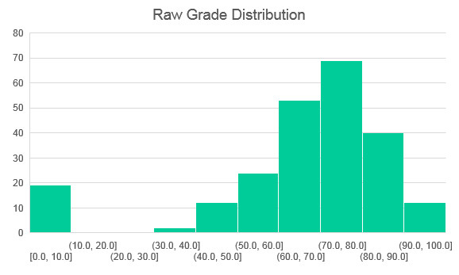
Midterm Exam Scores
 | Q1 | Q2 | Q3 | Q4 | Q5 | Total
Average Points | 9.4 | 9.4 | 8.8 | 7.9 | 2.7 | 38.3
Average Percent | 79% | 79% | 73% | 66% | 45% | 80%
Highest Score | 12 | 12 | 12 | 12 | 6 | 52.0
Number Achieved | 22 | 12 | 11 | 13 | 2 | 2
Number of students in class who got highest score on each Q

Slide 2
Adjustment
Based on length of exam, grading will be out of 48 points instead of 52.
This adjusts for the fact that many people were unable to finish
To compute your percentage grade, divide your score by 48.

Slide 3
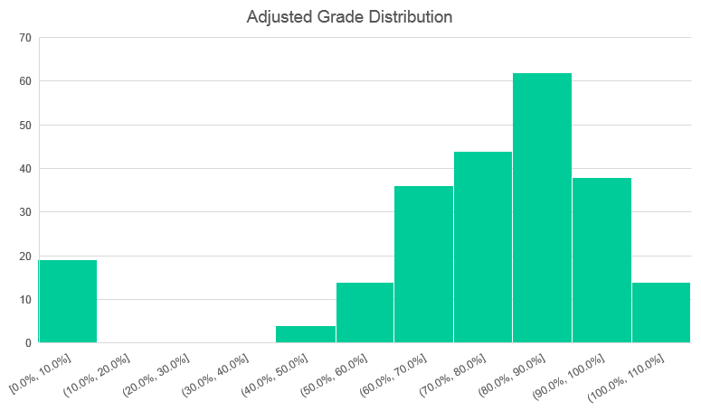
Adjusted Distribution
 | Total | Percent
A | 57 | 27%
B | 57 | 27%
C | 48 | 23%
D | 32 | 15%
F | 18 | 8%
See Slide Notes
Notes:
Note: There are no actual letter grade assignments on the exam. The grade table is for your information only. The midterm will contribute to your final grade by adding whatever points you received towards your total points for all work, which will then be divided by the maximum points across all work. The column percent indicates what percentage of the class fell into a certain letter grade bin, as a way of communicating where the class as a whole stands. Obviously the final grade distribution will depend upon final, projects, and extra credit.

