Slide 1
Employee Performance
Management System
Product walkthrough and role-based operating model
Admin • Manager • Employee
EPMS
Java 17 | Servlets/JSP | PostgreSQL | Neon + Render

Slide 2
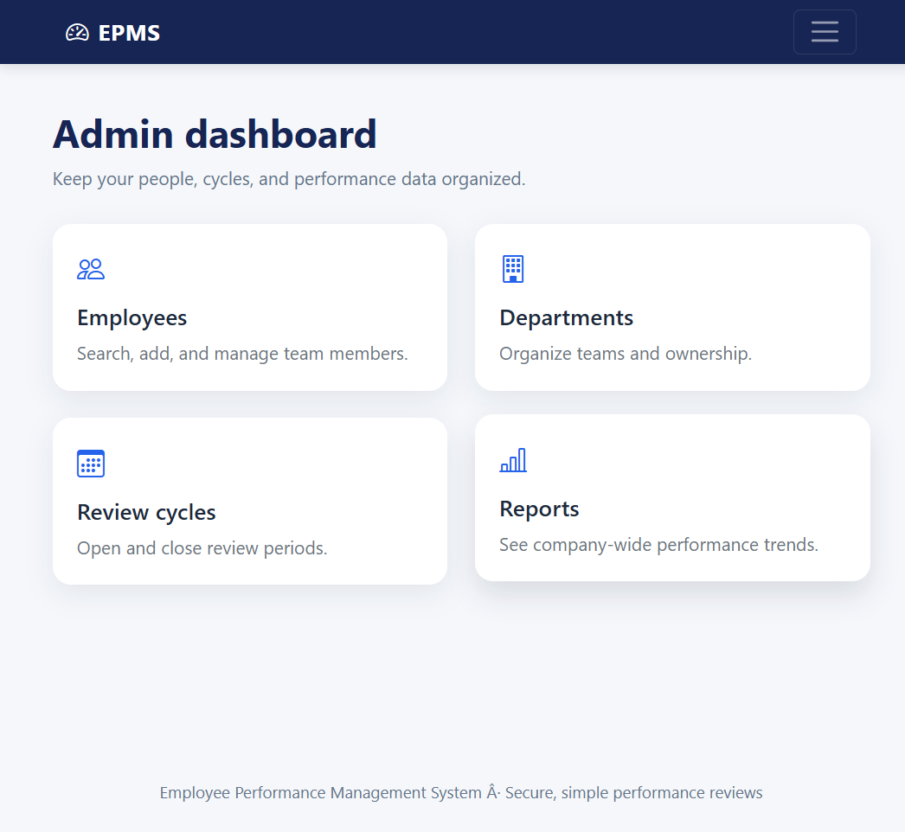
Admin experience
Organization control, people management, and performance visibility.
Role capabilities
Manage employees, departments, and review cycles from a single workspace.
Search the workforce and create employee profiles with department and manager ownership.
Open or close review periods so the business follows a consistent cadence.
Use reports to monitor department averages, rating distribution, and top performers.
EPMS | Employee Performance Management System
ADMIN 02

Slide 3
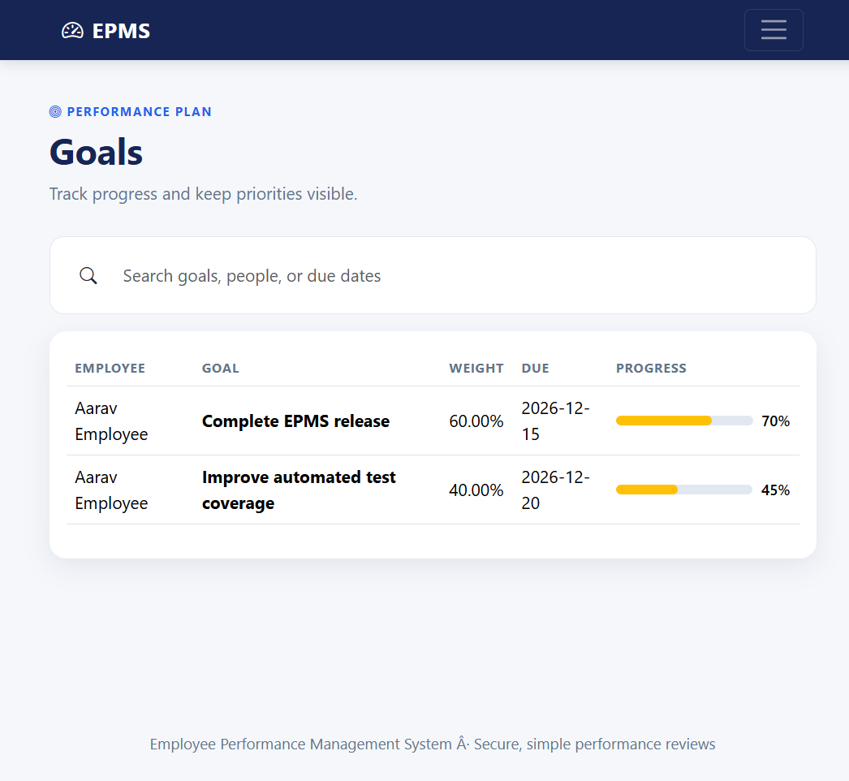
Manager experience
Turn team priorities into measurable goals and useful feedback.
Role capabilities
Review team goals and monitor progress against due dates and weights.
Submit structured reviews with ratings, comments, strengths, and improvements.
Use reports to identify coaching opportunities and recognize strong performance.
Keep employee development connected to the active review cycle.
EPMS | Employee Performance Management System
MANAGER 03

Slide 4
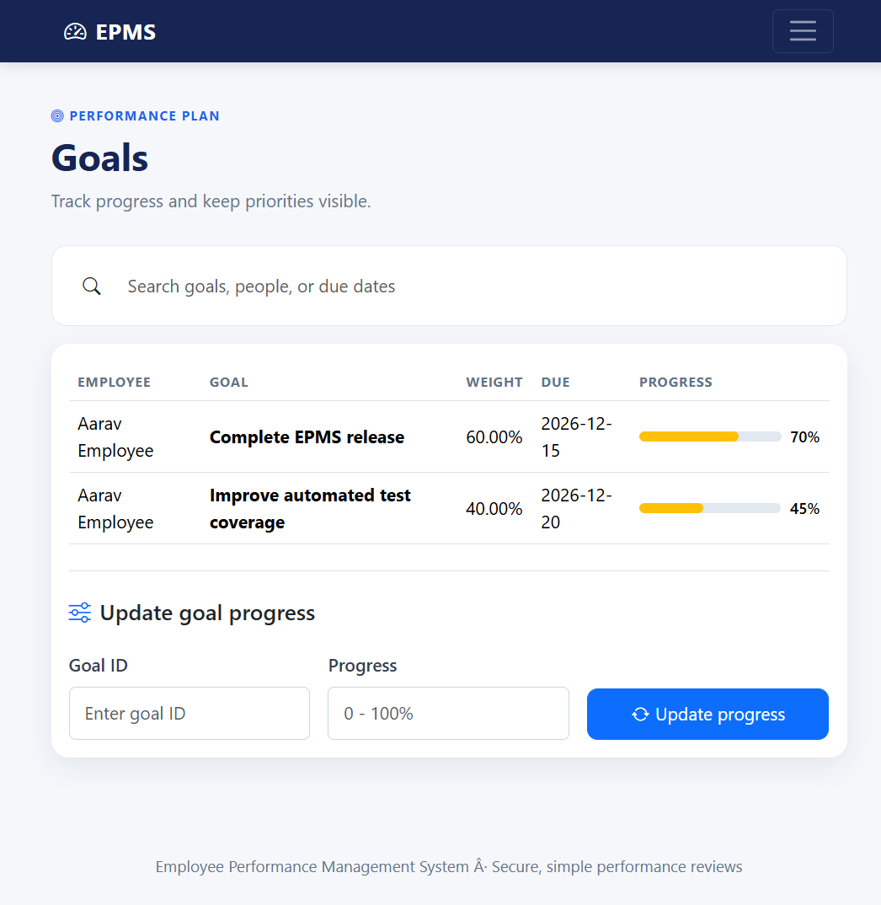
Employee experience
A focused self-service space for goals, growth, and updates.
Role capabilities
View assigned goals and update progress from 0 to 100 percent.
Read manager feedback and complete self-assessment activities.
Track notifications and stay aware of review and performance updates.
Use the same responsive interface on desktop or mobile-sized screens.
EPMS | Employee Performance Management System
EMPLOYEE 04

Slide 5
How work moves through EPMS
A repeatable cycle keeps accountability clear across every role.
1
Admin setup
2
Manager planning
3
Employee execution
Create departments, employees, managers, and the review cycle.
Assign weighted goals with descriptions and due dates.
Employees update progress and complete self-assessments.
4
Manager review
5
Leadership insight
Managers submit ratings and actionable feedback.
Reports summarize averages, distributions, and performers.
The result is a transparent performance loop: goals → progress → feedback → insights.
EPMS | Employee Performance Management System
WORKFLOW 05

Slide 6
Deployment and operational readiness
The application is packaged for a managed PostgreSQL and container deployment.
Technology foundation
Demo evidence captured
Java 17 + Maven WAR
Tomcat 9 + Servlet 4.0 + JSP/JSTL
PostgreSQL + JDBC + HikariCP
Neon database + Render container
BCrypt authentication + role filters
Bootstrap 5 + Chart.js responsive UI
✓ Admin dashboard and employee management
✓ Manager goals and review workflow
✓ Employee goals and notifications
✓ Reports with chart and CSV export
✓ Local Tomcat health check: 200 OK
Next production hardening: CSRF protection, removal of demo credentials, and complete CRUD/error-page coverage.
EPMS | Employee Performance Management System
DELIVERY 06

