Slide 1


Networking Project
Guided By Professors :-
Ayda Roknaldin
Ahmad Reza Madabadi

Slide 2
Our Team
Navandeep Singh (1896509)
Vishnu Vardhan Reddy Parakala (1894987)
Paras Patni Deepak Kumar (1896045)
Jobanjeet Singh (1896280)

Slide 3
Mission
Design and configure a complex network for a company having several sites in five cities.

Slide 4
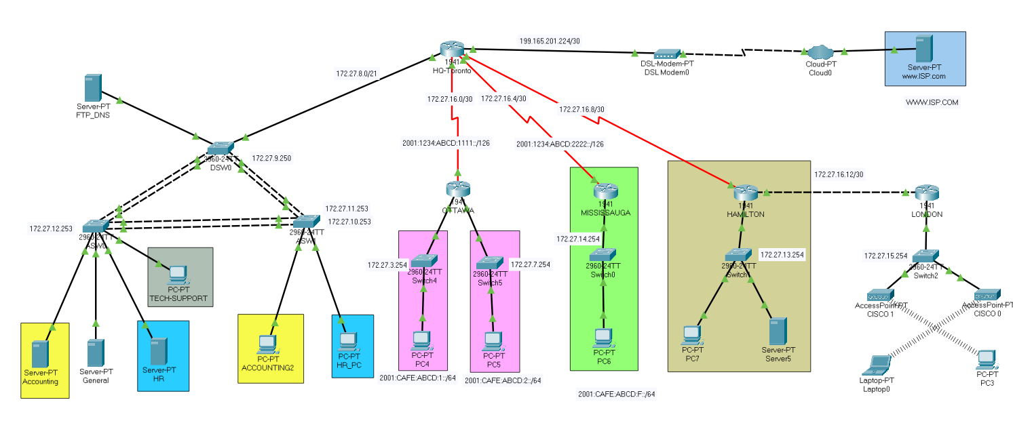
Topological Diagram

Slide 5
Implementation of topology
Subnetting
DHCP
OSPF
ETHERCHANNEL
PAT
STP-Root Bridge
Access-List
Encapsulation (PAP, CHAP)

Slide 6
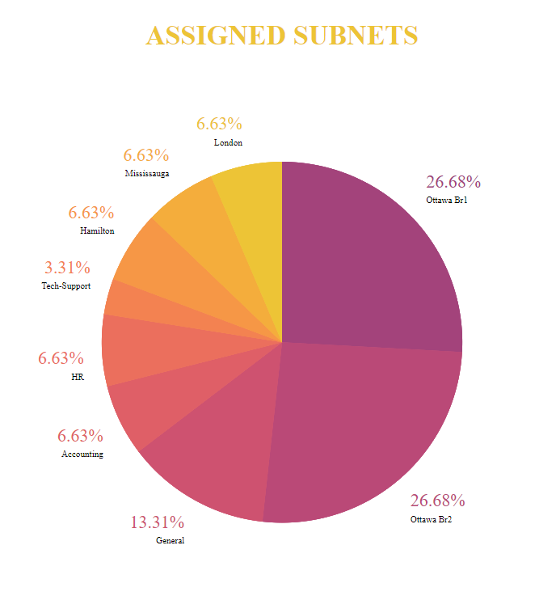
Subnetting
HQ-TORONTO: 1022
OTTAWA: 2046
MISSISSAUGA: 254
HAMILTON : 254
LONDON: 254

Slide 7
DHCP
Implemented on these routers:
HQ-TORONTO
OTTAWA
MISSISSAUGA
HAMILTON
LONDON
Example:
ip dhcp pool VLAN2
network 172.27.11.0 255.255.255.0
default-router 172.27.11.1
dns-server 172.27.9.254
ip dhcp excluded-address 172.27.11.1

Slide 8
OSPF
Implemented on these routers:
HQ-TORONTO
OTTAWA
MISSISSAUGA
HAMILTON
LONDON
Example:
router ospf 1
router-id 1.1.1.1
log-adjacency-changes
network 172.27.16.0 0.0.0.3 area 0
network 172.27.16.4 0.0.0.3 area 0
network 172.27.16.8 0.0.0.3 area 0
network 172.27.11.0 0.0.0.255 area 0
network 172.27.10.0 0.0.0.255 area 0
network 172.27.8.0 0.0.1.255 area 0
network 172.27.12.0 0.0.0.127 area 0
default-information originate

Slide 9
ETHERCHANNEL
Implemented on these switches:
DSW0
ASW0
ASW1
Example:
ASW0(config)#interface range fastEthernet 0/18-19
ASW0(config-if-range)#sh
ASW0(config-if-range)#channel-group 2 mode active
ASW0(config-if-range)#
Creating a port-channel interface Port-channel 2
ASW0(config-if-range)#no sh
ASW0(config-if-range)#interface port-channel 2
ASW0(config-if)#switchport mode trunk

Slide 10
PAT
Implemented on this router:
HQ-TORONTO
Example:
interface GigabitEthernet0/1
ip address 199.165.201.225 255.255.255.252
ip nat outside
duplex auto
speed auto
interface GigabitEthernet0/0.2
ip nat inside
interface GigabitEthernet0/0.3
ip nat inside
ip nat inside source list 1 interface GigabitEthernet0/1 overload
access-list 1 permit 172.27.0.0 0.0.255.255
Verify:
Toronto-HQ# sh ip nat translations

Slide 11
STP-Root Bridge
Implemented on these switches:
DSW0
ASW0
ASW1
Example:
Root Bridge for the VLAN-4(GENERAL) is DSW0
spanning-tree vlan 4 root primary
Root Bridge for the VLAN-11(Tech-Support) IS ASW0
spanning-tree vlan 11 root primary
Root Bridge for the VLAN-2 and 3(i.e. HR and ACCOUNTING) respectively is ASW1
spanning-tree vlan 2 root primary
spanning-tree vlan 3 root primary

Slide 12
Access-List
Example:
access-list 1 permit 172.27.0.0 0.0.255.255

Slide 13
Encapsulation
Implemented on these routers:
HQ-TORONTO
OTTAWA
MISSISSAUGA
PAP: Ottawa and Toronto
Example:
Ottawa-Router(config)# interface s0/0/0
Ottawa-Router(config-if)# encapsulation ppp
Ottawa-Router(config)# username Toronto-HQ secret cisco
Ottawa-Router(config)# interface s0/0/0
Ottawa-Router(config-if)# ppp authentication pap
Ottawa-Router(config-if)# ppp pap sent-Ottawa-Router password cisco
CHAP: Toronto and Mississauga
Example:
Router(config)# hostname Mississauga
Mississauga (config)# interface s0/0/0
Mississauga (config-if)# encapsulation ppp
Mississauga(config)# username Toronto-HQ secret cisco
Mississauga(config)# interface s0/0/0
Mississauga(config-if)# ppp authentication chap

Slide 14

Thank You

