Slide 1


Slide 2
MongoDB at SAYS.com

Slide 3
SAYS is a Social News Network

Slide 4
460,000 users

Slide 5
how we use MongoDB

Slide 6
news & social sharing

Slide 7
news

Slide 8
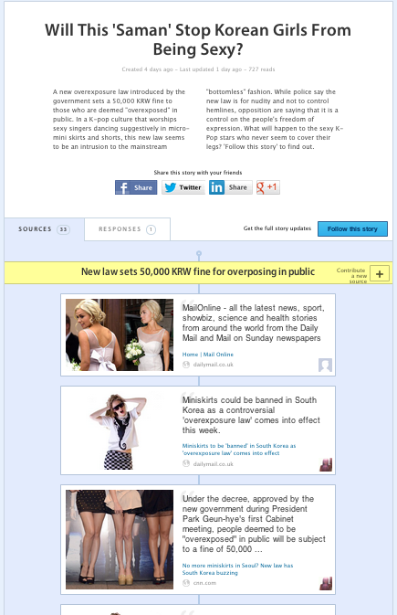
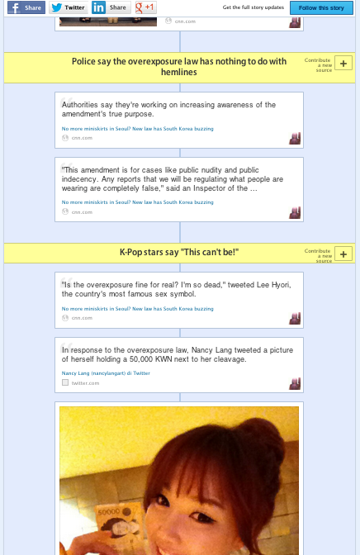

Slide 9
125 thousands news sources

Slide 10
2 millions page views

Slide 11
social sharing

Slide 12
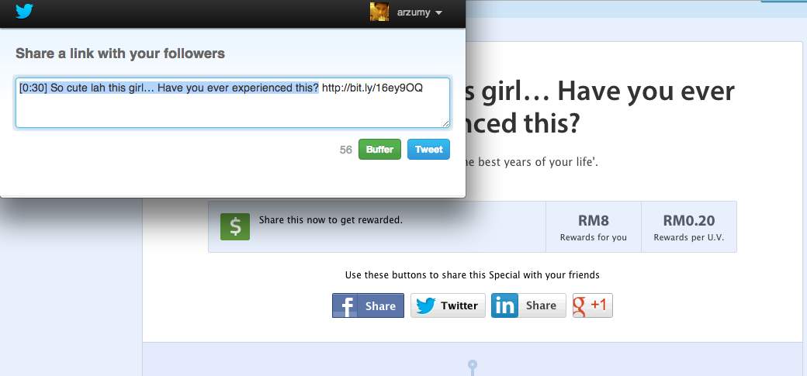

Slide 13
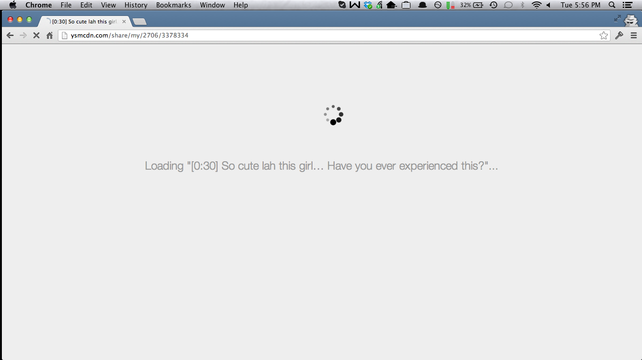

Slide 14
10 millions clicks

Slide 15
10 - 2 = 8

Slide 16
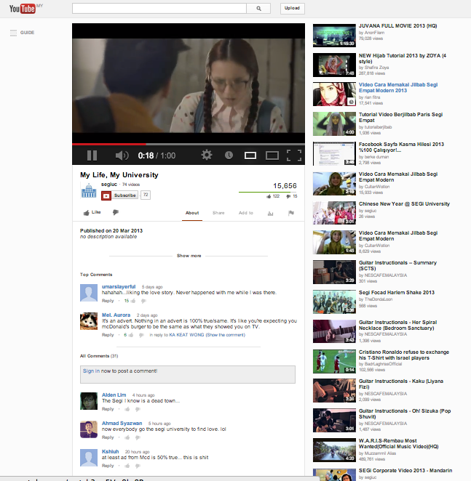

Slide 17
random stuff that we’ve learned

Slide 18
always turn on firewall
mongo your-domain.com
MongoDB shell version: 2.0.0connecting to: your-domain.com/test
> show dbs;

Slide 19
pick the right ODM
or, don’t use mongomapper

Slide 20
schema free is liberating

Slide 21
but of course, no validation

Slide 22
it’s built for activity feeds!

Slide 23
{
title: "Will This 'Saman' Stop Korean Girls From Being Sexy?",
followers: [647269,239531..]
}
{
_id : ObjectId("514ed1630b86ec46b852074a"),
feed : [
{
actor_id: 647719,
actor_nickname: "acai1986",
actor_display_name: "acai1986",
actor_profile_url: "https://d1t7rrtjhzq2b3.cloudfront.net/assets/user_photo_medium-94a42019c5f75edaf50ca194ef72ec91.jpg",
story_id: ObjectId("514be1e21a610d5fc80003e8"),
story_slug: "korea-overexposure-law-no-more-miniskirts-for-k-pop-stars",
story_title: "Will This 'Saman' Stop Korean Girls From Being Sexy?",
story_thumbnail_url: "http://thegrandnarrative.files.wordpress.com/2011/03/no-pants-subway-ride-taiwan.jpg",
story_category_slug: "news",
source_id: ObjectId("514ed15e1a610d331400012d"),
source_title: "Home | Mail Online",
source_image_url: "http://i.mol.im/i/pix/2013/01_01/jenknew_302x322.jpg",
source_url: "http://dailymail.co.uk",
activity_type: "new_source",
created_at: ISODate("2013-03-24T10:11:43.305Z")
}
],
user_id : 647269
}

Slide 24
use atomic update for large object

Slide 25
watchout for data growth
your stupid driver might not return any error

Slide 26
think before embed doc

Slide 27
thanks
@arzumy
@nvunguyen

