Slide 1
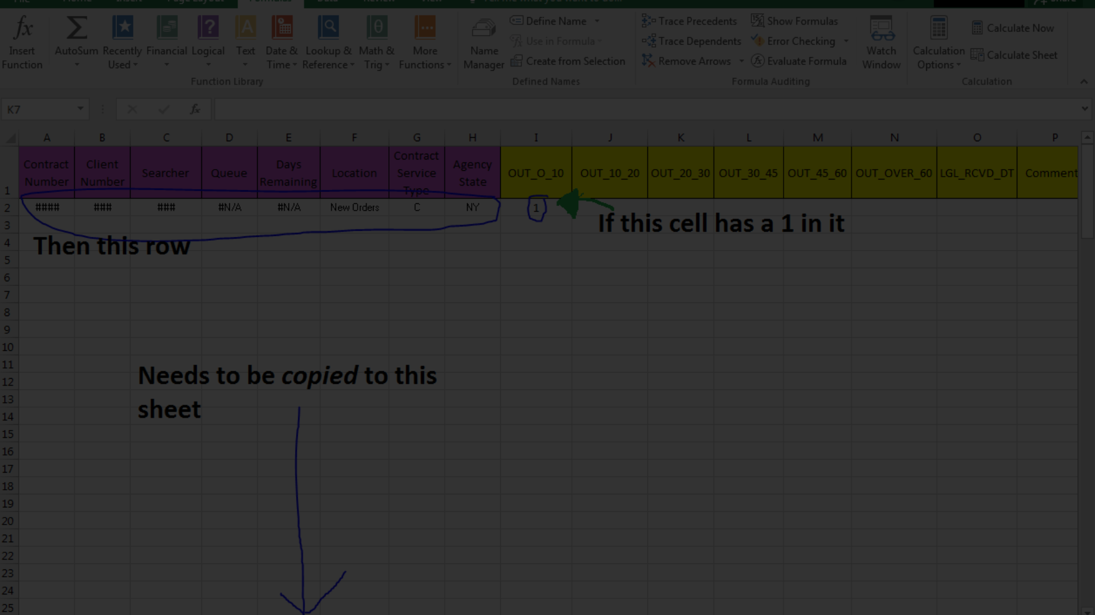
Name : Paras Raut
Github : https://github.com/parasraut21
Email : parasraut2511@gmail.com
Ph No. : 9356375273
Linked : https://www.linkedin.com/in/paras-raut
Website Scraping Using Python
by Paras Raut

Slide 2
Uploading Input Data
Prepare your input data in an Excel file named "Input.xlsx". Ensure that it has the columns 'URL_ID' and 'URL' for the script to read.

Slide 3
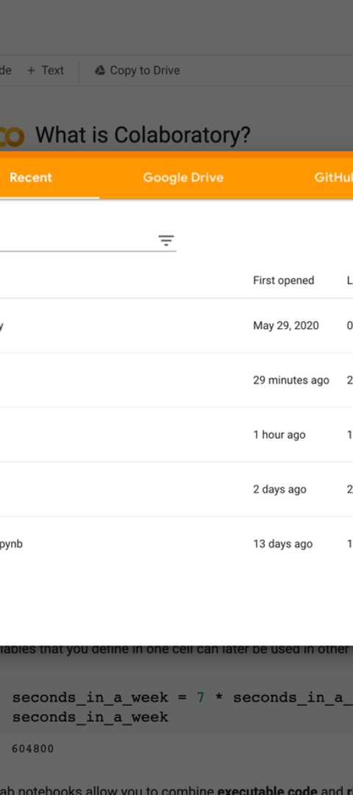
Opening Google Colab
1
Step 1
Open Google Colab in your web browser
2
Step 2
Create a New Colab Notebook
3
Step 3
Copy and Paste Code

Slide 4
Pasting Code in Colab Notebook
Step 4
Step 5
Step 6
Copy the entire Python code provided earlier.
Paste the copied code into a cell in the Colab notebook.
Run the Code

Slide 5
Uploading Output Files
Output Excel File
Positive Words File
Negative Words File
Look for the "Output_Data_Structure_YYYYMMDD_HHMMSS.xlsx" file. Download it to get the main analysis results.
Download the "Positive_Words.txt" file.
Download the "Negative_Words.txt" file.

Slide 6
Analyzing Results
1
Dependencies
2
Additional Dependencies
3
Instructions for Downloading Dependencies
The script uses various Python libraries such as os, requests, BeautifulSoup, pandas, nltk, datetime, and google.colab.
The script dynamically downloads NLTK resources for tokenization, sentiment analysis, and stopwords.
Run the provided NLTK download commands within the Colab notebook to ensure all required resources are available.

