Slide 1
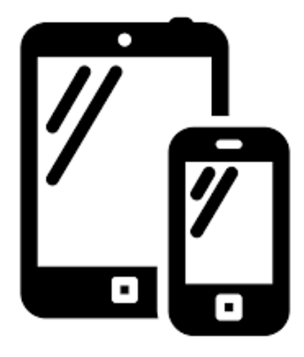

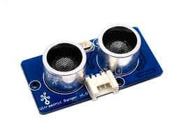
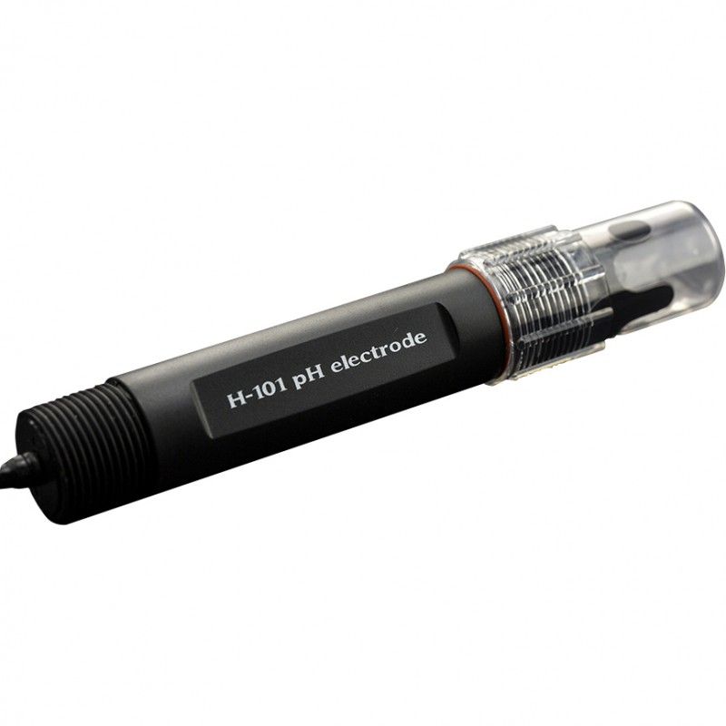


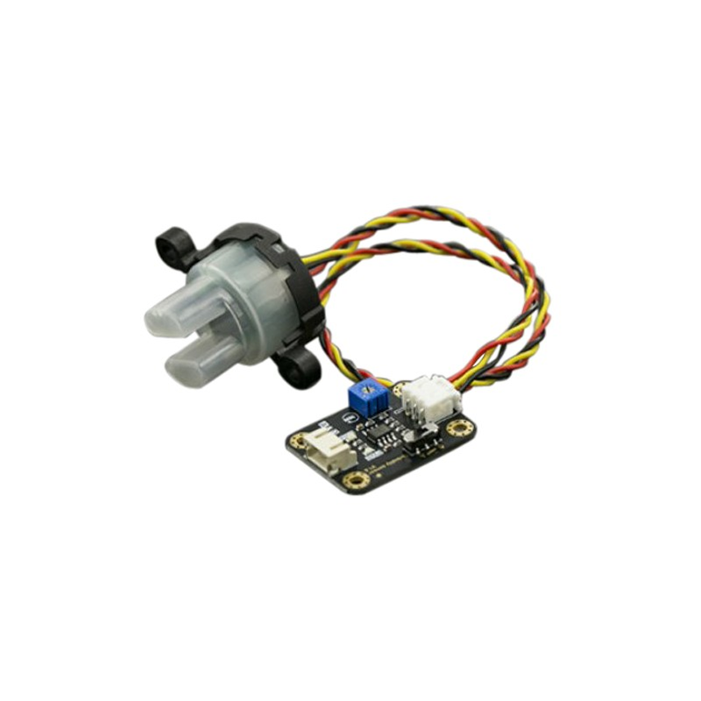
Predix Architecture – Smart City
Intel
Edison
Gateway
MicroServices
Ux Components
Groove Ultrasonic Ranger
Machine
Data Ingestion
Simulator
Location
REST
Waste Management
Water Management
Bin Asset
Waste Analytics
Notifications
Water Asset
Water Analytics
Hospital Inventory
Hospital Management
City Dashboard
JPA
Spring Boot
Spring MVC
Swagger
Px
Angular
Polymer
pH Sensor
html5
javascript
css
JDBC
JDBC
Postgres
Turbidity Sensor
Predix Cloud
Spring boot Container (Tomcat)
NGINX
UAA
ACS
Asset
Time Series
Analytics
Postgres
Location
Mobile

