Slide 1

Polyglot Persistence Demo
Final presentation & Demonstration
Date: December 11, 2025
By: Paras Tiwari, Nischal Neupane, Sandhya Shahi Thakuri

Slide 2
Agenda
Introduction
Project Goals & Motivation
Features and Capabilities
Architecture Overview
Databases & Why Each Was Chosen
API
Kafka and Why?
Frontend: Visualization (vis-network)
Deployment & Run Instructions
Demos
Results & Metrics
Conclusion
Future work
References

Slide 3
Polyglot Persistence
Polyglot Persistence refers to using multiple data storage technologies within a single system or application, choosing each database based on the specific needs of different data types or workloads. It allows organizations to optimize performance, scalability, and flexibility.
Uses different databases (SQL, NoSQL, graph, etc.) within one application to match each data type’s needs.
Improves performance and scalability by selecting the best storage solution for each function.
Enhances flexibility, allowing teams to choose tools based on workload (transactions, analytics, relationships).
Supports complex systems by avoiding a “one-size-fits-all” database approach.

Slide 4
Project Goals & Motivation
Demonstrate polyglot persistence: use multiple specialized DBs in a single system
01
Show event-driven synchronization via Kafka
02
Provide real-time visualization and analytics
03
Build maintainable, modular code that can be deployed in containers
04
Notes:
- Emphasize trade-offs between specialized DBs and the motivation for picking each.

Slide 5
Features and Capabilities
User Management
  Create/Get/Update/Delete users: PostgreSQL (relational DB)
  User sync to social graph: Neo4j (automatically when user is created/deleted)
  User profile caching: Redis (performance optimization)
  User events logging: TimescaleDB (audit trail and analytics)

Slide 6
Features and Capabilities
Post Management
Store posts: MongoDB (document DB—flexible schema)
Retrieve posts enriched with user data: API gateway orchestrates MongoDB + PostgreSQL
Post event tracking: Kafka publishes POST_CREATED/UPDATED/DELETED; TimescaleDB logs events

Slide 7
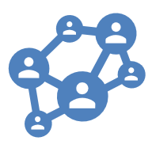
Features and Capabilities
Social Graph & Relationships
Create follow relationships: Neo4j (graph DB)
Relationship caching: Redis
Analytics & Monitoring
Event statistics: TimescaleDB (time-series DB—optimized for events, metrics, time-bucketed queries)
Cache performance metrics: Redis introspection endpoints

Slide 8
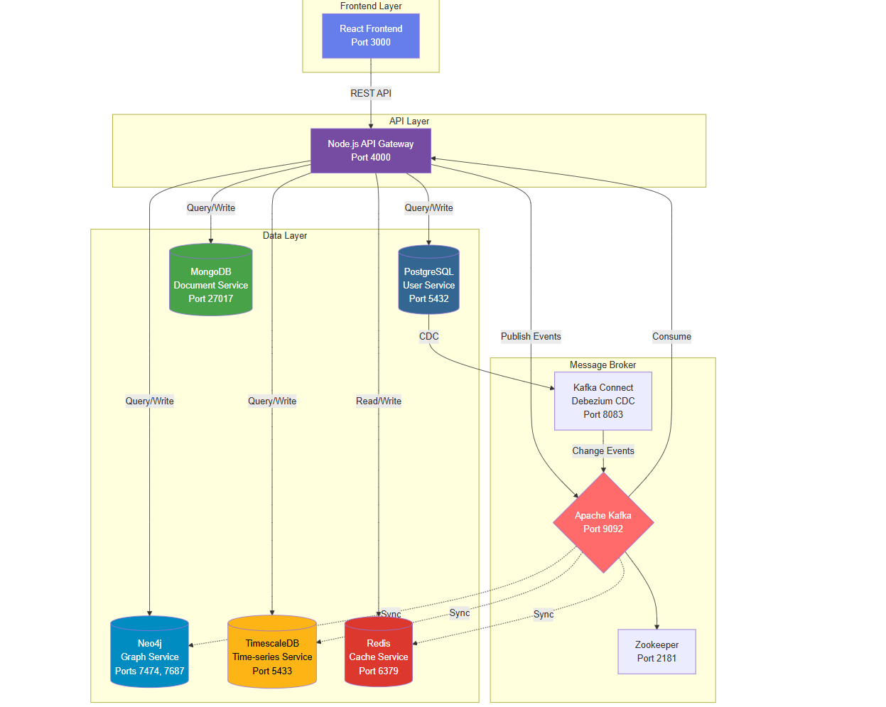
High-Level Architecture
Notes:
- Walk through the diagram slowly: UI -> API -> DB writes, and explain Kafka's place in syncing and analytics.

Slide 9
Databases
PostgreSQL (Users): ACID, strong consistency, relational queries
MongoDB (Posts): Flexible schema, documents for content
Neo4j (Graph): Native graph queries and visualization
TimescaleDB (Events): Time-series optimized analytics
Redis (Cache): Low-latency reads and profile caching
Notes:
- Mention how each DB addresses specific requirements.

Slide 10
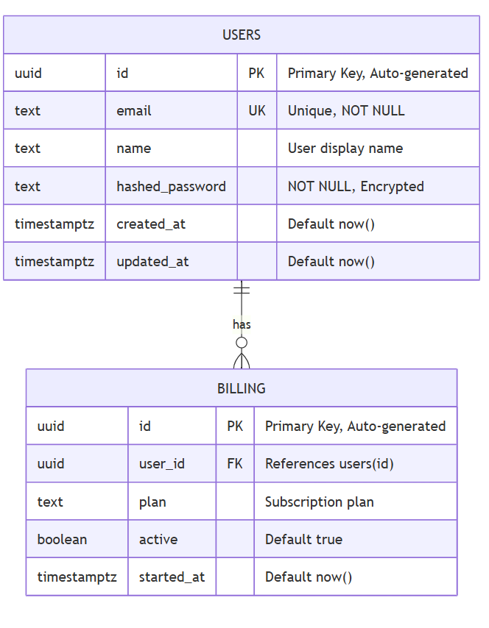
Postgres
Relationships:
One-to-many: One user can have multiple billing records (subscription history)
Foreign key constraint ensures referential integrity

Slide 11
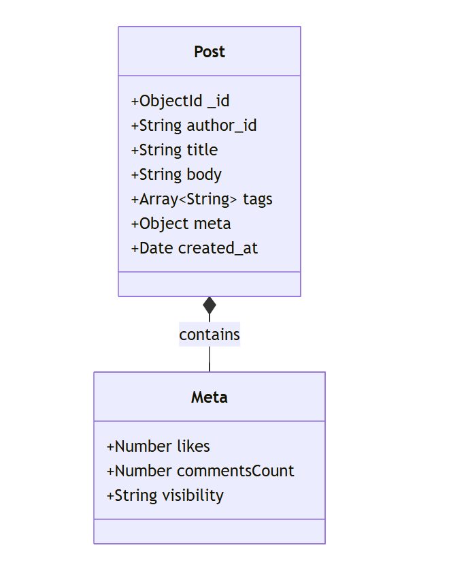
MongoDB
Field Descriptions:
_id: MongoDB auto-generated ObjectId
author_id: Reference to PostgreSQL user UUID (cross-database reference)
title: Post title (indexed for search)
body: Full text content
tags: Array for categorization and filtering
meta: Nested object for flexible metadata
created_at: Timestamp for sorting

Slide 12
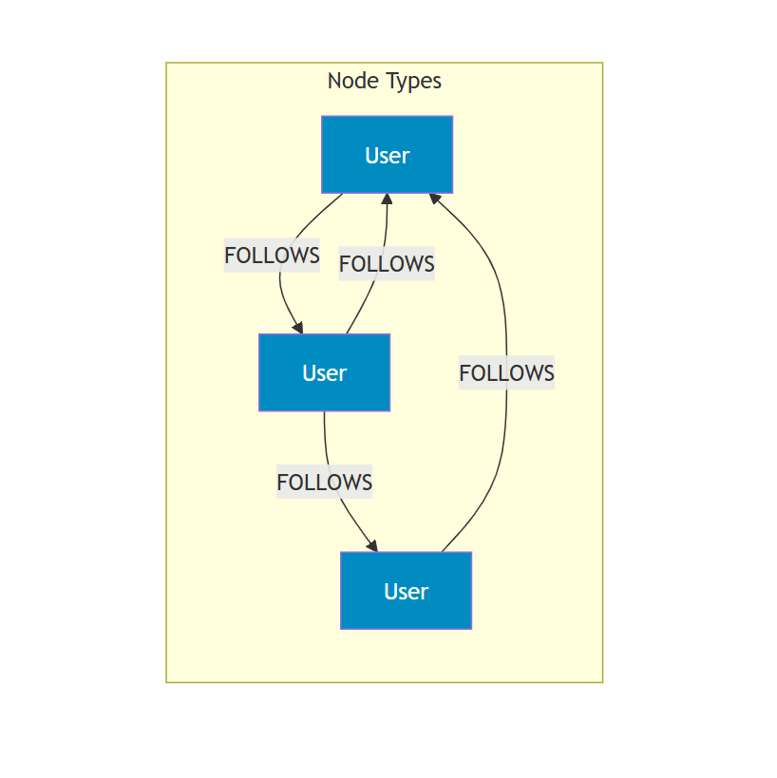
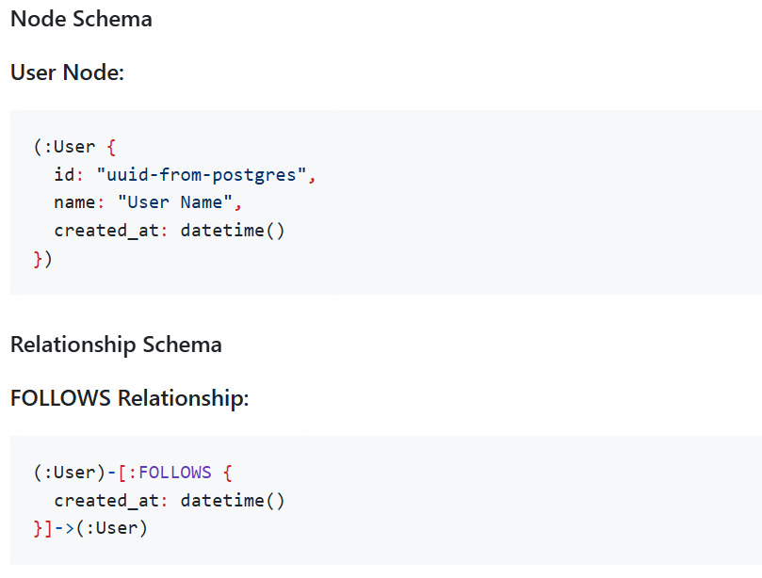
Neo4j (Graph)

Slide 13
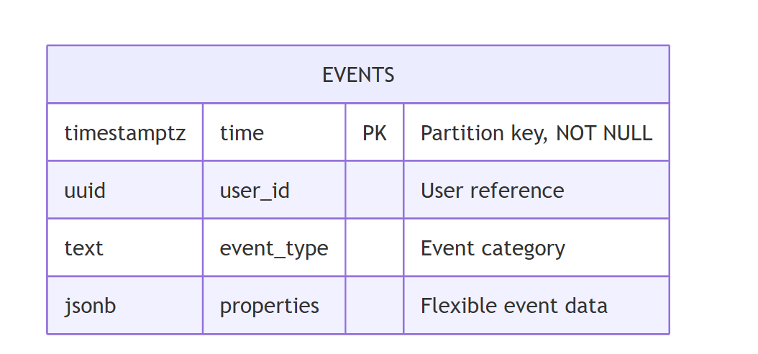
TimescaleDB (Events):
Hypertable Characteristics:
Automatically partitioned by time (default: 7 days per chunk)
Optimized for time-range queries
Efficient compression for historical data
Continuous aggregates for real-time analytics

Slide 14
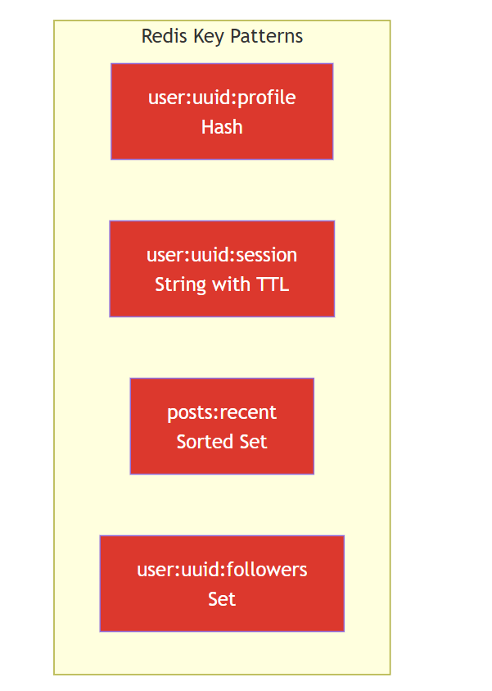
Redis (Cache):
Key Patterns and Data Types
User Profile Cache (Hash):
Key: user:{user_id}:profile
Type: Hash
TTL: 3600 seconds (1 hour)
Fields:
- id: "user-uuid"
- name: "User Name"
- email: "user@example.com"
- created_at: "2025-12-04T10:00:00Z"

Slide 15
API Endpoints Overview
`POST /users` — create user (sync to Neo4j + publish USER_CREATED)
`GET /users` — list users
`PUT /users/:id` — update user (publish USER_UPDATED)
`DELETE /users/:id` — delete user (publish USER_DELETED)
`POST /posts` — create post (publish POST_CREATED)
`GET /posts` — get posts (enriched with user data)
`POST /follow` — create follow (Neo4j + publish FOLLOW_CREATED)
`GET /relationships` — list relationships
`GET /analytics` — TimescaleDB stats
`GET /cache-status` — Redis metrics
Notes:
- Highlight how endpoints publish events and how consumers handle them.

Slide 16

Kafka
Definition: Kafka is a distributed, durable, high-throughput event streaming platform (message broker) that stores ordered logs of events (topics) and lets multiple producers and consumers read/write those logs.
Core concepts:
Topic (named stream)
Producer (writes events)
Consumer (reads events)
Partition (ordered subset of a topic for parallelism)
Offset (position in partition)
Broker (Kafka server)
Zookeeper (coordination in this setup).
Notes:
- Emphasize idempotency (consumer should be safe if message reprocessed).

Slide 17
Why Kafka is used in this system?
Decoupling services: Producers (API writes / CDC) publish events once; many independent consumers can react (Neo4j sync, Redis cache, Timescale analytics) without tight coupling.
Fan-out & multiple targets: One write to Postgres → a single USER_CREATED event can update Neo4j, prime Redis, and log to TimescaleDB concurrently.

Slide 18
Kafka Consumers — What We Implemented
`services/api/lib/kafka-consumers.js` implements handlers:
TimescaleDB logging for all events
Redis caching of user profiles (1 hour TTL) on USER_CREATED/UPDATED
Redis deletion on USER_DELETED
Neo4j node deletion on USER_DELETED (DETACH DELETE)
Logging and safe handling for post/follow events
Notes:
- Emphasize idempotency (consumer should be safe if message reprocessed).

Slide 19
Frontend: Graph Visualization (vis-network)
`vis-network` is a UI library for react for network visualization
`GraphSection.jsx` uses `vis-network` Network for interactive nodes and edges `Vis-network`
Features: zoom/pan, physics layout, click handlers for node details
Notes:
- Mention performance benefits and ease of integration with DOM-based events.

Slide 20
Deployment & Docker
`docker-compose.yml` orchestrates 10 services:
zookeeper, kafka, postgres, timescaledb, mongo, neo4j, redis, kafka-connect, api, frontend
Health checks ensure DB readiness before API startup
Quick start :
  cd or ls "Example:\path\to\Advanced-Database-Project"
  docker-compose up -d
Notes:
- Explain environment variables for DB connection strings and Kafka broker.

Slide 21
Demo
1. Start the stack with Docker Compose
2. Open Frontend at `http://localhost:3000`
3. Create a user via UI (or curl)
4. Show Neo4j Browser — user node created
5. Create a post — show enrichment (post has user info)
6. Create a follow relationship — show graph update
7. Show TimescaleDB analytics endpoint results
8. Show Redis cache status endpoint
Notes:
- These steps demonstrate both sync and async flows.

Slide 22
Results & Metrics (Observed)
Neo4j nodes created on user creation
TimescaleDB receives event logs for each CRUD operation
Redis caches profiles with expected TTL(Time-To-Live)
UI updates reflect graph changes within seconds
Notes:
- If available, include example metrics (QPS, event latency). If not, request user to provide sample runs.

Slide 23
Conclusion
What We Accomplished
Integrated 5 specialized databases into single coherent system
Implemented event-driven architecture with Kafka for loose coupling
Built modular, maintainable code with separation of concerns
Deployed with Docker for reproducibility and portability
Final Thoughts
Polyglot persistence is powerful for diverse data needs
Success requires understanding trade-offs and investing in observability
Build for testability from the start
This is a learning project—production needs security, monitoring, disaster recovery
Notes:
- These are next steps for production readiness.

Slide 24
Future Work & Enhancements
Add JWT-based authentication and RBAC
Secure Kafka with TLS and authentication
Enable DB backups and retention for TimescaleDB
Rate-limit APIs and add monitoring/alerts
Notes:
- These are next steps for production readiness.

Slide 25
Thank you
Questions?
Notes:
- Offer to run a live demo or export the deck to PPTX/PDF on request.

Slide 26
References
SaKleppmann (2017) - Designing Data-Intensive Applications
dalage & Fowler (2012) - NoSQL Distilled
Newman (2015) - Building Microservices
Kreps et al. (2011) - Kafka: A Distributed Messaging System
Martin (2008) - Clean Code

