Slide 1
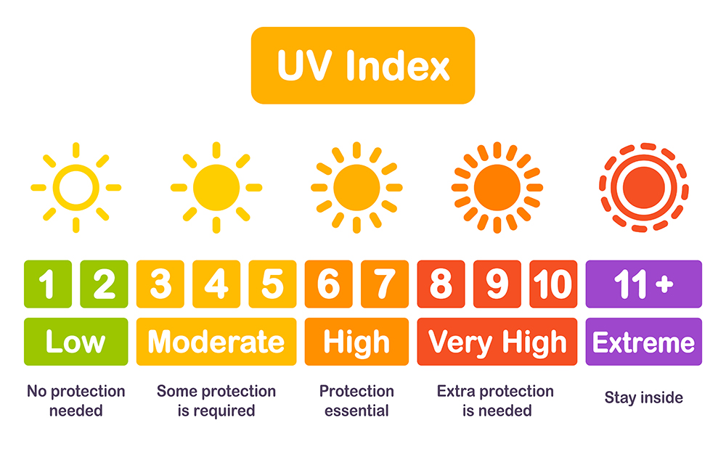
Western Australia UV Index
Analysis
Tourism WA has engaged our small firm to present the UV index and the temperature weather data for residents and tourists to increase the use of sunscreen and to prevent skin cancer.

Slide 2
Western Australia UV Index Analysis
Our Team (SASA)
http://127.0.0.1:5000/about
The purpose of this analysis:
Analysing UV index across Western Australia
Help planning a trip within Western Australia
Why only Western Australia?
Tourism WA has engaged us to do an analysis on UV index
Plus, where else we can go during Covid-19 😝

Slide 3


Western Australia UV Index
Data Source
UV Index for Western Australia:
https://openweathermap.org/api
Western Australia Cities Info:
https://simplemaps.com/data/au-cities

Slide 4


Western Australia UV Index
Extract Historical Data from OpenWeather API
OpenWeather API
csv and Json

Slide 5

Western Australia UV Index
Historical Data Storage
Python
Flask
csv file
SQLITE

Slide 6
Western Australia UV Index
Why SQLITE?
Structured data
The license for SQLite is open-source
SQLite does not require a server to run

Slide 7
Western Australia UV
Current UV Index
http://127.0.0.1:5000/index

Slide 8
Western Australia UV
Historical UV Index
http://127.0.0.1:5000/historical

Slide 9
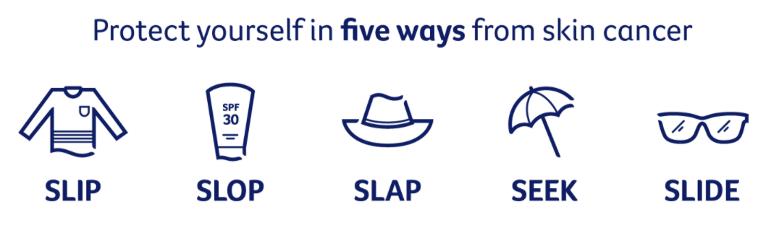

Western Australia UV Index
Conclusion
In Year 2020, city had highest UV index and in month
In Year 2020, lowest……..
The average UV index in 2020 summer was 1 , autumn was 1, winter was 1 and spring was 1.
In the next 8 days, the forecast UV index is between ………
Through this analysis, we hope that we have raised awareness of the high UV index in WA throughout the year.
In general, WA has very high UV index. Therefore it is important that we always practise Slip, Slop, Slap, Seek and Slide.

