Slide 1


A
MINI PROJECT
ON
APuML: An Efficient Approach to Detect Mobile Phishing Webpages using Machine Learning
SUPERVISIOR
Gautham Rampalli
Assistant Professor
Dept of IT
COORDINATOR
S. Sangeetha
Assistant Professor
Dept of IT
PRENSENTED BY :
  B22IT033
  B21IT034
  B21IT040
  B21IT053

Slide 2
OUTLINE
OBJECTIVE
ABSTRACT
INTRODUCTION
PROJECT OVERVIEW
METHODOLOGY
CONCLUSIONS AND FUTURE SCOPE

Slide 3
01
OBJECTIVE
Model Development: Design and implement a machine learning model for phishing website detection.
Feature Engineering: Identify relevant features from URLs, content to create a comprehensive feature set.
Dataset Preparation: Collect a diverse dataset with labelled examples of phishing and legitimate websites.
Real-Time Detection: Develop a system for real-time phishing website detection using the trained model.
Continuous Monitoring

Slide 4
ABSTRACT
Tremendous resources are spent by organizations guarding against and recovering from cybersecurity attacks by online hackers who gain access to sensitive and valuable user data. Phishing websites anticipate internet users to mistake them as genuine ones in order to reveal user information without notice. Traditional methods of detecting phishing websites, such as static blacklists, are limited in their ability to adapt to the evolving tactics employed by attackers. In recent times machine learning techniques have been used in the classification and detection of phishing websites. We use different classifiers: the Decision tree, Naive Bayesian classifier, support vector machine, and Random Forest. These are tested with a dataset containing real world URLs where each could be categorized as a legitimate site, or phishing site.

Slide 5
INTRODUCTION
A phishing website is a fake site that tricks people into sharing personal information, pretending to be a trustworthy website. It aims to steal sensitive data like passwords or credit card details for malicious purposes
Phishing website is one of the types under Malicious Websites which refers to online platforms designed with harmful intent, aiming to compromise user security, privacy, or computer systems.
Machine learning (ML) has emerged as a powerful tool in the realm of cybersecurity, offering the potential to automate the identification of phishing websites based on patterns and features inherent in their structure and behavior.

Slide 6
To avoid falling victim to phishing websites, it's essential to be vigilant and adopt good cybersecurity practices. Here are some safety measures:
Check the URL: Phishing websites often use URLs that resemble legitimate sites but may have slight misspellings or extra characters
Verify the Website's Legitimacy: Use official channels to access websites. Avoid clicking on links provided in emails or messages.
Check for Website Security Seals: Legitimate websites often display security seals or logos such as trust badges, SSL logos, security certifications.
Avoid Pop-Up Windows: Be wary of pop-up windows or prompts asking for sensitive information.
Use Two-Factor Authentication (2FA): Enabling two-factor authentication adds an extra layer of security beyond just a password.

Slide 7
Stats say that…
Google found 46,000 phishing websites in 2020.
Over 1.4 million new phishing websites are created every month.
Mobile users are three times more likely to fall for phishing scams.
Phishing attacks cost businesses $3.92 million on average.
The average loss per phishing attack is estimated to be $4.6 million.
Phishing attacks increased by 220% in 2020 due to the COVID-19 pandemic.
83% of UK businesses that suffered a cyber attack in 2022 reported the attack type as phishing.

Slide 8





PROJECT OVERVIEW:
1. Data Collection
2. Data Preprocessing
3. Machine learning Models
4. User Interface Design
5. Phishing URL Detection

Slide 9
METHODOLOGY
Create the CSV files(legitimate and phishing) which will have the extracted features of the URLs present in the original dataset(URL & Label).
Train the models with these datasets and check the accuracy with the test data.
The model which has the highest accuracy will be used to detect the Phishing websites.
We take the URL as an input from the user and will find whether it’s a Phishing or a Legitimate.

Slide 10

DATA COLLECTION
Detecting phishing websites involves collecting and analyzing various types of data to identify suspicious patterns and behaviors.
Usually, the phishing website data is collected from Phish Tank or OpenPhish. PhishTank.com is a website where phishing URLs are detected and can be accessed via API call.
There are publicly available datasets like the UCI machine learning repository dataset, Kaggle datasets in which there are many records each having URL, type (legitimate/phishing) as attributes of that URL.

Slide 11
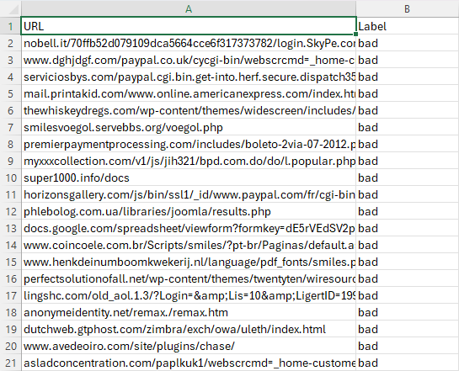
SAMPLE DATA

Slide 12

DATA PREPROCESSING
In case of URL based analysis for designing machine learning models, we need to extract these features in order to form a dataset that can be used for the training. There are four categories of the features that are most commonly considered for feature extraction. They are as follows:
1) Address Bar based features
2) Abnormal based features
3) HTML and JavaScript based features
4) Domain based features

Slide 13
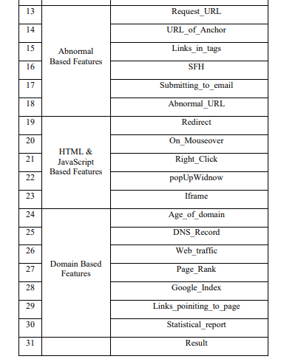
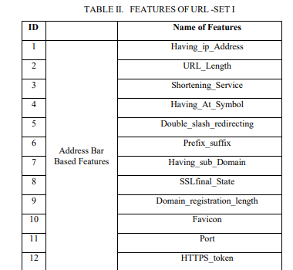
FEATURES EXTRACTION
Attributes are represented with binary values that indicate if the property is present or absent.
Some features have 3 values that represent its strength ranging from low, medium and high.
At the end, there is a result which identifies the true nature of the URL, -1 if it is a phishing site and 1 if it is a legitimate site.

Slide 14

TRAINING THE MODEL
We will explore a range of algorithms, each with its unique approach to classify websites as legitimate or phishing (Naive Bayes, Support Vector Machine, Decision Tree, Random Forest, K-Neighbours).
The process involves training a model with a dataset that encompasses both the phishing and legitimate sites, enabling the model to acquire characteristics for distinguishing between the two types.
Notable features for detecting phishing websites include specific words or phrases in the content or URL, the structure of the website's URL, and its overall layout and design.

Slide 15
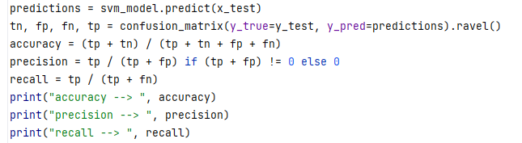
The machine learning model learns patterns and relationships between these features and the corresponding labels during the training process.
The model learns to recognize patterns and relationships between the input features and the output labels during the training phase.
The strength of machine learning lies in its ability to generalize from past examples to make predictions on new, unseen data. Even the choice of the algorithm, feature engineering, and the quality of the dataset play crucial roles in the model's predictive accuracy.

Slide 16
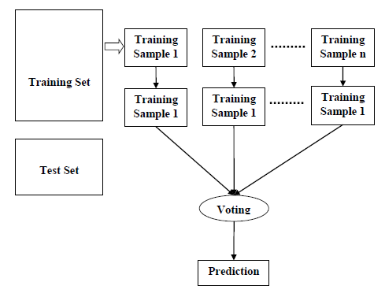
RANDOM FOREST
A Supervised Learning technique applicable to both classification and regression problems, involves aggregating predictions from multiple decision trees to enhance accuracy and stability. The process comprises two steps: firstly, constructing a random forest of decision trees, and secondly, consolidating predictions from these trees to produce a final averaged output.

Slide 17
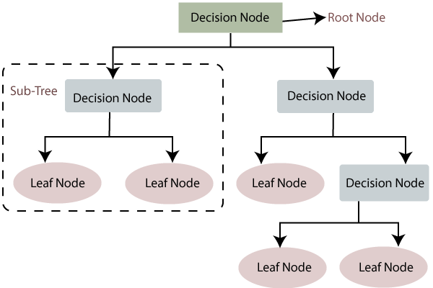
DECISION TREE
It is a supervised machine learning algorithm that makes decisions by recursively partitioning the dataset based on input features. It selects the best feature at each node to maximize the information gain or minimize the impurity. This process continues until a stopping criterion is met, resulting in a tree-like structure where each leaf node represents a class or a numerical value.

Slide 18
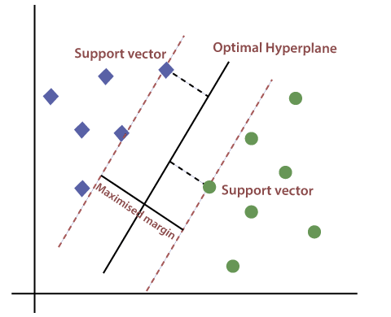
SUPPORT VECTOR MACHINE
Support Vector Machine (SVM) is a machine learning algorithm for detecting phishing websites. It identifies a hyperplane that best separates legitimate and phishing sites, maximizing the margin between them. By focusing on critical data points (support vectors), SVM effectively distinguishes between the two classes, making it valuable for robust phishing detection in online security applications.

Slide 19
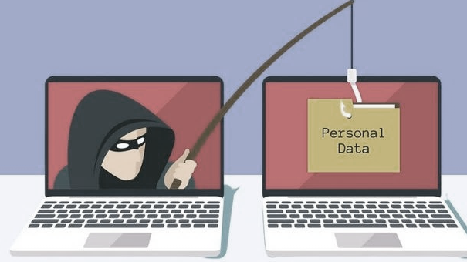

RESULTS
Random Forest works efficiently with the accuracy of 0.966.
Random Forest accuracy ==> 0.9663
Random Forest precision ==> 0.8661
Random Forest recall ==> 0.6996

Slide 20
Creating a User Interface
Creating a user interface (UI) for phishing website detection using machine learning involves designing a system that allows users to interact with the underlying model. We can build a User Interface using HTML/CSS and flask or Online platforms.

Slide 21
CONCLUSION AND FUTURE SCOPE
In summary, utilizing machine learning for phishing website detection has proven crucial for enhancing online security. This proposed approach is a completely client-side solution and does not rely on any third-party services. The combination of advanced models, URL-based analysis, and feature selection techniques has improved the accuracy. Feature selection and dimensionality reduction techniques streamline data, and various machine learning algorithms show effective classification.
The future of machine learning in phishing detection includes improving accuracy, real-time detection, and incorporating behavioral analysis. Efforts will focus on addressing adversarial attacks, integrating with the cybersecurity ecosystems. Emphasis on user education, privacy preservation, and adaptability to evolving threats will contribute to more robust and effective detection systems.

Slide 22
REFERENCES
[1] P. Zhang, A. Oest, H. Cho, Z. Sun, R. Johnson, B. Wardman, S. Sarker, A. Kapravelos, T. Bao, R. Wang, Y. Shoshitaishvili, A. Doupé, and G.-J. Ahn, ‘‘CrawlPhish: Large-scale analysis of client-side cloaking techniques in phishing,’’ in Proc. IEEE Symp. Secur.
[2] ENISA. (2021). Cybersecurity for SMEs—Challenges and Recommendations. [Online]. Available: https://www.enisa.europa.eu/publications/ enisa-report-cybersecurity-for-smes
[3] Cisco. (2021). Cyber Security Threat Trends: Phishing, Crypto Top the List. [Online]. Available:https://umbrella.cisco.com/info/2021-cybersecurity-threat-trends-phishing-crypto-top-the-list
[4] M. Alsharnouby, F. Alaca, and S. Chiasson, ‘‘Why phishing still works: User strategies for combating phishing attacks,’’ Int. J. Hum.-Comput. Stud., vol. 82, pp. 69–82, Oct. 2015.
[5] Anti-Phishing Working Group—APWG. (2022). Phishing Activity Trends Report-1Q. [Online]. Available: https://docs.apwg.org/reports/ apwg_trends_report_q1_2022.pdf

Slide 23
THANK YOU

