Slide 1


A MAJOR PROJECT PRESENTATION ON
STUDENT PERFORMANCE PREDICTION APPRAOCH BASED ON EDUCATIONAL DATA MINING
SUPERVISOR
Mr. Gautam Rampalli
Associate Professor
Dept of IT
COORDINATOR
Mr. M. Kishore
Assistant Professor
Dept of IT
PRENSENTED BY :
  B21IT034
  B21IT053
  B21IT033
  B21IT040

Slide 2
Find the best way to pick students who will do well, test how well pre-admission tests predict success, compare different ways of analyzing data, and see if focusing on key criteria helps students do better.
PROBLEM STATEMENT

Slide 3
ABSTRACT
Significance of Admission Process : The admission process in higher education institutions plays a pivotal role in selecting academically promising candidates.
Predictive Data Mining : Utilizing predictive data mining as a powerful tool to analyze data, including test scores, grades, and extracurricular activities.
Informed Admissions : Predictive data mining algorithms identify patterns and predict which students are likely to succeed in college, aiding universities in making more informed admission decisions.
Positive Impact : Informed admissions can lead to higher graduation rates and improved outcomes for students, ensuring they thrive in the academic environment.

Slide 4
MODULES AND FUNCTioNALITIES
Data Collection and Preprocessing: Gather relevant data from various sources, ensuring its accuracy and reliability. Preprocess the data to clean, transform, and organize it for further analysis.
Pre-admission Test Score Analysis: Assess the relationship between pre-admission test scores and subsequent academic performance. Analyze the predictive power of these scores in determining students' success in their academic endeavors.
Data Mining Model Implementation: Implement various data mining models, such as Artificial Neural Network (ANN), Decision Trees (DT), and Support Vector Machines (SVM), to identify patterns and make predictions based on the collected data.

Slide 5
Modules and functionalities
Comparative Performance Analysis: Compare the performance of the different data mining models to determine which one provides the most accurate predictions for student performance based on the available data.
Weighting and Impact Analysis of Admission Criteria: Investigate the impact of assigning different weights to various admission criteria on students' academic performance. Analyze how emphasizing certain criteria affects the overall success of the admitted students.

Slide 6
techniques
Artificial Neural Network: A neural network is a method in artificial intelligence that teaches computers to process data in way that is inspired by the human brain.
Support Vector Machine: It is a type of supervised learning algorithm used in machine learning to solve classification and regression tasks.
Decision Tree: It is a tree like structure that represents a series of decisions and their possible consequences.
Gaussian Naïve Bayes: Classifies data based on probabilities using a simplified Bayes' theorem approach. Efficient for large datasets.
Gradient Boosting: Combines multiple weak decision trees into a stronger model through sequential learning. Effective for improving model accuracy over a single decision tree.

Slide 7
techniques
K-Nearest Neighbors: Classifies data points based on the similarity to their k nearest neighbors in the training data. Simple to implement.
Random Forest: Ensemble learning method that combines multiple decision trees for improved performance and addressing overfitting issues.
Logistic Regression:Statistical model used for binary classification problems. Estimates the probability of an outcome based on independent variables.

Slide 8
Input attributes:
Output:
High School Grade Average(HSGA)
Scholastic Achievement Admission Test(SAAT)
General Aptitude Test(GAT)
First year CGPA

Slide 9
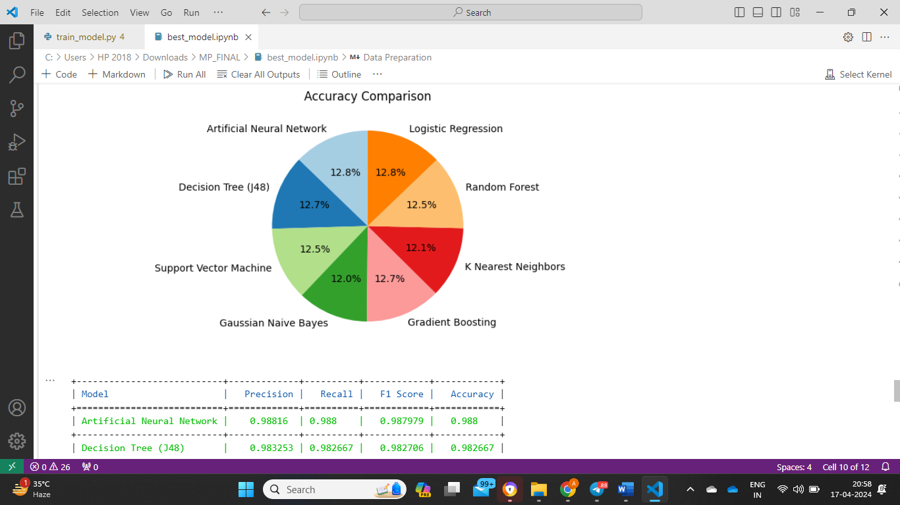
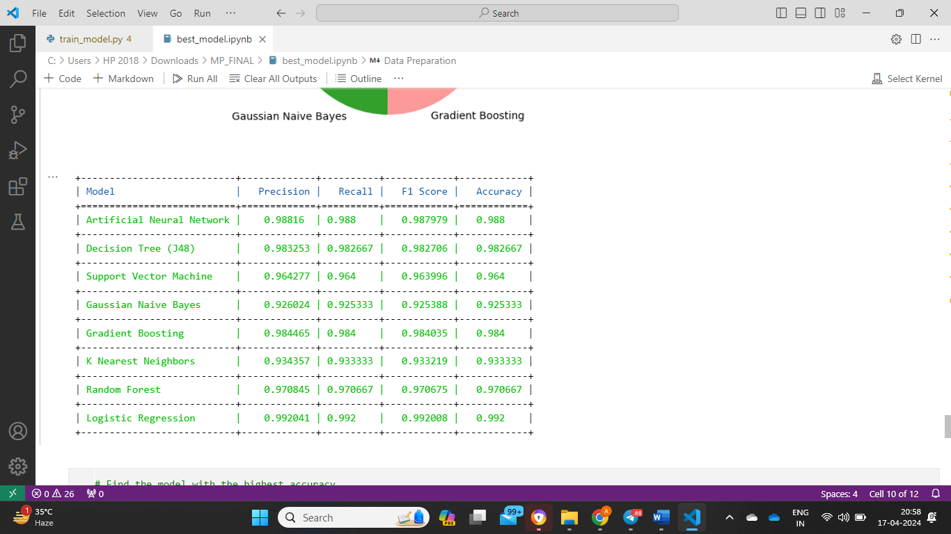
RESULTS

Slide 10
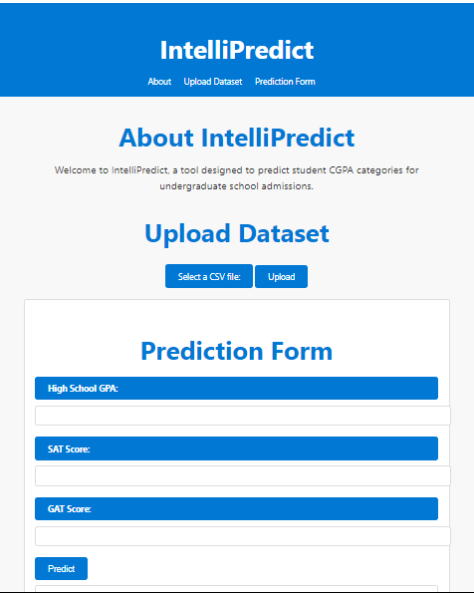
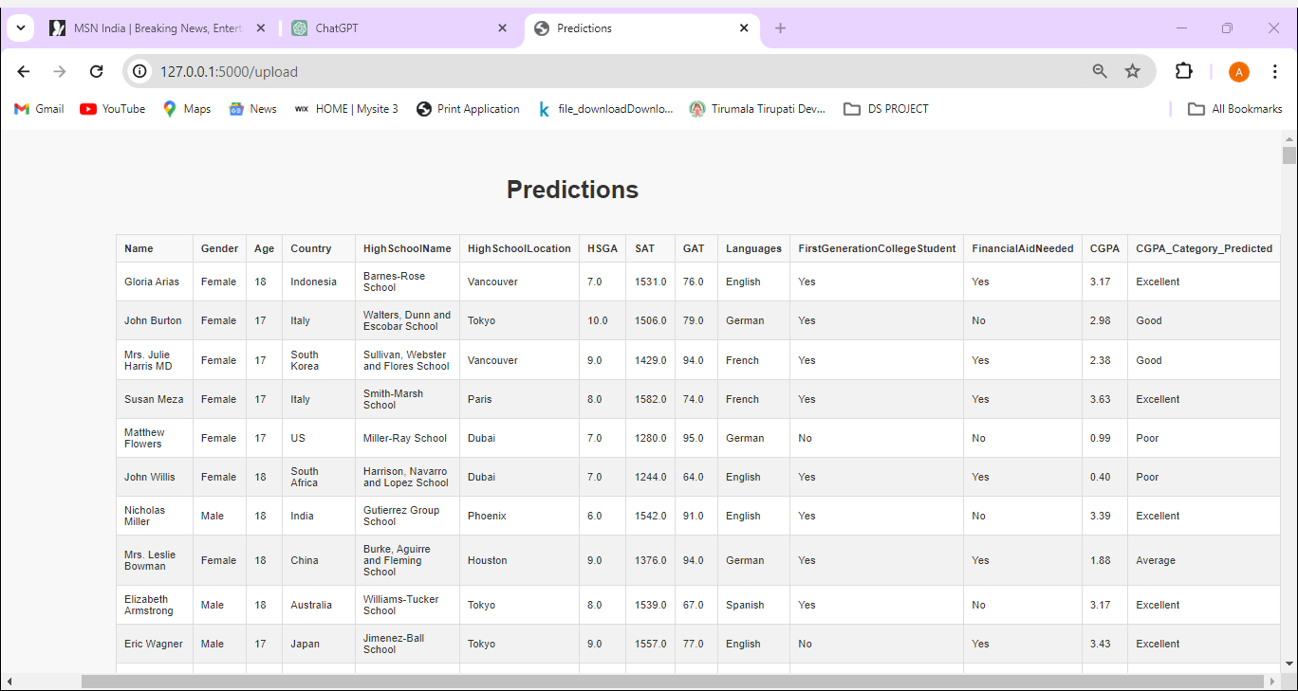
results

Slide 11
conclusion
This study explored the potential of leveraging predictive data mining techniques to enhance university admissions processes. We evaluated eight distinct machine learning models for their effectiveness in predicting student CGPA.
In conclusion, this investigation demonstrates the potential of data mining for enhancing university admissions. While Logistic Regression showcases impressive performance,

Slide 12
THANK YOU

