Slide 1

DSC530-T302 Data Exploration and Analysis
The Relationship Between Cigarette Prices and Smoking Prevalence
Submitted by
Parbati Belbase
Submitted to
Matthew Metzger

Slide 2
Introduction
Smoking is seen as a public health challenge globally.
Objective: To explore the relationship between cigarette prices and smoking prevalence.
Hypotheses:
Null Hypothesis (H0): There is no significant relationship between cigarette prices and smoking prevalence.
Alternate Hypothesis (H1): Higher cigarette prices are associated with lower smoking prevalence.

Slide 3
Data Description
Source of Data: Kaggle
Quantitative Variables:
Cigarette Smoking Prevalence
Tobacco Smoking Prevalence
Tobacco Use Prevalence
Most Sold Brand Cigarette Price
Premium Brand Cigarette Price
Covered Time Frame: 2008-2018

Slide 4
Methodology
Exploratory Data Analysis
Summarized data with statistics and histograms.
PMF and CDF
Analyzed distribution and cumulative trends.
Regression Analysis
Tested the relationship between prices and smoking prevalence.

Slide 5
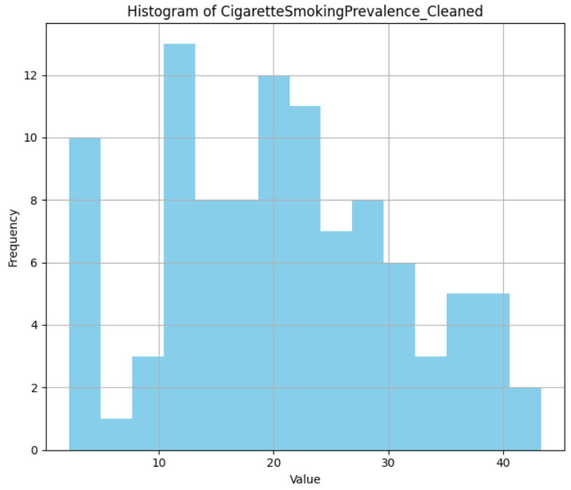
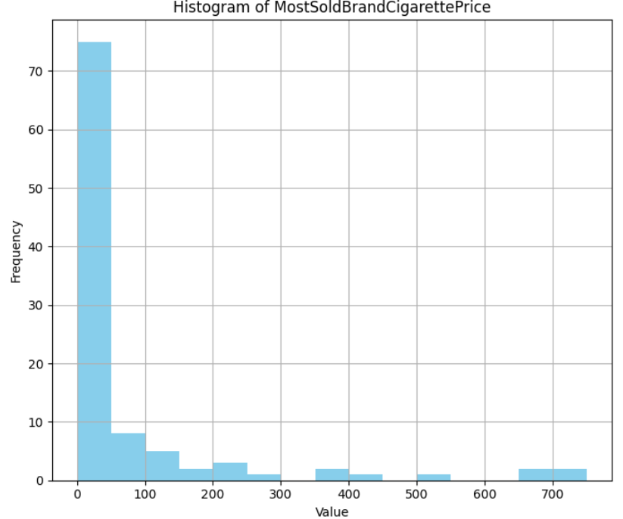
Results of EDA
Visualizations

Slide 6
Results of EDA
Key Insights:
Smoking prevalence varies widely across countries.
Significant outliers exist in cigarette prices (e.g., countries with prices above 500).

Slide 7
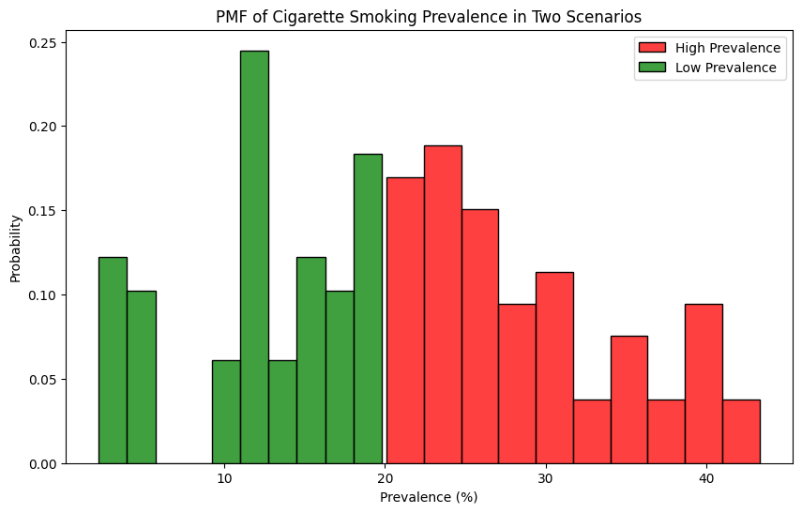
PMF Analysis
PMF Analysis was done to compare smoking prevalence distributions in high vs. low prevalence countries.

Slide 8
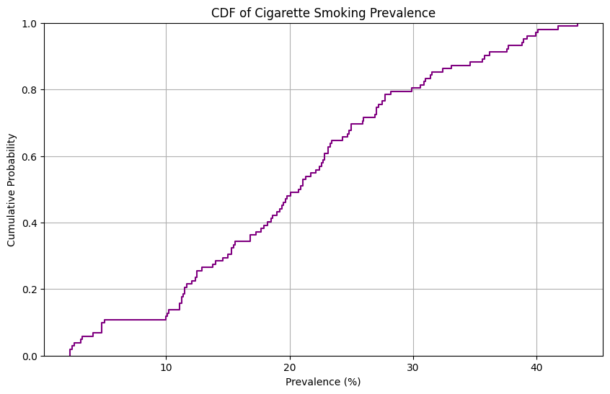
CDF Analysis
CDF Analysis was done to show cumulative smoking prevalence to identify median and quartile trends.

Slide 9
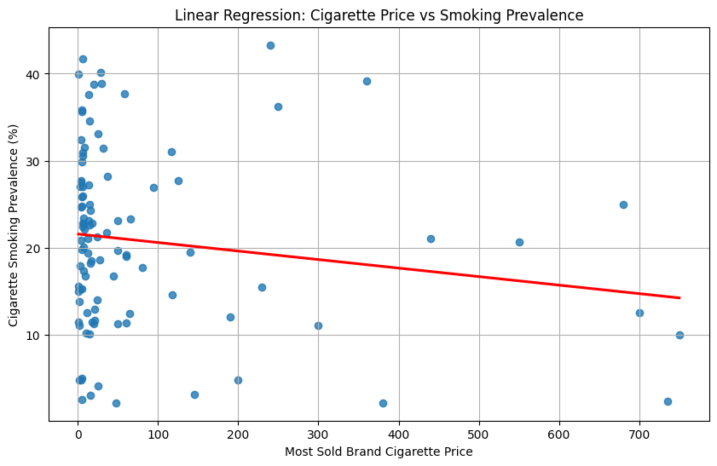
Regression Analysis
Simple Regression
R-squared= 0.024
P-value > 0.05
Indicates no significant relationship

Slide 10
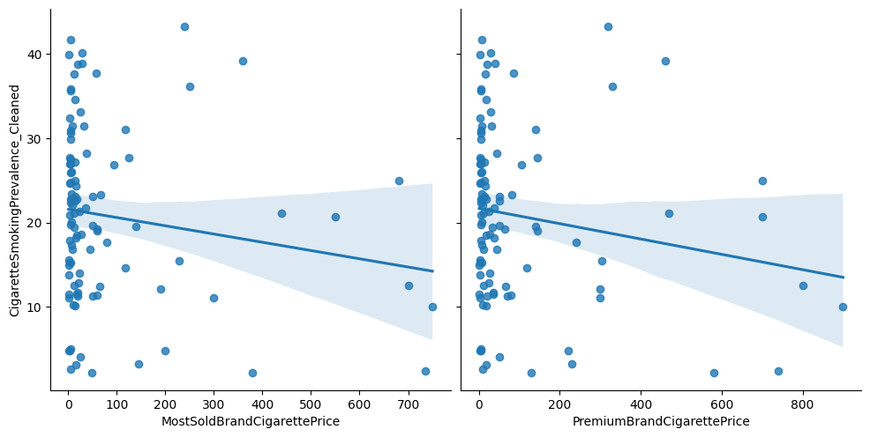
Regression Analysis
Multivariate Regression
R-squared= 0.032
Both predictors i.e most sold and premium prices are still insignificant.

Slide 11
Regression Analysis
Conclusion from Analysis
There is no statistically significant relationship between cigarette prices and smoking prevalence.
Hence, we fail to reject the null hypothesis.

Slide 12
Conclusion
Summary of Findings
The alternate hypothesis was not supported statistically. Price alone does not seem to help reduce changes in people’s smoking habits.
Hypothesis Testing
We fail to reject the null hypothesis which means the relationship between cigarette prices and smoking rates is weak and could be influenced by other factors.

