Slide 1

OnboardAI
AI Employee Pre-boarding & Onboarding Command Center
AI For All 2.0 · Cowork Capstone · Use Case 2 — People Ops & Onboarding Concierge
Amol Parbat · 25 Sep 2026

Slide 2
1
The problem
A new hire's first two weeks are scattered across people, tools and documents
Repetitive questions
Generic answers
Blockers found late
People Ops answers the same leave, hours and document questions again and again — by hand.
HR bots answer confidently but not from THIS company's policies — so answers can be wrong.
A BGV discrepancy or missing bank form is noticed only when payroll slips.
Result: slow, inconsistent onboarding and a poor first impression for the new hire.

Slide 3
2
The solution: one AI command center
Grounded in company data — every answer comes from a tool, not LLM memory
Welcome
Answer
Track
Protect
Personal note (Groq) + Gmail email + Calendar invite for virtual roles
Policy answers from Aarohan's own policies, with source & confidence
Progress %, blockers and next priorities per new hire
Pay / legal / grievance questions escalated to a human
Users: People Ops coordinators (primary) · Hiring managers · New hires (via assistant)

Slide 4
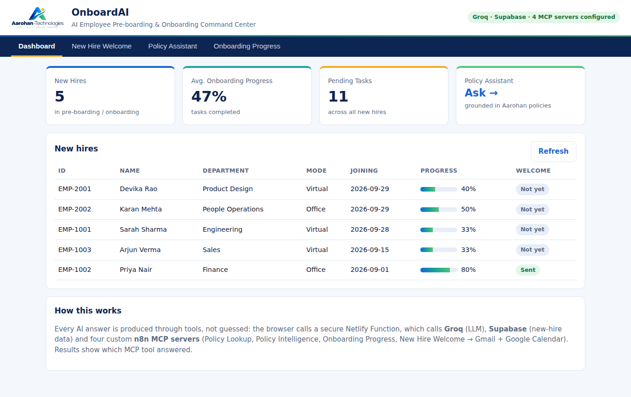
3
OnboardAI overview
Four tabs — simple enough for a non-technical HR user
Dashboard — new hires, average progress, pending tasks
New Hire Welcome — generate, review, send
Policy Assistant — Quick Lookup, Policy Intelligence, AI chat
Onboarding Progress — status, tasks, blockers
Colours taken from the Aarohan logo; works on mobile

Slide 5
4
Architecture
Simplest thing that works: static page + one serverless function
Groq
Llama 3.3 70B
Policy Lookup
Policy Intelligence
Browser
HTML/CSS/JS · no keys
Netlify Function
/api/* · keys in env vars
Supabase
employees · tasks · pgvector
Onboarding Progress
n8n MCP ×4
Streamable HTTP
New Hire Welcome
Gmail · Google Calendar · Google Drive · Gemini embeddings (inside n8n)

Slide 6
5
AI capabilities
The LLM writes and decides — tools supply the facts
Personalised writing
Grounded Q&A (RAG)
Groq drafts a warm, human welcome note using the hire's role, department, start date and work mode.
Semantic search over 38 policy chunks; confidence gating decides; Groq only rephrases the evidence.
Agentic tool use
Guardrails
Chat uses Groq tool-calling: it picks get_policy, answer_policy_question, get_onboarding_status or list_new_hires.
Pay, legal, grievance, termination → escalated to a human before the LLM runs. No cross-employee data sharing.

Slide 7
6
MCP integration
4 custom MCP servers — used by the web app AND by Claude Cowork
MCP endpoint (n8n) | Tool | What it returns
onboardai-policy-lookup | get_policy | Policy text + Google Drive source link
onboardai-policy-intelligence | answer_policy_question | Answer, source section, similarity, confidence, human-review flag
onboardai-onboarding-progress | get_onboarding_status | % complete, status, blockers, next priorities
onboardai-new-hire-welcome | onboard_new_hire | Email sent / calendar created (virtual only)
The app speaks MCP directly: initialize → tools/call over Streamable HTTP (JSON or SSE). Every result in the UI shows which MCP tool answered.

Slide 8
7
n8n integration
Each tool = thin MCP wrapper + a Logic workflow that does the real work
MCP Server Trigger → "Call n8n Workflow Tool" → Engine (Logic) sub-workflow
Engines read n8n Data Tables (Employees, Tasks, Documents, Policies)
Welcome engine: Gmail send → IF virtual → Google Calendar event
Intelligence engine: Gemini embedding → Supabase pgvector top-5 → deterministic evidence & confidence rules
All 9 workflows + data exported to n8n-backup/ (credentials stripped) before the trial ends
Why this matters
Business rules (what counts as "Blocked", when to ask a human) live in visible, auditable workflows — not hidden inside a prompt.

Slide 9
8
Supabase
Persistent data + vector search
onboarding_employees / tasks
policy_chunks (pgvector)
onboarding_activity
New-hire list and task checklist. New hires added in the app get a default checklist automatically.
38 chunks from 8 Google Drive policy docs, 768-dim embeddings, cosine search via the Intelligence MCP.
Audit log: welcome sent (email + calendar status), chat tool usage.
Row-Level Security on every table · accessed only from the server function

Slide 10
9
Groq
The only LLM provider — fast, free tier, key never leaves the server
Model: llama-3.3-70b-versatile (configurable via GROQ_MODEL)
Welcome drafting · evidence → plain-English answers · tool-calling chat agent (max 4 tool rounds)
GROQ_API_KEY stored as a Netlify secret env var; browser only calls /api/*
No fallback providers — one predictable, low-cost dependency

Slide 11
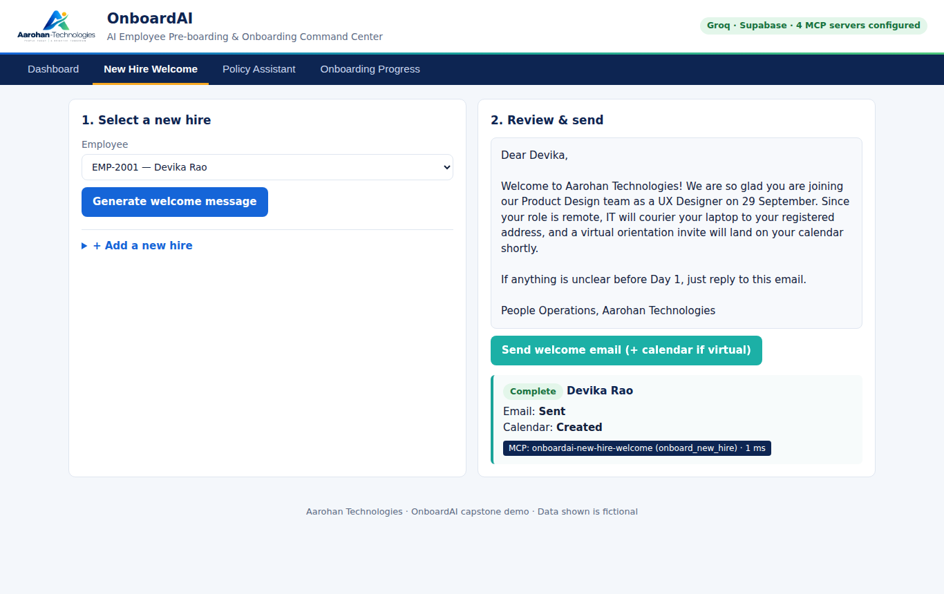
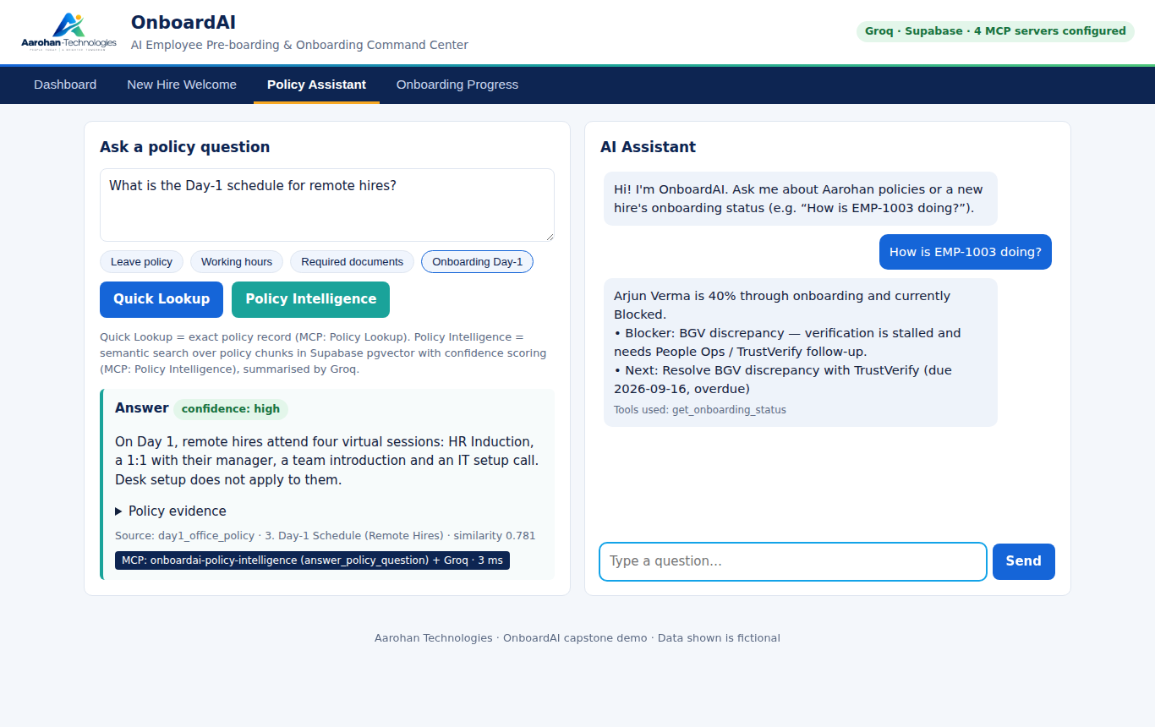
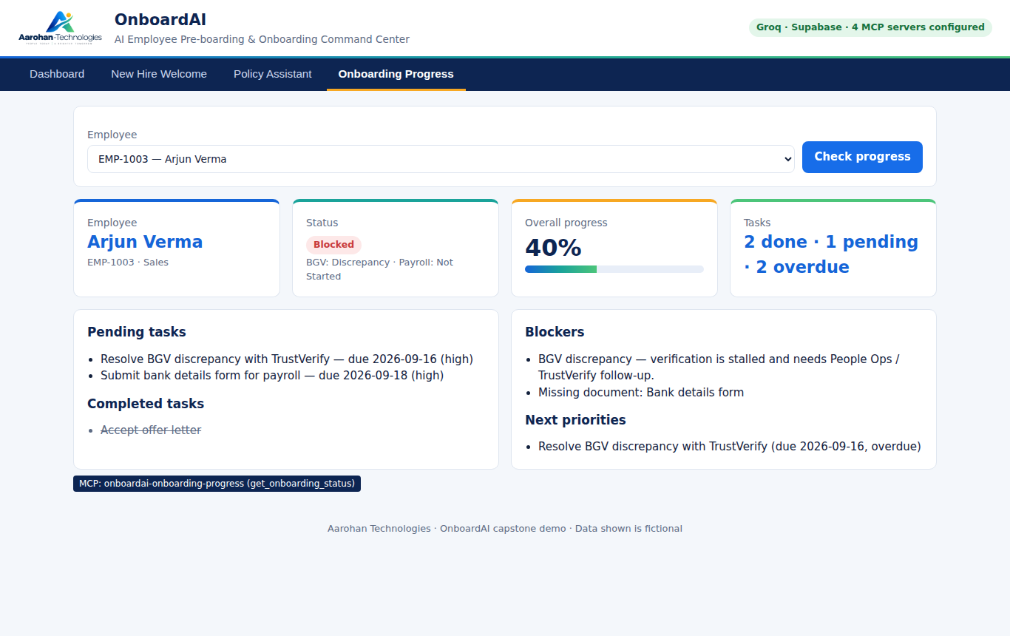
10
UI flow
Screens from the local test run (same UI as deployed)
Welcome: draft → send
Policy answers + chat with tool trace
Progress: status, tasks, blockers

Slide 12
11
Live demo flow (5 minutes)
1
Dashboard: 5 new hires, average progress, pending tasks
2
Welcome Devika (virtual): Groq note → Send → Gmail email + Calendar invite
3
Ask "What is the leave policy?" → Quick Lookup with Drive link
4
Ask "Day-1 schedule for remote hires" → Intelligence: high confidence + source
5
Progress for Arjun (EMP-1003): Blocked — BGV discrepancy
6
Chat "Can I get a salary hike?" → escalated to a human

Slide 13
12
Business value
Expected impact — to be measured in a pilot, not yet proven
Time back for People Ops
Consistent, correct answers
Earlier risk detection
Routine policy questions and status checks answered self-serve; welcome + invite in one click.
Only from company policy, with source; low-confidence answers flagged for a human.
BGV, document and overdue-task blockers surfaced before Day 1 — protects first payroll.
Pilot metrics to track: % questions answered without HR · time from offer to "ready for Day 1" · # hires with payroll delayed

Slide 14
13
Security
API keys only in Netlify environment variables — never in the browser or GitHub (.env.example has names only; automated secret scan)
n8n backups exported with all credentials stripped
Input validation (employee ID format, question length) and HTML-escaped output
Row-Level Security enabled on all Supabase tables
Human escalation for pay, legal, grievance and termination topics
Fictional data only — demo RLS and open MCP endpoints must be tightened before real use

Slide 15
14
Honest limitations
What it does not do yet
n8n cloud trial ends in about 8 days — workflows backed up, migration planned
No login or roles yet: anyone with the link can view demo data and send test welcomes
Employee data split between n8n Data Tables and Supabase
Policy Intelligence embeddings use Gemini inside n8n (stored vectors depend on it)
Welcome email body is a fixed n8n template; the Groq note is shown in the app
Limitation I would fix next: unify data + add Supabase Auth

Slide 16
15 Future roadmap
Week 1
Week 2
Week 3
Later
Move the 4 MCP tools to Supabase Edge Functions; one data store
Supabase Auth with roles: new hire / manager / People Ops
Day-3 proactive nudges (Slack/email) + weekly manager digest
Document upload & verification, Slack buddy assignment, time-to-productive analytics
Thank you · OnboardAI by Amol Parbat

