Slide 1
Customer
Insight Engine
E-Commerce Customer Behaviour Analysis
Python · SQL Server · Power BI
5,000 Customers
30 Unique Products
17 Features
End-To-End

Slide 2
Project Overview
Business Problem
Dataset
How can a retail company understand customer purchasing behaviour to increase revenue, improve customer retention, and optimize marketing strategies?
Type: Retail / E-commerce Level: Customer Transaction Size: 5,000 records, 17 columns
↓ Low Retention
◎ Discount Efficacy
▲ Product Demand
Who buys once vs. repeatedly?
Do promos actually drive spend?
Which categories earn the most?
⊕ Payment Behavior
◑ Seasonal Demand
Preferred payment channels?
Which season drives peak sales?

Slide 3
Data Dictionary
Field Name | Description
Customer ID | Unique identifier for each customer
Age / Gender | Customer demographics
Item Purchased | Product purchased by the customer
Category | Product category (Clothing, Electronics, etc.)
Purchase Amount | Amount spent by the customer
Location | Customer's geographic location
Size / Colour | Product size (S, M, L) & color
Season | Season of purchase (Winter, Summer, etc.)
Review Rating | Customer rating for the product
Subscription Status | Whether customer is subscribed (Yes/No)
Shipping Type | Type of shipping selected
Discount Applied | Whether discount was applied
Previous Purchases | Number of past purchases
Payment Method | Mode of payment
Frequency of Purchases | Purchase frequency (Weekly, Monthly, etc.)

Slide 4
Tools & Pipeline
01
02
03
Python + Pandas
SQL Server
Power BI
▸ Loaded raw CSV into DataFrame
▸ 12 analytical queries written
▸ 2-page interactive dashboard
▸ Category consistency correction
▸ Revenue by category & gender
▸ KPI cards: 5K customers, $994K spend
→
→
▸ Smart missing value imputation
▸ Discount impact analysis
▸ Revenue by gender, category, season
▸ Duplicate detection & removal
▸ Customer segmentation (New / Returning / Loyal)
▸ Shipping mode comparison chart
▸ Column standardisation (snake_case)
▸ Subscription vs spend behaviour
▸ Age group revenue donut chart
▸ Exported clean data to SQL Server
▸ Top products per category (window functions)
▸ Top/Bottom 5 items by rating & revenue

Slide 5
Python — Exploratory Data Analysis
1. Data Loading
2. Initial Exploration
Imported pandas, loaded customer_shopping_behavior.csv into a structured DataFrame for downstream analysis.
Used df.head(), df.describe(), df.info() and df.isnull().sum() to understand shape, types, and gaps.
3. Category Correction
4. Missing Value Handling
Found item–category mismatches; built a mapping dictionary and corrected category labels — a real-world data quality fix.
Applied domain logic per column: Electronics/Accessories → 'N/A', Clothing → mode, Ratings → product-level mean, Prior Purchases → 0.
5. Duplicate Removal
6. Column Standardisation
Identified duplicates via Customer ID and dropped them to ensure each customer appears exactly once.
Renamed all columns to lowercase snake_case (SQL & Power BI friendly) then exported the clean dataset via pyodbc/SQLAlchemy.

Slide 6
SQL Server — Data Analysis
$486K
+20%
3,085
1,190
Electronics Revenue
(#1 Category)
Avg Spend Lift
with Discounts
Loyal Customers
(>10 purchases)
Repeat Buyers
who Subscribe
12 Business Questions Answered
Q1 Which category generates the highest revenue?
Q2 Are discounts increasing purchase value?
Q3 Total revenue by gender breakdown?
Q4 Discount users who spent above average?
Q5 Top 5 products by average review rating?
Q6 Bottom 5 products by average review rating?
Q7 Standard vs Express shipping purchase avg?
Q8 Do subscribers spend more than non-subscribers?
Q9 Top 5 products by discount usage %?
Q10 Customer segmentation: New / Returning / Loyal?
Q11 Top 3 products per category (window function)?
Q12 Revenue contribution by age group?

Slide 7
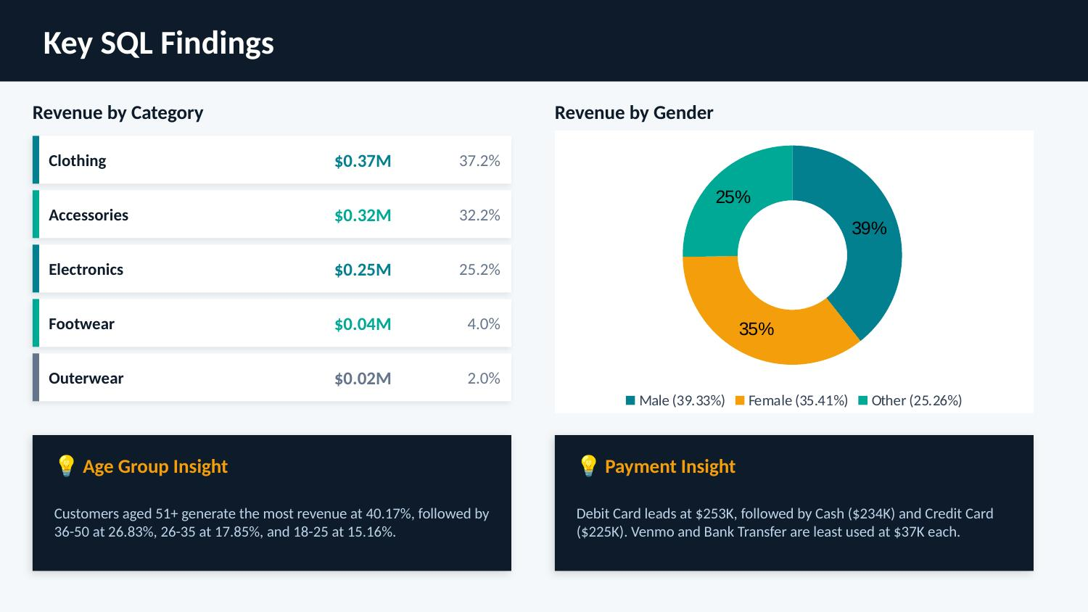

Slide 8
Power BI — Interactive Dashboard
5,000
30
$994K
$198.84
3.62★
Total Customers
Unique Products
Total Spend
Avg Spend
Avg Rating
Page 1 — Overview Dashboard
Page 2 — Product & Location Deep Dive
▸ Revenue by Gender (donut: Male 39%, Female 35%, Other 25%)
▸ Top 5 Items by Rating (Gloves 3.86, Sandals 3.84, Boots 3.82)
▸ Revenue by Category (bar: Electronics leads at $486K)
▸ Bottom 5 Items by Rating (Phone 2.94, Headphones 3.08)
▸ Revenue by Season (Spring $243K → Winter $241K → Summer $236K)
▸ Top 5 Items by Revenue (Headphones $138K, Phone $126K)
▸ Shipping Mode comparison (Express 1,199 vs Standard 1,201 orders)
▸ Bottom 5 Items by Revenue (Jeans $8K, Gloves $8K)
▸ Revenue by Age Distribution (51+ age group contributes 40%)
▸ Top 5 Locations by Revenue (New York $144K leads)
▸ Payment Method breakdown (Debit Card 25.5% most popular)
▸ Bottom 5 Locations (Kansas, Hawaii lowest at ~$3.4K–$3.9K)
🎛️ Interactive Slicers: Category · Gender · Discount Applied · Subscription Status

Slide 9
Conclusions & Recommendations
01
Electronics = Revenue Engine
02
Target 51+ Age Segment
Electronics alone generates $486K (48% of total). Focus inventory, marketing, and promotions here first.
Customers aged 51+ contribute 40% of total revenue. Loyalty programs should be tailored to this demographic.
03
Subscriptions Drive Spend
04
Discounts Need Balancing
Subscribers spend 63% more on average. Growing the subscriber base is a high-ROI strategy.
Discounts raise average order value by 20%, but must be selective — non-discount revenue is still higher overall.
05
3,085 Loyal Customers
06
New York Is Top Market
62% of customers are classified as loyal. Retain them with VIP programs and personalised recommendations.
New York generates $144K — 14.5% of all revenue. Geographic campaigns should prioritise top 5 cities.

Slide 10
Technical Stack Summary
End-to-End Data Analytics Portfolio Project
Python
& Pandas
SQL
Server
Power BI
Data Cleaning
& EDA
Business
Analysis
Interactive
Dashboard
✓ Done
✓ Done
✓ Done
Customer Insight Engine · Full Pipeline Project · Portfolio Ready

