Slide 1
The Third Annual
ICFP
Programming Contest
John Reppy Greg Morrisett
Bell Labs Cornell University

Slide 2
Huge thanks
Sponsers:
  ICFP and ICFP sponsers
    Compaq, EAPLS, Lucent, Sun, Microsoft Research, University of Montreal
  Cambridge University Press.
  O’Reilly and Associates.
Running things:
  Stephanie Weirich, Fred Smith, Dan Grossman, Dan Wang, Dean Eckstrom, Bill Holmes

Slide 3
Overview
Aug. 26: we publish the task
Teams have 72 hours to finish the task.
Any team composition.
Any programming language (that runs on our Linux boxes).
Correctness counts.
Features count.
Efficiency counts.

Slide 4
A Timeline
Feb. 2: I refuse to do the contest.
Feb. 4: John signs on if I will. Sigh.
Jun. 6: Martin asks if we’ve thought about the contest. We haven’t.
Jun. 14: John and I meet in Cannes.
Aug: John & Fred put together sample code
Aug 23: Web site up -- 70 teams registered
Aug 24: Slashdot advertises the contest.
Aug 26: 800 teams! The contest begins...
Aug 27: Cornell web site crashes.

Slide 5
The Task: A Ray Tracer
Implement a simple functional language called GML used to describe and render scenes.
  dynamically-typed, postscript-style language
  geometric primitives (sphere, cube, etc.)
    parameterized by a surface function
  constructive solid geometry operations
    union, difference, intersection, etc.
  affine transforms (scale, rotate, translate)
  lights: directional, point, & spot
  render operation: spits out a .ppm file

Slide 6
Example GML code
{ /v /u /face red 1.0 0.0 1.0} cube /cube1
%% the scene consists of two cubes
cube1 -1.5 -0.5 1.5 translate
cube1 30.0 rotatex 30.0 rotatez
0.5 -0.5 1.5 translate
union /scene
0.5 0.5 0.5 point %% Ambient
[ sun ] %% Lights (not shown here)
scene
2 %% Depth
90.0 %% fov
320 %% width (pixels)
200 %% height (pixels)
"cube.ppm” render

Slide 7
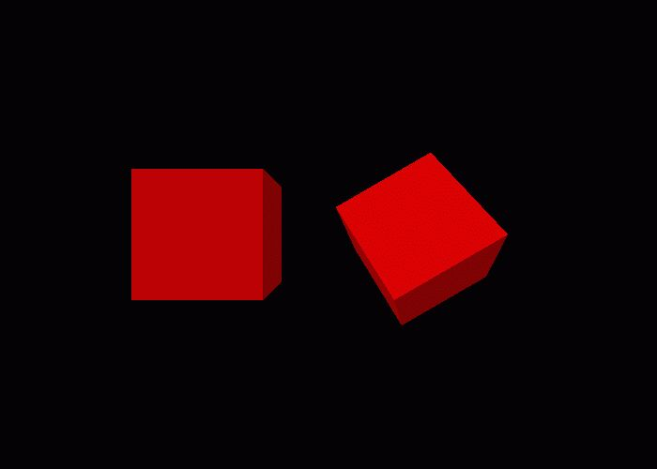
Example Image

Slide 8
Three Tiers
Tier 1: GML ops, planes, spheres, unions, & directional lights
Tier 2: cones, cubes, cylinders, & point lights.
Tier 3: difference, intersect, & spotlight.
A Tier-n implementation would have to be at least as correct and significantly faster to beat a Tier-n+1 implementation.

Slide 9

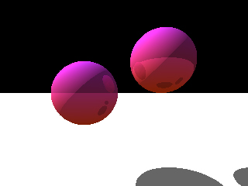
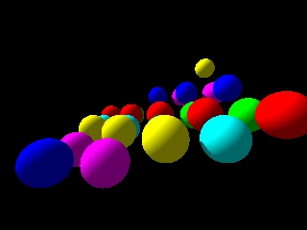
Some Tier-1 Images

Slide 10
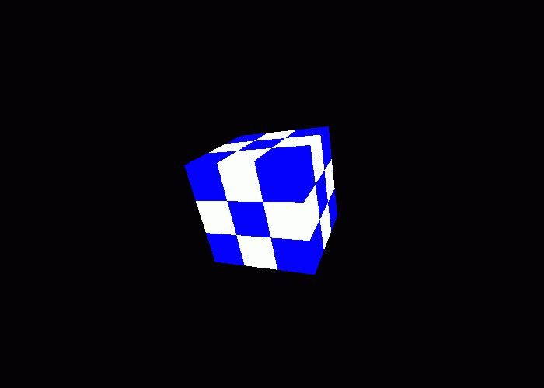
A Tier-2 Image

Slide 11
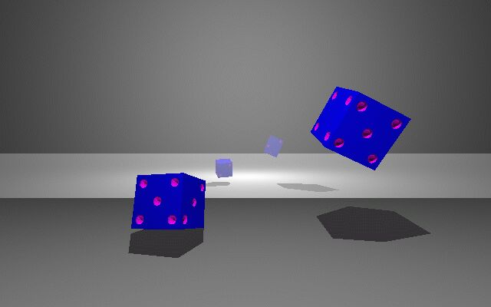
A Tier-3 Image

Slide 12
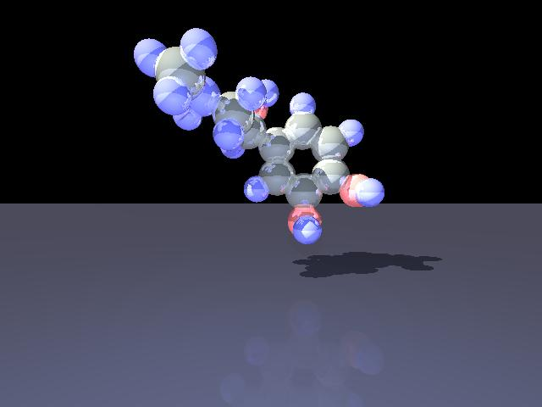
Adrenaline [Harley]

Slide 13
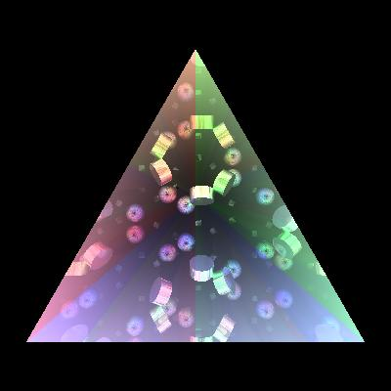
Kaleidoscope [Schmitt]

Slide 14
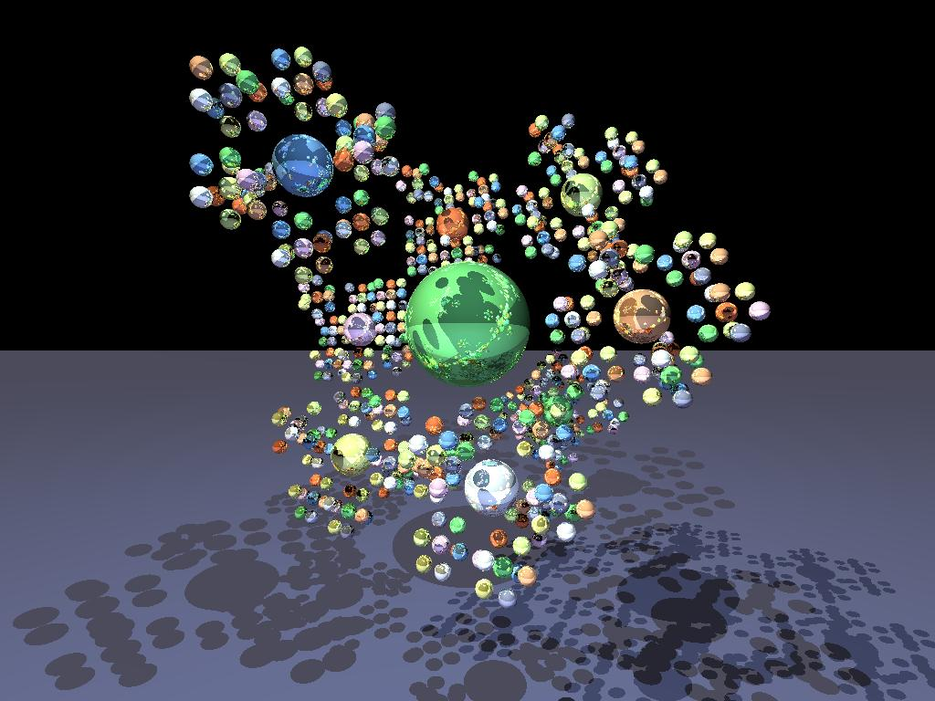
Fractal [Doligez & Harley]

Slide 15
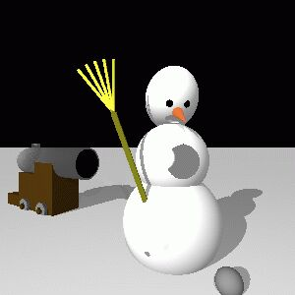
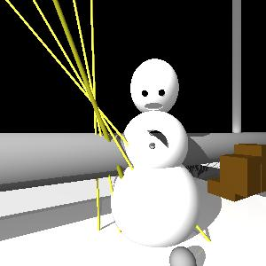
Example Bugs
Snowgoon [Smith & Yang]

Slide 16
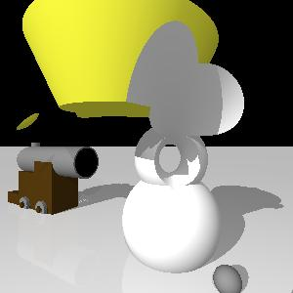
Hmmm...

Slide 17
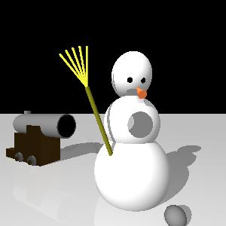
Subtle...

Slide 18
Some Statistics
Number of teams registered: > 800
Number of entries submitted: 39
Countries represented:
  USA(18), Germany(4), Canada(3), Australia(3), New Zealand(3), France(2), UK(2), Poland, Switzerland, Belgium, Sweden, Netherlands
Team size: 1-13
# of versions of task description: 18!

Slide 19
Languages Used
C/C++ 7 Mercury 1
Clean 1 ML 9
Dylan 1 Perl 2
Eiffel 1 Python 1
Haskell 6 Scheme 2
Java 6 Smalltalk 2

Slide 20
How We Judged
Several rounds to weed out entries:
1. test GML primitive operations
2. test “correctness” of tier-1 images
  avg. distance in color space from ref.
  eyeball double-check
3. test correctness & speed of tier-2
4. test correctness & speed of tier-3

Slide 21
The Rankings
Judges Prize (best image)
  ($100 + books, journals, registration)
4th place
3rd place
2nd place
  ($400 + books, journals, registration)
1st place
  ($1000 + books, journals, registration)

Slide 22
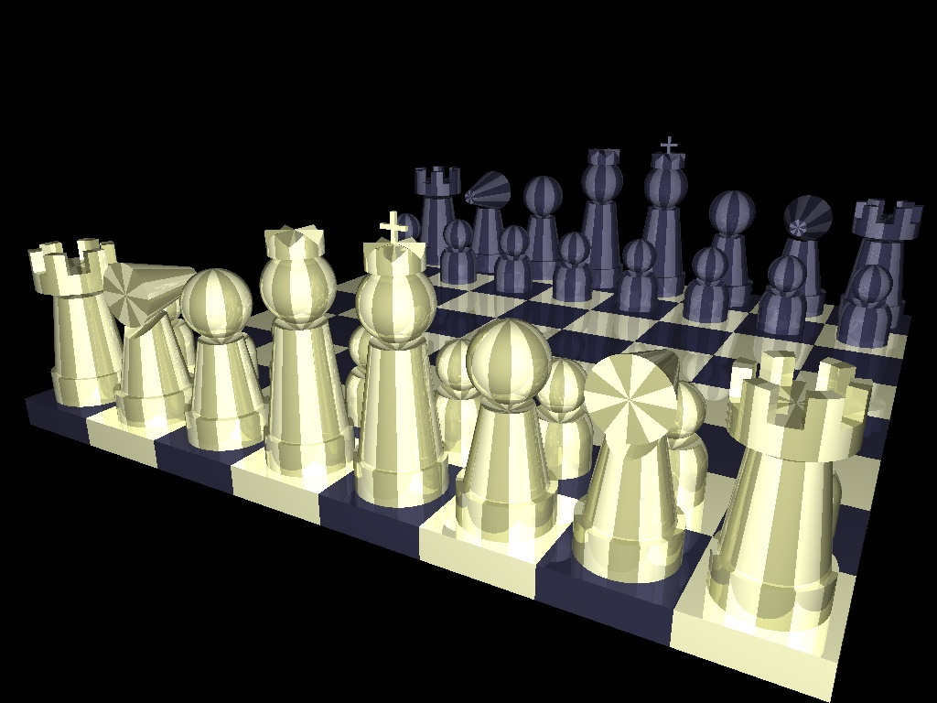
Judges’ Prize Image

Slide 23
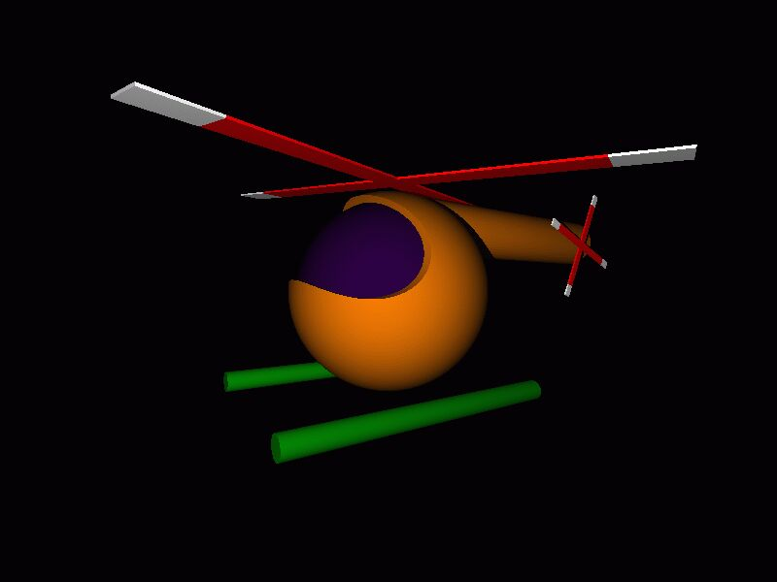
Judges’ Prize: Team Helikopter
Congratulationss to
Andreas Rossberg & Leif Kornstaedt!

Slide 24
The Judges Proclaim:
Team Helikopter is an extremely
cool pair of hackers.

Slide 25
4th Place
13 team members!
Australia, Belgium, and UK members
Tier-3 entry
Bounding boxes
coded in....Mercury!
Congrats to the Merry Mercurians! (R.Becket, T.Dowd, F.Henderson, S.Taylor, P.Ross, D.G.Jeffery, T.Leeuwenburg, T.Conway, R.Jeschofnik, M.Brown, M.Liddell, D.Overton, P. Eckersley)

Slide 26
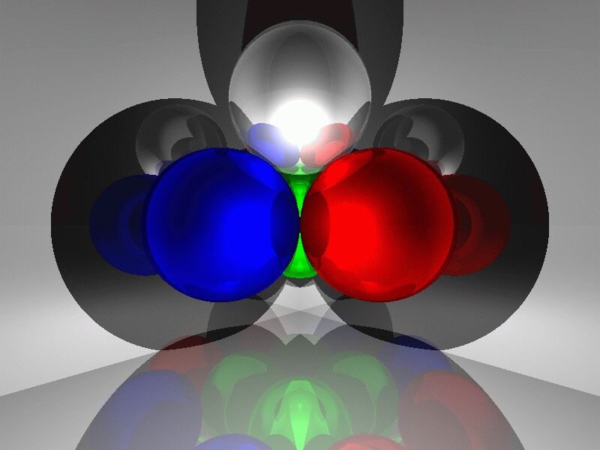
A Mercurial Image

Slide 27
3rd Place
5 team members
Tier-3 entry
Bounding boxes
100x faster on Chess than 4th place
coded in...
Haskell!
Congrats to Team Galois Connections!
(J.Launchbury, A.Gill, J. Lewis, T. Nordin, T.Sauerwein)

Slide 28
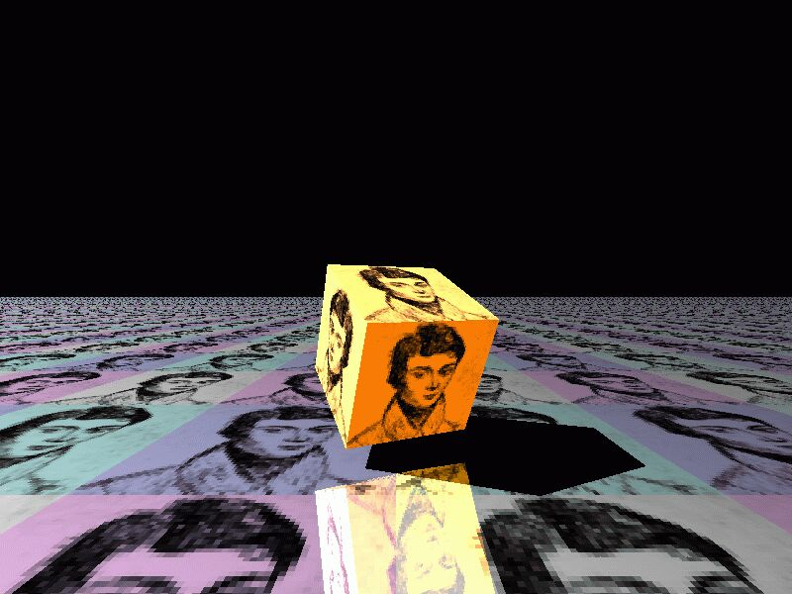
Cubist Galois

Slide 29
2nd Place (Prize Winner)
7 team members
Tier-3 entry
Bounding spheres, BSP-trees
5.5x faster on Chess than 3rd place
Coded in...
O’Caml!
Congrats to Team Camls ‘R Us (D.Doligez, S.Ailleret, P.Cuoq, R.Harley, F.Le Fessant, X.Leroy, A.Schmitt)

Slide 30
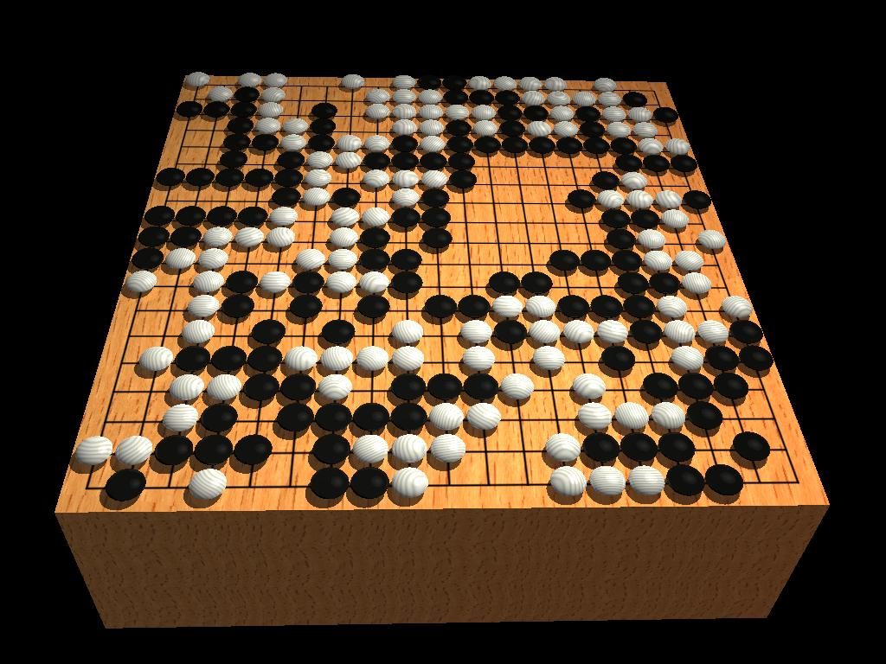
A Go game [Doligez & Cuoq]

Slide 31
The Judges Proclaim:
O’Caml is a fine programming tool for many applications.
(and the INRIA team can run the contest next year...)

Slide 32
1st Prize
4 team members
Tier-3 entry
Bounding spheres, GML optimization
4 different implementations!!!
8x faster on Snowgoon than 2nd place
Coded in...
O’Caml!
Congrats to Team PLClub!!! (J.Vouillon, V.Gapeyev, H.Hosoya, & E.Sumii)

Slide 33
The Judges Exclaim:
O’Caml is the programming tool of choice for the discriminating hacker.

Slide 34
Words of Wisdom
“An interesting observation is that every bug that took more than three minutes to find was a problem with a sign in the code.”
-Lennart Augustsson
“A correct graphics program has an even number of sign errors...”
-Jim Blinn

