Slide 1
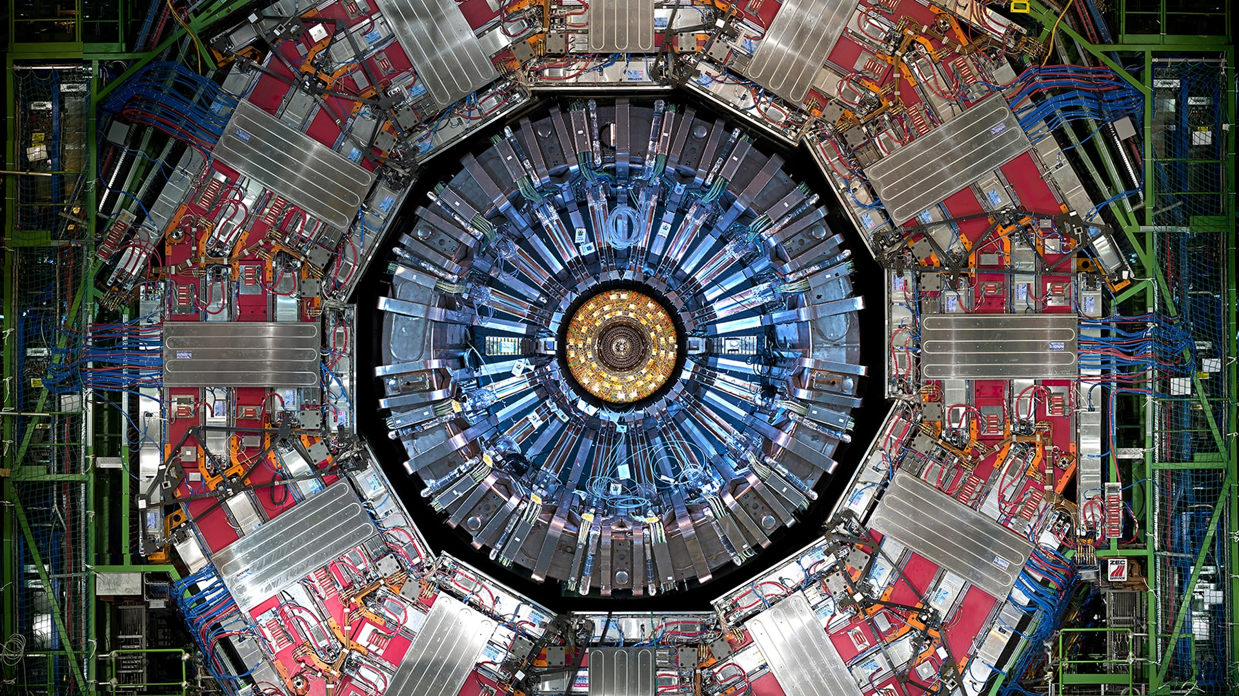
Chapter 2. Particle detectors

Slide 2
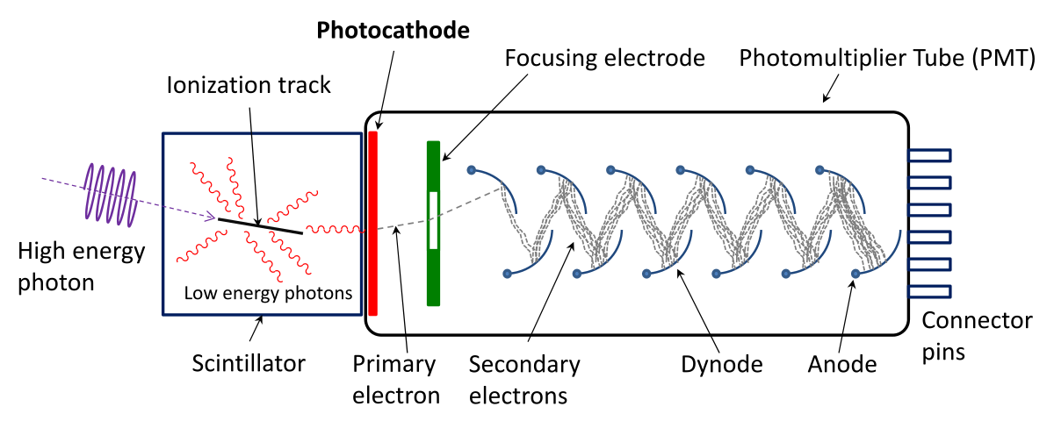
Introduction
Particle Physics experiments and applications require some kind of device able to:
Identify when/if a particle is passing through it
Measure one or several properties of the particle (energy, momentum, charge, spin, etc.)
Possibly identify the type of particle
Devices with these functionalities are called “Particle Detectors”
Most particle detectors are logically composed by two parts:
Active material: volume where the particle interacts with the detector producing “signal”
Collection mechanism: system able to detect and possibly reconstruct the signal
Collection mechanism
Active material

Slide 3
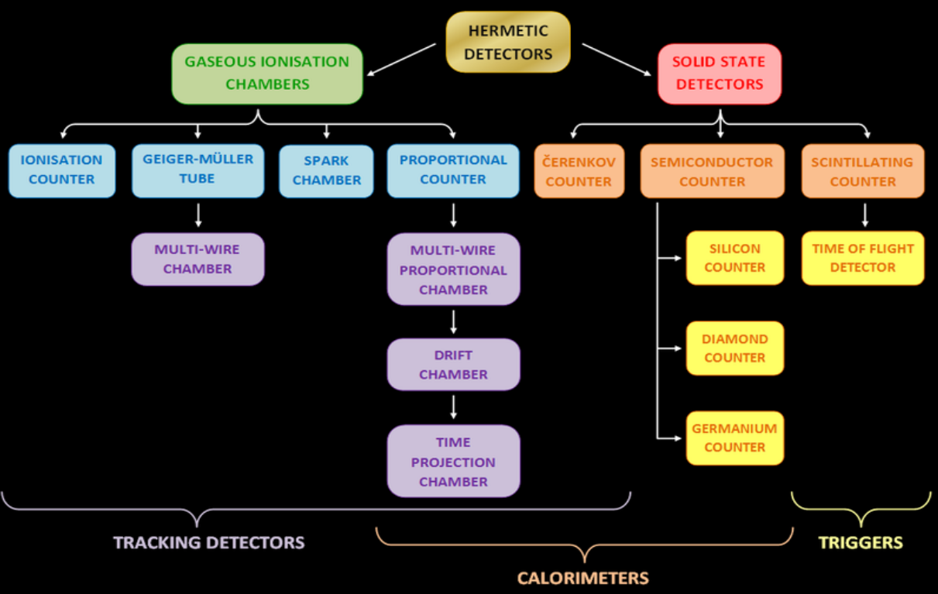
The detector zoo
There is a large variety of detectors according to the type of particle and the technology used

Slide 4
Active material: interactions with matter
Particles interact with the electrons and/or nuclei of the medium they cross
This interaction can be electromagnetic, weak or strong depending on the particle
The effects of this interaction can be used to detect the particles
To understand how detectors work we need to understand how particles interact with matter
Detectors should have an active material in which this interaction takes place
Interactions of particles
with matter
Neutral particle
interactions
Charged particle
interactions

Slide 5
Neutral particle interactions
Neutral particles such as photons, neutrons, K⁰, and others suffer different interactions
Photons
Photoelectric effect
Comptom effect
Pair production
Moderate/Low energy
neutrons
Scattering
Absorption
Fission
High Energy
neutral hadrons (n, K⁰)
Nuclear interactions
Neutrinos
Weak interactions

Slide 6
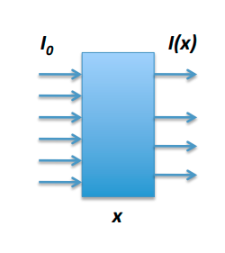
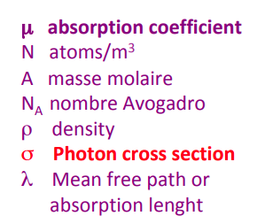
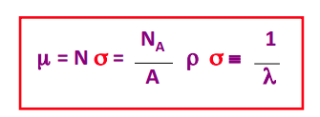
Photon interactions
Since photons do not have charge they are always indirectly detected:
In their interactions they produce electrons/positrons that interact with matter
Photons may be absorbed (photoelectric effect or e⁺e⁻ creation) or scattered (Compton effect)
An attenuation law is introduced based on the fact that the interaction probability is constant
$I\left(x\right)=I_{0}e^{−μx}$

Slide 7
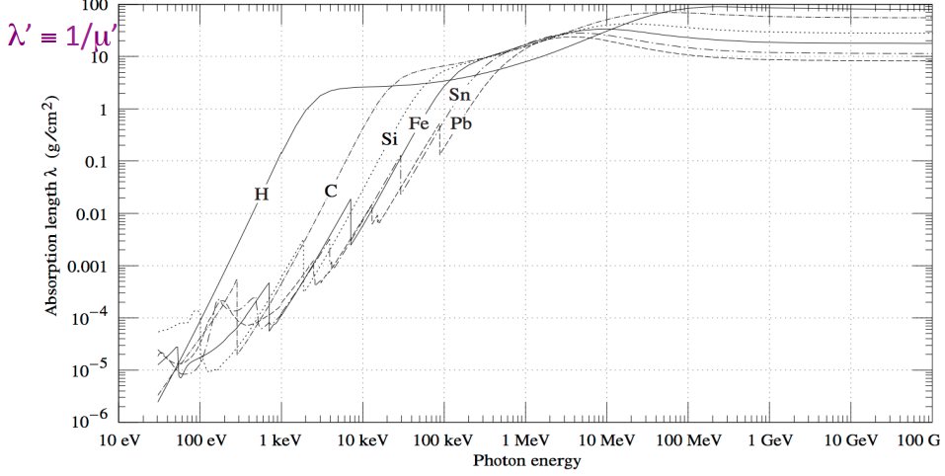
Photon absorption length
Frequently instead of working with the distance we use the distance times density
This quantity is more sensitive to the real amount of matter in the crossed distance
$x'=xρ$
$I\left(x\right)=I_{0}e^{−μx}$
$μ'=μ/ρ$
$I\left(x\right)=I_{0}e^{−μ'x'}$
$λ'=1/μ'$

Slide 8
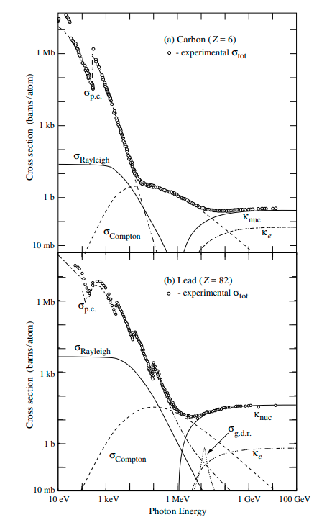
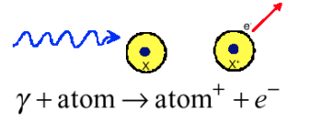
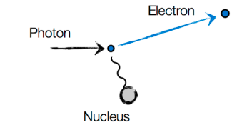
Photoelectric effect
Photoelectric effect
The energy of the photon is transferred to the electron
The photon is absorbed and the electron is extracted
The atom gets ionized
The final energy of the electron depends on the binding energy (the electron energy level in the atom)
Photoelectric effect
$E_{e}=hν−E_{ebinding}$
Different trends at low and high energies
$σ∼{Z^{5}}/{E_{γ}^{3.5}}$
$σ∼{Z^{5}}/{E_{γ}}$

Slide 9
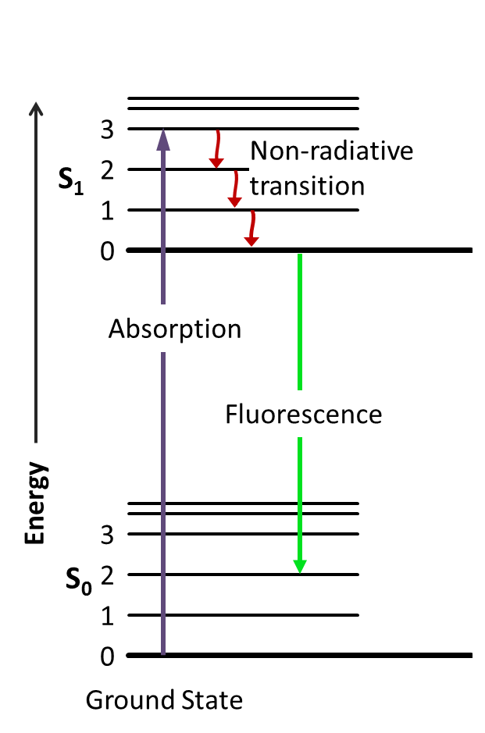
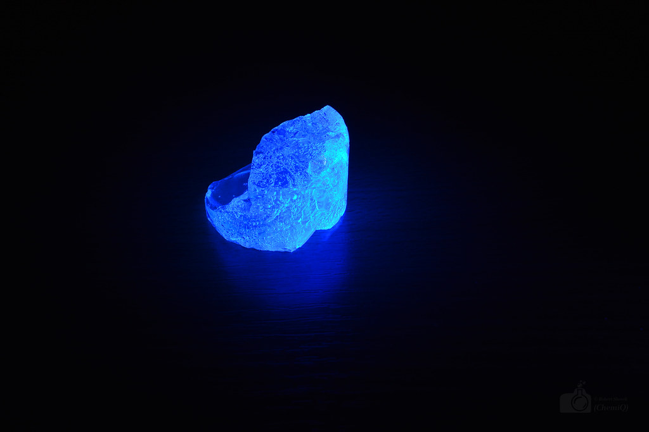
(After) Photoelectric effect: fluorescence
After the emission of a photoelectron the ionizedatom (molecule) is an excited state
The ionized atom (molecule) returns to the ground state emiting photons
This is an important effect in a kind of active materials called: scintillators

Slide 10
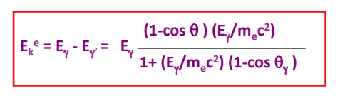
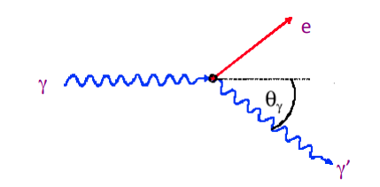
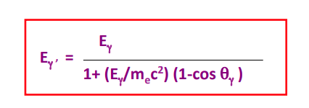
Compton scattering
Scattering of light on free electrons (if E_{photon}>>E_{binding} a binded electron is considered free)
When the angle is 0 the initial photon gives all its energy to the outgoing photon
When the angle is backwards the outgoing electron has maximum energy
And the outgoing photon minimum energy but it cannot get completely absorbed

Slide 11
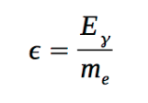
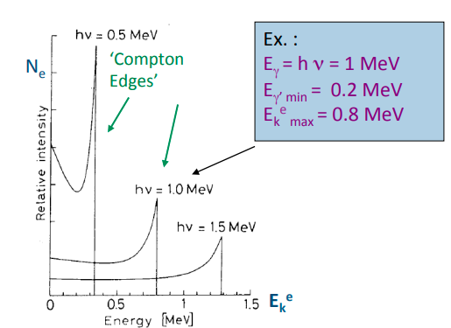
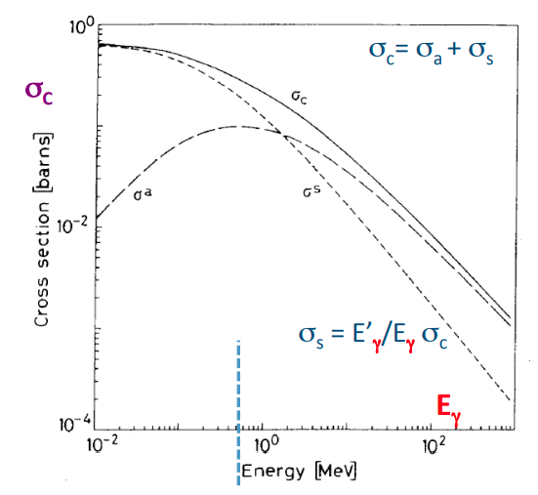
Compton edges and cross section
The photon can never give all its energy to the electron producing the so called “edges”
The cross section is given by the Klein-Nishina formula

Slide 12
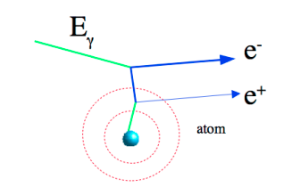
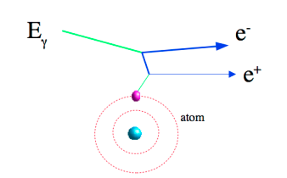
Pair production of electron-positron
The photon interacts with the field of a nucleus or electron and makes a pair e⁺e⁻
This process cannot take place in the vacuum because of energy-momentum conservation
Pair production in the field of a nucleus
Pair production in the field of an electron
It is also frequently known as “photon conversion”
This effect is a “threshold effect”: the photon energy has to be enough to generate 2 electrons
$m_{x}=\left\{\begin{aligned}m_{N} \\ m_{e}\end{aligned}\right\}$
$E_{γ}>2m_{e}c^{2}\left(1+{m_{e}}/{m_{x}}\right)$

Slide 13
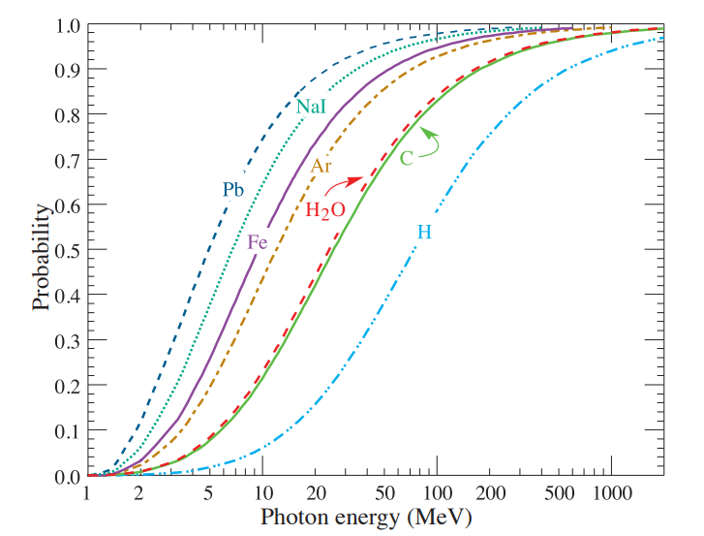






Pair production of electron-positron
The cross section of pair production rises one the threshold has been reached
Three different regions: “low”, “medium” and “high” (saturation) energy regimes
Saturation
$ε→∞$
Medium
Low

Slide 14
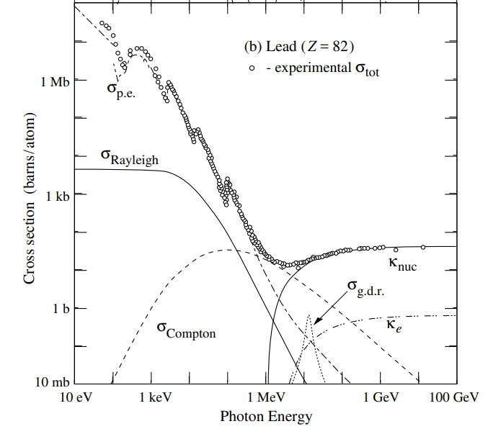
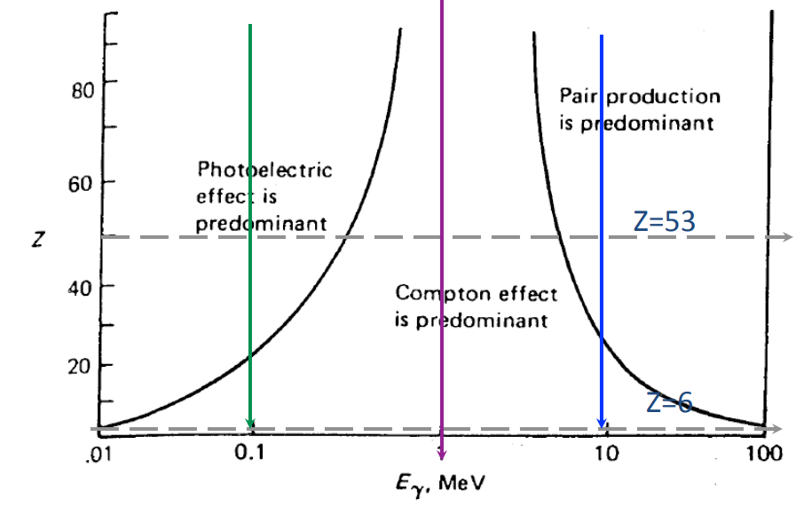
Photon total cross section
Photoelectric effect dominates at low, Compton at medium and pair production at high E
Compton dominates for low Z materials (photoelectric and pair production increase with Z)
Other processes not treated here: Raylaigh scattering, photo nuclear interactions
Photoelectric
Compton
Pairs

Slide 15
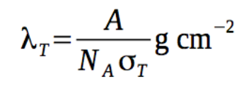
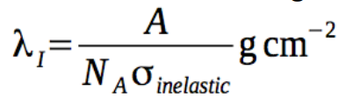
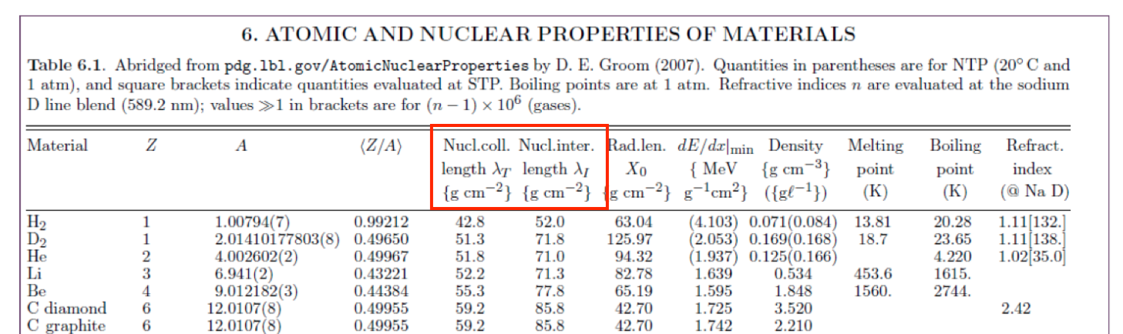
Hadron collisions and interaction lenghts
The total cross section for very high energy hadrons is expressed as:
The inelastic part of the total cross-section is susceptible to induce hadron showers
Two mean lenghts are introduced to deal with this kind of interactions
Nuclear collision length:
Mean free path of a particle before undergoing a nuclear interaction
Nuclear interaction length:
Mean free path of a particle before undergoing an inelastic nuclear interacion
$σ_{T}=σ_{elastic}+σ_{inelastic}$

Slide 16
Neutron interactions
Neutrons interact via the “strong interaction” with nuclei (short range force ~ 10⁻¹³ cm)
Classification of neutrons:
Cold or ultracold neutrons E_{n} < 0.025 eV
Thermal or slow neutrons E_{n} ~ 0.025 eV
Intermediate neutrons E_{n} ~ 0.025 eV – 0.1 MeV
Fast neutrons E_{n} ~ 0.1 MeV – 10-20 MeV
High energy neutrons E_{n} > 20 MeV
Low-moderate energy neutrons
Scattering
Absorption
Fission
High energy neutrons
Hadron shower production

Slide 17

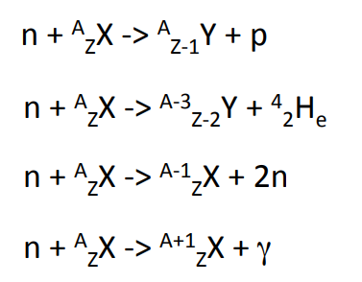

Low-intermediate energy Neutron interactions
Scattering with nuclei (important for moderation):
The neutron changes energy and the nucleus gets in an excited state
Absorption and nuclear reactions (the neutron is absorbed and a nuclear reaction takes place)
Low A-Z transitions (typically emission of a proton, alpha particle, or neutrons)
Fission process: the nucleus is splitted in two and more neutrons are produced
High A-Z transitions
Importan for chain reactions in nuclear reactors

Slide 18
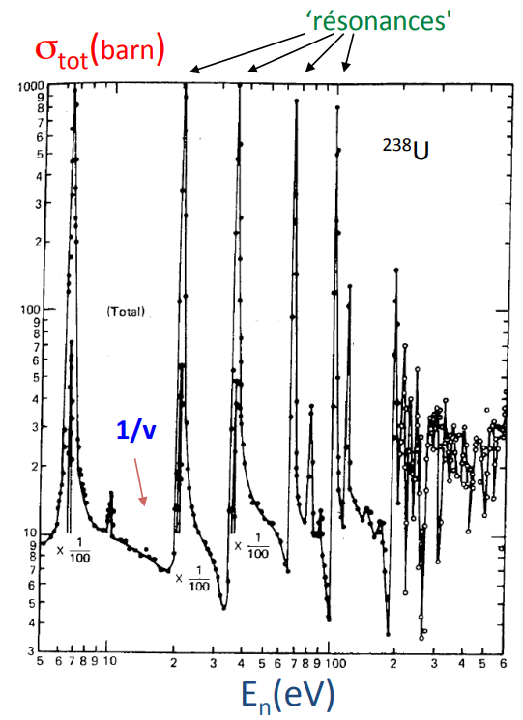
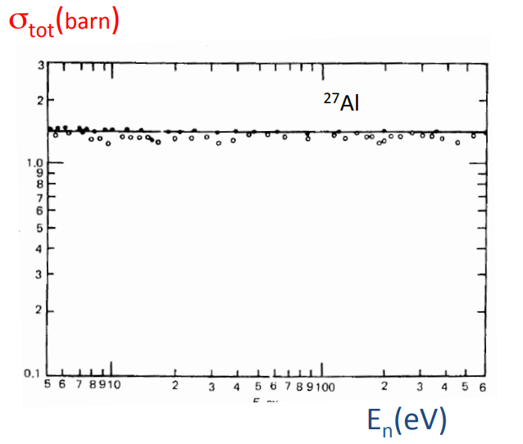
Low-intermediate energy Neutron cross sections
The cross-section goes like ~ 1/v_{n} with v_{n} the velocity of the neutron
On top of this effect there are the absorption resonances characteris of every nucleus

Slide 19
Charged particle interactions
Charged particles suffer a wide variety of different interactions
Ionization
Bremsstrahlung
Multiple scattering
Cerenkov
Nuclear interactions

Slide 20
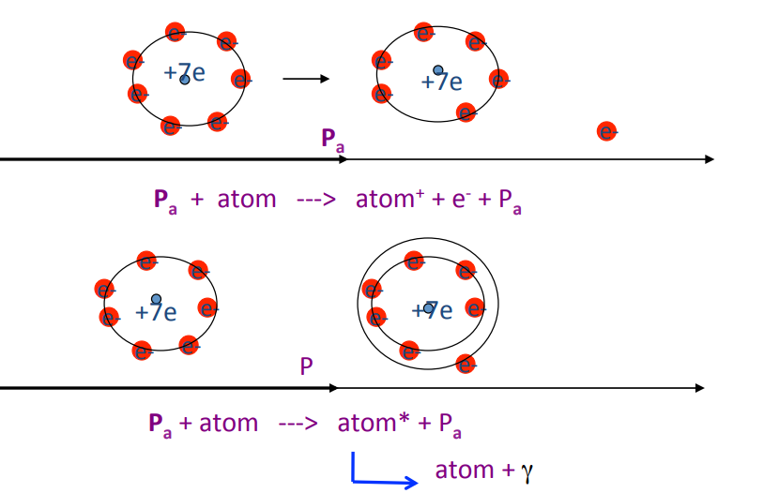
Inelastic collisions with atom electrons (Ionization)
The charged particle interacts, giving energy, with the electron of an atom
This process is dominant for heavy charged particles M_{pa} >> m_{e}
Ionization
Excitation
Inelastic collisions on the nucleus are much less frequent (because the mass is much higher)
The particle loses a bit of energy and its direction remains mostly unchanged

Slide 21

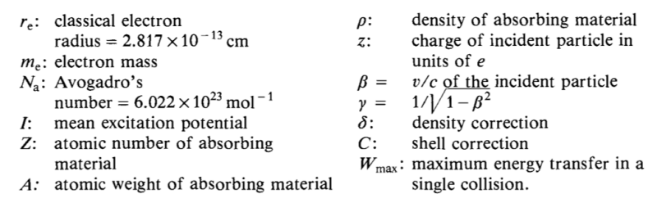
Inelastic collisions with atom electrons (Ionization)
The avarage energy loss of a particle due to ionization is given by the Bethe & Bloch Formula
This formula is valid for particles with a mass much higher than the electrons m_{p} >> m_{e}
The maximum energy transfer takes place in head-on or knock-on collisions
$W_{max}=E_{a}^{max}−m_{e}=\frac{2m_{e}β^{2}γ^{2}}{{\left({E_{CM}}/M\right)}^{2}}$

Slide 22
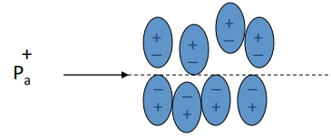
Shell and Density effect corrections
The C term accounts for the fact that the electron is not at rest in the atom
It is a small correction only relevant at low energies
If the binding energy of the electron is taken into account the energy loss is reduced
The “δ” term or “density effect” → accounts for the polarization induced by the particle
The atoms get polarized due to the charge of the particle
The energy loss is reduced because of the shielding of the electric field
It depends on the particle speed and on the matter densitiy
This process is relevant at high energy

Slide 23
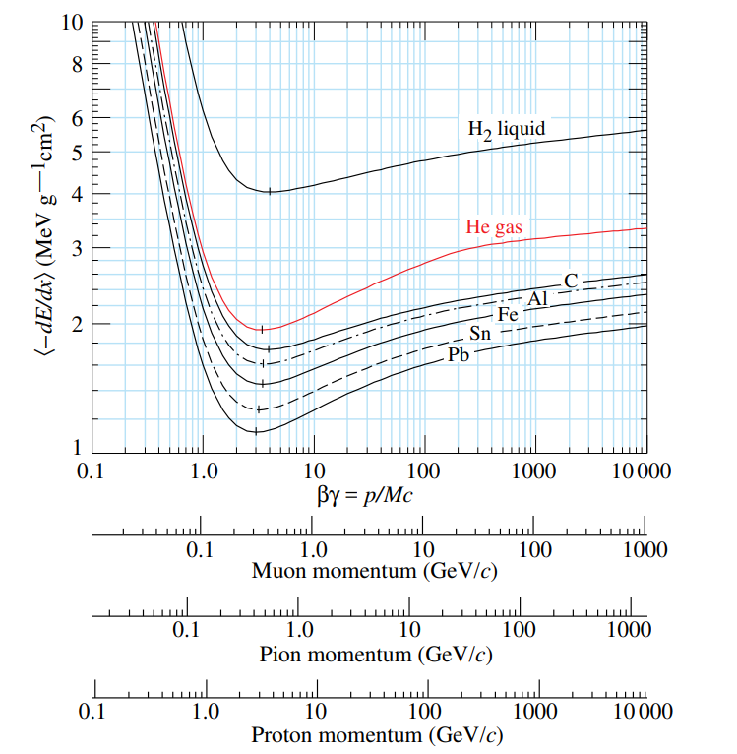
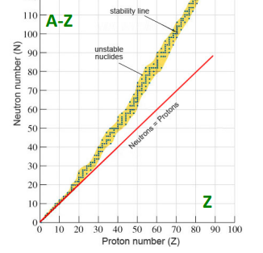
Stopping power or mean specific energy loss
The energy loss is usually given in the form of the stopping power
${−dE}/{\left(ρdx\right)}$
The dependency on the material is almost removed since Z/A ~ 0.5
At low energy the term 1/β² dominates
At high energy → logarithmic term
There is a minimum of ionization
MIP → Minimum Ionizaing Particle
$lnβγ$
$1/{β^{2}}$
$1/{β^{2}}$

Slide 24
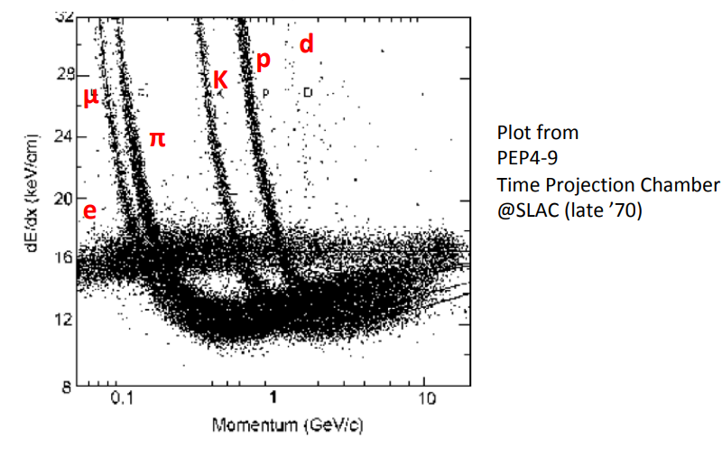
Use of dE/dx for particle identification
The energy loss can be used to identify particles if the momentum is measured independently
Indeed with the momentum known the Bethe Bloch formula can be used to measure β
With the momentum and βknown the mass of the particle can be extracted

Slide 25
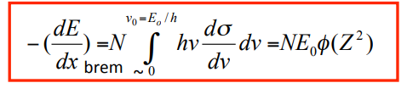
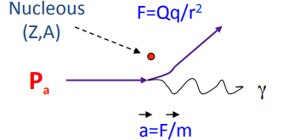

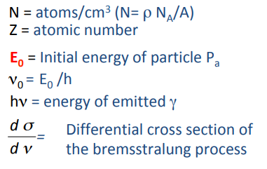



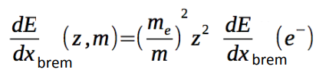
Bremsstrahlung. Mean radiative energy loss
An accelerated or decelerated charged particle emits electromagnetic radiation
This effect takes place when the particle is accelerated in the field of a nucleous
It is particularly relevant for electrons and positrons due to their small mass
For electrons
For other particles

Slide 26
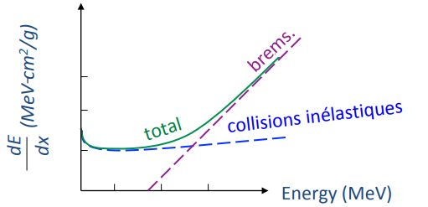
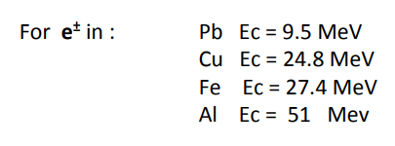
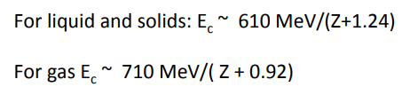
Comparison of Bremsstrahlung vs. ionization
The average energy loss due to ionization increases with the log of energy and linear with Z
The average energy loss due to Brem increases linearly with energy and linear with Z²
The energy in which the two stopping powers equal each other is called the critical energy
For other particles the critical energy scales according to the square of the mass ratio
$E_{c}\left(Pa\right)∝{\left({m_{Pa}}/{m_{e}}\right)}^{2}E_{c}\left(e\right)$

