Slide 1
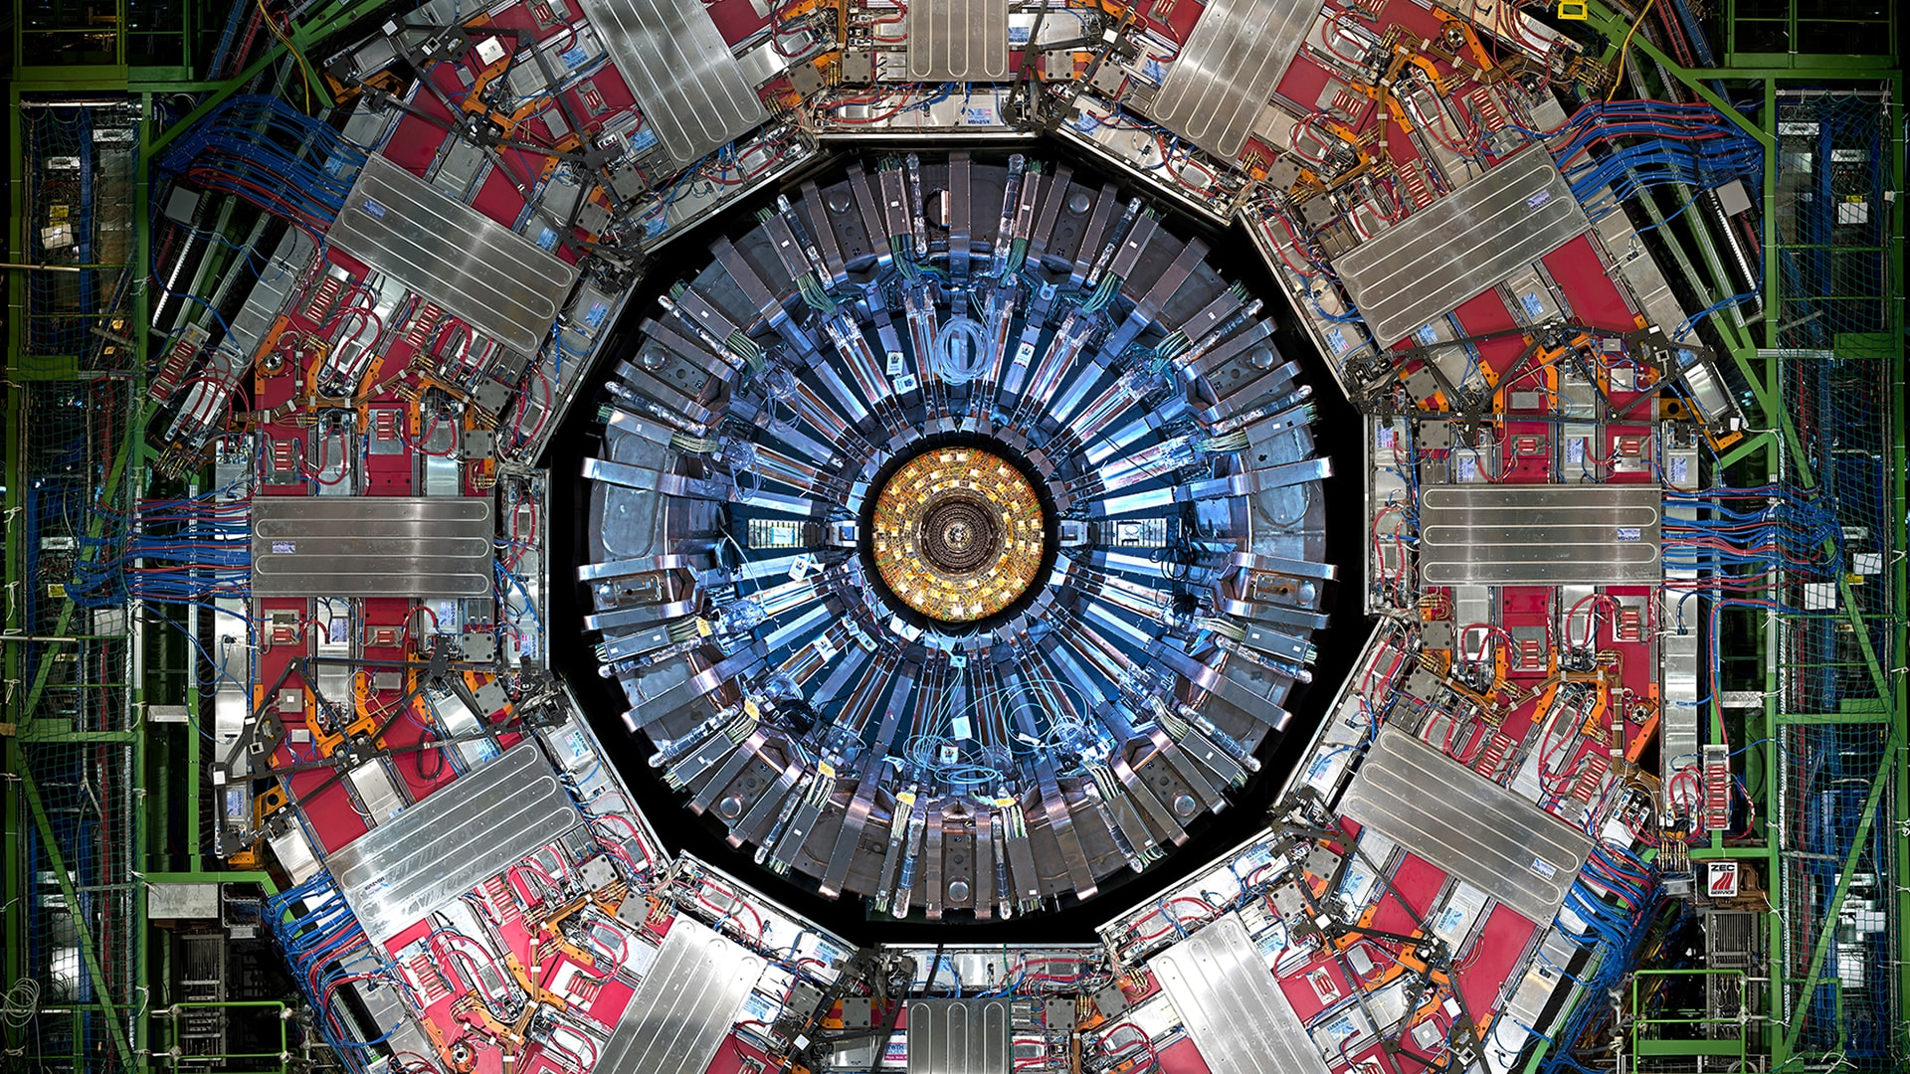
Chapter 6. The weak interaction

Slide 2
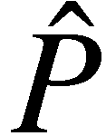
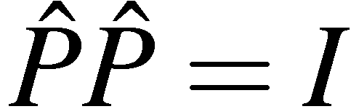
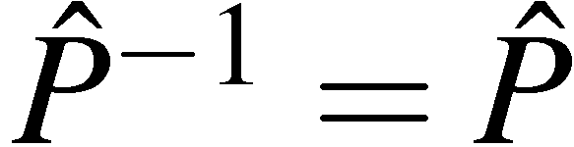
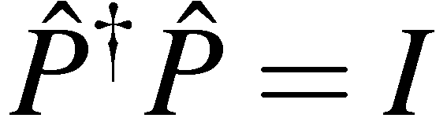
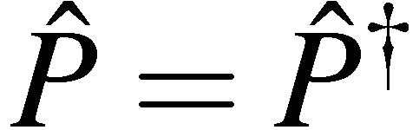
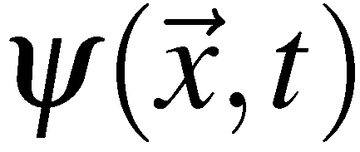

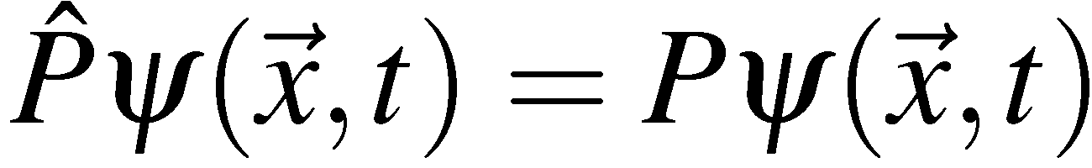
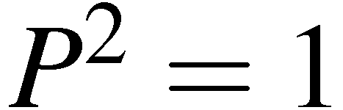
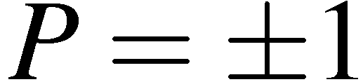
Parity
The parity operator performs spatial inversion through the origin:
applying twice:
so
To preserve the normalisation of the wave-function
Unitary
But since
Hermitian
which implies Parity is an observable quantity. If the interaction Hamiltonian
commutes with , parity is an observable conserved quantity
If is an eigenfunction of the parity operator with eigenvalue
since
Parity has eigenvalues
QED and QCD are invariant under parity
Experimentally observe that Weak Interactions do not conserve parity
Prof. M.A. Thomson
1

Slide 3
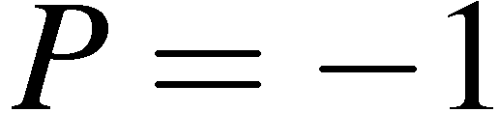
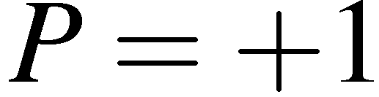
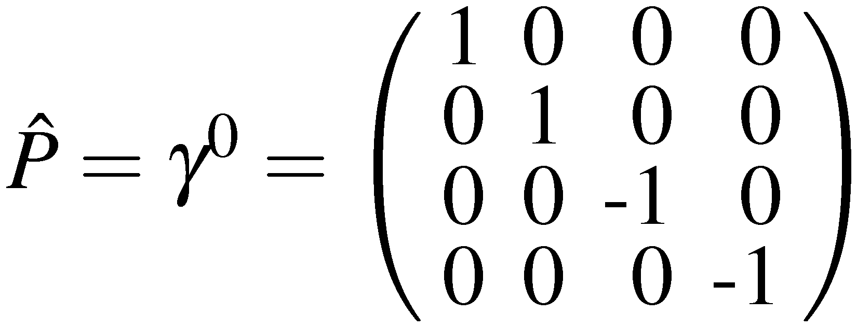
Intrinsic Parities of fundamental particles:
Spin-1 Bosons
From Gauge Field Theory can show that the gauge bosons have
Spin-½ Fermions
From the Dirac equation showed (handout 2):
Spin ½ particles have opposite parity to spin ½ anti-particles
Conventional choice: spin ½ particles have
and anti-particles have opposite parity, i.e.
For Dirac spinors it was shown (handout 2) that the parity operator is:
<número>

Slide 4
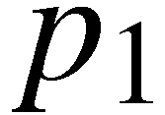
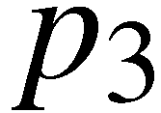

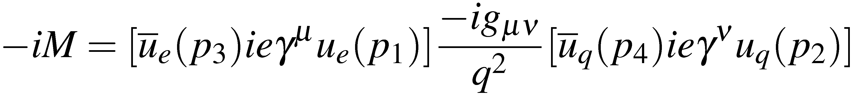
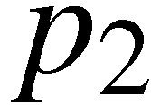
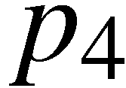
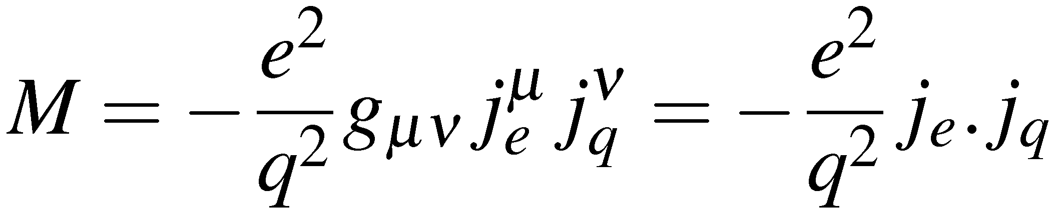

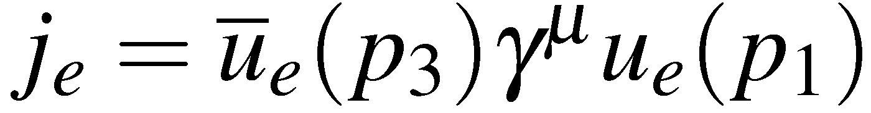
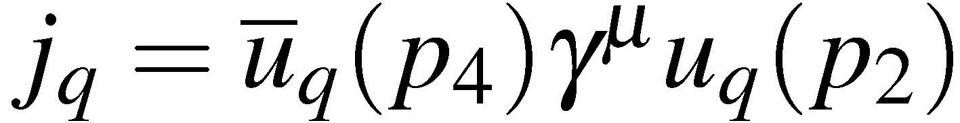
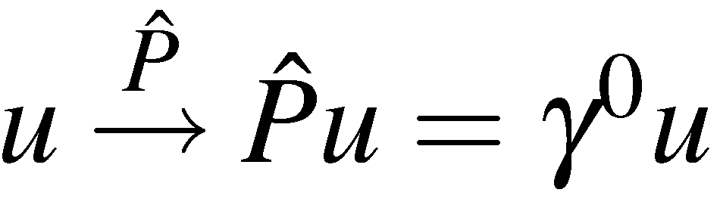
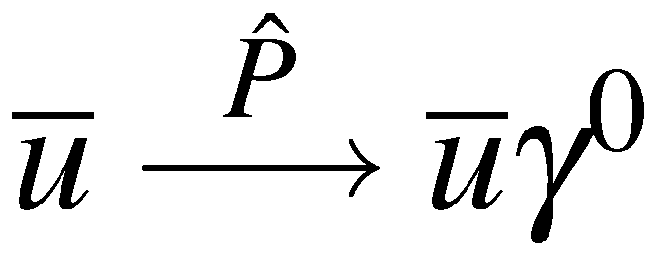
Parity Conservation in QED and QCD
Consider the QED process e–q  e–q
e–
e–
The Feynman rules for QED give:
Which can be expressed in terms of the electron and
quark 4-vector currents:
q
q
with
and
Consider the what happen to the matrix element under the parity transformation
Spinors transform as
Adjoint spinors transform as
Hence
<número>

Slide 5
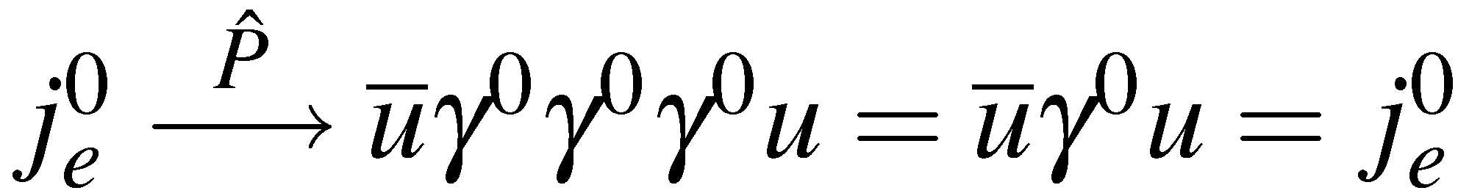
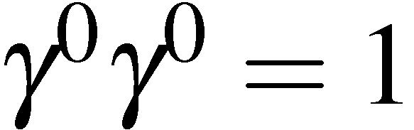
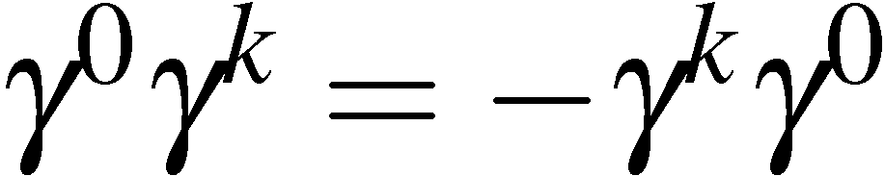
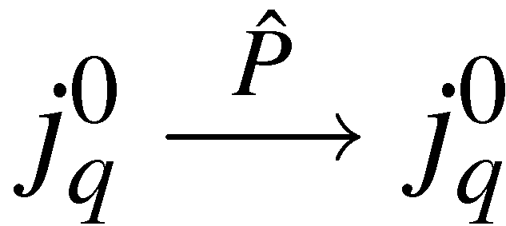
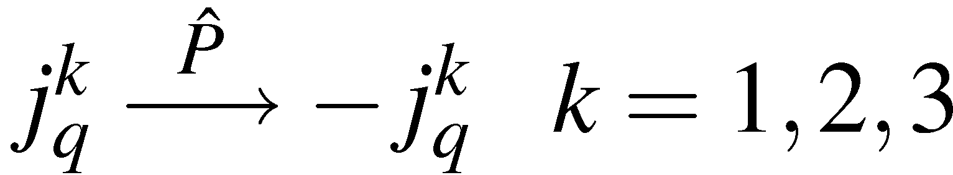
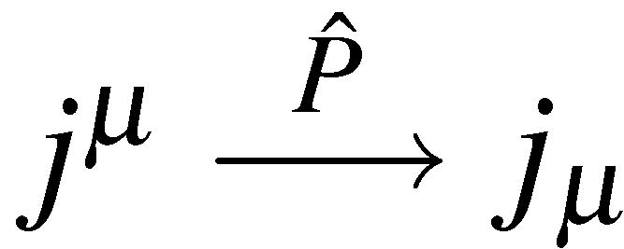
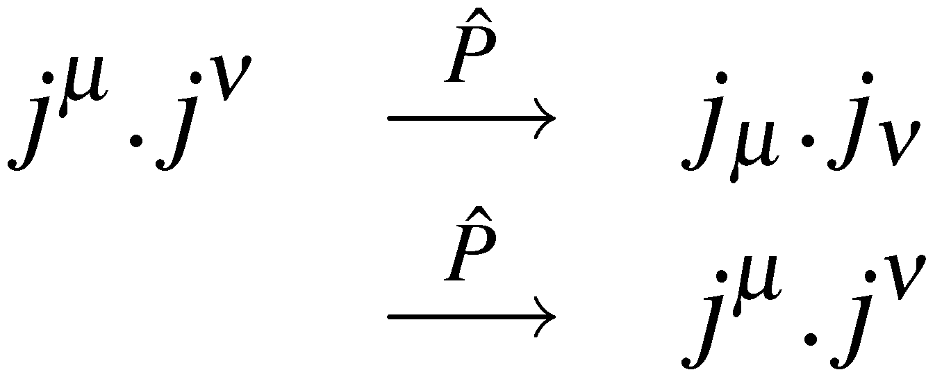
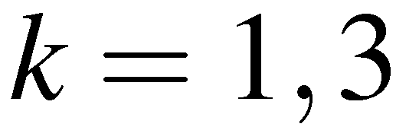
Consider the components of the four-vector current
0:
since
k=1,2,3:
since
The time-like component remains unchanged and the space-like components
change sign
Similarly
or
Consequently the four-vector scalar product
QED Matrix Elements are Parity Invariant
Parity Conserved in QED
The QCD vertex has the same form and, thus,
Parity Conserved in QCD
<número>

Slide 6
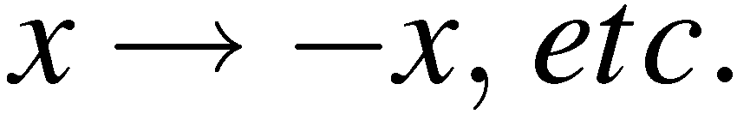
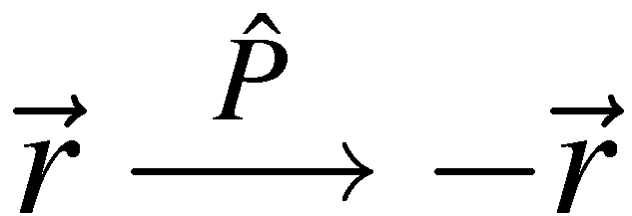
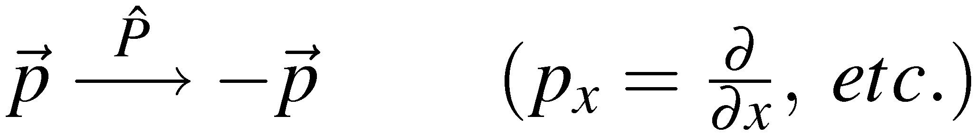
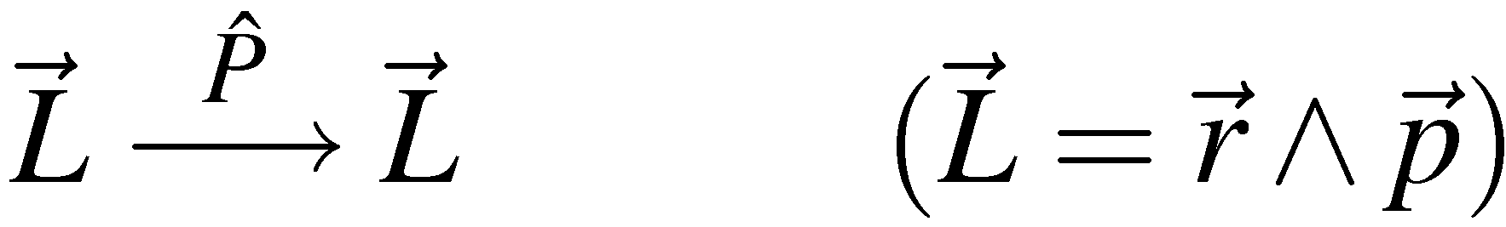
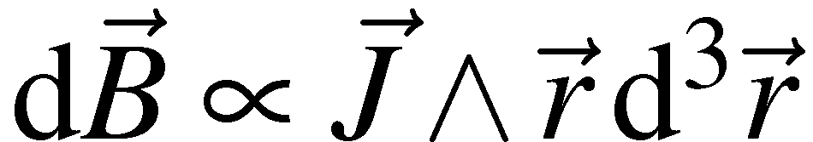
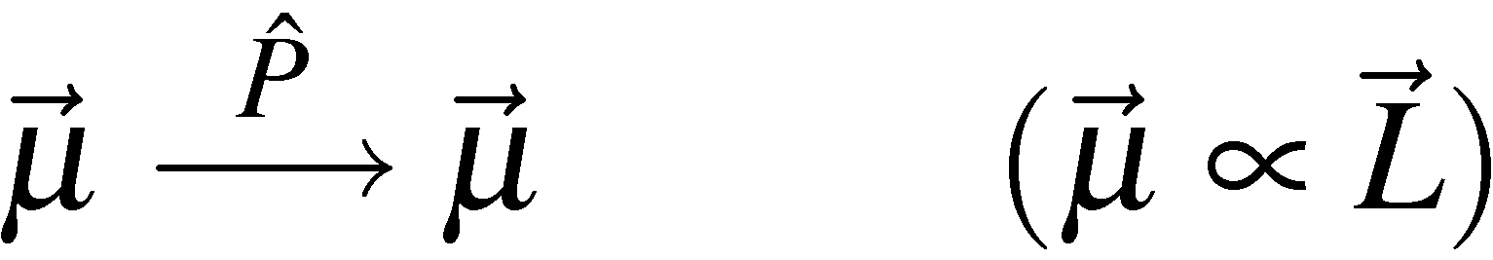
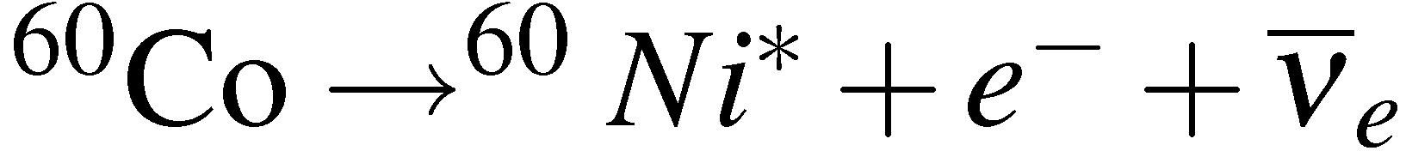
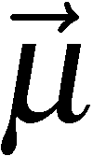
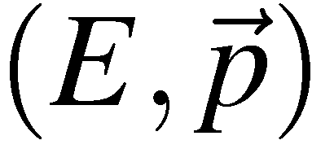
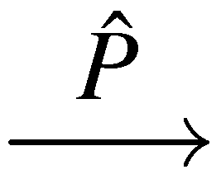
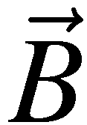
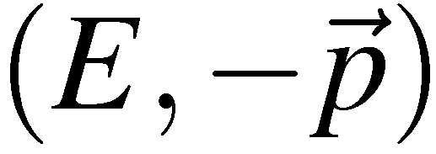
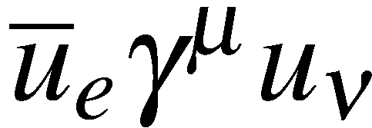
Parity Violation in β-Decay
The parity operator corresponds to a discrete transformation
Under the parity transformation:
Vectors
change sign
Note B is an
axial vector
Axial-Vectors
unchanged
1957: C.S.Wu et al. studied beta decay of polarized cobalt-60 nuclei:
Observed electrons emitted preferentially in direction opposite to applied field
If parity were conserved:
expect equal rate for producing e– in directions along and opposite to the nuclear spin.
more e- in c.f.
Conclude parity is violated in WEAK INTERACTION
that the WEAK interaction vertex is NOT of the form
<número>

Slide 7
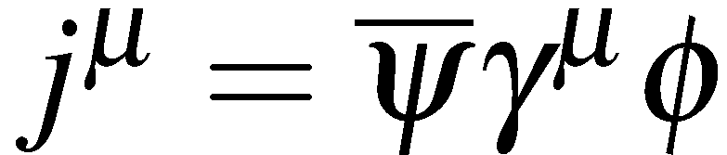
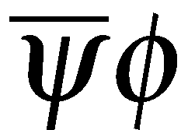
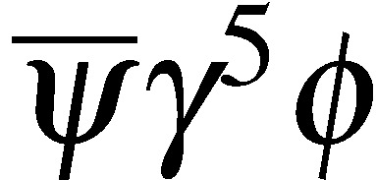
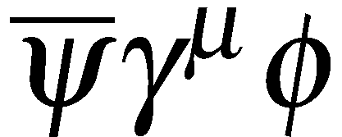
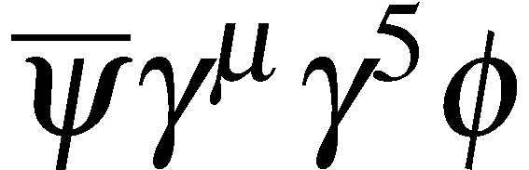
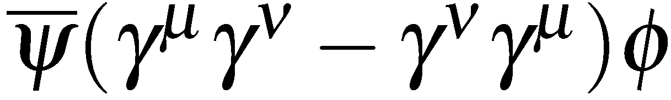

Bilinear Covariants
The requirement of Lorentz invariance of the matrix element severely restricts
the form of the interaction vertex. QED and QCD are “VECTOR” interactions:
This combination transforms as a 4-vector (Handout 2 appendix V)
In general, there are only 5 possible combinations of two spinors and the gamma
matrices that form Lorentz invariant currents, called “bilinear covariants”:
Type Form Components “Boson Spin”
SCALAR
PSEUDOSCALAR
VECTOR
AXIAL VECTOR
TENSOR
1
1
4
4
6
0
0
1
1
2
Note that in total the sixteen components correspond to the 16 elements of
a general 4x4 matrix: “decomposition into Lorentz invariant combinations”
In QED the factor arose from the sum over polarization states of the virtual
photon (2 transverse + 1 longitudinal, 1 scalar) = (2J+1) + 1
Associate SCALAR and PSEUDOSCALAR interactions with the exchange of a
SPIN-0 boson, etc. – no spin degrees of freedom
<número>

Slide 8





V-A Structure of the Weak Interaction
The most general form for the interaction between a fermion and a boson is a
linear combination of bilinear covariants
For an interaction corresponding to the exchange of a spin-1 particle the most
general form is a linear combination of VECTOR and AXIAL-VECTOR
The form for WEAK interaction is determined from experiment to be
VECTOR – AXIAL-VECTOR (V – A)
e–
ν_{e}
V – A
Can this account for parity violation?
First consider parity transformation of a pure AXIAL-VECTOR current
with
or
<número>

Slide 9



The space-like components remain unchanged and the time-like components
change sign (the opposite to the parity properties of a vector-current)
Now consider the matrix elements
For the combination of a two axial-vector currents
Consequently parity is conserved for both a pure vector and pure axial-vector
interactions
However the combination of a vector current and an axial vector current
changes sign under parity – can give parity violation !
<número>

Slide 10






Now consider a general linear combination of VECTOR and AXIAL-VECTOR
(note this is relevant for the Z-boson vertex)
Consider the parity transformation of this scalar product
If either g_{A} or g_{V} is zero, Parity is conserved, i.e. parity conserved in a
pure VECTOR or pure AXIAL-VECTOR interaction
Relative strength of parity violating part
Maximal Parity Violation for V-A (or V+A)
<número>

Slide 11






Chiral Structure of QED (Reminder)
Recall (Handout 4) introduced CHIRAL projections operators
project out chiral right- and left- handed states
In the ultra-relativistic limit, chiral states correspond to helicity states
Any spinor can be expressed as:
The QED vertex
in terms of chiral states:
conserves chirality, e.g.
In the ultra-relativistic limit only
two helicity combinations are
non-zero
<número>

Slide 12









Helicity Structure of the WEAK Interaction
The charged current (W±) weak vertex is:
e–
ν_{e}
Since projects out left-handed chiral particle states:
(question 16)
Writing and from discussion of QED, gives
Only the left-handed chiral components of particle spinors and right-handed chiral components of anti-particle spinors participate in charged current weak interactions
At very high energy , the left-handed chiral components are
helicity eigenstates :
LEFT-HANDED PARTICLES
Helicity = -1
RIGHT-HANDED ANTI-PARTICLES
Helicity = +1
<número>

Slide 13







In the ultra-relativistic limit only left-handed particles and right-handed antiparticles participate in charged current weak interactions
e.g. In the relativistic limit, the only possible electron – neutrino interactions are:
e–
ν_{e}
ν_{e}
e⁺
ν_{e}
e–
The helicity dependence of the weak interaction parity violation
e.g.
RH anti-particle
LH particle
RH particle
LH anti-particle
Valid weak interaction
Does not occur
<número>

Slide 14




Helicity in Pion Decay
The decays of charged pions provide a good demonstration of the role of
helicity in the weak interaction
EXPERIMENTALLY:
Might expect the decay to electrons to dominate – due to increased phase
space…. The opposite happens, the electron decay is helicity suppressed
Consider decay in pion rest frame.
Pion is spin zero: so the spins of the ν and μ are opposite
Weak interaction only couples to RH chiral anti-particle states. Since
neutrinos are (almost) massless, must be in RH Helicity state
Therefore, to conserve angular mom. muon is emitted in a RH HELICITY state
But only left-handed CHIRAL particle states participate in weak interaction
<número>

Slide 15








The general right-handed helicity solution to the Dirac equation is
with
and
project out the left-handed chiral
part of the wave-function using
giving
In the limit this tends to zero
similarly
In the limit ,
<número>

Slide 16



Hence
RH Helicity
RH Chiral
LH Chiral
In the limit , as expected, the RH chiral and helicity states are identical
Although only LH chiral particles participate in the weak interaction
the contribution from RH Helicity states is not necessarily zero !
m_{ν} ≈ 0: RH Helicity ≡ RH Chiral
m_{μ} ≠ 0: RH Helicity has
LH Chiral Component
Expect matrix element to be proportional to LH chiral component of RH Helicity
electron/muon spinor
from the kinematics
of pion decay at rest
Hence because the electron mass is much smaller than the pion mass the decay
is heavily suppressed.
<número>

Slide 17











Evidence for V-A
The V-A nature of the charged current weak interaction vertex fits with experiment
EXAMPLE charged pion decay
(question 17)
Experimentally measure:
Theoretical predictions (depend on Lorentz Structure of the interaction)
V-A
or
V+A
Scalar
or
Pseudo-Scalar
EXAMPLE muon decay
Measure electron energy and angular distributions relative to muon spin direction. Results expressed in terms
of general S+P+V+A+T form in “Michel Parameters”
e.g. TWIST expt: 6x10⁹ μ decays Phys. Rev. Lett. 95 (2005) 101805
V-A Prediction:
<número>

Slide 18









Weak Charged Current Propagator
The charged-current Weak interaction is different from QED and QCD
in that it is mediated by massive W-bosons (80.3 GeV)
This results in a more complicated form for the propagator:
in handout 4 showed that for the exchange of a massive particle:
massless
massive
In addition the sum over W boson polarization states modifies the numerator
W-boson propagator
spin 1 W±
However in the limit where is small compared with
the interaction takes a simpler form.
W-boson propagator ( )
The interaction appears point-like (i.e no q² dependence)
<número>

Slide 19






Connection to Fermi Theory
In 1934, before the discovery of parity violation, Fermi proposed, in analogy
with QED, that the invariant matrix element for β-decay was of the form:
where
Note the absence of a propagator : i.e. this represents an interaction at a point
After the discovery of parity violation in 1957 this was modified to
(the factor of √2 was included so the numerical value of G_{F} did not need to be changed)
Compare to the prediction for W-boson exchange
which for becomes:
Still usually use to express strength
of weak interaction as the is the quantity
that is precisely determined in muon decay
<número>

Slide 20






Strength of Weak Interaction
Strength of weak interaction most precisely measured in muon decay
Here
To a very good approximation the W-boson
propagator can be written
In muon decay measure
Muon decay
To obtain the intrinsic strength of weak interaction need to know mass of
W-boson:
(see handout 14)
The intrinsic strength of the weak interaction is similar to, but greater than,
the EM interaction ! It is the massive W-boson in the propagator which makes
it appear weak. For weak interactions are more likely than EM.
<número>

Slide 21
Summary
Weak interaction is of form Vector – Axial-vector (V-A)
Consequently only left-handed chiral particle states and right-handed
chiral anti-particle states participate in the weak interaction
MAXIMAL PARITY VIOLATION
Weak interaction also violates Charge Conjugation symmetry
At low weak interaction is only weak because of the large W-boson
mass
Intrinsic strength of weak interaction is similar to that of QED
<número>

Slide 22








From W to Z
The W± bosons carry the EM charge - suggestive Weak are EM forces are related.
W bosons can be produced in e⁺e⁻ annihilation
With just these two diagrams there is a problem:
the cross section increases with C.o.M energy
and at some point violates QM unitarity
UNITARITY VIOLATION: when QM calculation gives larger
flux of W bosons than incoming flux of electrons/positrons
Problem can be “fixed” by introducing a new boson, the Z. The new diagram
interferes negatively with the above two diagrams fixing the unitarity problem
Only works if Z, γ, W couplings are related: need ELECTROWEAK UNIFICATION
<número>

Slide 23









SU(2)_{L} : The Weak Interaction
The Weak Interaction arises from SU(2) local phase transformations
where the are the generators of the SU(2) symmetry, i.e the three Pauli
spin matrices
3 Gauge Bosons
The wave-functions have two components which, in analogy with isospin,
are represented by “weak isospin”
The fermions are placed in isospin doublets and the local phase transformation
corresponds to
Weak Interaction only couples to LH particles/RH anti-particles, hence only
place LH particles/RH anti-particles in weak isospin doublets:
RH particles/LH anti-particles placed in weak isospin singlets:
Weak Isospin
Note: RH/LH refer to chiral states
<número>

Slide 24










For simplicity only consider
The gauge symmetry specifies the form of the interaction: one term for each
of the 3 generators of SU(2) – [note: here include interaction strength in current]
The charged current W⁺/W⁻ interaction enters as a linear combinations of W₁, W₂
The W± interaction terms
Express in terms of the weak isospin ladder operators
Origin of in Weak CC
W⁺
corresponds to
Bars indicates
adjoint spinors
which can be understood in terms of the weak isospin doublet
<número>

Slide 25





Similarly
W⁻
corresponds to
However have an additional interaction due to W³
expanding this:
NEUTRAL CURRENT INTERACTIONS !
<número>

Slide 26













Electroweak Unification
Tempting to identify the as the
However this is not the case, have two physical neutral spin-1 gauge bosons,
and the is a mixture of the two,
Equivalently write the photon and in terms of the and a new neutral
spin-1 boson the
The physical bosons (the and photon field, ) are:
is the weak
mixing angle
The new boson is associated with a new gauge symmetry similar to that
of electromagnetism : U(1)_{Y}
The charge of this symmetry is called WEAK HYPERCHARGE
Q is the EM charge of a particle
I_{W} is the third comp. of weak isospin
3
By convention the coupling to the B_{μ} is
(this identification of hypercharge in terms of Q and I₃ makes all of the following work out)
<número>

Slide 27


For this to work the coupling constants of the W³, B, and photon must be related
e.g. consider contributions involving the neutral interactions of electrons:
γ
W³
B
The relation
is equivalent to requiring
Writing this in full:
which works if:
(i.e. equate coefficients of L and R terms)
Couplings of electromagnetism, the weak interaction and the interaction of the
U(1)_{Y} symmetry are therefore related.
<número>

Slide 28





The Z Boson
In this model we can now derive the couplings of the Z Boson
for the electron
Writing this in terms of weak isospin and charge:
For RH chiral states I₃=0
Gathering up the terms for LH and RH chiral states:
Using: gives
with
i.e.
<número>

Slide 29









Unlike for the Charged Current Weak interaction (W) the Z Boson couples
to both LH and RH chiral components, but not equally…
W³ part of Z couples only to
LH components (like W±)
B_{μ} part of Z couples equally to
LH and RH components
Use projection operators to obtain vector and axial vector couplings
<número>

Slide 30






























Which in terms of V and A components gives:
with
Hence the vertex factor for the Z boson is:
Using the experimentally determined value of the weak mixing angle:
Fermion
<número>

Slide 31


Summary
The Standard Model interactions are mediated by spin-1 gauge bosons
The form of the interactions are completely specified by the assuming an
underlying local phase transformation GAUGE INVARIANCE
U(1)_{em}
QED
SU(2)_{L}
Charged Current Weak Interaction + W³
SU(3)_{col}
QCD
In order to “unify” the electromagnetic and weak interactions, introduced a
new symmetry gauge symmetry : U(1) hypercharge
U(1)_{Y}
B_{μ}
The physical Z boson and the photon are mixtures of the neutral W boson
and B determined by the Weak Mixing angle
Have we really unified the EM and Weak interactions ? Well not really…
Started with two independent theories with coupling constants
Ended up with coupling constants which are related but at the cost of
introducing a new parameter in the Standard Model
Interactions not unified from any higher theoretical principle… but it works!
<número>

