Slide 1
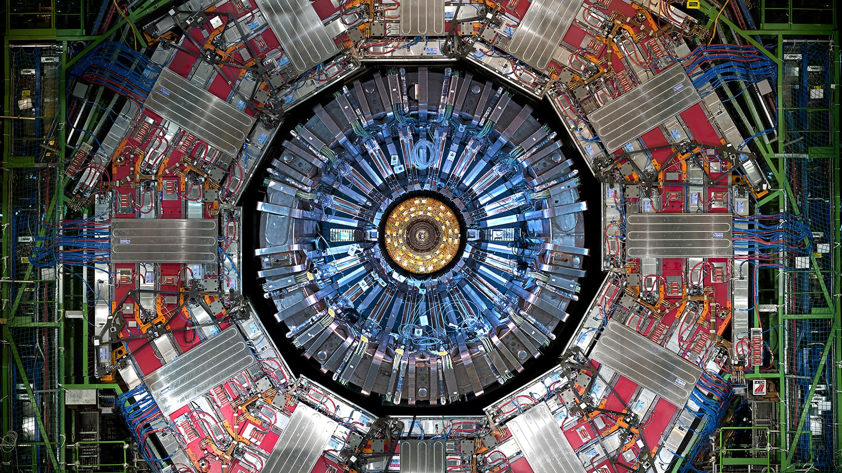
Chapter 5. Electron-Positron annihilation

Slide 2
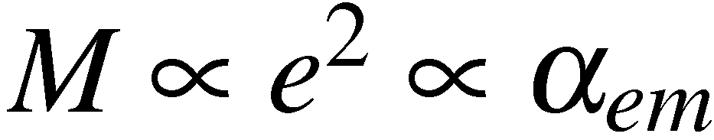
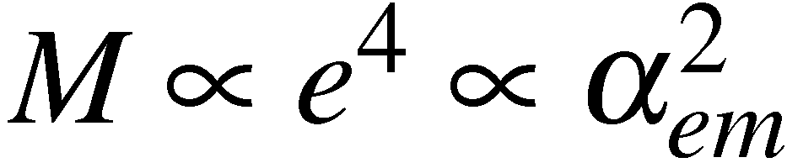
QED Calculations
How to calculate a cross section using QED (e.g. e⁺e–  μ⁺μ– ):
❶ Draw all possible Feynman Diagrams
For e⁺e–  μ⁺μ– there is just one lowest order diagram
e⁺
μ⁺
γ
e–
μ–
+ many second order diagrams + …
e⁺
γ
μ⁺
e⁺
μ⁺
γ
+
+…
e–
μ–
e–
μ–
❷ For each diagram calculate the matrix element using Feynman rules
derived in handout 4.
❸ Sum the individual matrix elements (i.e. sum the amplitudes)
Note: summing amplitudes therefore different diagrams for the same final
state can interfere either positively or negatively!
<número>

Slide 3
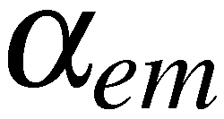
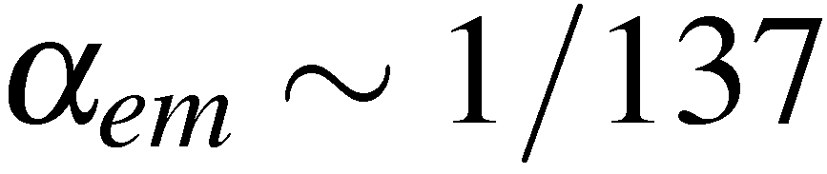
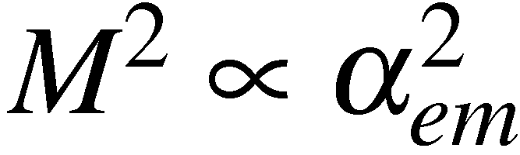
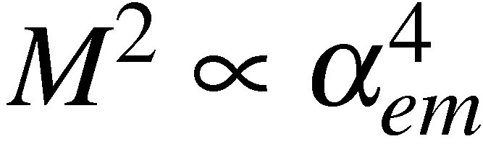
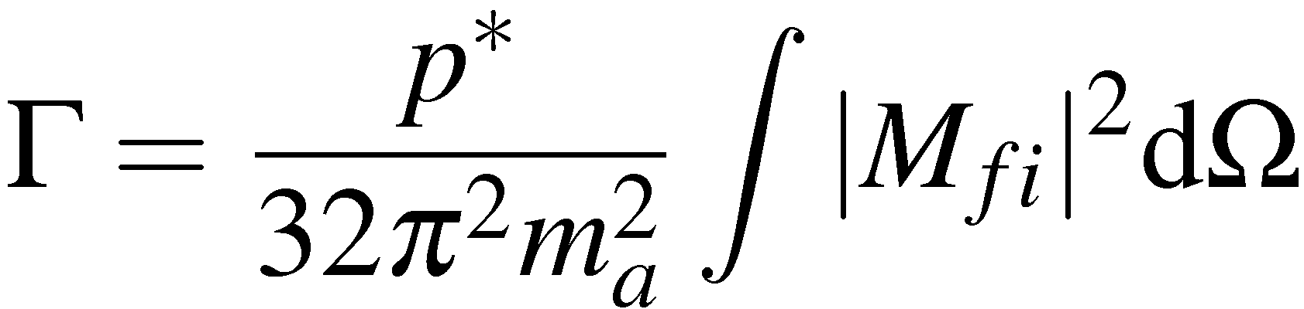
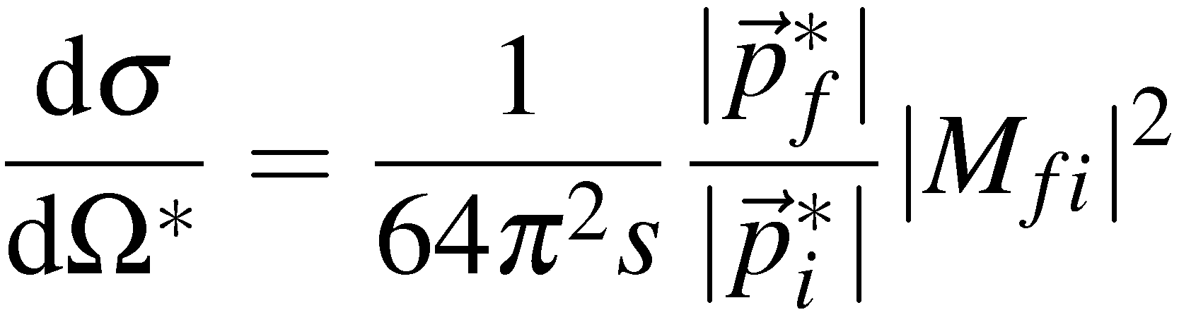
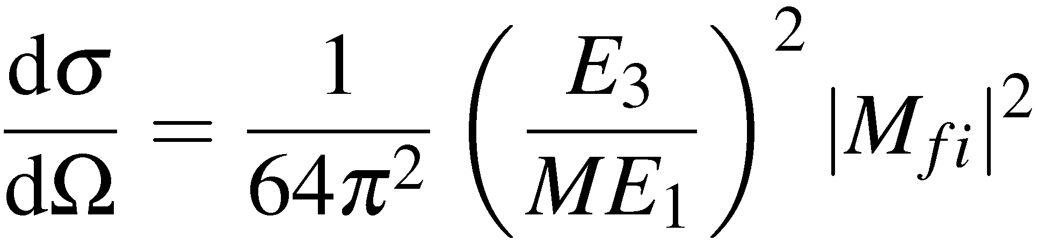
and then square
this gives the full perturbation expansion in
For QED the lowest order diagram dominates and
for most purposes it is sufficient to neglect higher order diagrams.
e⁺
μ⁺
e⁺
γ
μ⁺
γ
e–
μ–
e–
μ–
❹ Calculate decay rate/cross section using formulae from handout 1.
e.g. for a decay
For scattering in the centre-of-mass frame
(1)
For scattering in lab. frame (neglecting mass of scattered particle)
<número>

Slide 4
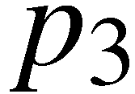
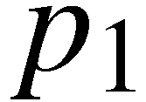
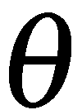
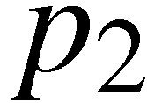
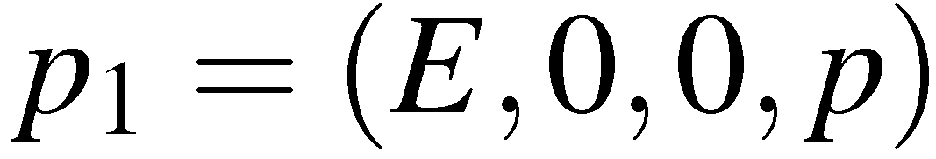
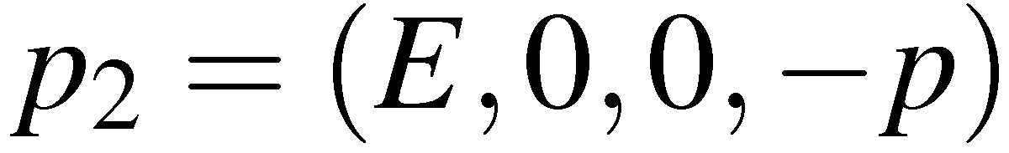
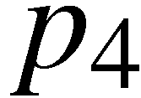
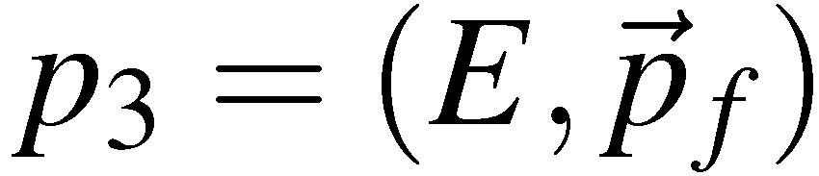
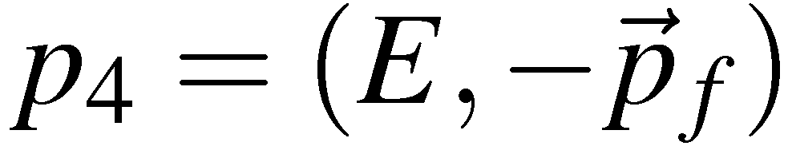
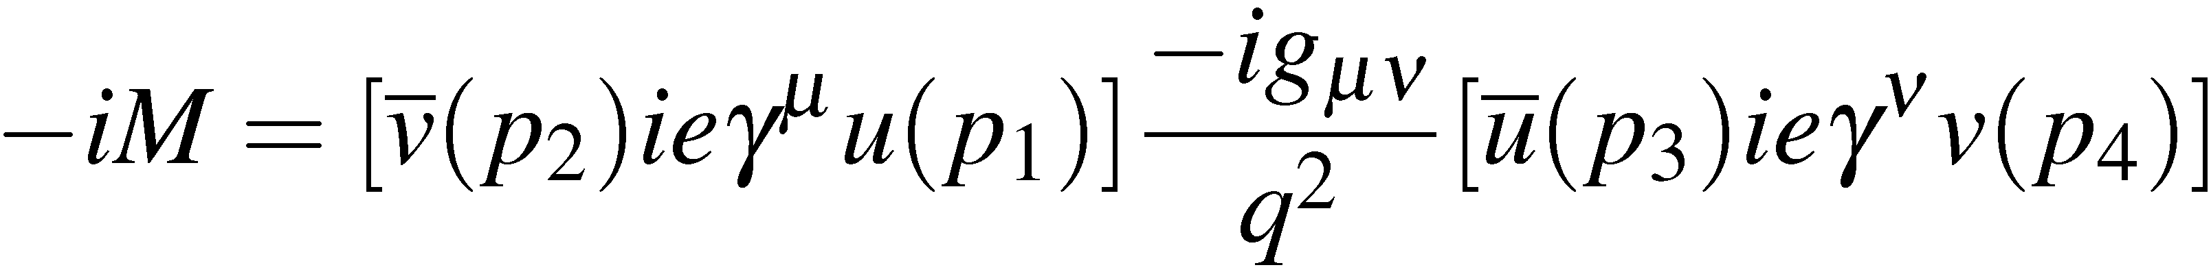


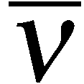

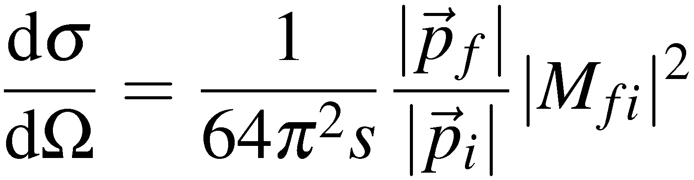
Electron Positron Annihilation
Consider the process:
e⁺e–  μ⁺μ–
μ–
Work in C.o.M. frame (this is appropriate
for most e⁺e– colliders).
e–
e⁺
μ⁺
Only consider the lowest order Feynman diagram:
e⁺
μ⁺
Feynman rules give:
γ
NOTE:
Incoming anti-particle
Incoming particle
Adjoint spinor written first
e–
μ–
In the C.o.M. frame have
with
<número>

Slide 5
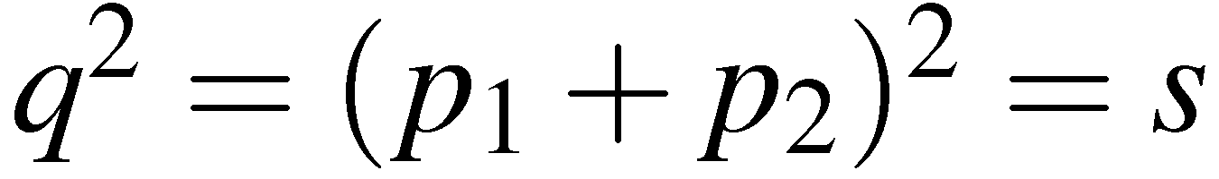
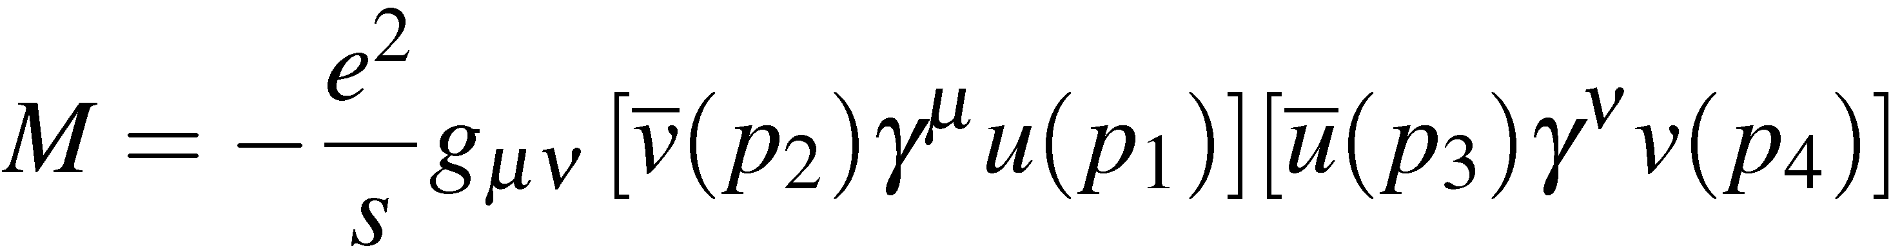
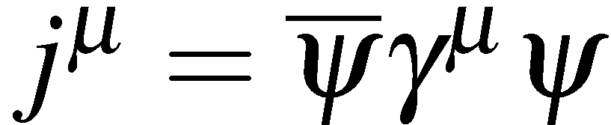
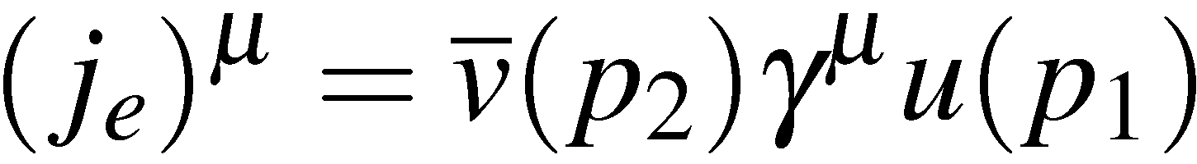
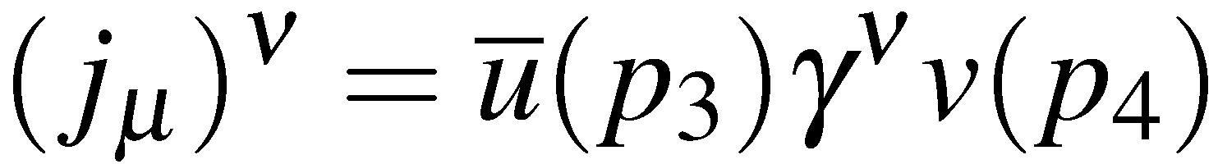
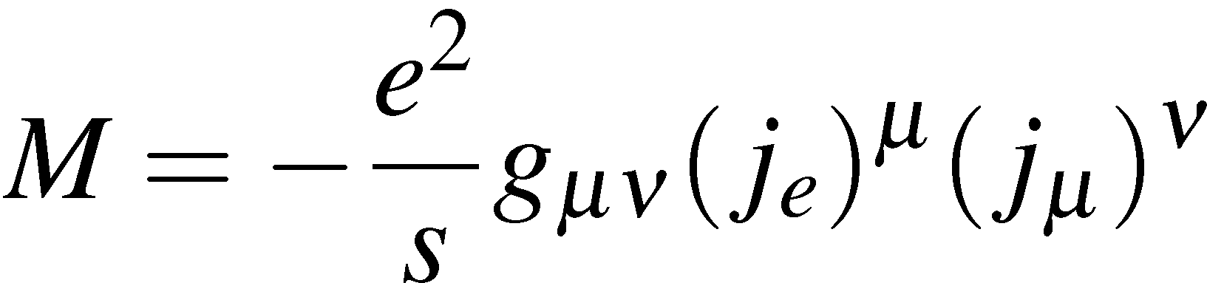
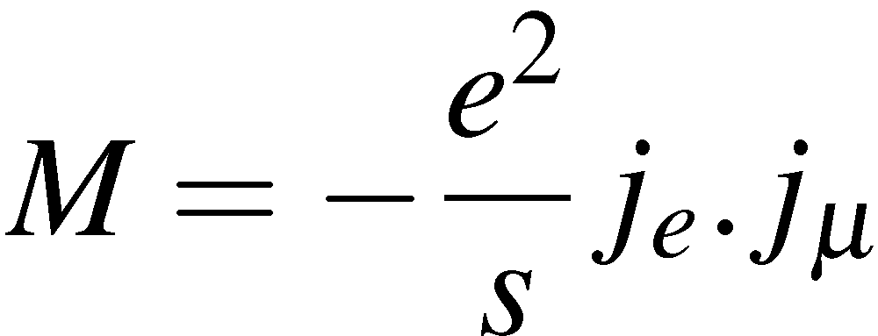
Electron and Muon Currents
Here and matrix element
In handout 2 introduced the four-vector current
which has same form as the two terms in [ ] in the matrix element
The matrix element can be written in terms of the electron and muon currents
and
Matrix element is a four-vector scalar product – confirming it is Lorentz Invariant
<número>

Slide 6
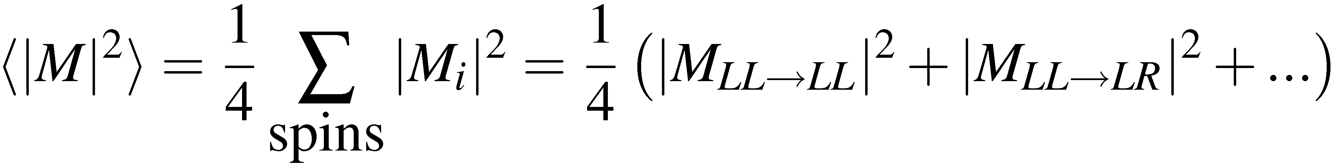
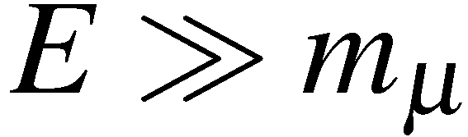
Spin in e⁺e– Annihilation
In general the electron and positron will not be polarized, i.e. there will be equal
numbers of positive and negative helicity states
There are four possible combinations of spins in the initial state !
e–
e⁺
e–
e⁺
e–
e⁺
e–
e⁺
RL
RR
LL
LR
Similarly there are four possible helicity combinations in the final state
In total there are 16 combinations e.g. RLRR, RLRL, ….
To account for these states we need to sum over all 16 possible helicity
combinations and then average over the number of initial helicity states:
i.e. need to evaluate:
for all 16 helicity combinations !
Fortunately, in the limit only 4 helicity combinations give non-zero
matrix elements – we will see that this is an important feature of QED/QCD
<número>

Slide 7
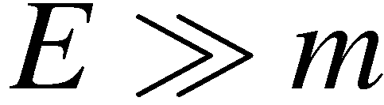
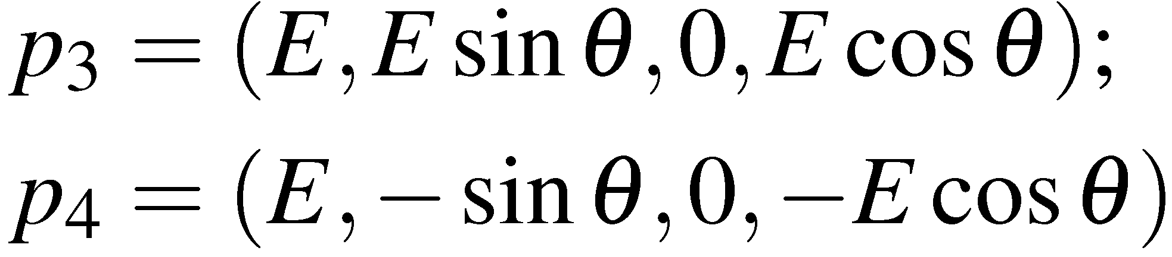
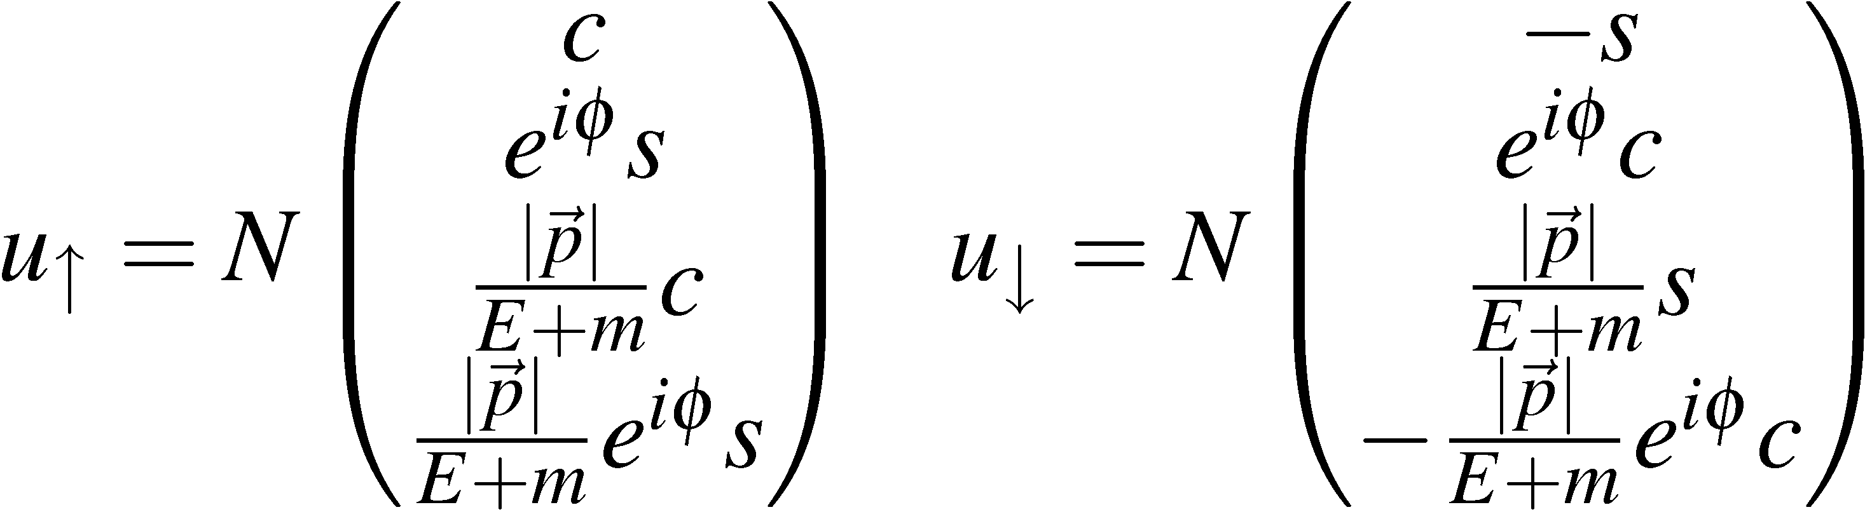
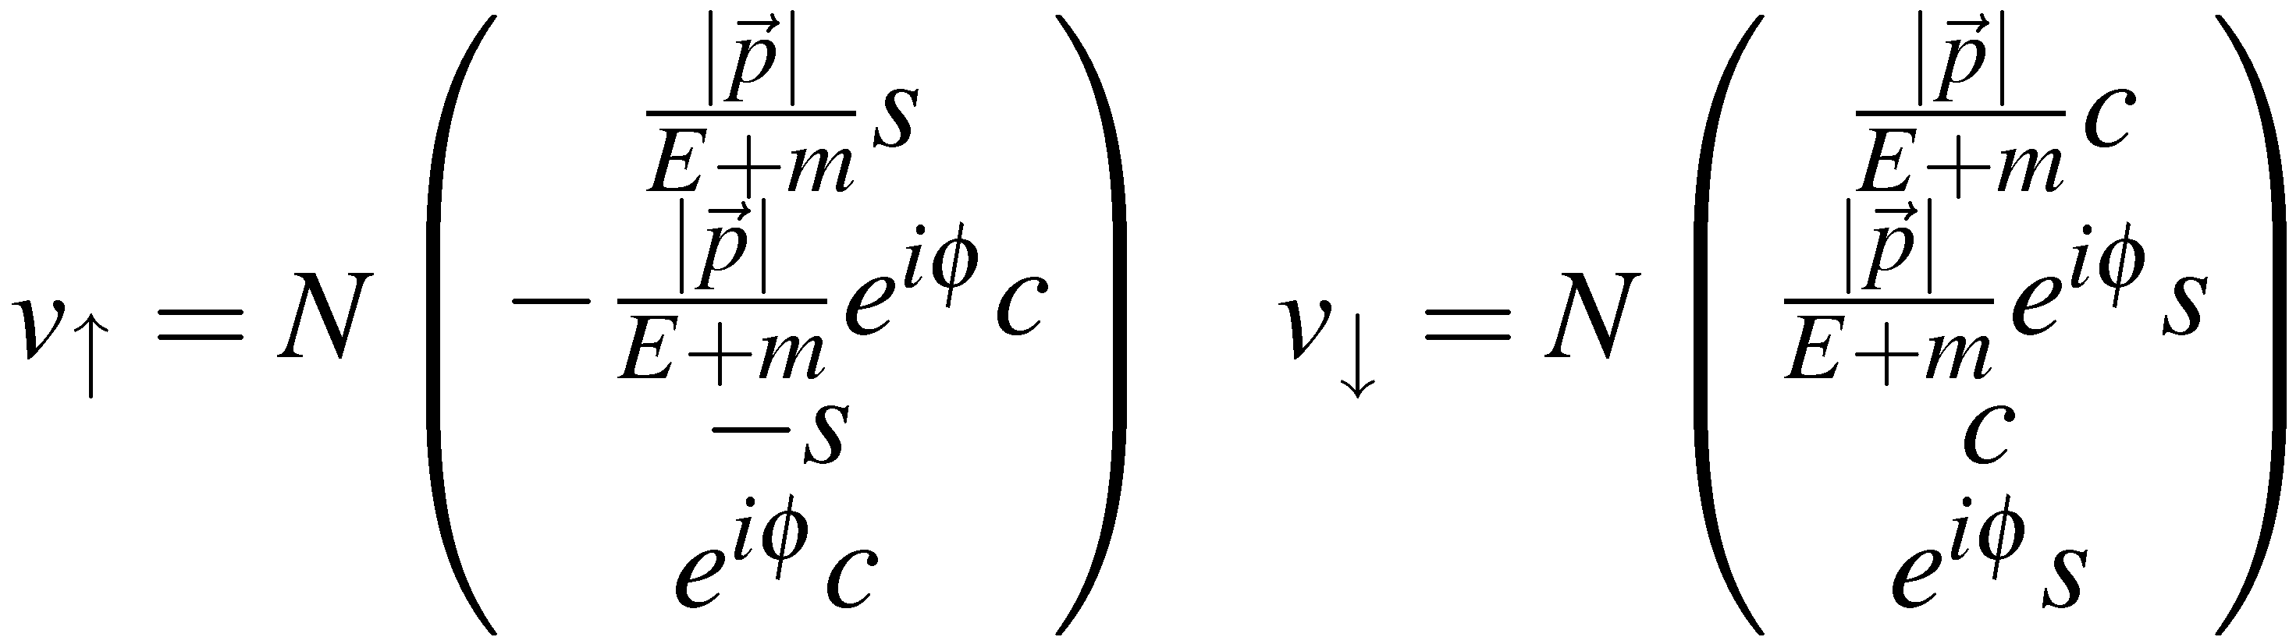
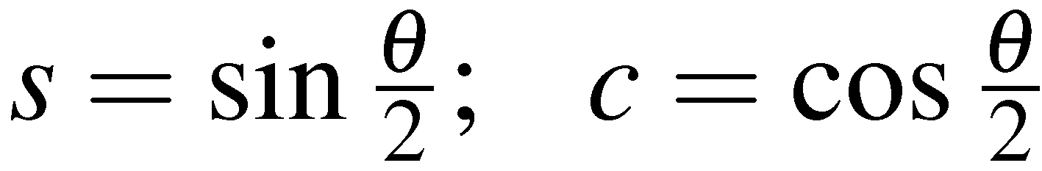
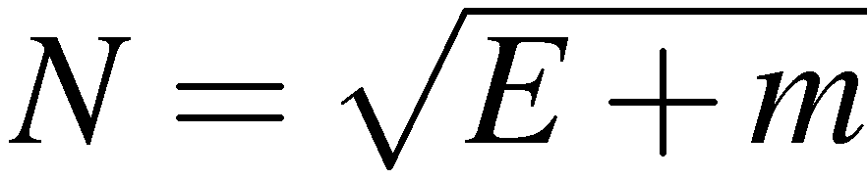
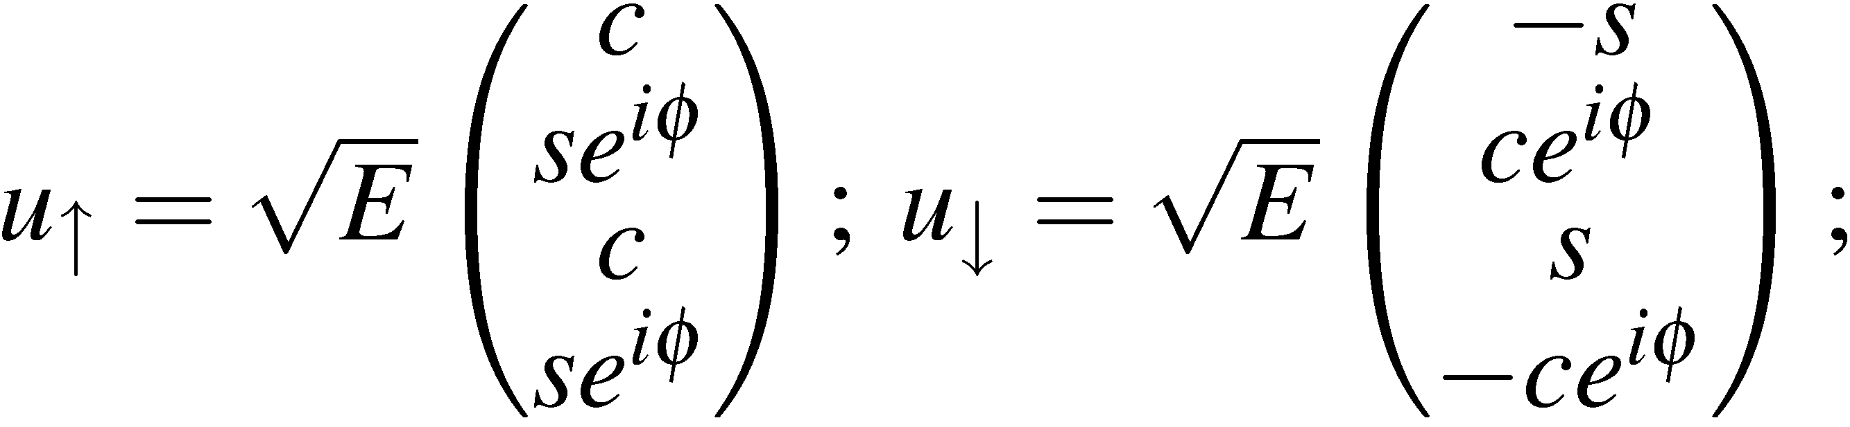
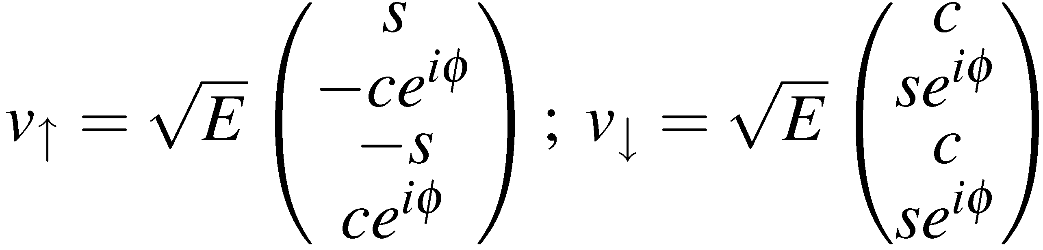
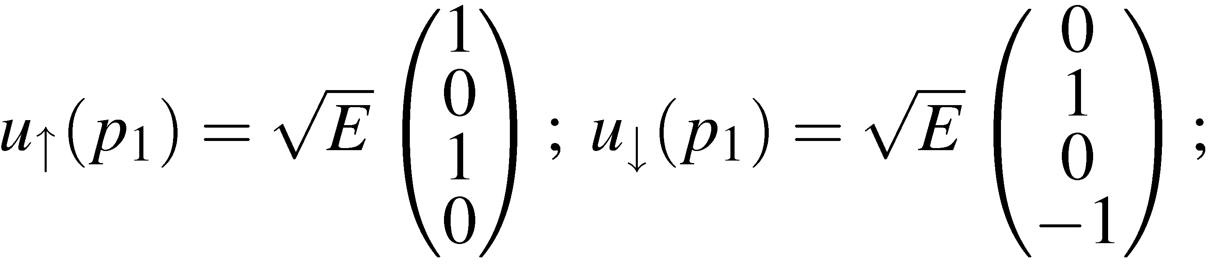
μ–
In the C.o.M. frame in the limit
e–
e⁺
E
μ⁺
Left- and right-handed helicity spinors (handout 3) for particles/anti-particles are:
where
and
In the limit these become:
The initial-state electron can either be in a left- or right-handed helicity state
<número>

Slide 8
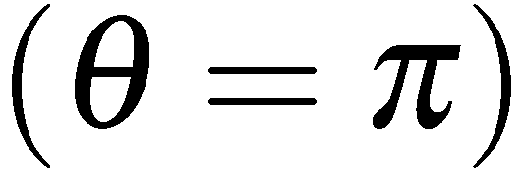
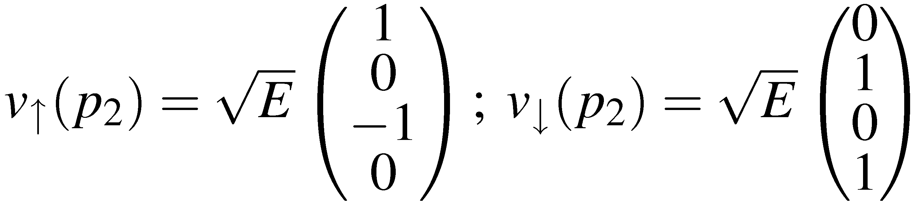
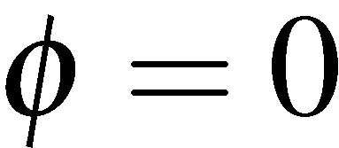
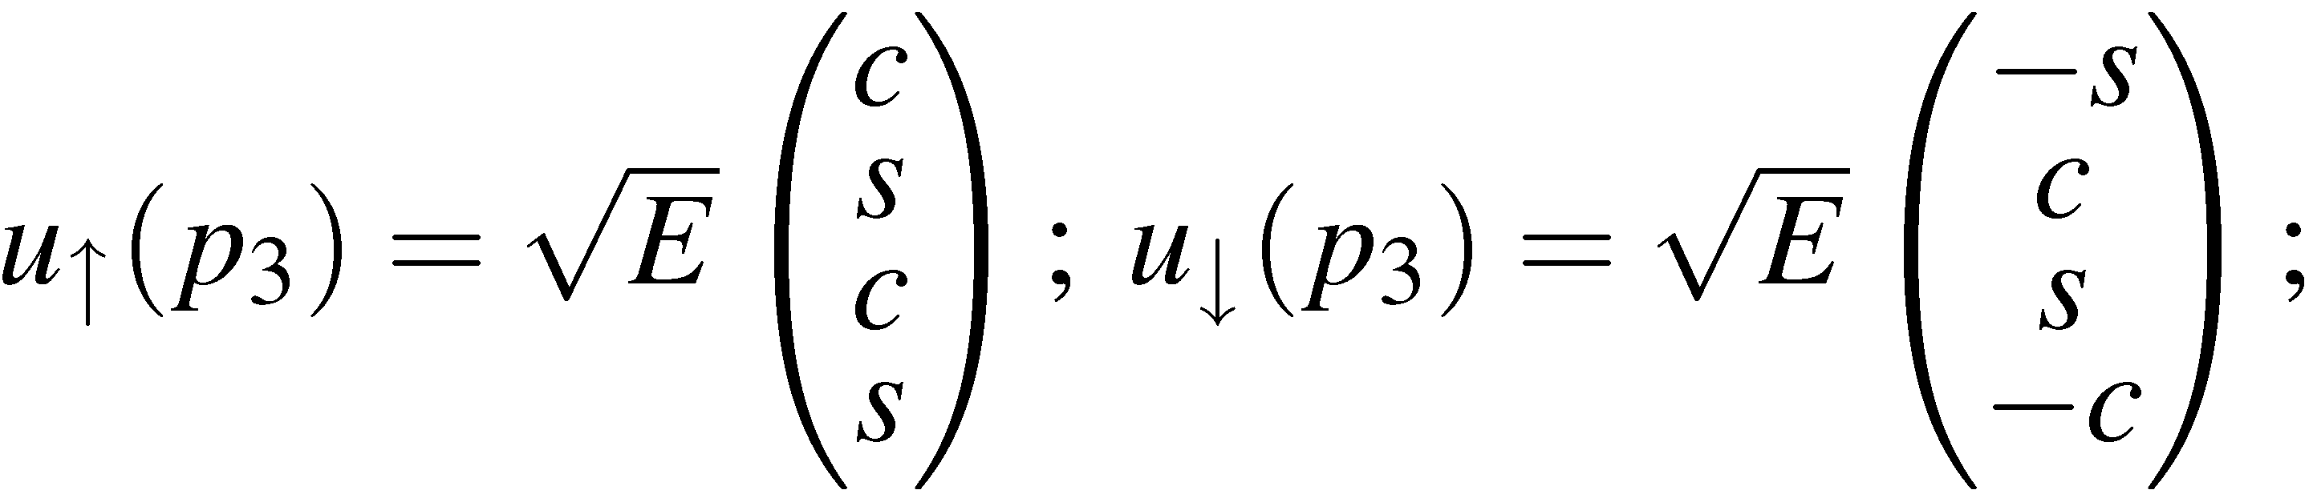
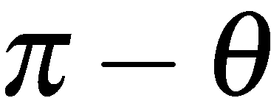
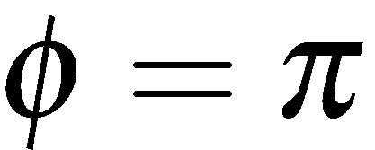
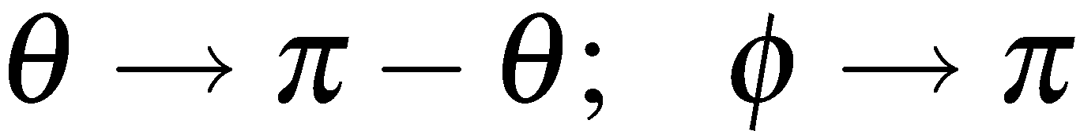
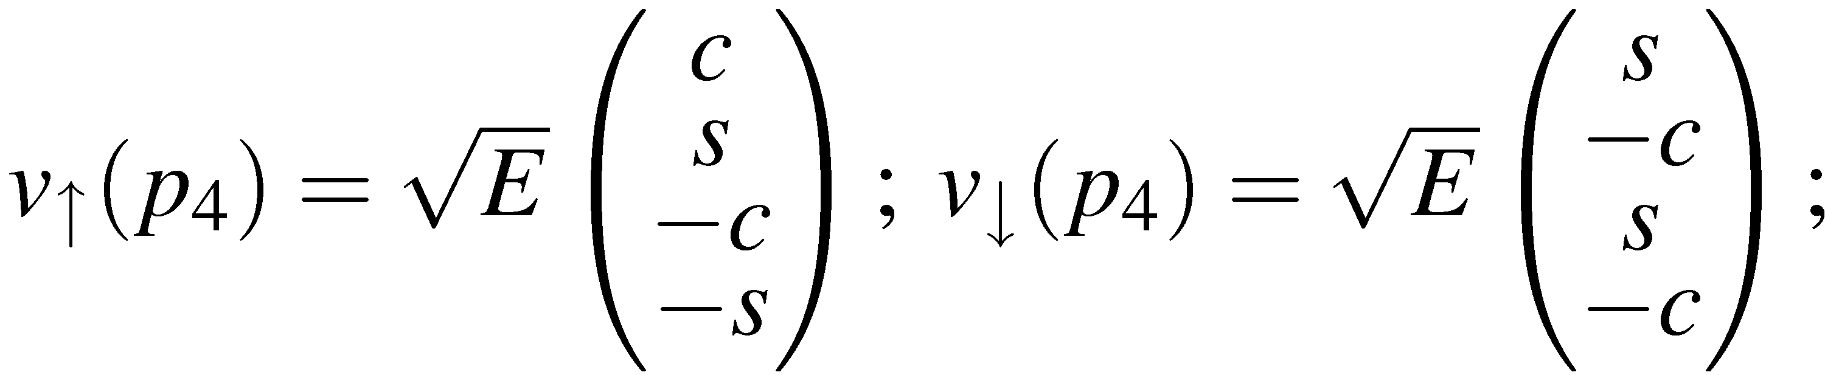
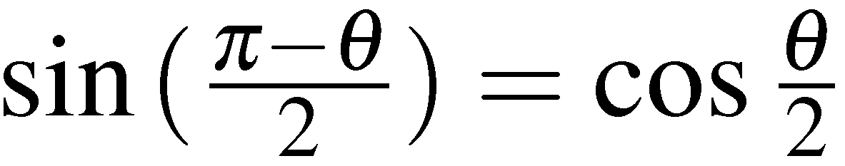
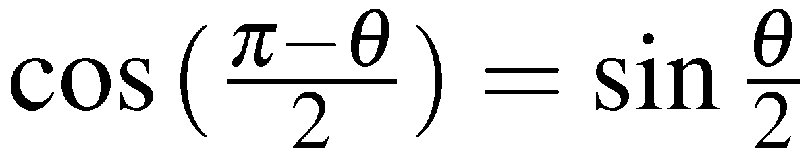


For the initial state positron can have either:
Similarly for the final state μ– which has polar angle and choosing
μ–
μ⁺
And for the final state μ⁺ replacing
obtain
using
Wish to calculate the matrix element
first consider the muon current for 4 possible helicity combinations
μ–
μ–
μ–
μ–
RR
RL
LR
LL
μ⁺
μ⁺
μ⁺
μ⁺
<número>

Slide 9







The Muon Current
Want to evaluate
for all four helicity combinations
For arbitrary spinors with it is straightforward to show that the
components of are
(3)
(4)
(5)
(6)
Consider the combination using
with
<número>

Slide 10

Hence the four-vector muon current for the RL combination is
The results for the 4 helicity combinations (obtained in the same manner) are:
μ–
RL
μ⁺
μ–
RR
μ⁺
μ–
LL
μ⁺
μ–
LR
μ⁺
IN THE LIMIT only two helicity combinations are non-zero !
This is an important feature of QED. It applies equally to QCD.
In the Weak interaction only one helicity combination contributes.
The origin of this will be discussed in the last part of this lecture
But as a consequence of the 16 possible helicity combinations only
four given non-zero matrix elements
<número>

Slide 11

Electron Positron Annihilation cont.
Previously we derived the muon currents for the allowed helicities:
μ–
μ⁺
μ–
μ⁺
Now need to consider the electron current
<número>

Slide 12








The Electron Current
The incoming electron and positron spinors (L and R helicities) are:
The electron current can either be obtained from equations (3)-(6) as before or
it can be obtained directly from the expressions for the muon current.
Taking the Hermitian conjugate of the muon current gives
<número>

Slide 13



Taking the complex conjugate of the muon currents for the two non-zero
helicity configurations:
To obtain the electron currents we simply need to set
e–
e⁺
e–
e⁺
<número>

Slide 14
Electron Positron Annihilation cont.
e⁺e–  μ⁺μ–
For now only have to consider the 4 matrix elements:
μ–
μ–
M_{RR}
e–
e⁺
e–
e⁺
M_{RL}
μ⁺
μ⁺
μ–
μ–
M_{LR}
M_{LL}
e–
e⁺
e–
e⁺
μ⁺
μ⁺
RR = RL→RL
RL = RL→LR
LL = LR→RL
RR = LR→LR
Here the first subscript refers to the helicity
of the e⁻ and the second to the helicity of the μ⁻.
Don’t need to specify other helicities due to
“helicity conservation”, only certain chiral
combinations are non-zero.
<número>

Slide 15




Matrix Element Calculation
We can now calculate for the four possible helicity combinations.
e.g.
the matrix element for which will denote
μ–
e–
e⁺
μ⁺
Using:
gives
where
<número>

Slide 16



Similarly
M_{RR}
μ–
M_{RL}
μ–
M_{LR}
μ–
M_{LL}
μ–
e–
e–
e–
e–
e⁺
e⁺
e⁺
e⁺
μ⁺
μ⁺
μ⁺
μ⁺
-1
cosθ
+1
-1
cosθ
+1
-1
cosθ
+1
-1
cosθ
+1
Assuming that the incoming electrons and positrons are unpolarized, all 4
possible initial helicity states are equally likely.
<número>

Slide 17








Differential Cross Section
The cross section is obtained by averaging over the initial spin states
and summing over the final spin states:
Example:
-1
cosθ
+1
Mark II Expt., M.E.Levi et al.,
Phys Rev Lett 51 (1983) 1941
e⁺e–  μ⁺μ–
pure QED, O(α³)
QED plus Z
contribution
Angular distribution becomes slightly asymmetric in higher
order QED or when Z
contribution is included
<número>

Slide 18





The total cross section is obtained by integrating over using
giving the QED total cross-section for the process e⁺e–  μ⁺μ–
Lowest order cross section
calculation provides a good
description of the data !
This is an impressive result. From
first principles we have arrived at an
expression for the electron-positron
annihilation cross section which is
good to 1%
<número>

Slide 19









Spin Considerations
The angular dependence of the QED electron-positron matrix elements can
be understood in terms of angular momentum
Because of the allowed helicity states, the electron and positron interact
in a spin state with , i.e. in a total spin 1 state aligned along the
z axis: or
Similarly the muon and anti-muon are produced in a total spin 1 state aligned
along an axis with polar angle
μ–
e.g.
M_{RR}
e–
e⁺
μ⁺
Hence where corresponds to the spin state, , of
the muon pair.
<número>

Slide 20






Lorentz Invariant form of Matrix Element
Before concluding this discussion, note that the spin-averaged Matrix Element
derived above is written in terms of the muon angle in the C.o.M. frame.
μ–
e–
e⁺
μ⁺
The matrix element is Lorentz Invariant (scalar product of 4-vector currents)
and it is desirable to write it in a frame-independent form, i.e. express in terms
of Lorentz Invariant 4-vector scalar products
In the C.o.M.
giving:
Hence we can write
Valid in any frame !
<número>

Slide 21


CHIRALITY
The helicity eigenstates for a particle/anti-particle for are:
where
Define the matrix
In the limit the helicity states are also eigenstates of
In general, define the eigenstates of as LEFT and RIGHT HANDED CHIRAL
states
i.e.
In the LIMIT (and ONLY IN THIS LIMIT):
<número>

Slide 22



This is a subtle but important point: in general the HELICITY and CHIRAL
eigenstates are not the same. It is only in the ultra-relativistic limit that the
chiral eigenstates correspond to the helicity eigenstates.
Chirality is an import concept in the structure of QED, and any interaction of the
form
In general, the eigenstates of the chirality operator are:
Define the projection operators:
The projection operators, project out the chiral eigenstates
Note projects out right-handed particle states and left-handed anti-particle states
We can then write any spinor in terms of it left and right-handed
chiral components:
<número>

Slide 23


Chirality in QED
In QED the basic interaction between a fermion and photon is:
Can decompose the spinors in terms of Left and Right-handed chiral components:
Using the properties of
(Q8 on examples sheet)
it is straightforward to show
(Q9 on examples sheet)
Hence only certain combinations of chiral eigenstates contribute to the
interaction. This statement is ALWAYS true.
For , the chiral and helicity eigenstates are equivalent. This implies that
for only certain helicity combinations contribute to the QED vertex !
This is why previously we found that for two of the four helicity combinations
for the muon current were zero
<número>

Slide 24
Allowed QED Helicity Combinations
In the ultra-relativistic limit the helicity eigenstates ≡ chiral eigenstates
In this limit, the only non-zero helicity combinations in QED are:
Scattering:
“Helicity conservation”
R
R
L
L
Annihilation:
L
R
R
L
<número>

Slide 25




Crossing Symmetry
In the ultra-relativistic limit the helicity eigenstates ≡ chiral eigenstates
In this limit, the only non-zero helicity combinations in QED are:
Annihilation:
Scattering:
<número>

Slide 26
Summary
In the centre-of-mass frame the e⁺e–  μ⁺μ– differential cross-section is
NOTE: neglected masses of the muons, i.e. assumed
In QED only certain combinations of LEFT- and RIGHT-HANDED CHIRAL
states give non-zero matrix elements
CHIRAL states defined by chiral projection operators
In limit the chiral eigenstates correspond to the HELICITY eigenstates
and only certain HELICITY combinations give non-zero matrix elements
RR
μ–
RL
μ–
LR
μ–
LL
μ–
e–
e–
e–
e–
e⁺
e⁺
e⁺
e⁺
μ⁺
μ⁺
μ⁺
μ⁺
<número>

