Slide 1
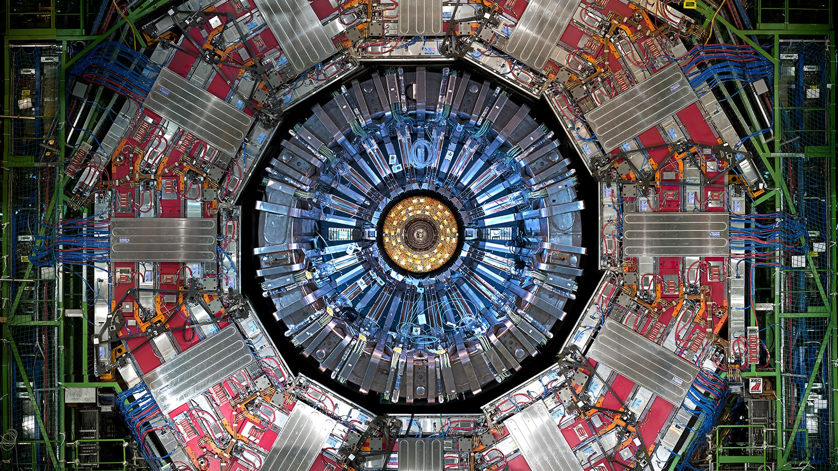
Chapter 7. The strong interaction

Slide 2
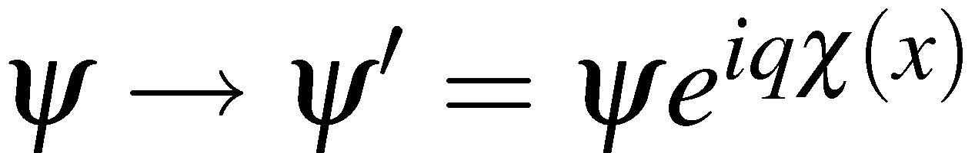
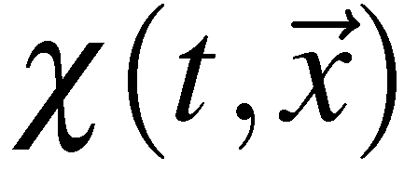
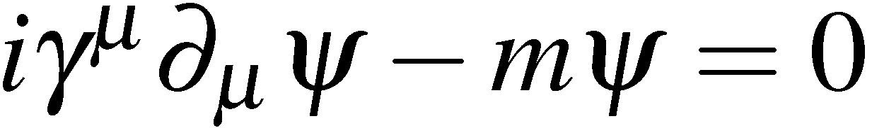
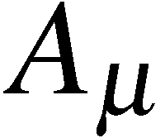
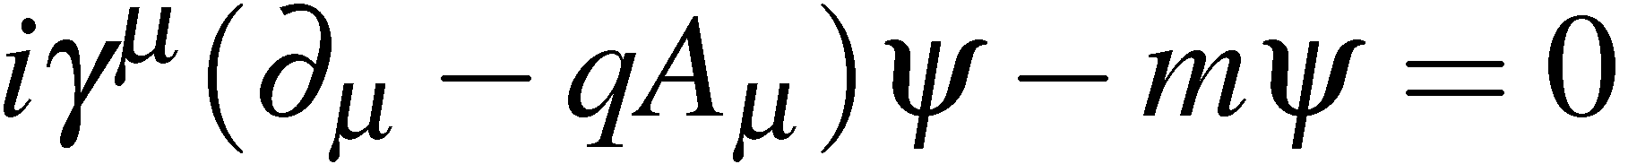
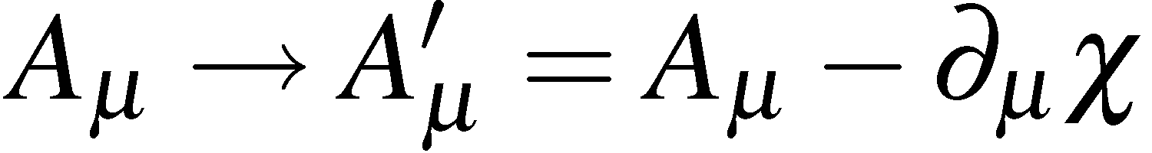
The Local Gauge Principle
(see the Appendices A, B and C for more details)
All the interactions between fermions and spin-1 bosons in the SM are specified
by the principle of LOCAL GAUGE INVARIANCE
To arrive at QED, require physics to be invariant under the local phase
transformation of particle wave-functions
Note that the change of phase depends on the space-time coordinate:
Under this transformation the Dirac Equation transforms as
To make “physics”, i.e. the Dirac equation, invariant under this local
phase transformation FORCED to introduce a massless gauge boson, .
+ The Dirac equation has to be modified to include this new field:
The modified Dirac equation is invariant under local phase transformations if:
Gauge Invariance
<número>

Slide 3
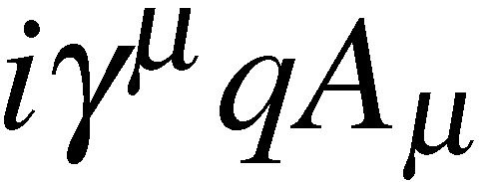
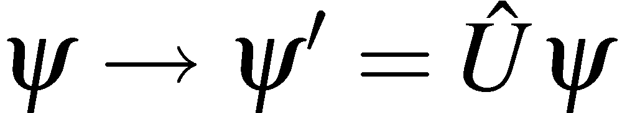
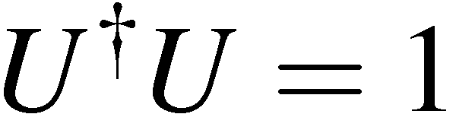
For physics to remain unchanged – must have GAUGE INVARIANCE of the new
field, i.e. physical predictions unchanged for
Hence the principle of invariance under local phase transformations completely
specifies the interaction between a fermion and the gauge boson (i.e. photon):
interaction vertex:
(see p.111)
QED !
The local phase transformation of QED is a unitary U(1) transformation
i.e.
with
Now extend this idea…
<número>

Slide 4
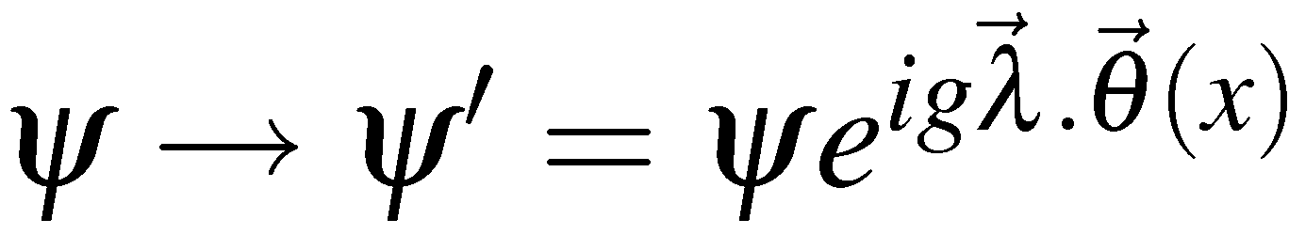
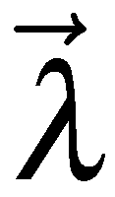
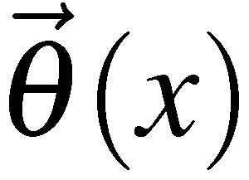
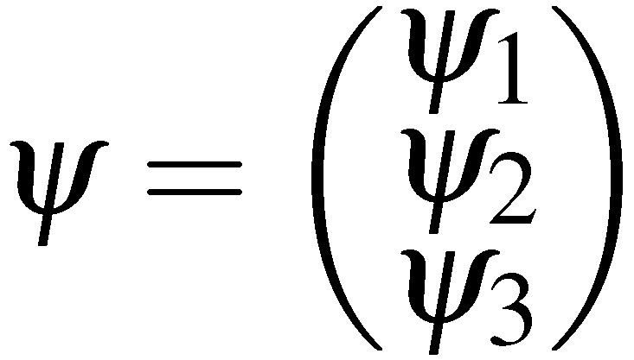
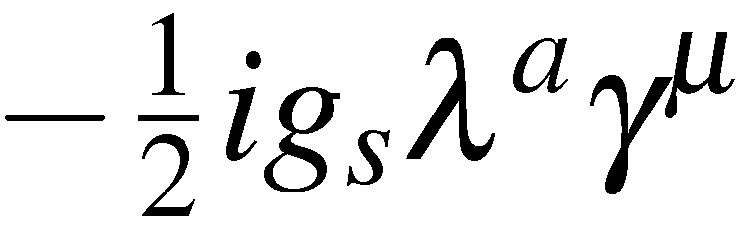
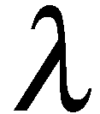
From QED to QCD
Suppose there is another fundamental symmetry of the universe, say
“invariance under SU(3) local phase transformations”
i.e. require invariance under
where
are the eight 3x3 Gell-Mann matrices introduced in handout 7
are 8 functions taking different values at each point in space-time
8 spin-1 gauge bosons
wave function is now a vector in COLOUR SPACE
QCD !
QCD is fully specified by require invariance under SU(3) local phase
transformations
Corresponds to rotating states in colour space about an axis whose direction is different at every space-time point
interaction vertex:
Predicts 8 massless gauge bosons – the gluons (one for each )
Also predicts exact form for interactions between gluons, i.e. the 3 and 4 gluon
vertices – the details are beyond the level of this course
<número>

Slide 5


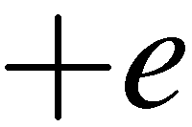
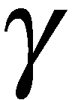
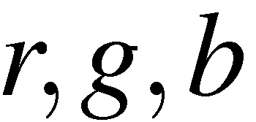

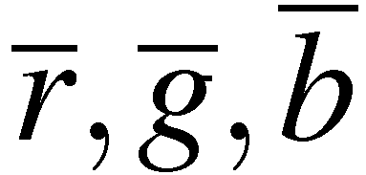

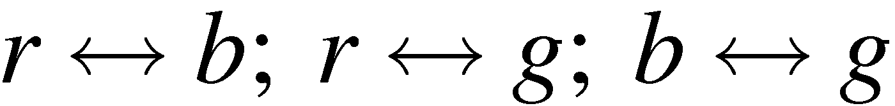
Colour in QCD
The theory of the strong interaction, Quantum Chromodynamics (QCD),
is very similar to QED but with 3 conserved “colour” charges
In QED:
the electron carries one unit of charge
the anti-electron carries one unit of anti-charge
the force is mediated by a massless “gauge
boson” – the photon
In QCD:
quarks carry colour charge:
anti-quarks carry anti-charge:
The force is mediated by massless gluons
In QCD, the strong interaction is invariant under rotations in colour space
i.e. the same for all three colours
SU(3) colour symmetry
This is an exact symmetry, unlike the approximate uds flavour symmetry
discussed previously.
<número>

Slide 6
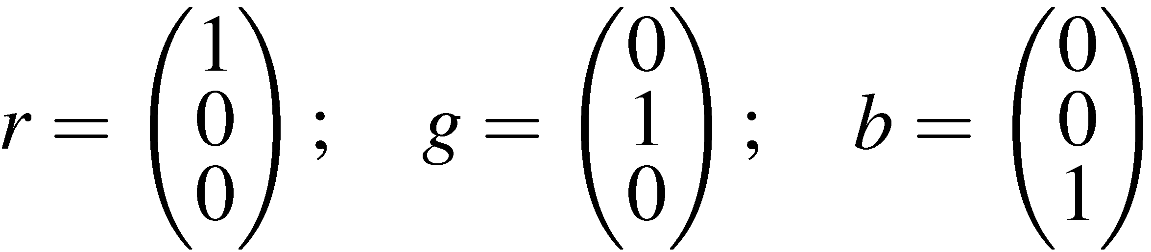
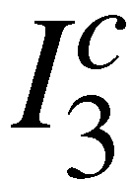
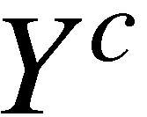
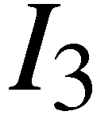

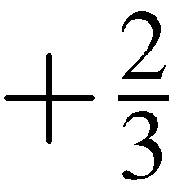
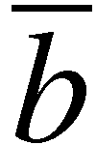
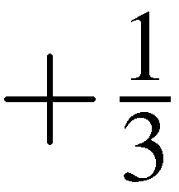

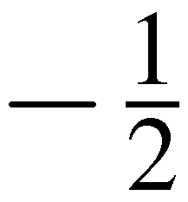
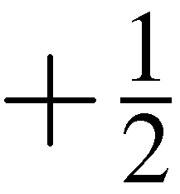

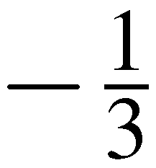
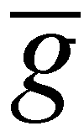
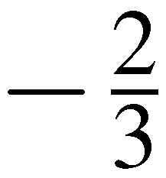
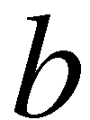
Represent SU(3) colour states by:
Colour states can be labelled by two quantum numbers:
colour isospin
colour hypercharge
Exactly analogous to labelling u,d,s flavour states by and
Each quark (anti-quark) can have the following colour quantum numbers:
quarks
anti-quarks
<número>

Slide 7
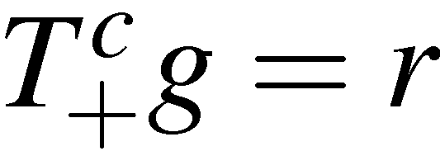
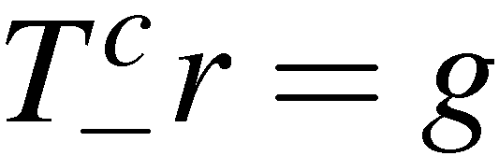

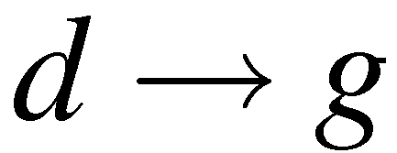
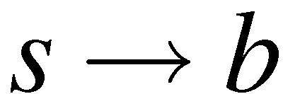
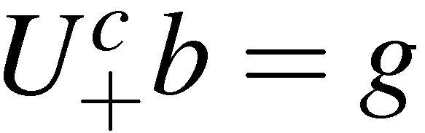
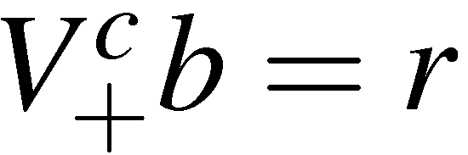
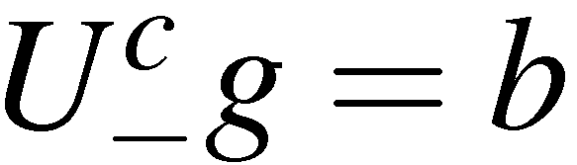
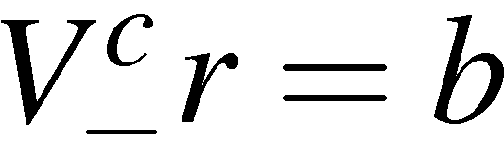
Colour Confinement
It is believed (although not yet proven) that all observed free particles are
“colourless”
i.e. never observe a free quark (which would carry colour charge)
consequently quarks are always found in bound states colourless hadrons
Colour Confinement Hypothesis:
only colour singlet states can exist as free particles
All hadrons must be “colourless” i.e. colour singlets
To construct colour wave-functions for
hadrons can apply results for SU(3) flavour
symmetry to SU(3) colour with replacement
g
r
just as for uds flavour symmetry can
define colour ladder operators
b
<número>

Slide 8
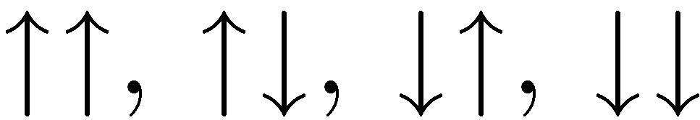
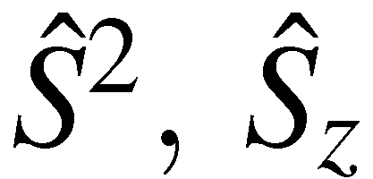
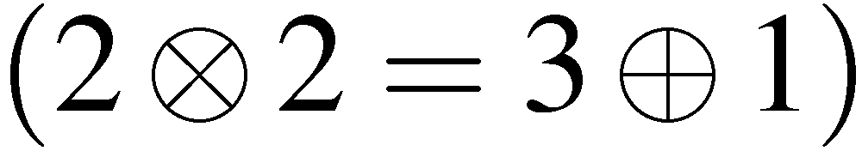
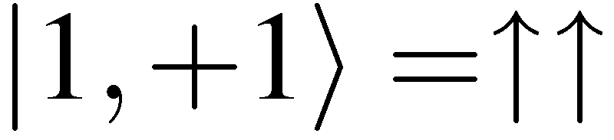
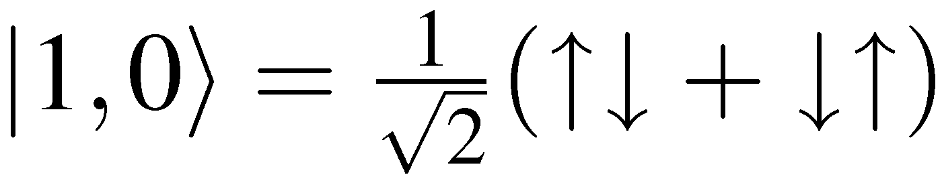
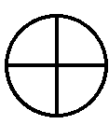
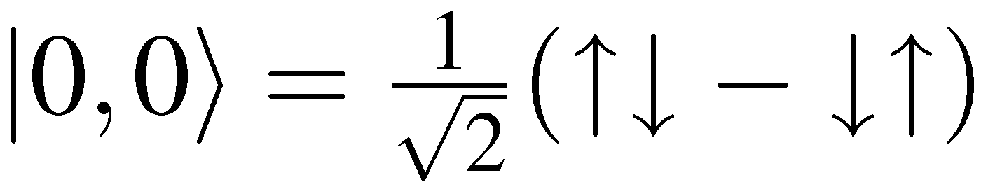
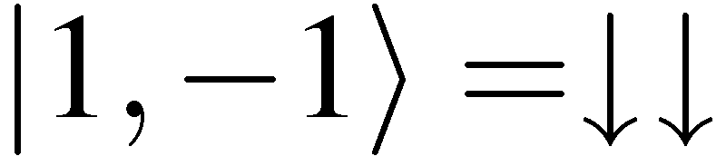



Colour Singlets
It is important to understand what is meant by a singlet state
Consider spin states obtained from two spin 1/2 particles.
Four spin combinations:
Gives four eigenstates of
spin-1
triplet
spin-0
singlet
The singlet state is “spinless”: it has zero angular momentum, is invariant
under SU(2) spin transformations and spin ladder operators yield zero
In the same way COLOUR SINGLETS are “colourless”
combinations:
they have zero colour quantum numbers
invariant under SU(3) colour transformations
ladder operators all yield zero
NOT sufficient to have : does not mean that state is a singlet
<número>

Slide 9















Meson Colour Wave-function
Consider colour wave-functions for
The combination of colour with anti-colour is mathematically identical
to construction of meson wave-functions with uds flavour symmetry
Coloured octet and a colourless singlet
Colour confinement implies that hadrons only exist in colour singlet
states so the colour wave-function for mesons is:
Can we have a state ? i.e. by adding a quark to the above octet can we form
a state with . The answer is clear no.
bound states do not exist in nature.
<número>

Slide 10








Baryon Colour Wave-function
Do qq bound states exist ? This is equivalent to asking whether it possible to
form a colour singlet from two colour triplets ?
Following the discussion of construction of baryon wave-functions in
SU(3) flavour symmetry obtain
No qq colour singlet state
Colour confinement bound states of qq do not exist
BUT combination of three quarks (three colour triplets) gives a colour
singlet state (pages 235-237)
<número>

Slide 11




The singlet colour wave-function is:
Check this is a colour singlet…
It has : a necessary but not sufficient condition
Apply ladder operators, e.g.
(recall )
Similarly
Colourless singlet - therefore qqq bound states exist !
Anti-symmetric colour wave-function
Allowed Hadrons i.e. the possible colour singlet states
Mesons and Baryons
Exotic states, e.g. pentaquarks
To date all confirmed hadrons are either mesons or baryons. However, some
recent (but not entirely convincing) “evidence” for pentaquark states
<número>

Slide 12


Gluons
In QCD quarks interact by exchanging virtual massless gluons, e.g.
q_{b}
q_{r}
q_{b}
q_{r}
q_{b}
q_{r}
rb
br
q_{r}
q_{b}
q_{r}
q_{b}
q_{r}
q_{b}
Gluons carry colour and anti-colour, e.g.
q_{b}
q_{r}
q_{r}
q_{r}
br
rb
rr
Gluon colour wave-functions
(colour + anti-colour) are the same
as those obtained for mesons
(also colour + anti-colour)
OCTET +
“COLOURLESS” SINGLET
<número>

Slide 13
So we might expect 9 physical gluons:
OCTET:
SINGLET:
BUT, colour confinement hypothesis:
only colour singlet states
can exist as free particles
Colour singlet gluon would be unconfined.
It would behave like a strongly interacting
photon infinite range Strong force.
Empirically, the strong force is short range and therefore know that the physical
gluons are confined. The colour singlet state does not exist in nature !
NOTE: this is not entirely ad hoc. In the context of gauge field theory (see minor
option) the strong interaction arises from a fundamental SU(3) symmetry.
The gluons arise from the generators of the symmetry group (the
Gell-Mann matrices). There are 8 such matrices 8 gluons.
Had nature “chosen” a U(3) symmetry, would have 9 gluons, the additional
gluon would be the colour singlet state and QCD would be an unconfined
long-range force.
NOTE: the “gauge symmetry” determines the exact nature of the interaction
FEYNMAN RULES
<número>

Slide 14
Gluon-Gluon Interactions
In QED the photon does not carry the charge of the EM interaction (photons are
electrically neutral)
In contrast, in QCD the gluons do carry colour charge
Gluon Self-Interactions
Two new vertices (no QED analogues)
triple-gluon vertex
quartic-gluon vertex
In addition to quark-quark scattering, therefore can have gluon-gluon scattering
e.g. possible
way of arranging
the colour flow
<número>

Slide 15


Gluon self-Interactions and Confinement
Gluon self-interactions are believed to give
rise to colour confinement
e⁺
q
Qualitative picture:
Compare QED with QCD
In QCD “gluon self-interactions squeeze
lines of force into a flux tube”
e⁻
q
What happens when try to separate two coloured objects e.g.
qq
q
q
Form a flux tube of interacting gluons of approximately constant
energy density
Require infinite energy to separate coloured objects to infinity
Coloured quarks and gluons are always confined within colourless states
In this way QCD provides a plausible explanation of confinement – but
not yet proven (although there has been recent progress with Lattice QCD)
<número>

Slide 16
Hadronisation and Jets
Consider a quark and anti-quark produced in electron positron annihilation
i) Initially Quarks separate at
high velocity
q
q
q
q
ii) Colour flux tube forms
between quarks
iii) Energy stored in the
flux tube sufficient to
produce qq pairs
q
q
q
q
iv) Process continues
until quarks pair
up into jets of
colourless hadrons
This process is called hadronisation. It is not (yet) calculable.
The main consequence is that at collider experiments quarks and gluons
observed as jets of particles
e⁺
q
γ
e–
q
<número>

Slide 17






QCD and Colour in e⁺e⁻ Collisions
e⁺e– colliders are an excellent place to study QCD
e⁺
q
Well defined production of quarks
QED process well-understood
no need to know parton structure functions
+ experimentally very clean – no proton remnants
γ
e–
q
In handout 5 obtained expressions for the cross-section
In e⁺e– collisions produce all quark flavours
for which
In general, i.e. unless producing a bound state,
produce jets of hadrons
H.J.Behrend et al., Phys Lett 183B (1987) 400
Usually can’t tell which jet
came from the quark and
came from anti-quark
Angular distribution of jets
Quarks are spin ½
<número>

Slide 18










Colour is conserved and quarks are produced as
For a single quark flavour and single colour
Experimentally observe jets of hadrons:
Factor 3 comes from colours
Usual to express as ratio compared to
u,d,s:
u,d,s,c:
u,d,s,c,b:
Data consistent with expectation
with factor 3 from colour
<número>

Slide 19







Jet production in e+e- Collisions
e⁺e– colliders are also a good place to study gluons
OPAL at LEP (1989-2000)
e⁺
q
e⁺
q
q
γ/Z
γ/Ζ
e⁺
γ/Ζ
e–
q
e–
q
e–
q
Experimentally:
Three jet rate measurement of
Angular distributions gluons are spin-1
Four-jet rate and distributions QCD has an underlying SU(3) symmetry
<número>

Slide 20












The Quark – Gluon Interaction
Representing the colour part of the fermion wave-functions by:
Particle wave-functions
The QCD qqg vertex is written:
q
q
Only difference w.r.t. QED is the insertion of the 3x3
SU(3) Gell-Mann matrices
Gluon a
colour i  j
Isolating the colour part:
Hence the fundamental quark - gluon QCD interaction can be written
<número>

Slide 21












Feynman Rules for QCD
External Lines
incoming quark
outgoing quark
spin 1/2
incoming anti-quark
outgoing anti-quark
incoming gluon
spin 1
outgoing gluon
Internal Lines (propagators)
spin 1 gluon
a, b = 1,2,…,8 are gluon colour indices
Vertex Factors
spin 1/2 quark
i, j = 1,2,3 are quark colours,
a = 1,2,..8 are the Gell-Mann SU(3) matrices
+ 3 gluon and 4 gluon interaction vertices
Matrix Element -iM = product of all factors
<número>

Slide 22









Matrix Element for quark-quark scattering
Consider QCD scattering of an up and a down quark
u
u
The incoming and out-going quark colours are
labelled by
In terms of colour this scattering is
The 8 different gluons are accounted for by
the colour indices
d
d
NOTE: the δ-function in the propagator ensures
a = b, i.e. the gluon “emitted” at a is the
same as that “absorbed” at b
Applying the Feynman rules:
where summation over a and b (and μ and ν) is implied.
Summing over a and b using the δ-function gives:
Sum over all 8 gluons (repeated indices)
<número>

Slide 23







QCD vs QED
QED
e–
e–
μ–
μ–
QCD
u
u
QCD Matrix Element = QED Matrix Element with:
or equivalently
d
d
+
QCD Matrix Element includes an additional “colour factor”
<número>

Slide 24


















Evaluation of QCD Colour Factors
QCD colour factors reflect the gluon states that are involved
Gluons:
❶ Configurations involving a single colour
r
r
Only matrices with non-zero entries in 11 position are involved
r
r
Similarly find
<número>

Slide 25












❷ Other configurations where quarks don’t change colour
e.g.
r
r
Only matrices with non-zero entries in 11 and 33 position
are involved
b
b
Similarly
❸ Configurations where quarks swap colours
e.g.
r
g
Only matrices with non-zero entries in 12 and 21 position
are involved
Gluons
g
r
❹ Configurations involving 3 colours
e.g.
r
b
Only matrices with non-zero entries in the 13 and 32 position
But none of the λ matrices have non-zero entries in the
13 and 32 positions. Hence the colour factor is zero
b
g
colour is conserved
<número>

Slide 26





Colour Factors : Quarks vs Anti-Quarks
Recall the colour part of wave-function:
The QCD qqg vertex was written:
q
q
Now consider the anti-quark vertex
The QCD qqg vertex is:
Note that the incoming anti-particle now enters on the LHS of the expression
For which the colour part is
i.e indices ij are
swapped with respect
to the quark case
Hence
c.f. the quark - gluon QCD interaction
<número>

Slide 27




Finally we can consider the quark – anti-quark annihilation
q
QCD vertex:
with
q
<número>

Slide 28











Consequently the colour factors for the different diagrams are:
e.g.
q
q
q
q
q
q
q
q
q
q
q
q
Colour index of adjoint spinor comes first
<número>

Slide 29

Summary
Superficially QCD very similar to QED
But gluon self-interactions are believed to result in colour confinement
All hadrons are colour singlets which explains why only observe
Mesons
Baryons
A low energies
Can’t use perturbation theory !
Non-Perturbative regime
Where calculations can be performed, QCD provides a good description
of relevant experimental data
<número>

