Slide 1
SCANPI
(Shellplayer, SCANPI and SCANPIMOB)
PETER ARBUTHNOTT
13th March 2013
Notes:
Share info to them about github / setup details
Get suggestions for ‘vinyl’ & ‘tapes’ to digital?
Story – my wife says we’ve got too much stuff taking up too much space etc (but not that yeah?)
Shitted baron of a friend broke stereo… It was time to digitise things…
You can do it too?
Drop all shellplayer, put in link to github etc
Push PHP to github etc
If not for them or for me then remove? - Only say ‘interesting’ things
First came the PI and shellplayer (quickly became mobile use case)
Second came website cause shelling is so 2012 (and too awkward in an SSH window on a mobile)
Third came ‘scan’ as functional selection process instead of browse
Finally scanpimob makes your mobile / tablet the controller or all things!
The xth thing ‘you’ are going to want to do is…

Slide 2
SCANPI – The Basics
The net
Router + Modem
Big Disc
PI
Beocenter
4600

Slide 3
SCANPI – Router + Modem Stuff
The net
Router + Modem
Big Disc
Virgin Broadband [other providers exist]
192.168.0.X, 227 chosen for PI [22/7 obviously]
Might have preferred 192.168.3.14 but…
Port forwarding for HTTP, HTTPS, SSH, FTP
Any connected WIFI device can SSH and HTTP through.
EXTERNALLY 82.24.252.201 [that too will change]
PI
Beocenter
4600

Slide 4
SCANPI – Big Disc Stuff
The net
Router + Modem
Big Disc
Format = FAT32 [full compatibility with Win + Mac]
2TB = £50 [ish, and it’ll only get cheaper]
USB [2 for speed]
Separate power supply
Mounted twice – once as main disc, once as NTFS in a loopback file/disc thing [full Linux file control etc]
All Music ‘standardised’ into …
/musicdir/[BAND]/[ALBUM]/[TRACK].mp3
PI
Beocenter
4600

Slide 5
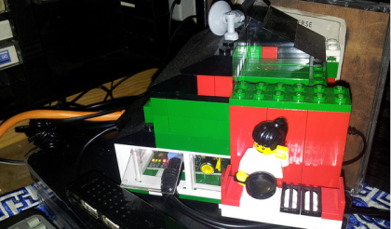
SCANPI – PI Pic
The net
Router + Modem
Big Disc
PI
Beocenter
4600

Slide 6
SCANPI – PI Text
The net
Router + Modem
Big Disc
8GB SD-Card Linux £10 [ish, and it’ll only get cheaper]
Static IP = 192.168.0.227 [file /etc/network/interfaces]
Mounted = /mnt/2tb_USB_hard_disc/
Loopback Mounted = /mnt/scanpi/ [file /etc/fstab]
Apt-got = Apache2, php5, mpg123
Headless [no screen after setup, but see later…]
PI
Beocenter
4600

Slide 7
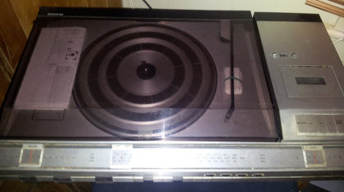
SCANPI – Beocenter 4600 Pic
The net
Router + Modem
Big Disc
PI
Beocenter
4600

Slide 8
SCANPI – Beocenter 4600 Text
The net
Router + Modem
Big Disc
Free from Sister-in-law’s Loft [previous house owner left it]
Manufactured: 1977 - 1980
Designer: Jacob Jensen
Weight: 1 tonne [metric]
[ sudo amixer cset numid=3 1 ]
Audio out from PI to 5 pin din INPUT
Speakers = 2 [*interesting* 2 pin din connectors]
PI
Beocenter
4600

Slide 9
SCANPI – Shellplayer play
The net
Router + Modem
Big Disc
9 Shell scripts to make music from the Big Disc squee out through the PI to the Beocenter.
play.sh the key function - play items from the queue.
[Find and read next file in queue...]
nextinqueue=`find "$queuedir" -type f | sort | head -1`
filetoplay=`cat $nextinqueue`
[Move file from queue to played...]
mv "$nextinqueue" "$playeddir"
[Call MPG123 to play file...]
/usr/bin/mpg123 "$filetoplay"
PI
Beocenter
4600

Slide 10
SCANPI – Shellplayer the rest
The net
Router + Modem
Big Disc
9 Shell scripts to make music from the Big Disc squee out through the PI to the Beocenter.
album.sh queue all the tracks from an album.
band.sh queue all the tracks from a band.
exit.sh stop the nohup playback.
go.sh nohup and loop the play function.
queue.sh adds tracks to the queue.
reindex.sh read the big disc into an index.
skip.sh skip the currently playing track.
track.sh queue a single track.
PI
Beocenter
4600

Slide 11
SCANPI – Shellplayer it works
The net
Router + Modem
Big Disc
With some judicious “ln -s /scanpi/shellplayer/go.sh g” [see why all the functions start with different letters]
*ALL* you have to do is …
SSH from device to 192.168.0.227. Type “./g” to go.
Don’t like the track it’s playing? Type ”./s” to skip,
Want to queue up a track? Type “./t” and it’ll guide you through track selection. Want to queue up an album? Type “./a” and it’ll guide you through album selection.
*ALL* …
PI
Beocenter
4600

Slide 12
SCANPI – Birth Text
The net
Router + Modem
Big Disc
SSH? Too complicated. [said the *user group*]
SCANPI = A four page website
Point your browser at http://192.168.0.227/scanpi
BROWSE through bands.
Click ‘queue’ to add track, album or band to the queue.
[But that’s JUST a huge MP3 device isn’t it?]
PI
Beocenter
4600

Slide 13
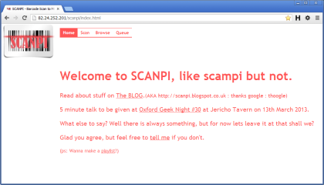
SCANPI – Birth Pic
The net
Router + Modem
Big Disc
PI
Beocenter
4600

Slide 14
SCANPI – Growth
The net
Router + Modem
Big Disc
Interact with your music collection!
SCAN = invoke scanner app on device
Scan barcode from original CD
Talk to the musicbrainz.org
Look up Big Disc and show album details
Pick track [or album or band] to queue
PI
Beocenter
4600

Slide 15
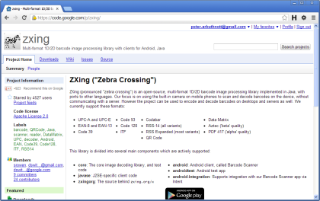
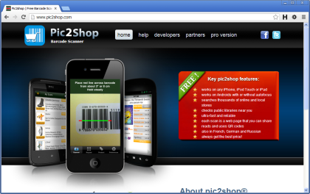
SCANPI – Growth Scanners
The net
Router + Modem
Big Disc
PI
Beocenter
4600

Slide 16
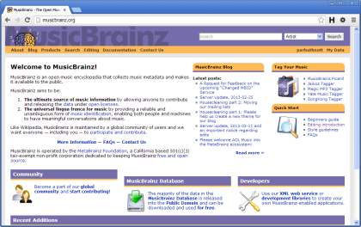
SCANPI – Growth Music Brainz
The net
Router + Modem
Big Disc
PI
Beocenter
4600

Slide 17
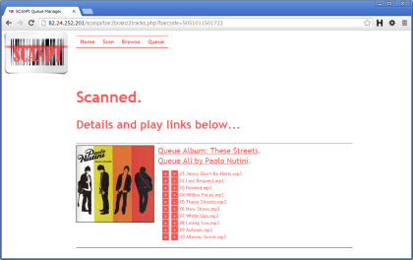
SCANPI – Growth Result
The net
Router + Modem
Big Disc
PI
Beocenter
4600

Slide 18
SCANPI – Worth
The net
Router + Modem
Big Disc
Of external use.
PLAY = added to the queue page, allows transmission of the relevant track to the current device.
Further functionality.
QUEUE = See details and remove items from Queue. Move items from Played to Queue.
PI
Beocenter
4600

Slide 19
SCANPI – SCANPIMOB
The net
Router + Modem
Big Disc
But I’m on a mobile / tablet!
SCANPIMOB = All the functions of SCANPI but delivered with the help of JQuery Mobile
[now it looks sweet on other devices]
http://192.168.0.227/scanpimob
PI
Beocenter
4600

Slide 20
SCANPI – Has Issues
The net
Router + Modem
Big Disc
SCANNING APPS?
Pic2shop VS ZebraCrossing (ZXing) VS …
On which device and how much will it cost me?
WOT NO BARCODE?
Anything older than about 1975
All those mix tapes / CDs
Bjork, Motorhead and Bueno Vista Social Club?
Accented characters won’t play nicely with FAT32.
“&” VS “and” VS “+” can cause mismatches.
PI
Beocenter
4600

Slide 21
SCANPI – Has Some Answers
The net
Router + Modem
Big Disc
2D barcodes – finally a *real world* use?
A sheet with 2D barcodes, each a SCANPI URL
[the pseudo result of a successful scan]
Mix tapes / CDs
Give it a name and put it into the ‘tapes’ directory
Text Munging
Turns the anomalies back to standards
PI
Beocenter
4600

Slide 22
SCANPI – Playlists
The net
Router + Modem
Big Disc
But I can’t be bothered going through the play process for EVERY track – can’t you just create playlists?
Yes. M3U (supported by Win, Mac, iP[*], but requires a free to download app thingy on Android / Blackberry.
PI
Beocenter
4600

Slide 23
SCANPI – Next
The net
Router + Modem
Big Disc
Playlists to Queue and Back
Release all PHP to github or similar
PI app to show album cover when playing item
Static barcode reader
Like / dislike functions?
PI
Beocenter
4600

