Slide 1
Generative Models and Naïve Bayes
Ke Chen
Reading: [14.3, EA], [3.5, KPM], [1.5.4, CMB]

Slide 2
Outline
Background and Probability Basics
Probabilistic Classification Principle
  Probabilistic discriminative models
  Generative models and their application to classification
  MAP and converting generative into discriminative
Naïve Bayes – an generative model
  Principle and Algorithms (discrete vs. continuous)
  Example: Play Tennis
Zero Conditional Probability and Treatment
Summary

Slide 3
Background
There are three methodologies:
a) Model a classification rule directly
  Examples: k-NN, linear classifier, SVM, neural nets, ..
  b) Model the probability of class memberships given input data
  Examples: logistic regression, probabilistic neural nets (softmax),…
c) Make a probabilistic model of data within each class
  Examples: naive Bayes, model-based ….
Important ML taxonomy for learning models
probabilistic models vs non-probabilistic models
discriminative models vs generative models

Slide 4
Background
Based on the taxonomy, we can see different the essence of learning models (classifiers) more clearly.
 | Probabilistic | Non-Probabilistic
Discriminative | Logistic Regression Probabilistic neural nets …….. | K-nn Linear classifier SVM Neural networks ……
Generative | Naïve Bayes Model-based (e.g., GMM) …… | N.A. (?)

Slide 5
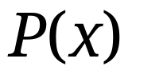


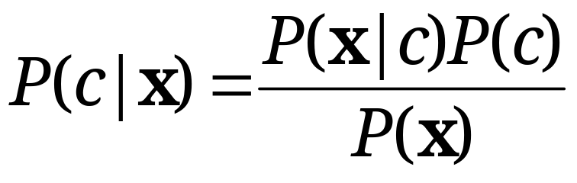
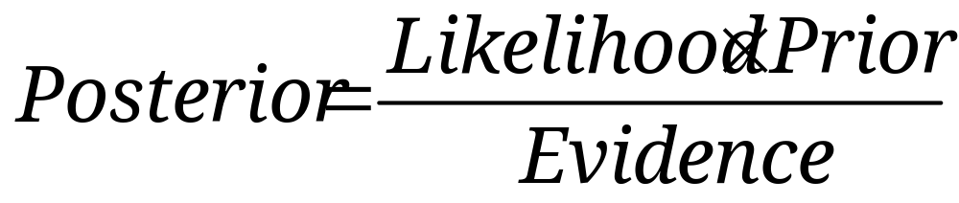
Probability Basics
Prior, conditional and joint probability for random variables
  Prior probability:
  Conditional probability:
  Joint probability:
  Relationship:
  Independence:
Bayesian Rule
Discriminative
Generative

Slide 6
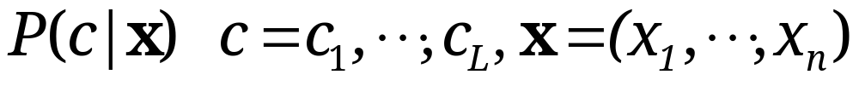







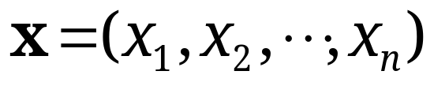
Probabilistic Classification Principle
Establishing a probabilistic model for classification
  Discriminative model
To train a discriminative classifier regardless its probabilistic or non-probabilistic nature, all training examples of different classes must be jointly used to build up a single discriminative classifier.
Output L probabilities for L class labels in a probabilistic classifier while a single label is achieved by a non-probabilistic classifier .
Discriminative
Probabilistic Classifier

Slide 7
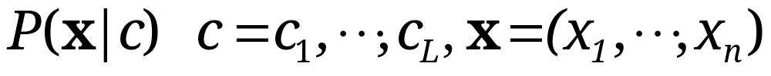



Probabilistic Classification Principle
Establishing a probabilistic model for classification (cont.)
  Generative model (must be probabilistic)
L probabilistic models have to be trained independently
Each is trained on only the examples of the same label
Output L probabilities for a given input with L models
“Generative” means that such a model produces data subject to the distribution via sampling.
Generative
Probabilistic Model
for Class 1
Generative
Probabilistic Model
for Class L

Slide 8


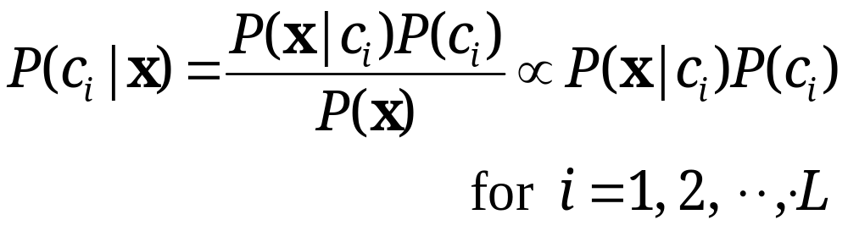
Probabilistic Classification Principle
Maximum A Posterior (MAP) classification rule
  For an input x, find the largest one from L probabilities output by a discriminative probabilistic classifier
  Assign x to label c* if is the largest.
Generative classification with the MAP rule
  Apply Bayesian rule to convert them into posterior probabilities
  Then apply the MAP rule to assign a label
Common factor for all L probabilities

Slide 9
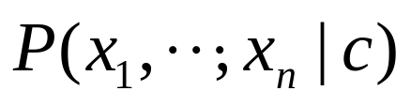
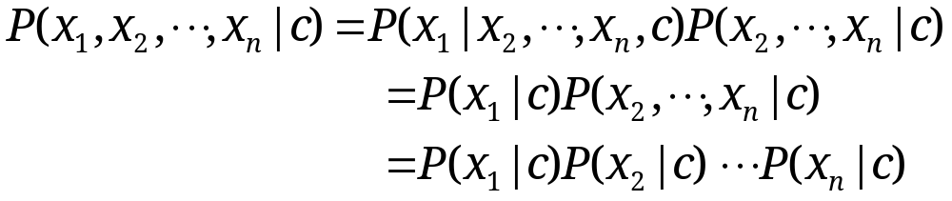
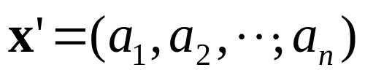


Naïve Bayes
Bayes classification
  Difficulty: learning the joint probability is infeasible!
Naïve Bayes classification
  Assume all input features are class conditionally independent!
  Apply the MAP classification rule: assign to c* if
Applying the independence assumption
Notes:
For a class, the previous generative model can be decomposed by n generative models of a single input.

Slide 10
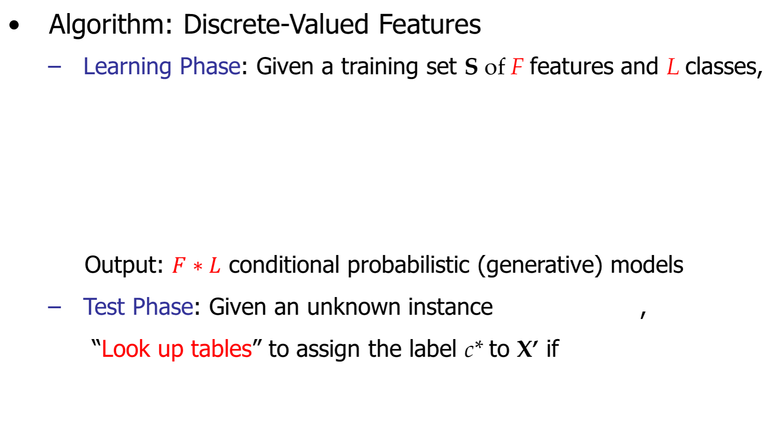
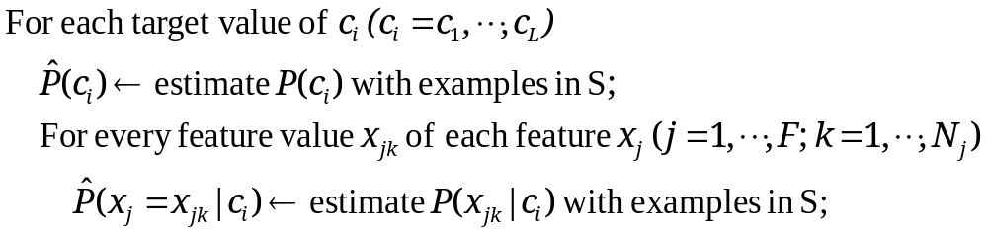
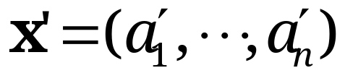
Naïve Bayes

Slide 11

Example
Example: Play Tennis

Slide 12
Example
Learning Phase
Outlook | Play=Yes | Play=No
Sunny | 2/9 | 3/5
Overcast | 4/9 | 0/5
Rain | 3/9 | 2/5
Temperature | Play=Yes | Play=No
Hot | 2/9 | 2/5
Mild | 4/9 | 2/5
Cool | 3/9 | 1/5
Humidity | Play=Yes | Play=No
High | 3/9 | 4/5
Normal | 6/9 | 1/5
Wind | Play=Yes | Play=No
Strong | 3/9 | 3/5
Weak | 6/9 | 2/5
P(Play=Yes) = 9/14
P(Play=No) = 5/14

Slide 13
Example
Test Phase
  Given a new instance, predict its label
  x’=(Outlook=Sunny, Temperature=Cool, Humidity=High, Wind=Strong)
  Look up tables achieved in the learning phrase
  Decision making with the MAP rule
P(Outlook=Sunny|Play=Yes) = 2/9
P(Temperature=Cool|Play=Yes) = 3/9
P(Huminity=High|Play=Yes) = 3/9
P(Wind=Strong|Play=Yes) = 3/9
P(Play=Yes) = 9/14
P(Outlook=Sunny|Play=No) = 3/5
P(Temperature=Cool|Play==No) = 1/5
P(Huminity=High|Play=No) = 4/5
P(Wind=Strong|Play=No) = 3/5
P(Play=No) = 5/14
P(Yes|x’) ≈ [P(Sunny|Yes)P(Cool|Yes)P(High|Yes)P(Strong|Yes)]P(Play=Yes) = 0.0053
P(No|x’) ≈ [P(Sunny|No) P(Cool|No)P(High|No)P(Strong|No)]P(Play=No) = 0.0206
Given the fact P(Yes|x’) < P(No|x’), we label x’ to be “No”.

Slide 14
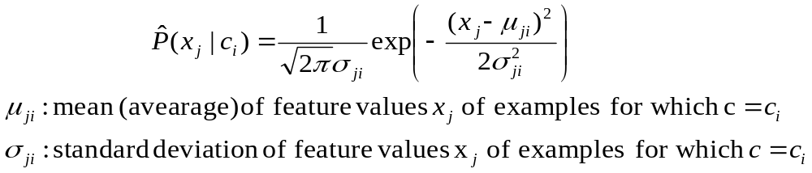
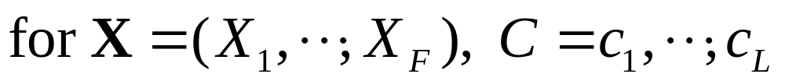



Naïve Bayes
Algorithm: Continuous-valued Features
  Numberless values taken by a continuous-valued feature
  Conditional probability often modeled with the normal distribution
  Learning Phase:
  Output: normal distributions and
  Test Phase: Given an unknown instance
    Instead of looking-up tables, calculate conditional probabilities with all the normal distributions achieved in the learning phrase
    Apply the MAP rule to assign a label (the same as done for the discrete case)

Slide 15
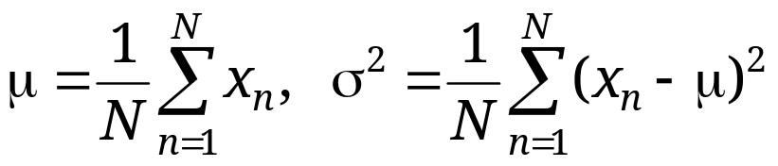
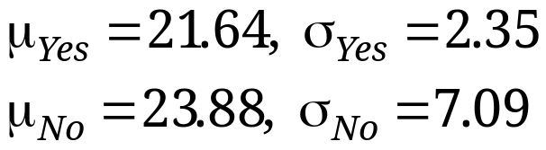
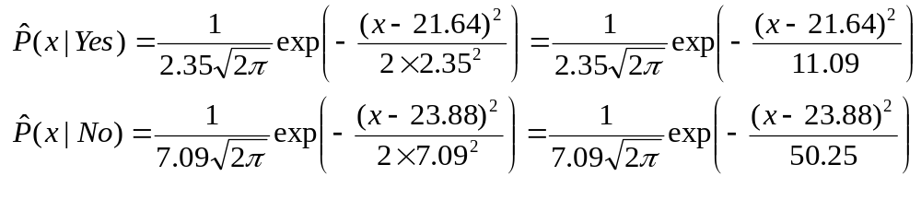
Naïve Bayes
Example: Continuous-valued Features
  Temperature is naturally of continuous value.
  Yes: 25.2, 19.3, 18.5, 21.7, 20.1, 24.3, 22.8, 23.1, 19.8
  No: 27.3, 30.1, 17.4, 29.5, 15.1
  Estimate mean and variance for each class
  Learning Phase: output two Gaussian models for P(temp|C)

Slide 16
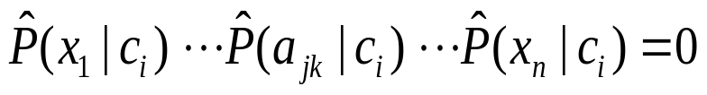
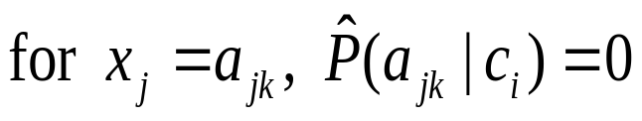
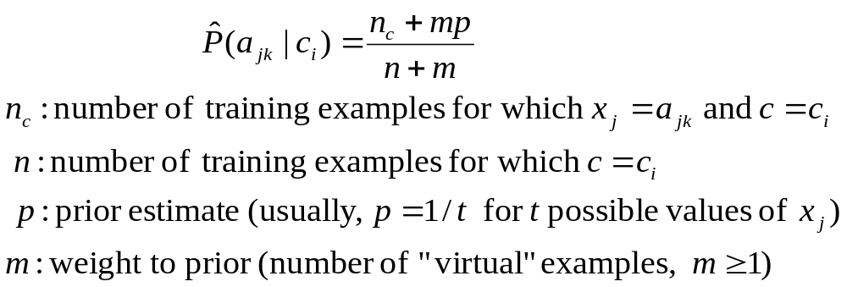
Zero conditional probability
If no example contains the feature value
  In this circumstance, we face a zero conditional probability problem during test
  For a remedy, class conditional probabilities re-estimated with
(m-estimate)

Slide 17
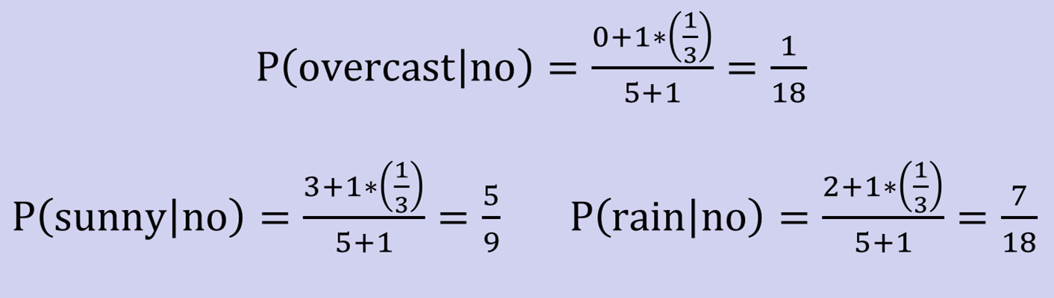
Zero conditional probability
Example: P(outlook=overcast|no)=0 in the play-tennis dataset
  Adding m “virtual” examples (m: up to 1% of #training example)
    In this dataset, # of training examples for the “no” class is 5.
    We can only add m=1 “virtual” example in our m-esitmate remedy.
  The “outlook” feature can takes only 3 values. So p=1/3.
  Re-estimate P(outlook|no) with the m-estimate

Slide 18
Summary
Probabilistic Classification Principle
  Discriminative vs. Generative models: learning P(c|x) vs. P(x|c)
  Generative models for classification: MAP and Bayesian rule
Naïve Bayes: the conditional independence assumption
  Training and test are very efficient.
  Two different data types lead to two different learning algorithms.
  Working well sometimes for data violating the assumption!
Naïve Bayes: a popular generative model for classification
  Performance competitive to most of state-of-the-art classifiers even in presence of violating independence assumption
  Many successful applications, e.g., spam mail filtering
  A good candidate of a base learner in ensemble learning
  Apart from classification, naïve Bayes can do more…

