Slide 1
ParcelMyBox Portal
Empowering Logistics Through Smart Automation
https://parcelmybox.com/
Notes:
https://parcelmybox.com/

Slide 2
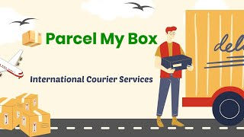
Solutions
Notes:
https://parcelmybox.com/

Slide 3
Locations
India USA
Hyderabad Bay Area
Chennai Raleigh
Ahmedabad Rochester( …)
Notes:
https://parcelmybox.com/

Slide 4
Social Media
Insta : @parcel_mybox
Whatsapp channel:
YouTube : @parcelmybox
Email : parcelmybox3@gmail.com
Notes:
https://parcelmybox.com/

Slide 5
Internship
Web Portal for Operational Automation
Scope : Selected Modules (TBD)
Commitment : 12 weeks( 20 hours per week)
Meeting: daily 30 minutes ( M-F)
Code: Github
Certificate: based on Completion
Monetary Reward : TBD

Slide 6
Portal Overview
Leads Manager
Quote Manager
Shipment Handling
Invoice and Payments
Tracking Shipments
Support and Grievances
Rate Manager
Partner Rates & Selection

Slide 7
Leads Manager
• Capture and manage customer inquiries
• Automate follow-ups and nurturing
• Track conversion funnel

Slide 8
Quote Manager
• Generate quotes based on shipment parameters
• Apply rate rules and discounts
• Share quotes with customers

Slide 9

Volumetric Weight Calculator
Volumetric Weight calculates weight according to the dimensions of the parcel
Bigger Items are more expensive to ship, so volumetric weight is calculated

Slide 10
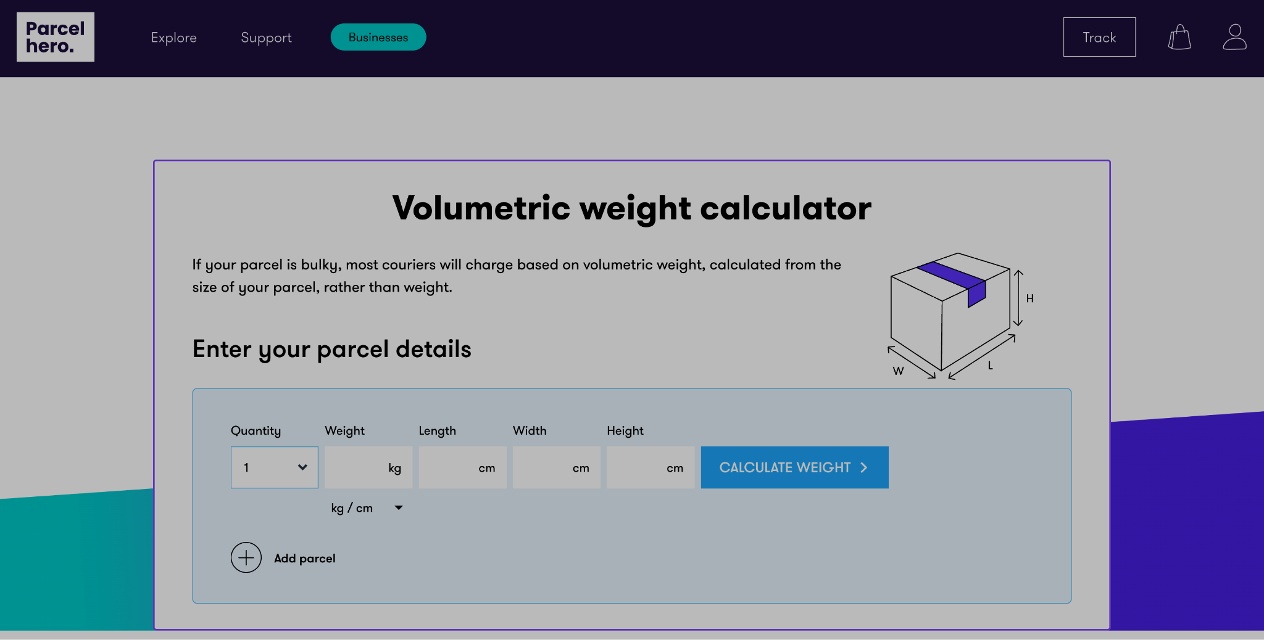
Website Overall Layout

Slide 11
Shipment Handling
• Book, schedule, and manage shipments
• Label generation and courier assignment
• Bulk uploads and API integration

Slide 12
Invoice and Payments
• Generate and send invoices
• Support prepaid, postpaid, and wallet
• Integrate online payment gateways

Slide 13
Tracking Shipments
• Real-time tracking dashboard
• Partner API integrations
• SMS/email notifications

Slide 14
Support and Grievances
• Raise and resolve customer issues
• SLA-based ticketing system
• FAQs, chatbot, live agent

Slide 15
Rate Manager
• Define/manage rate cards
• Dynamic/seasonal pricing updates
• Simulate cost estimates

Slide 16
Partner Selection
• Database of logistics partners
• Partner-specific rates and services
• Recommend optimal partner via AI/rules

Slide 17
Thank You
Contact us for a demo or more information

