Slide 1
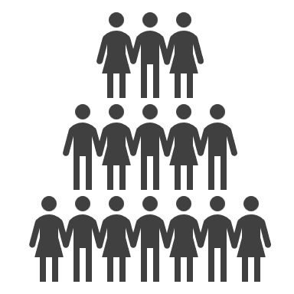



Generative AI
Society
Corporation
Optimize Ethics
Develop Product
AI Developer

Slide 2
Generative AI
I think that generative AI has lots of potential however, I think that the model should be fair, no matter what. When asked to do something that breaks societal norms, and my moral norms, I would have a very hard time wanting to take the task on.

Slide 3
On a Professional Level
I think the best way to work and develop generative AI is to think about the harm it can cause rather than good. Thinking about harm can help limit the use of the model.
Vigorous testing, and lots of trials and errors in a controlled environment, prior to depolyment.

Slide 4
What can you contribute?
In which ways can you as an emerging AI architect contribute to a culture of ethical AI within the industry and amongst your peers?
Governance
Corporate policies
Be honest with co-workers
Be transparent about issues that you think are unreasonable
Think of worst outcome, before the best outcome.
Technological mitigation and tools

Slide 5
Societal Level
Which ethical framework do you think should be a guide?
I think that the framework to limit generative AI should be any economic frame
work.
The GDP should not go down because people lost their jobs to Generative AI, and only two or three companies control them.

