Slide 1
QUALITY
=
CUSTOMERS’ SATISFACTION
Quality Theories
PARCIDIO ANDRE

Slide 2


Today's Agenda
1
Overview
2
Quality theories
3
Application of quality theories

Slide 3
Overview
These are bodies of methodology that provide guiding principles to manage and achieve quality
FOUNDED ON COST OF QUALITY
CONTROL QUALITY:
NEEDED TO ACHIVE QUALITY
CONSEQUENCES OF POOR QUALITY

Slide 4
Quality Theories
1
Deming's Theory
2
Crosby’s theory
3
Juran’s Theory
4
Ishikawa’s Theory

Slide 5
What about it?
Deming’s
Theory
These theory suggests that quality can only be achieve with the application of continuous incremental improvements towards zero defects in all processes, products and services.
1
Edwards Deming
2
85% of cost of quality is a management problem
2
Leadership; resources

Slide 6
What about it?
Crosby’s
Theory
Suggests that quality should be achieved right at the first time that a product is produced or a service is rendered. In this case, only when conformance to the customers' requirements and standards is perfected than quality is achieved
1
Philip B. Crosby
2
Zero defects practice (Do it right in the first time)
3
Prevention

Slide 7
How are you feeling?
Juran’s
Theory
Suggests that quality in a project is only possible if the people in a project team are well educated and trained to perform their assigned tasks.
Improve the quality of people first. Then quality of products or service
1
Joseph Juran
2
Fitness for use (Stakeholders or customers expectations are met or exceeded.)
3
Division of labor

Slide 8
How are you feeling?
Ishikawa’s
Theory
Suggests that quality may only be achieved if it is measure.
This theory suggests that implementation of internal coordination and the use of specialized statistical tools and technique, such as the six sigma, can help a project team produce quality results.
1
Kaoru Ishikawa
2
Cause-and-effect diagrams (Fishbone)
3
80 – 20 Pareto principle

Slide 9


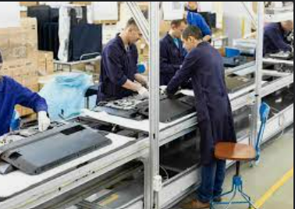
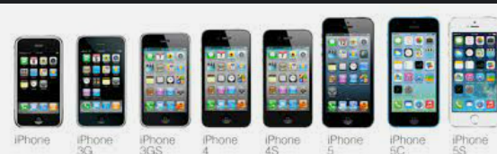
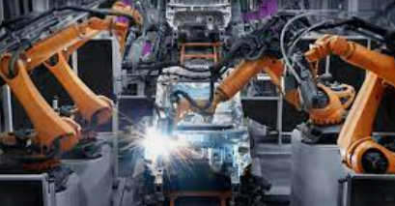
Applications
Ishikawa’s theory
Crosby’s Theory
Juran’s Theory
Deming’s Theory
Design of electronic
Medicine and medical equipment's
Vehicle manufacturing and assembly
Service and production
Six Sigma

Slide 10
Thank you!
Any Question?

