Slide 1
QoS-Aware Data Replication for
Applications in Distributed Systems
NIT WARANGAL
Project Members:-
Pardeep Kumar (UG107235)
Vaibhav Rawat (UG107255)
Prashant Sahu (UG107237)
Sneha Roy(UG107250)
Guided by:-
Dr. Ch.Sudhakar
Computer Science & Engineering
NIT Warangal

Slide 2
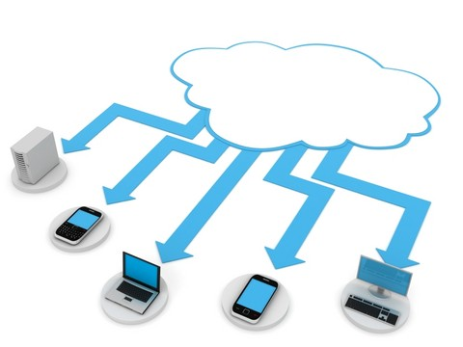
Distributed Computing Overview
An expression used to describe a variety of computing concepts.
Involves a large number of computers connected through a real-time
communication network.
Relies on converged infrastructure and sharing
computing resources rather than having local
servers or personal devices to handle application.

Slide 3
Why Distributed Computing is important ?
In traditional desktop computing ,we run software in our own PC and data is stored in there only, hence traditional computing is PC centric.
Distributed computing is an emerging Paradigm in computer industry where the computing is moved to a cluster of computers.
Now documents are stored on a collection of servers accessed via internet. Hence the distributed computing is document centric and easily
shareable.

Slide 4
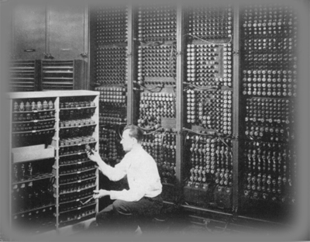
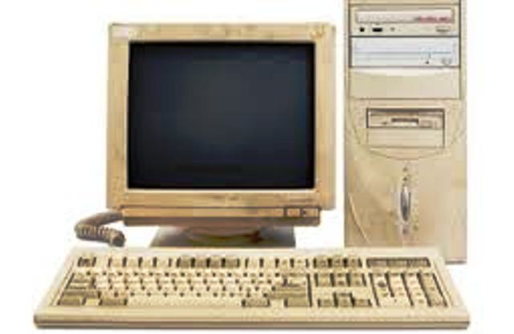
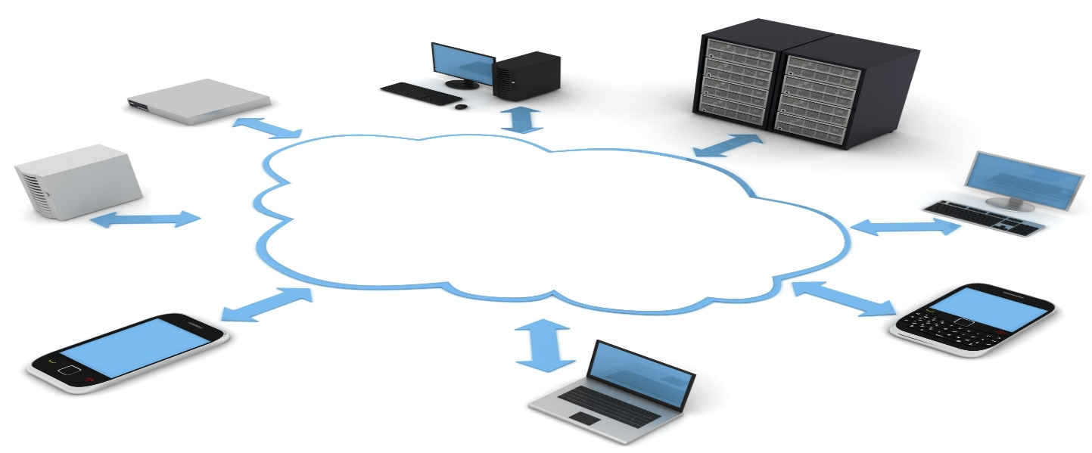

Slide 5
Properties of Distributed Computing
Powerful : Powerful in the sense that as there is large number of computers , thus more computing power and mass data storage possible.
Task Centric : Distributed computing focus on what one need and how application can do it for us. Here documents are given more priority than the applications which create them.
Flexible : Flexible as the users may be of different varieties and hence it has to match with their needs.
Self Healing : Self healing because backups are available for every document in the cluster . Hence if one document crashes there will be it's duplicate ready to run.

Slide 6
Arising Problems
More and more applications are developed in this computing environment and the chances of hardware failure is always possible.
For support of QoS requirements after data corruption, we need QoS-aware data replication (QADR) algorithms .
Different applications have different quality-of-service (QoS) requirements.

Slide 7
Quality of Service
Quality of service is the overall performance of a computer network seen by the users.
Quality of service is particularly important for the transport of traffic with special requirements.
Quality of service comprises requirements on all the aspects of a connection, such as service response time, signal-to-noise ratio, loss, interrupts, frequency response.

Slide 8
QoS Requirements in Distributed Systems
Response time of a data object access is defined as the QoS requirement in network.
Distributed computing has heterogeneous nodes.
Due to this, the data of a high-QoS application may be replicated in a low-performance node.
On data replication, data might be retrieved from low performance node.
Low-performance node has slow communication and disk access latencies, so QoS requirement gets violated.

Slide 9
QoS-Aware Data Replication (QADR) Algorithms
Considers the QoS requirements of applications in the data replication.
Main goal of the QADR problem is
to minimize the data replication cost, and
the number of QoS violated data replicas.

Slide 10
Problem Statement
“Quality of Service Aware Data Replication for Applications in Distributed Systems” which investigates the QADR problem for applications in distributed systems.
Modifying and applying the existing Min-Cost Max Flow ( MCMF ) algorithm to solve the QADR problem.

Slide 11
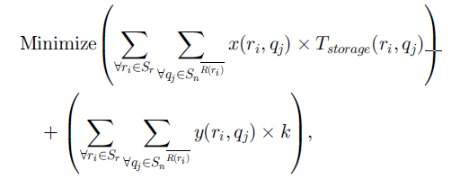
Mathematical Representation
Where ,
y(r_{i},q_{j}) is 1 if q_{j} is a QoS violated replica for replication ,0 otherwise.
x(r_{i},q_{j}) is 1 if q_{j} is a qualified node for replication,0 otherwise.
T_{storage(ri,qj)} is the total time for replication.

Slide 12
Transforming into MCMF problem
In the QADR problem, find all qualified and requesting nodes.
Qualified node should
Not be present within the same rack.
Have data replica time ,i.e.,
D+ L + 1/B < T
D=disk latency
L =network latency
B=bandwidth
T=threshold QoS time for requesting node

Slide 13
Replication relationship between requested and qualified nodes modeled as weighted-bipartite graph (WBG).
A source node s and a sink node t are added on two sides of WBG to connect with each of its requested nodes and each of its qualified nodes .
WBG gets converted to its equivalent NFG with source edges, bipartite edges, and sink edges.

Slide 14
Transforming into MCMF problem
(Capacity, cost, BW) on each source edge is set to (r,1,INF) where r is replication factor.
(Capacity, cost, BW) on each bipartite edge is set to (1,w,b) where w is weight of bipartite edge.
(Capacity, cost, BW) on each edge is (b,1,INF) where b is buffer size of node

Slide 15
Applying Min Cost Max Flow (MCMF)
Pass Network Flow Graph to MCMF to find optimal placement for QoS satisfied data replicas.
For requested nodes still left unsatisfied due to buffer constraints construct a NFG with unqualified nodes in a similar manner.
Apply MCMF to above NFG for QoS violated data replicas.

Slide 16
FLOW
Construct a bipartite graph based between request and qualified nodes
Data Nodes sending replication request to name node
Apply MCMF and find QoS violated data replicas
Converting to NFG (Add sink (t)and source (s))
Unsatisfied requested nodes
Finding Unqualified nodes
Add respective capacity and cost to edges
Apply Modified MCMF to NFG
QoS satisfied data replicas

Slide 17
Algorithm
Input: A set of requested nodes S_{r}
Output: Optimal Placement for the QoS-satisfied and QoS-violated data replicas.
S_{q} ←NULL
for each requested node r_{i} in S_{r} do
S_{q}^{r}_{i} ← Find the correspondingly qualified nodes of r_{i}
S_{q} ← S_{q} _{U} S_{q}^{r}_{i}
end for
Use S_{r} and S_{q} to model a network flow graph.

Slide 18
Set appropriate (capacity, cost) values on the edges of the edges of the network flow graph.
Apply an existing polynomial-time MCMF algorithm to obtain the MCMF solution of the network flow diagram.
Obtain the optimal placement for the QoS-satisfied data replicas from the MCMF solution.
S_{ur} ← NULL and S_{uq} ← NULL
For each requested node r_{i} in S_{r} do
f_{leaving} ← the amount of flow leaving from r_{i}
If f_{leaving} < r_{f} then
S_{ur} ← S_{ur} U r_{i}
S_{q}^{r}_{i} ← S - S_{q}^{r}_{i} / * the qualified nodes for r_{i} */
S_{uq} ← S_{uq} U S_{q}^{r}_{i}
end if
end for
Use S_{ur} and S_{uq} to model a new network flow graph.
Set appropriate (capacity, cost) values on the edges of the new network flow graph.
Apply the MCMF algorithm on the new network flow graph to obtain the MCMF solution.
Follow the MCMF solution to make the optimal placement of the QoS- Violated data replicas

Slide 19
Implementation and Results:
Implemented a model of distributed computing in C and Python language and UBUNTU Operating System.
Model consists of data nodes connected to name node with data nodes having different rack number.
Data nodes sends request to main server which calculates qualified nodes and applies Min Cost Max Flow algorithm for QoS Aware Data Replication.
The flow and cost of flow as well as the data replication nodes for each requested node is calculated.

Slide 20
D1
D8
R1
R4
D7
D2
NS
D3
D6
R2
R3
D4
D5
Network Topology for QADR in consideration for Distributed Computing.

Slide 21
Netkit Emulator
Network emulators are software environments that closely reproduce the functionalities and the behaviour of real world networks.
Netkit is an environment for setting up and performing networking experiments at low cost and with little effort.
It allows to "create" several virtual network devices (full-fledged routers, switches, computers, etc.) that can be easily interconnected in order to form a network on a single PC.
Netkit provides a collection of integrated easy to use, and widely tested tools to simplify the setup of a virtual network.

Slide 22
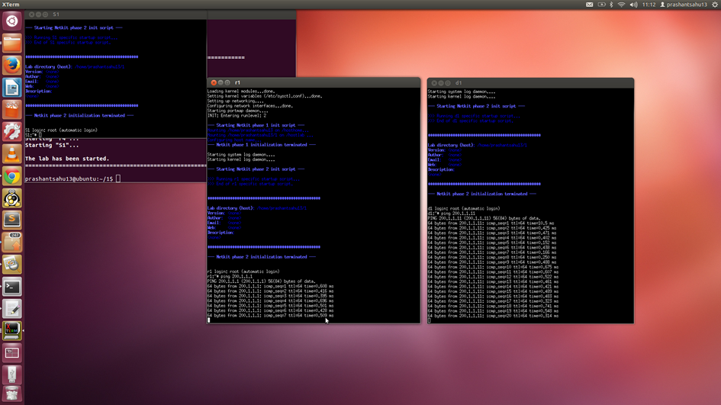
Connection between requesting node and switch

Slide 23
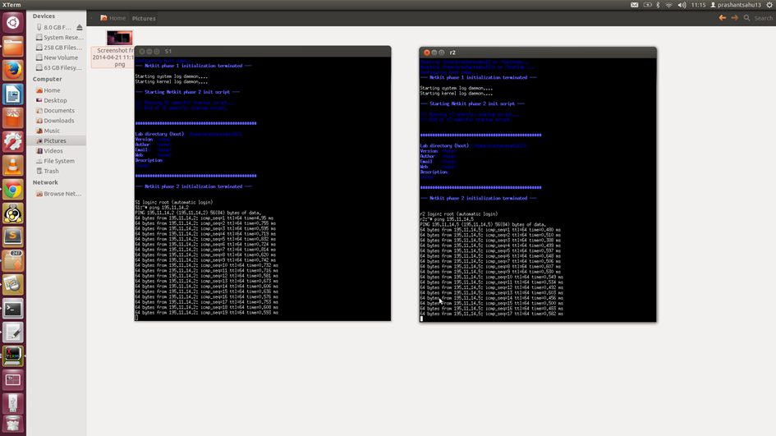
Connection between switch and name node

Slide 24
IP configuration
Lab.config
r1[0]="A" r1[1]="P"
r2[0]="A" r2[1]="Q"
r3[0]="A" r3[1]="R"
r4[0]="A" r4[1]="S"
d1[1]="P" d5[1]="R"
d2[1]="P" d6[1]="R"
d3[1]="Q" d7[1]="S"
d4[1]="Q" d8[1]="S"

Slide 25
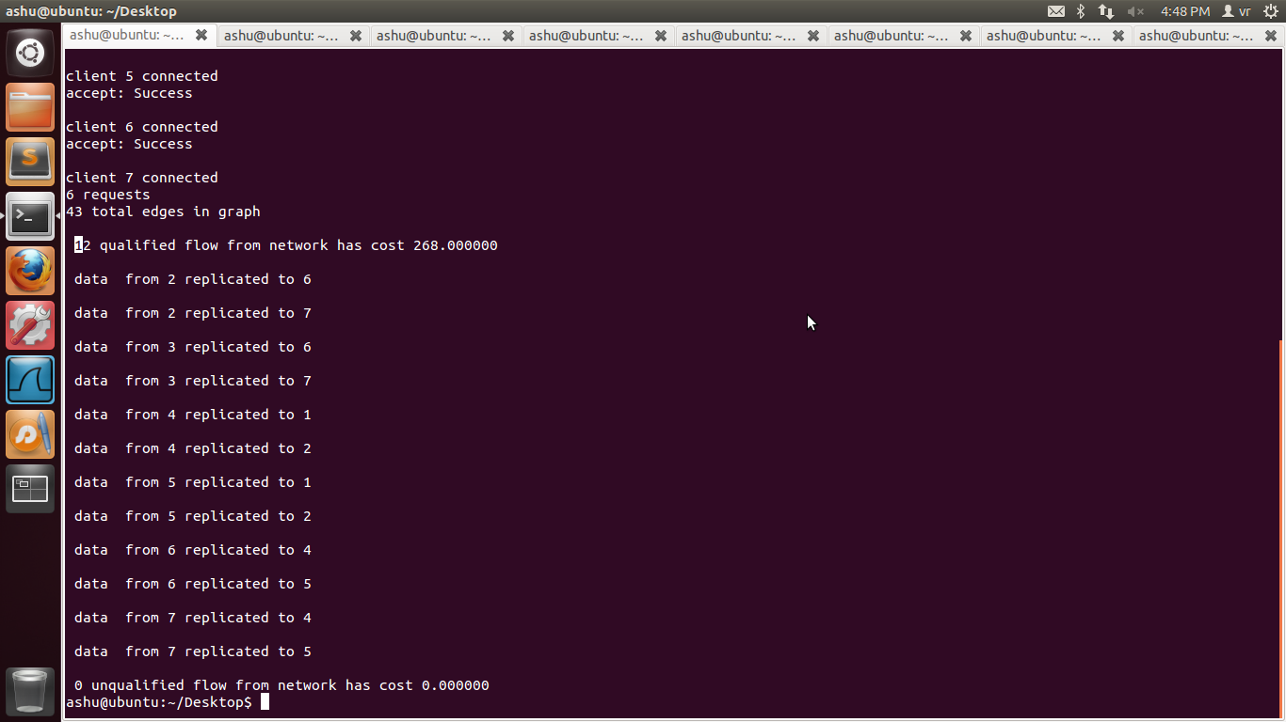
RESULTS
Result of applying QADR algorithm to our topology

Slide 26
Work Done in Current Semester
Simulated a Distributed Computing environment consisting of multiple virtual nodes and routes to construct a network topology using NETKIT EMULATOR for Linux (Ubuntu 12.04).
Proposed an alternative algorithm to solve the QADR problem.

Slide 27


