Slide 1
Done by : p.pavani
Evolution of Networking and nodes on a computer network …

Slide 2
ARPANET
1969 – First Network
Advanced Research Projects Agency NETwork.
The ‘National Science Foundation’ (mid 80’s) , created a new and high capacity network called NSFnet . This was more capable than ARPANET.
The inter networking of ARPANET , NSFnet , and some other private networks are connected to form INTERNET.

Slide 3
The INTERNET (Super-Network)
A world wide network of computer networks.
Common Use : Allows users connected to one network to communicate with users on another network.
Connects many smaller networks together and allows all the computers to exchange information with each other.
Common set of rules for communication – PROTOCOLS.

Slide 4
Protocols
Set of rules for communication.
TCP – Transmission control protocol
Responsible for dividing the file/message into packets on the source computer.
Also responsible for reassembling the received packets at the destination or recipient computer.
IP – Internet Protocol
Responsible for handling the address of destination computer so that each packet is routed(sent) to its proper destination.

Slide 5
How does an internet work …?
In internet , most computers are not connected directly. Rather they connect to smaller networks which in turn are connected through gateways to the internet backbone.
GATEWAYS : Device that connects dissimilar networks.
BACKBONE : Central interconnecting structure that connects one or more networks just like the trunk of tree or the spine of a human being.

Slide 6
How internet functions …?
At the source computer , the file/document to be sent to another computer is firstly divided into PACKETS .
Each packet is given a number serial wise .
All packets are then sent to address of destination computer .
The destination computer receives packets in random manner ; if a packet is lost or garbled , it will demand again.
The packets are reassembled in order and then the original file/document/file is obtained .

Slide 7
The Interspace
A client/server software program that allows multiple users to communicate online with real-time audio , video and text chat in dynamic 3D environments.
Provides the most advanced form of communication available on the Internet today.

Slide 8
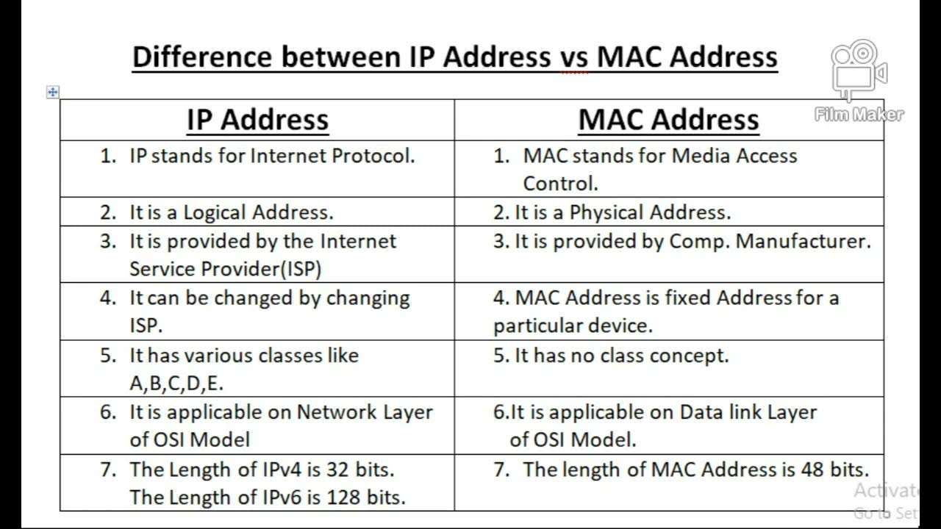
NODES on a computer network… Differences between IP address and MAC address :- IP Address MAC Address

Slide 9
THANK YOU !!!

