Slide 1
How Machines Work??

Slide 2
How human thinks ??
x | y
-2 | -4
-1 | -1
0 | 2
1 | 5
2 | 8
Now What is the y value for x = 15?
47
Equation is 3 x + 2

Slide 3
What is value of y for x1 = 5 and x2 = 3?
x1 | x2 | y
1 | -2 | 0
2 | -1 | 2
3 | 0 | 4
4 | 1 | 6
5 | 2 | 8
9
y = x1 + x2 + 1

Slide 4
How machine learning models find this y = x1 + x2 + 1 ??
y = x1 + x2 + 1 y = a1 x1 + a2 x2 + b
a1 and a2 and b starts with random value and
they are adjusted until it finds correct
pattern

Slide 5
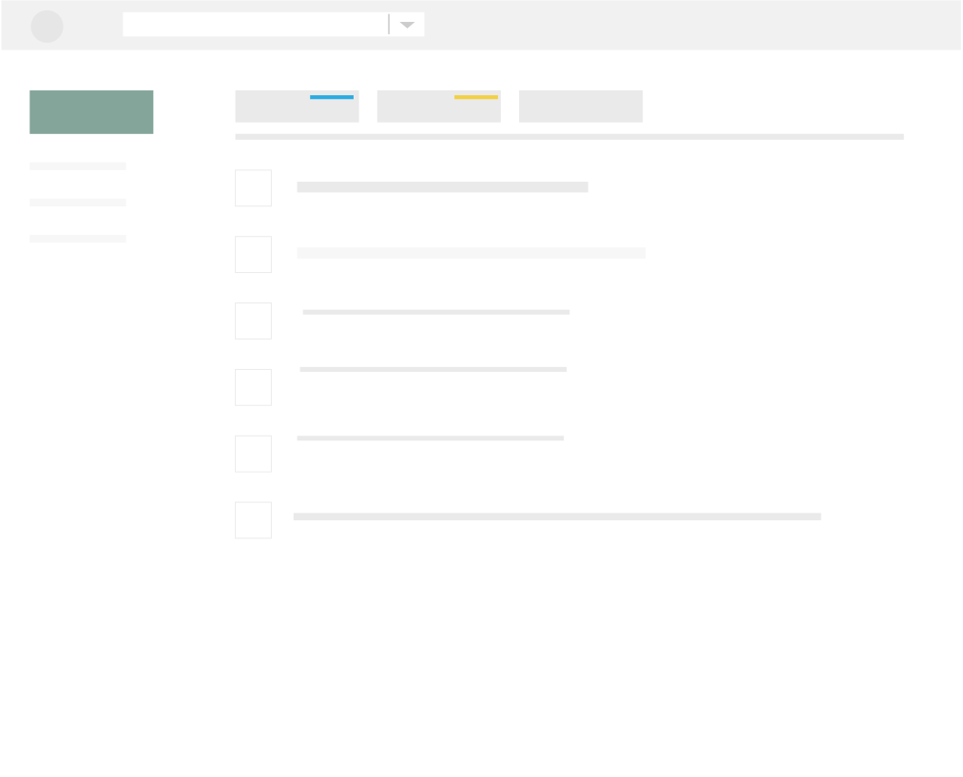


How human thinks ??

Slide 6
Sub : Wow You won 10 million USD$

Slide 7

Real
Fake

Slide 8

Fake
Fake
Fake
Fake

Slide 9
But what about machines
Do they understood Human Languages??

Slide 10
Steps in NLP
Mail / Text
Cleaning
Feature
Extraction
Training the machine models
Improve the model accuracy
Evaluating
The model
Deploy the Model

Slide 11




Some cleaning techniques
Stop Words Removal
Punctuation Removal
Lower case conversion
Remove stem words

Slide 12
Count Vectorizer for Feature extraction

Slide 13
Example
Document 1 It is going to rain today.
Document 2 Today I am not going outside. so today I wont watch season premiere
Document 3 I am going to watch the season premiere.

Slide 14
All unique words as features
Document | Going | Rain | Today | Outside | Watch | premiere
Document 1 | 1 | 1 | 1 | 0 | 0 | 0
Document 2 | 1 | 0 | 2 | 1 | 1 | 1
Document 3 | 1 | 0 | 0 | 0 | 1 | 1

Slide 15
TF IDF for finding features

Slide 16
Example
Document 1 It is going to rain today.
Document 2 Today I am not going outside.
Document 3 I am going to watch the season premiere.

Slide 17
Clean data and tokenize
Word | Count
Going | 3
To | 2
Today | 2
I | 2
Am | 2
It | 1
Is | 1
rain | 1

Slide 18
Find it’s Term Frequency= (Number of repetitions of word in a document) / (number of words in a document)
Word | Document 1
Going | 0.16
To | 0.16
Today | 0.16
I | 0
Am | 0
It | 0.16
Is | 0.16
rain | 0.16

Slide 19
Words/documents | Document1 | Document 2 | Document 3
Going | 0.16 | 0.16 | 0.12
To | 0.16 | 0 | 0.12
Today | 0.16 | 0.16 | 0
I | 0 | 0.16 | 0.12
Am | 0 | 0.16 | 0.12
It | 0.16 | 0 | 0
Is | 0.16 | 0 | 0
rain | 0.16 | 0 | 0

Slide 20
Find IDF
IDF =Log[(Number of documents) / (Number of documents containing the word)]
Word | IDF value
Going | log(3/3)
To | log(3/2)
Today | log(3/2)
I | log(3/2)
Am | log(3/2)
It | log(3/1)
Is | log(3/1)
rain | log(3/1)

Slide 21
Word | IDF value
Going | 0
To | 0.41
Today | 0.41
I | 0.41
Am | 0.41
It | 1.09
Is | 1.09
rain | 1.09

Slide 22
Final TF-IDF result
Words/ Documents | Going | to | today | i | am | it | is | rain
Document1 | 0 | 0.07 | 0.07 | 0 | 0 | 0.17 | 0.17 | 0.17
Document2 | 0 | 0 | 0.07 | 0.07 | 0.07 | 0 | 0 | 0
document3 | 0 | 0.05 | 0 | 0.05 | 0.05 | 0 | 0 | 0

