Slide 1
AVD612 | COURSE PROJECT
LMS UPDATE
LMS Linear
Equalizer
w[n+1] = w[n] + μ x[n] e*[n]
Learn weights
from known symbols
A readable Python simulation of adaptive equalization in digital communications
Measure BER, EVM,
and convergence
Team: [add names]
Institute / course details: [fill in]
Starter deck — verify results and add your team’s own findings.

Slide 2
02 / 10
The problem: intersymbol interference
Multipath makes a received symbol contain energy from neighboring symbols.
What happens in a real channel?
Simple channel model
r[n] = Σ h[k] a[n−k] + v[n]
●
A signal can arrive through multiple paths with different delays.
●
The receiver observes the current symbol mixed with delayed copies.
●
These delayed components cause intersymbol interference (ISI).
The goal
Use recent received samples to estimate the intended transmitted symbol and reduce ISI.
●
The constellation spreads, making bit decisions less reliable.
Concept: multipath FIR channel plus additive white Gaussian noise (AWGN)
02

Slide 3
03 / 10
Where the equalizer fits
The simulation focuses on the receiver block, but includes a small transmitter and channel so it can be tested.
TRANSMITTER
CHANNEL
LMS EQUALIZER
DETECTOR
Bits → BPSK /
QPSK / 16-QAM
Multipath FIR
+ complex AWGN
Adaptive FIR
filter weights
Nearest point →
estimated bits
Training: the receiver knows the reference symbols → computes error → updates the taps.
Testing: later symbols are compared with and without the equalizer.
AVD612 | LMS Equalizer | Educational simulation
03

Slide 4
04 / 10
What the equalizer learns
Each tap scales one received sample; the scaled samples combine to form one output.
Tap-delay line (conceptual view)
r[n]
r[n−1]
r[n−2]
…
r[n−M+1]
Σ
→ y[n]
w₀
w₁
w₂
…
wₘ₋₁
Output equation
Interpretation
y[n] = wᴴ[n] x[n]
LMS changes the weights when the output differs from the known training symbol.
AVD612 | LMS Equalizer | Educational simulation
04

Slide 5
05 / 10
Mathematical model
The code uses complex baseband samples and a configurable decision delay.
1. Channel
2. Equalizer input
r[n] = Σ h[k] a[n−k] + v[n]
x[n] = [r[n], r[n−1], …, r[n−M+1]]ᵀ
Multipath combines delayed transmitted symbols.
M recent samples enter the adaptive filter.
3. Output and target
4. Error
y[n] = wᴴ[n]x[n] d[n] = a[n−D]
e[n] = d[n] − y[n]
D aligns the output with the intended symbol.
Training error guides the weight adjustment.
M = equalizer tap count | μ = LMS step size | * = complex conjugate | H = conjugate transpose
Theory reference: Haykin, Adaptive Filter Theory; GNU Radio Linear Equalizer documentation
05

Slide 6
06 / 10
LMS: the adaptive update loop
LMS uses each error as a small correction, instead of solving for the optimal weights in one step.
Complex LMS update used by this code
01
Predict
Compute y[n] from current weights.
w[n+1] = w[n] + μ x[n] e*[n]
02
Compare
Output → error → weight update
e[n] = desired − estimated symbol.
03
Correct
Update all taps using μ and the error.
Choosing μ (step size)
Too large: fast changes but possible oscillation/divergence.
Too small: slower learning; may need more training symbols.
04
Repeat
Continue over the known training symbols.
The implementation uses wᴴx and therefore updates weights with x · conjugate(error).
06

Slide 7
07 / 10
Readable code structure
Each Python module has one main responsibility so a student can inspect one idea at a time.
modulation.py
channel.py
Bits ↔ BPSK, QPSK, 16-QAM symbols
FIR multipath plus AWGN
equalizer.py
simulation.py
LMS output, error, and tap updates
Training/test split, BER, EVM
plotting.py
tests/
Constellation, learning curve, BER sweep
Automated checks for math and behavior
Run checks with: python -m unittest discover -s tests -v
07

Slide 8
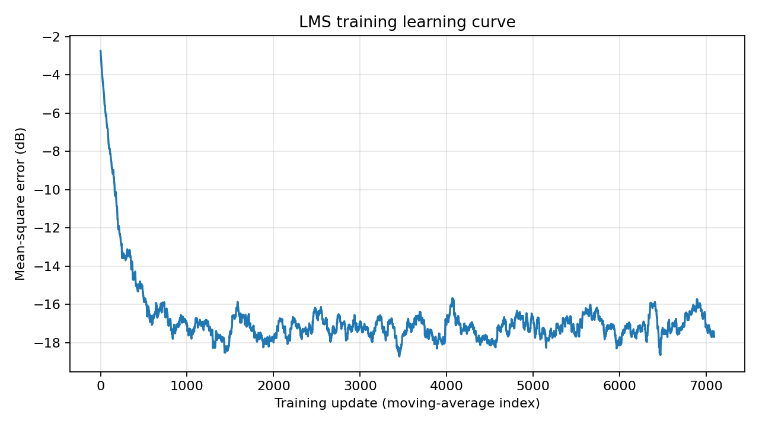
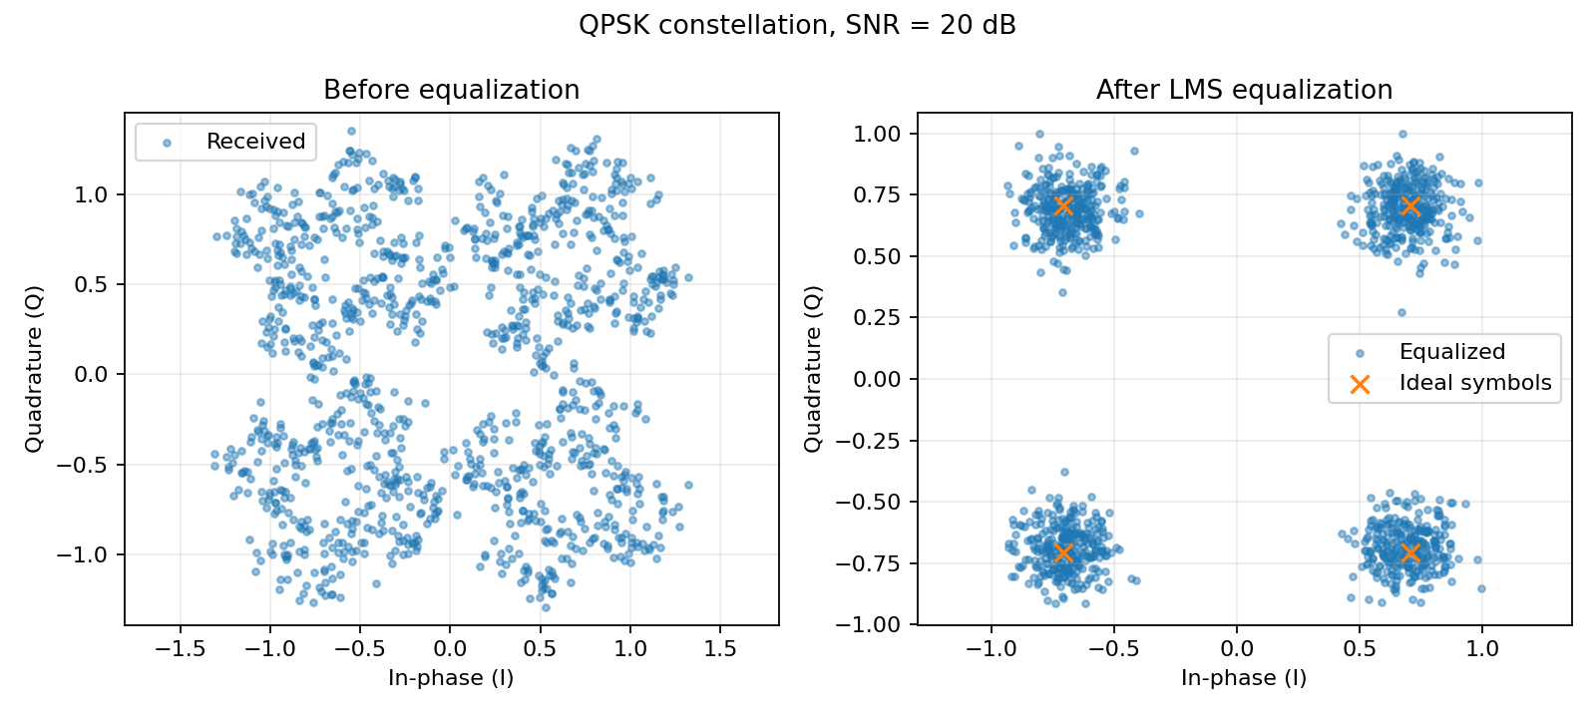
08 / 10
What the default experiment shows
Example run: QPSK, 20 dB SNR, 12,000 symbols, 9 taps, μ = 0.01, 60% training.
Training error falls
Constellation tightens
Interpretation: LMS learns a filter that reduces the channel distortion on this test case; the clusters are closer to their ideal points.
Figures are generated by the included Python code; reproduce them from your final version before presenting.
08

Slide 9
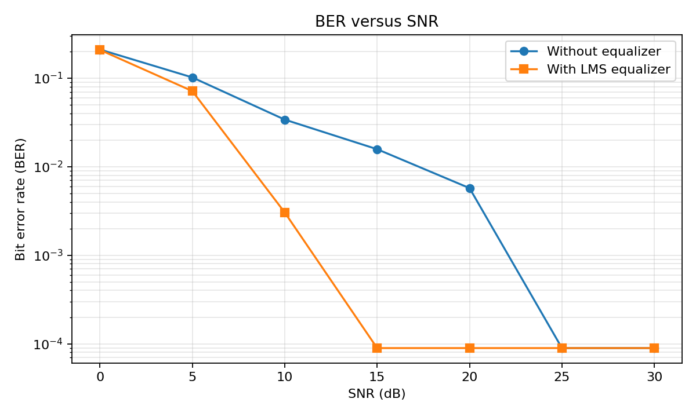
09 / 10
Performance: BER and EVM
Results are specific to the stated seed, channel, SNR, modulation and training setup.
Default run metrics
BER: 0.003857 → 0 observed
EVM: 0.4454 → 0.1358
Important to say aloud
Zero errors in one finite test packet means zero observed BER here, not that the true BER is mathematically zero.
The SNR sweep measures a finite number of bits per point; expand --sweep-symbols for smoother estimates.
AVD612 | LMS Equalizer | Educational simulation
09

Slide 10
10 / 10
Takeaways, limitations, and next steps
A good demonstration explains both where the algorithm works and where this simplified model stops.
Key takeaways
Limitations and next tests
●
LMS adjusts FIR weights from the measured training error.
●
Symbol-spaced model; no timing or carrier recovery.
●
Step size, training length, tap count, and decision delay matter.
●
No pulse shaping, real RF front end, or hardware measurements.
●
BER and EVM quantify different parts of receiver performance.
●
Compare several μ values, tap counts, modulations, and training fractions.
Viva check: explain y[n], e[n], the LMS update, and the conjugate in your own words.
Further reading: Haykin, Adaptive Filter Theory; GNU Radio Linear Equalizer / Adaptive Algorithm wiki
10

