Slide 1
Smart Recycling Waste Classifier

Slide 2
TEAM MEMBERS
V.PARDHIV -246Q5A4201
P.VARSHINI -236Q1A4202
B.SRI VENKATA SESHA SAI -236Q1A4209
B.PRANAY KUMAR -236Q1A4212

Slide 3
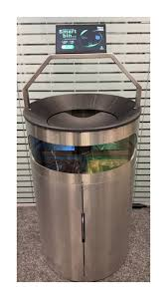
Project Introduction
Classifies waste into 5 categories:
- Plastic
- Paper
- Metal
- Glass
- Organic
Helps in smart recycling systems

Slide 4
Required Software
• Python (3.10 or 3.11)
• Visual Studio Code
• Python Extension (VS Code)
• Project code

Slide 5
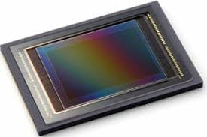
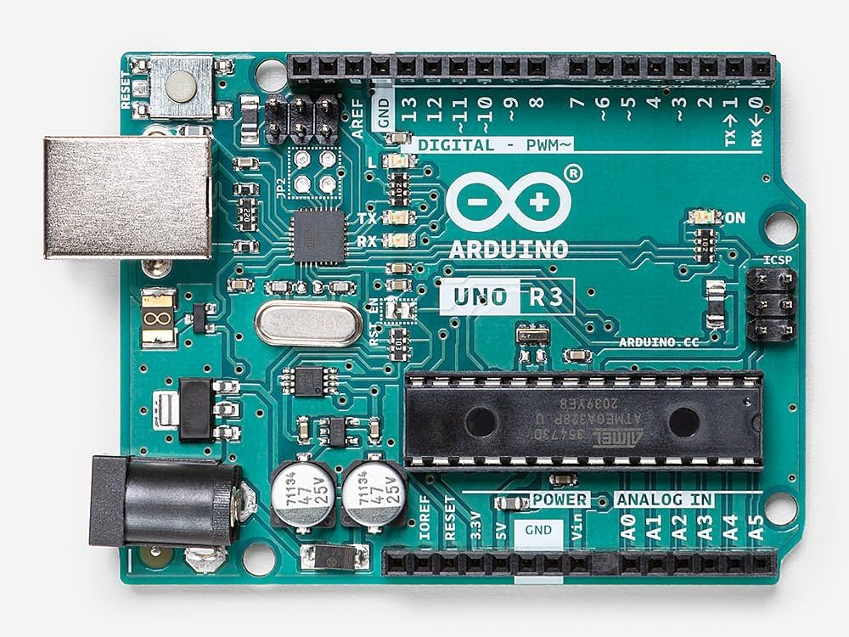

Required Hardware
Camera
Arduino board
Servo motor

Slide 6
WORKING MODEL
Image collection
Image preprocessing
Feature extraction using CNN
Model training
Prediction phase
Final work flow

Slide 7
IMAGE COLLECTION
Inside dataset create 5 folders:
• plastic
• paper
• metal
• glass
• organic
Add 50-100 images in each folder

Slide 8
IMAGE PREPROCESING
Before training, images are:
Resized to 128 × 128 pixels
Converted into numerical values
Normalized (pixel values divided by 255)This makes the images ready for the neural network

Slide 9
Feature extraction using CNN
The system uses a Convolutional Neural Network (CNN).CNN works in 3 main stages:
Convolution Layer :- Detects edges, shapes, textures, Extracts important patterns from images.
Pooling Layer :- Reduces image size, Keeps important features, Makes system faster and efficient.
Fully Connected Layer :- Combines all extracted features, Decides which waste category it belongs to.

Slide 10
MODEL TRAINING
During training:-
The model sees thousands of images.
It compares predicted output with actual category.
If prediction is wrong → error is calculated.
The model adjusts its internal weights.
This process repeats for multiple epochs.

Slide 11
PREDICTION PHASE
When a new waste image is given:
Image is resized and normalized.
Passed into trained CNN model.
Model calculates probability for each class.
Highest probability class is selected.
Output is displayed.

Slide 12
FINAL WORK FLOW
Camera → Capture Waste Image
(When someone puts waste near the bin, the camera takes a picture)
⬇
Python AI Model → Classifies Waste
(Your trained AI model (CNN) checks the image and decides whether it is in
a category.)
⬇
Signal sent to Arduino
(After classification, the Python program sends a signal to the Arduino board.)
⬇
Servo motor rotates correct bin
(The Arduino controls a servo motor, which rotates and opens the correct waste bin)
This creates a Smart Automatic Waste Segregation System.

Slide 13
CONCLUSION
The Smart Recycling Waste Classifier uses Artificial Intelligence and CNN technology to automatically identify and classify different types of waste. This system helps improve recycling efficiency, reduces human effort, and supports environmental sustainability. With future integration of hardware like Arduino and smart bins, it can become a fully automated waste segregation solution for smart cities.

