Slide 1
DELIVERY ROUTE OPTIMIZER
Data Structures and Algorithms – 3 (25CS2103E)
S. Pardhu Saradhi (2520090043)
U. Shiva Reddy (2520090172)
Team 23 | Section 10
Guide: K. Chandusha, Asst. Prof., CS&IT

Slide 2
2. Abstract
2
• The Delivery Route Optimizer is a DSA-based application for planning efficient delivery routes.
• It models the road network as a weighted graph: locations are vertices and roads are weighted edges.
• Dijkstra’s Shortest Path Algorithm with a Min Heap computes the shortest route.
• The application supports adding locations, connecting road distances, modifying routes, and finding the optimal delivery path.
• Graphs, Hash Maps, Arrays, Priority Queues, and Greedy Algorithms are demonstrated.
Delivery Route Optimizer | DSA-3 | Team 23

Slide 3
3. Problem Statement
3
• Delivery companies need efficient routes between a warehouse and customer locations.
• Manual route planning can be time-consuming and difficult to optimize.
• Basic graph traversal may not provide the shortest weighted path.
• Searching many possible routes can be computationally expensive.
• The project solves this using a weighted graph and Dijkstra’s shortest-path approach.
Delivery Route Optimizer | DSA-3 | Team 23

Slide 4
4. Motivation
4
• Apply Data Structures and Algorithms to a practical logistics problem.
• Reduce travel time, fuel consumption, and operational costs through efficient route selection.
• Demonstrate the practical use of graphs, adjacency lists, priority queues, hash maps, arrays, and greedy processing.
• Provide an easy-to-understand learning-oriented routing application.
Delivery Route Optimizer | DSA-3 | Team 23

Slide 5
5. Objectives
5
• Represent delivery locations and roads as a weighted graph.
• Store graph connections efficiently using an adjacency list.
• Use the warehouse as the source location.
• Apply Dijkstra’s algorithm to find an optimal delivery path.
• Use a Min Heap Priority Queue to process the smallest current distance.
• Allow locations and road distances to be added or modified.
• Display the resulting optimal delivery route.
Delivery Route Optimizer | DSA-3 | Team 23

Slide 6
6. Literature Survey
6
• Manual route planning – time-consuming and difficult to optimize.
• Basic graph traversal – may not provide the shortest weighted path.
• Inefficient graph representations – can require more memory for large networks.
• Searching many possible routes – can be computationally expensive.
• Proposed approach – Dijkstra + Min Heap + Adjacency List provides an efficient shortest-path solution.
Delivery Route Optimizer | DSA-3 | Team 23

Slide 7
7. Research Gap
7
• Manual approaches do not provide a systematic shortest-path calculation.
• Basic traversal is not sufficient for weighted shortest-path routing.
• Large networks require an efficient graph representation.
• The project combines an adjacency list, Min Heap Priority Queue, and Dijkstra’s algorithm in one routing workflow.
Delivery Route Optimizer | DSA-3 | Team 23

Slide 8
8. Proposed Methodology
8
• Input delivery locations and road distances.
• Create the weighted graph.
• Store connections using an adjacency list.
• Select the warehouse as the source.
• Initialize Dijkstra’s shortest-path calculation.
• Process locations using a Min Heap.
• Update shortest distances and previous nodes.
• Trace and display the optimal route.
Input
Weighted Graph
Adjacency List
Dijkstra + Min Heap
Optimal Route
Delivery Route Optimizer | DSA-3 | Team 23

Slide 9
9. System Architecture
9
System flow from input data to optimized delivery route:
Locations +
Road Distances
Weighted
Graph
Adjacency
List
Dijkstra +
Min Heap
Optimal
Route
• Input locations and distances are converted into a weighted graph.
• The graph is stored using an adjacency list.
• Dijkstra’s algorithm processes the graph with a Min Heap.
• The shortest route is reconstructed and displayed.
Delivery Route Optimizer | DSA-3 | Team 23

Slide 10
11. Dataset / Input Details
10
• No separate external dataset or CSV file is specified in the submitted materials.
• Input consists of delivery locations and road distances.
• Locations represent graph vertices.
• Roads represent weighted edges.
• Warehouse is used as the source location.
Delivery Route Optimizer | DSA-3 | Team 23

Slide 11
12. Implementation – Module 1
11
• Module 1 handles locations and road connections.
• Create the weighted graph from input.
• Store graph connections using an adjacency list.
• Add new locations and connect them with road distances.
• Modify existing route connections when required.
Delivery Route Optimizer | DSA-3 | Team 23

Slide 12
13. Implementation – Module 2
12
• Module 2 performs shortest-path calculation.
• Initialize shortest distances from the warehouse.
• Insert the source into the Min Heap.
• Select the location with the smallest current distance.
• Relax connected locations when a shorter route is found.
• Track previous nodes for route reconstruction.
Delivery Route Optimizer | DSA-3 | Team 23

Slide 13
14. Implementation – Module 3
13
• Module 3 reconstructs and displays the optimal route.
• Trace previous nodes from destination back to source.
• Construct the route sequence.
• Display the selected shortest route.
• Provide an easy-to-understand output for the user.
Delivery Route Optimizer | DSA-3 | Team 23

Slide 14
15. Experimental Setup
14
• Processor: Intel Core i3 or equivalent.
• RAM: Minimum 4 GB.
• Storage: Minimum 500 MB free space.
• Operating System: Windows or Linux.
• Standard monitor, keyboard and mouse.
• Internet connection is optional for the basic algorithm.
Delivery Route Optimizer | DSA-3 | Team 23

Slide 15
16. Results
15
• The system is designed to generate an optimal delivery route between warehouse and customer locations.
• The weighted graph represents the delivery network.
• Dijkstra’s algorithm determines the shortest path.
• The Min Heap supports selection of the smallest current distance.
• The final output is the optimal delivery route.
Delivery Route Optimizer | DSA-3 | Team 23

Slide 16
17. Performance Evaluation
16
• Adjacency List is used for memory-efficient graph representation.
• Min Heap supports efficient selection of the smallest current distance.
• Dijkstra’s algorithm provides shortest-path processing for the weighted graph.
• Measured execution-time and memory benchmarks were not included in the submitted PPT.
Delivery Route Optimizer | DSA-3 | Team 23

Slide 17
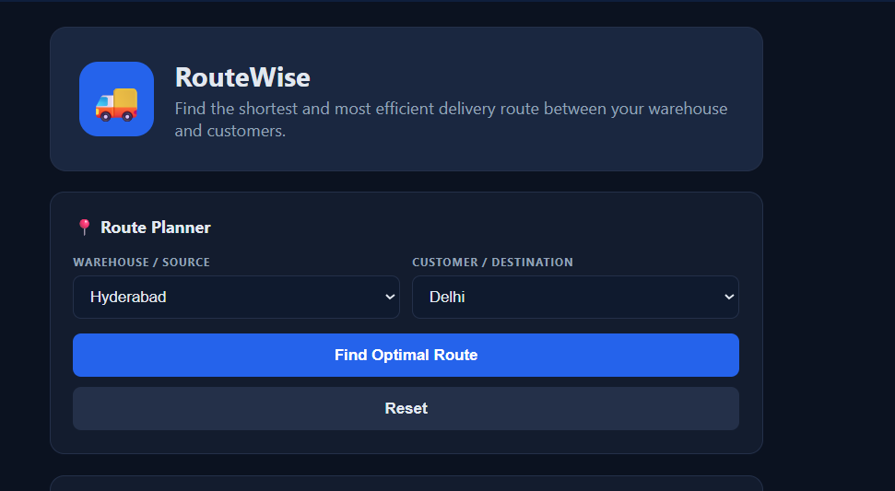
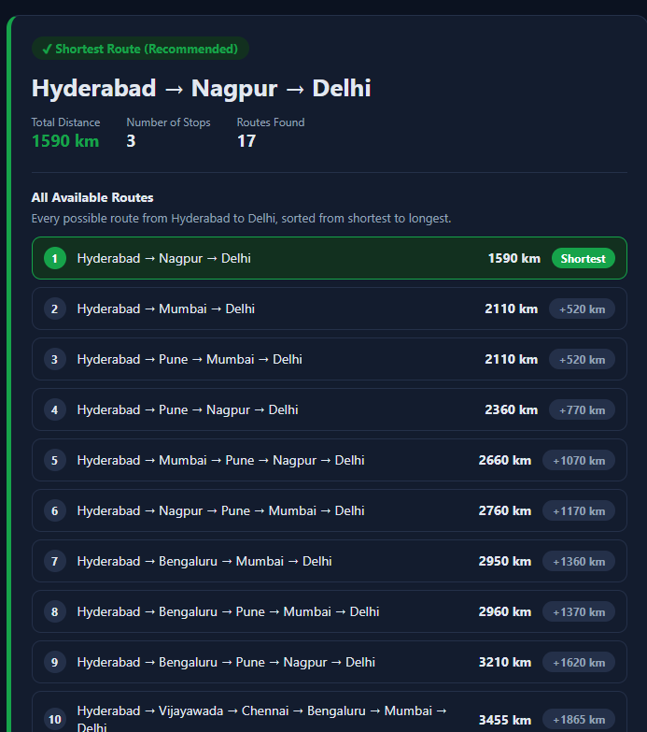
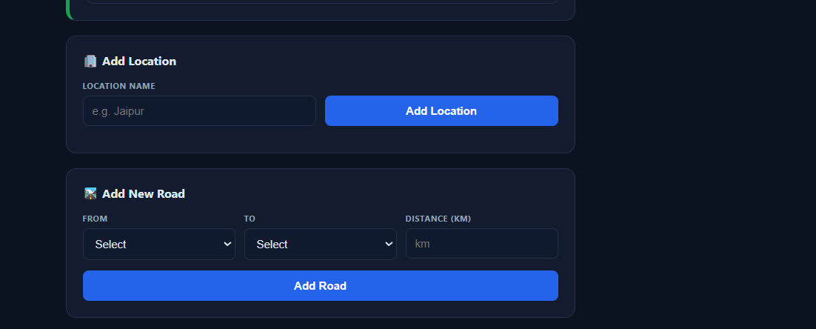
18. Screenshots / Working Demo
17
Delivery Route Optimizer | DSA-3 | Team 23

Slide 18
19. Comparison with Existing System
18
• Manual planning → time-consuming; proposed system uses algorithm-based routing.
• Basic traversal → may miss the shortest weighted path; proposed system uses Dijkstra.
• Inefficient graph storage → higher memory use; proposed system uses an adjacency list.
• Extensive route searching → computationally expensive; proposed system uses a Min Heap.
• Manual route selection → proposed system generates the optimal route.
Delivery Route Optimizer | DSA-3 | Team 23

Slide 19
20. Challenges & Solutions
19
• Challenge: Finding efficient routes → Solution: Dijkstra’s Shortest Path Algorithm.
• Challenge: Storing road connections → Solution: Adjacency List.
• Challenge: Selecting the smallest distance → Solution: Min Heap Priority Queue.
• Challenge: Managing location information → Solution: Arrays / Hash Maps.
• Challenge: Showing the final route → Solution: Previous-node tracking and route reconstruction.
Delivery Route Optimizer | DSA-3 | Team 23

Slide 20
21. Current Progress
20
• Project title, team details, and abstract finalized.
• Problem context and methodology defined.
• Weighted graph and adjacency-list representation established.
• Dijkstra and Min Heap processing identified.
• DSA concepts and software/hardware requirements documented.
• Final project PPT prepared.
Delivery Route Optimizer | DSA-3 | Team 23

Slide 21
22. Future Work
21
• Test the system with larger and more realistic road networks.
• Add detailed route visualization.
• Provide numerical performance benchmarks for different graph sizes.
• Support additional route constraints.
• Improve the user interface for location and road-distance entry.
• Evaluate multiple test cases and compare execution performance.
Delivery Route Optimizer | DSA-3 | Team 23

Slide 22
23. Conclusion
22
• The Delivery Route Optimizer applies DSA concepts to a practical logistics routing problem.
• Locations and roads are modeled as a weighted graph.
• An adjacency list provides efficient graph storage.
• Dijkstra’s algorithm with a Min Heap calculates an optimal delivery route.
• The project demonstrates practical use of Graphs, Arrays, Hash Maps, Priority Queues, and Greedy processing.
Delivery Route Optimizer | DSA-3 | Team 23

Slide 23
24. References
23
• Delivery Route Optimizer – Project Abstract, DSA-3 (25CS2103E), A.Y. 2026–2027.
• Delivery Route Optimizer – Final Project PPT, Team 23, Section 10.
• Project materials covering weighted graphs, adjacency lists, Dijkstra’s Shortest Path Algorithm, and Min Heap Priority Queues.
Delivery Route Optimizer | DSA-3 | Team 23

Slide 24
25. DSA Concepts Used
25
Core Structures
Algorithmic Components
• Graph – represents locations and roads.
• Adjacency List – stores graph connections efficiently.
• Array – stores distance and route information.
• Hash Map – supports location-related data management.
• Min Heap – selects the smallest distance.
• Dijkstra – finds the shortest path.
• Greedy Approach – chooses the currently closest location.
Delivery Route Optimizer | DSA-3 | Team 23

