Slide 1
SpeechT-RAG
Random-Process Concepts Behind Detecting Depression from Speech Timing
Based on: Zhang, Liu, Zhang, Ahmed, Epps (2025) — arXiv:2502.10950
Course Project — Random Processes

Slide 2
The Problem
Text-only LLMs struggle
Research Question
Depression detection from clinical interviews relies heavily on non-verbal cues — pauses, rhythm, tone. Text transcripts alone miss this, so LLMs perform poorly.
“How can acoustic temporal patterns from speech be integrated into text-based LLMs for depression detection, without training the LLM?”
Raw audio doesn't fit either
Speech encoders handle ~30s of audio; clinical interviews run much longer, so feeding raw audio directly into an LLM is impractical.
Confidence matters
Why it matters: depression is common and under-diagnosed; a low-cost, reliable speech-based screening aid could help route people to care sooner.
A mental-health tool must know when to say “I'm not sure” — accuracy alone is not enough for clinical trust.

Slide 3
What Is Random Here?
The Data
The Random Quantity
DAIC-WOZ dataset: 189 clinical-interview recordings, labeled Health / Depression
7 acoustic “landmarks” extracted per speaker (vocal-fold onset, bursts, frication, pitch jumps, etc.)
Time gap between two consecutive landmarks (e.g. “+s → –v”)
Varies occurrence-to-occurrence, sentence-to-sentence, speaker-to-speaker
The Random Process
X(pair, t) = duration between one landmark and the next, sampled repeatedly across an interview. Many occurrences per speaker → one speaker's distribution. Many speakers, split Health vs. Depression → two populations to compare.

Slide 4
Random Process Concepts Used
Concept | Where in the Paper | Why It's Useful
Mean & Variance | Statistical features of landmark-pair durations (mean, std, IQR, min, max) | Compresses noisy per-occurrence timing into one comparable number per speaker
Probability Distributions (Mann-Whitney U test) | Comparing duration distributions between Health vs. Depression groups | Confirms which timing patterns genuinely differ between groups, not just by chance
Mutual Information | Selecting similar training examples for retrieval (RAG) | Finds examples whose timing pattern statistically resembles the test speaker's
Gaussian Process | Gaussian Process Classifier (RBF kernel) for confidence scoring | Models class probability smoothly over timing-feature space → calibrated confidence

Slide 5
Why It All Fits Together
Speech
Landmark timing
(random process)
Mean / variance /
distribution
Mann-Whitney U test
(what's significant)
RAG + LLM
(classification)
Gaussian Process
(confidence)
→
→
→
→
→
Each arrow is a necessity, not a choice: without the random-process framing, there is no principled way to turn raw speech timing into a discriminative, retrievable, and trustworthy signal for the LLM.

Slide 6
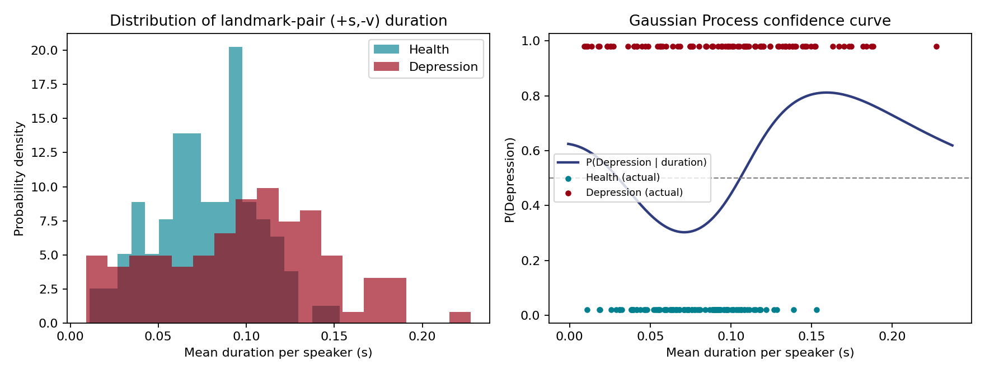
Experiment: Demonstrating the Concepts
DAIC-WOZ requires restricted clinical access, so we simulate landmark-pair (+s,–v) durations seeded with the paper's own published statistics (Table 2), then run the same statistical pipeline.
Health mean
0.077 s
Depression mean
0.099 s
Mann-Whitney p-value
0.0002
GPC test accuracy
70%
Mean confidence score
0.66

Slide 7
Key Takeaways
1
Timing is the signal
Depression shows up in how speech events are spaced in time — a genuine random process, not noise.
2
Distributions, not single values
Mean/variance and hypothesis testing (Mann-Whitney) are what make the difference between groups provable, not just visible.
3
Confidence needs a model too
A Gaussian Process turns a raw feature into both a decision and a calibrated trust score — critical for healthcare AI.
4
No audio needed in the LLM
By representing random-process statistics as text, SpeechT-RAG lets an off-the-shelf LLM “hear” timing without any retraining.

