Slide 1
Detecting Self Disclosure in Medical Forums
Physical conditions vs. Mental conditions

Slide 2
Self-Disclosure
Self-disclosure refers to the process of revealing personal information about oneself to others

Slide 3
Why we are researching on self-disclosure online?
In addition to facilitating social bonds, self-disclosure also produces a wide variety of health benefits, and self-disclosure in psychotherapy is thought to play a critical role in successful treatment outcome.
Research has been mainly done on the psychological aspect of this issue. We would like to consider whether patients in physical pain have the same tendency to self-disclose than mental patients or not. By finding which disease category has the most tendency to self-disclose, medical procedures could be revised and improved and hopefully help more patients.
In person, acts of self-disclosure bring a risk of the other person's displeasure or rejection. In rare cases, the disclosure can have violent consequences. Further, because of the revealed identities of the communicants, one party can tell the secrets or unflattering attributes of the other party to a wider social group. The degree of anonymity online, varying by whether the parties know each other in their normal lives, can sometimes encourage self-disclosure of intimate information because there is a lack of wider consequences.

Slide 4
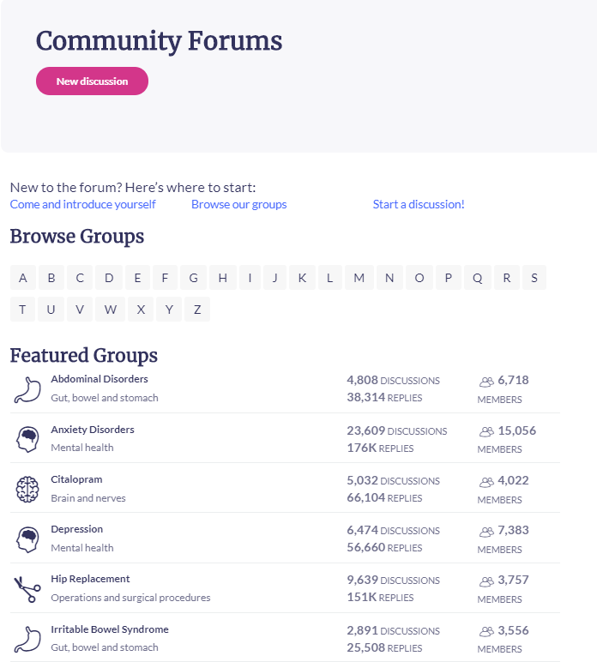
project goal
Our categories are as follows:
Mental health (anxiety disorder and depression)
Physical health (Abdominal disorders, Knee problems)
Comments are crawled from
an online health forum
Patient.info
find an approximate estimation of which disease category has the most tendency to self-disclose.

Slide 5
Text Preprocessing
Removing stopwords
Removing punctuation
Removing emojis
Removing digits
Spell-correction
Tokenizing
Padding sequences
Using Glove 100d to create an embedding matrix

Slide 6
Labelling the data
1500 comments labelled as self-disclosing comments
1050 comments labelled as non self-disclosing comments

Slide 7
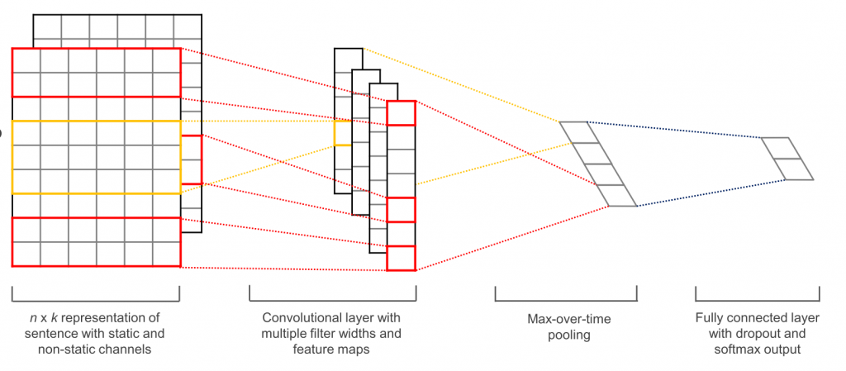
The model

Slide 8
The model & hyperparamters
Binary Classifier
Convolutional 1D (32 filters, kernel size of 8, relu activation)
Maxpooling 1D (10)
Adam optimizer (learning rate = 0.001, beta1 = 0.9, beta2 = 0.999)
Evaluation metrics: accuracy, precision, recall, F1
Batch size = 32
Epochs = 5

Slide 9
Evaluation of the model

Slide 10
Statistics

Slide 11
Conclusion

Slide 12
improvements
Regularization
More categories
More samples in each category
More labels
Static vs. non static channels

Slide 13
References
https://psychology.iresearchnet.com/social-psychology/self/self-disclosure/
Sloan, Denise M. Self-disclosure and psychological well-being. APA PsycNet
https://study.com/academy/lesson/self-representation-face-to-face-vs-online.html
patient.info
kim, “Convolutional Neural Networks for Sentence Classification”, 2014.

Slide 14
Any questions?

