Slide 1

$${2Ca}_{e}^{2+}⇌{2Ca}_{m}^{2+}$$
${Ca}_{e}^{2+}=A, {Ca}_{m}^{2+}=B, {Mg}_{e}^{2+}=C, {Mg}_{m}^{2+}=D,$ ${Pi}_{e}^{2−}=E, {Pi}_{m}^{2−}=F$

Slide 2
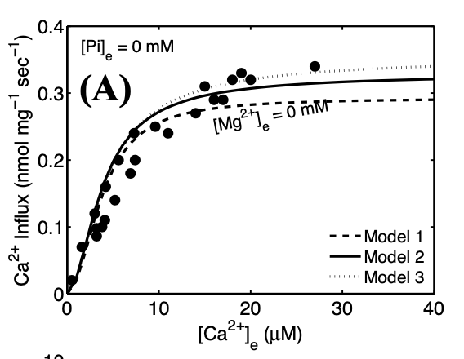
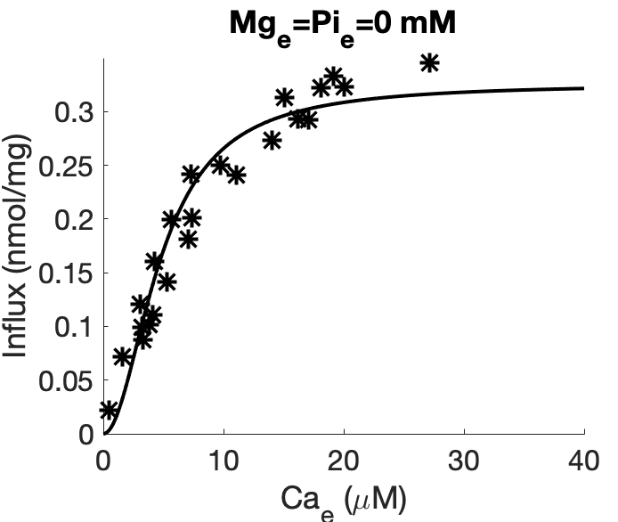
K_{A} = 4.7715305e-06 M
T_{max} = 3.1057560e-07 mmol/mg/s

Slide 3
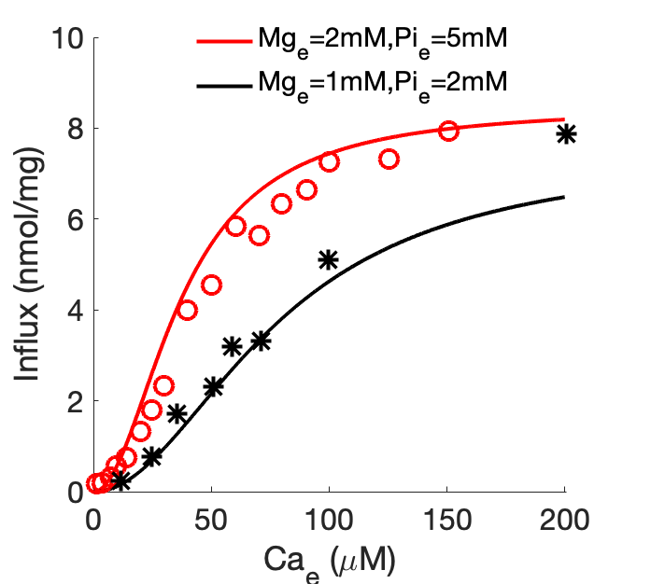
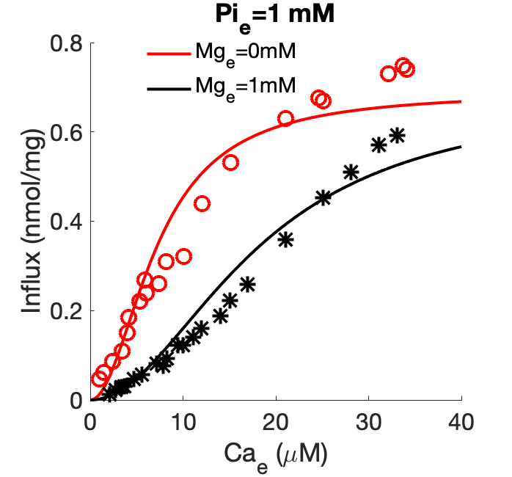
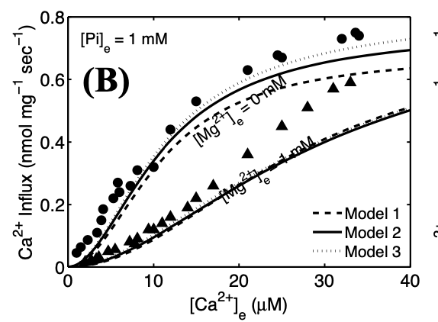
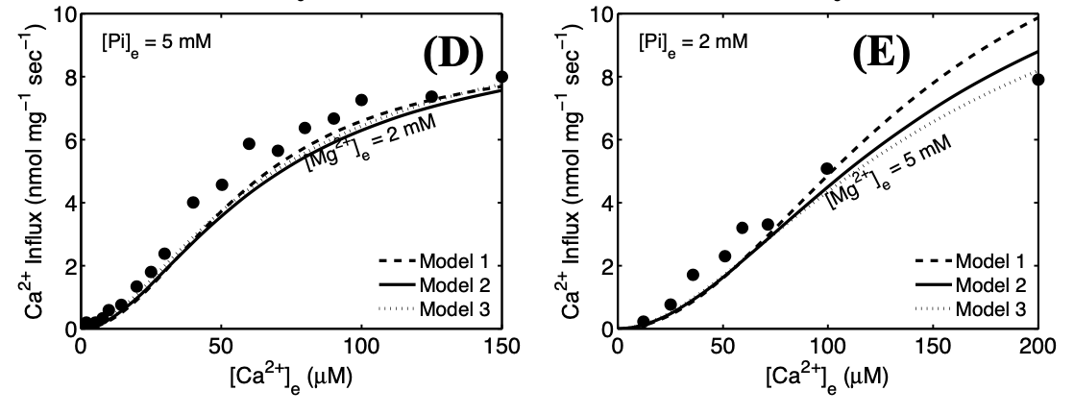
K_{Mg} = 2.8617845e-04 M
K_{Pi} = 1.9544085e-03 M

