Slide 1
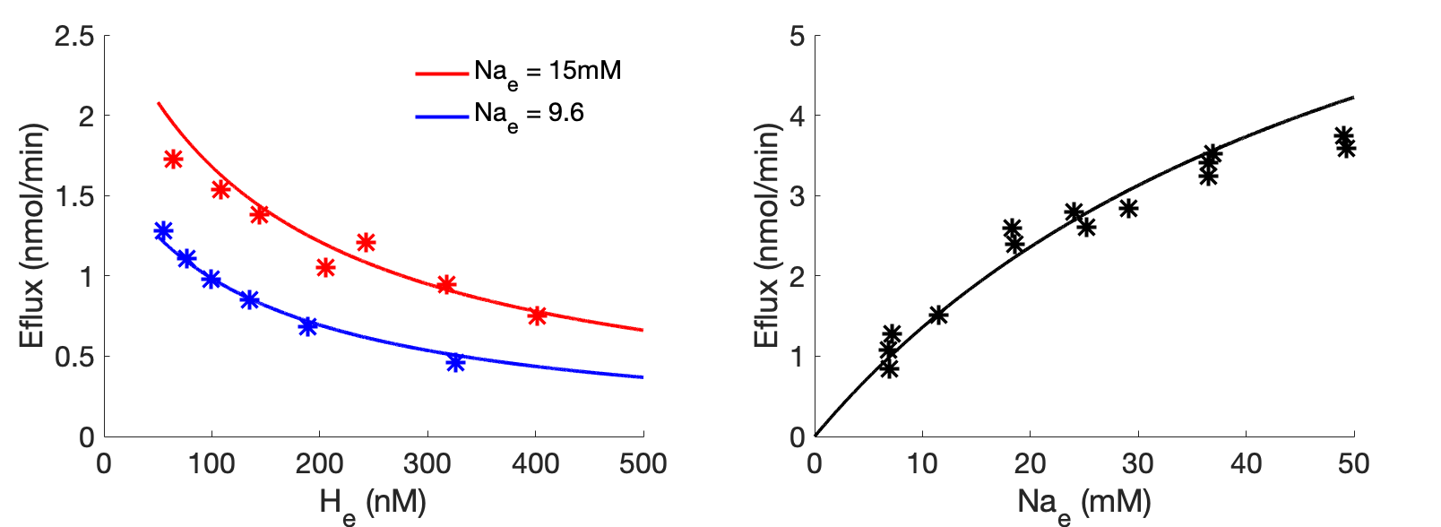

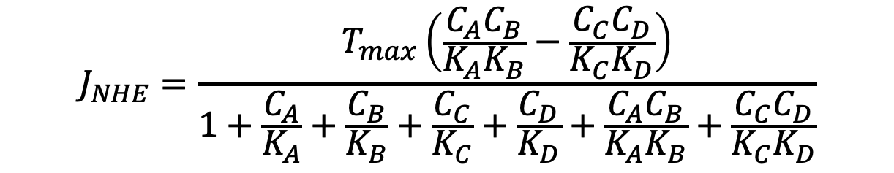
$${Na}_{m}^{+}+H_{e}^{+}⇌{Na}_{e}^{+}+H_{m}^{+}$$
$${Na}_{m}^{+}=A, H_{e}^{+}=B, {Na}_{e}^{+}=C, H_{m}^{+}=D$$
$$J_{NHE}=\frac{T_{max}\left(\frac{C_{A}C_{B}}{K_{A}K_{B}}−\frac{C_{C}C_{D}}{K_{C}K_{D}}\right)}{1+\frac{C_{A}}{K_{A}}+\frac{C_{B}}{K_{B}}+\frac{C_{C}}{K_{C}}+\frac{C_{D}}{K_{D}}+\frac{C_{A}C_{B}}{K_{A}K_{B}}+\frac{C_{C}C_{D}}{K_{C}K_{D}}}$$
K_{A} = K_{C} = 2.6066677e-04 M
K_{B} = K_{D} = 1.0028884e-09 M
T_{max} = 7.9818513e-08 mmol/mg

Slide 2
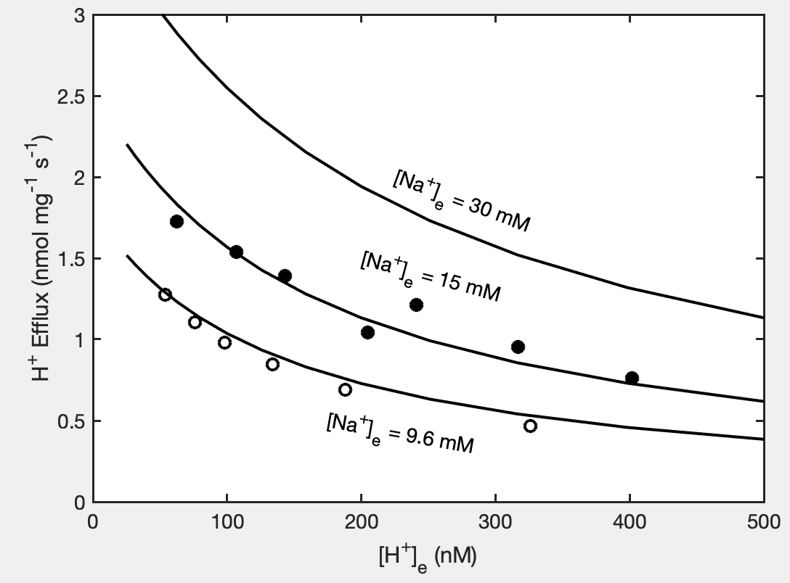
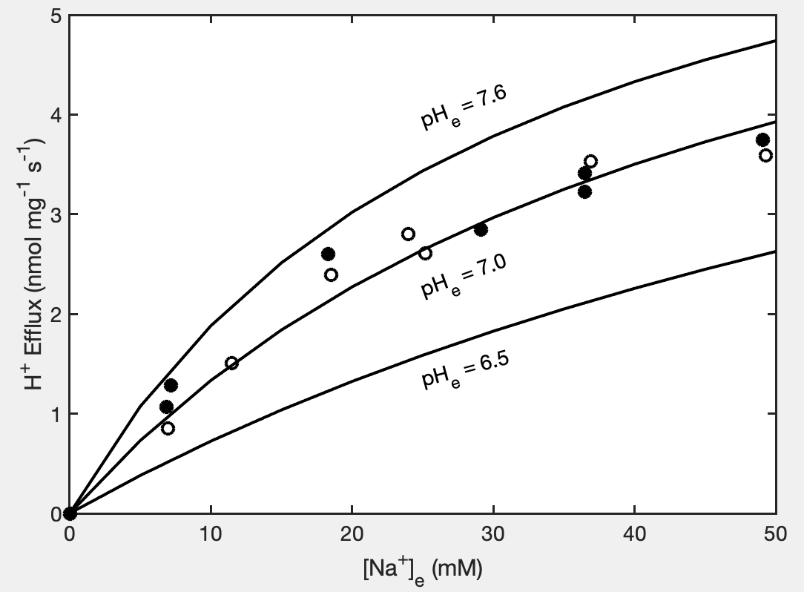

Slide 3
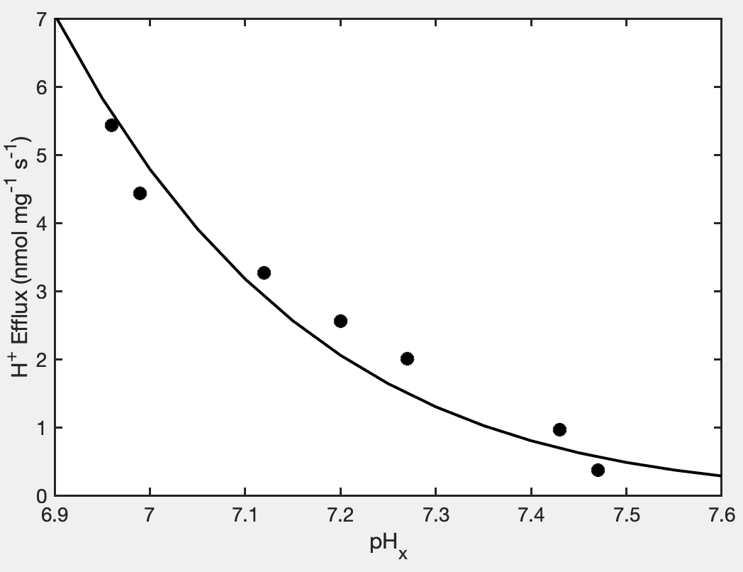
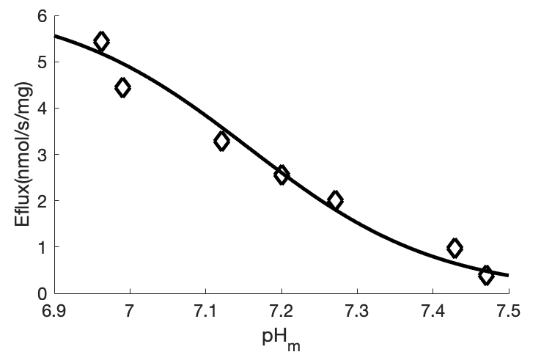
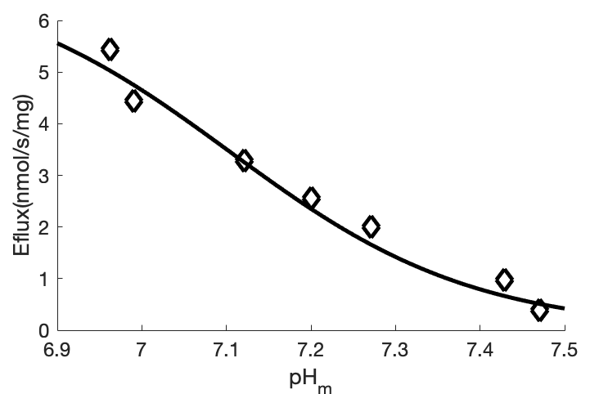
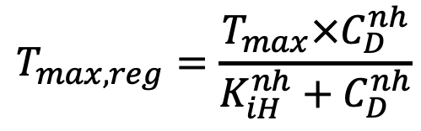
Matrix pH regulation of NHE
$$T_{max,reg}=\frac{T_{max}×C_{D}^{nh}}{K_{iH}^{nh}+C_{D}^{nh}}$$
K_{iH} = 6.9703537e-08 M
T_{max} = 6.2808496e-06 mmol/mg/s
nh = 3.45
K_{iH} = 7.8705711e-08 M
T_{max} = 6.9168565e-06 mmol/mg/s
nh = 3

