Slide 1
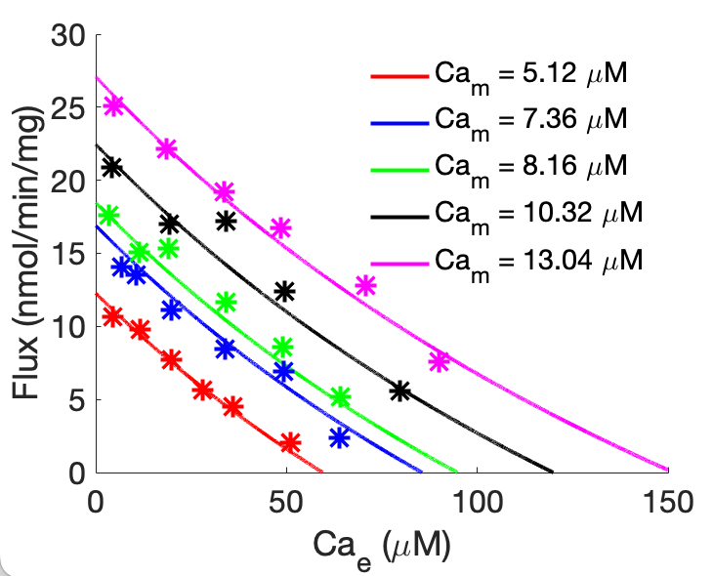


$${Ca}_{m}^{2+}+2H_{e}^{+} ⇌{Ca}_{e}^{2+}+2H_{m}^{+}$$
A = ${Ca}_{m}^{2+}$, B = $H_{e}^{+}$, C = ${Ca}_{e}^{2+}$, and D = $H_{m}^{+}$
K_{A} = 1.7193310e-05 M
K_{C} = 7.9526187e-05 M
T_{max} = 2.4649718e-04 mmol/mg/min

