Slide 1
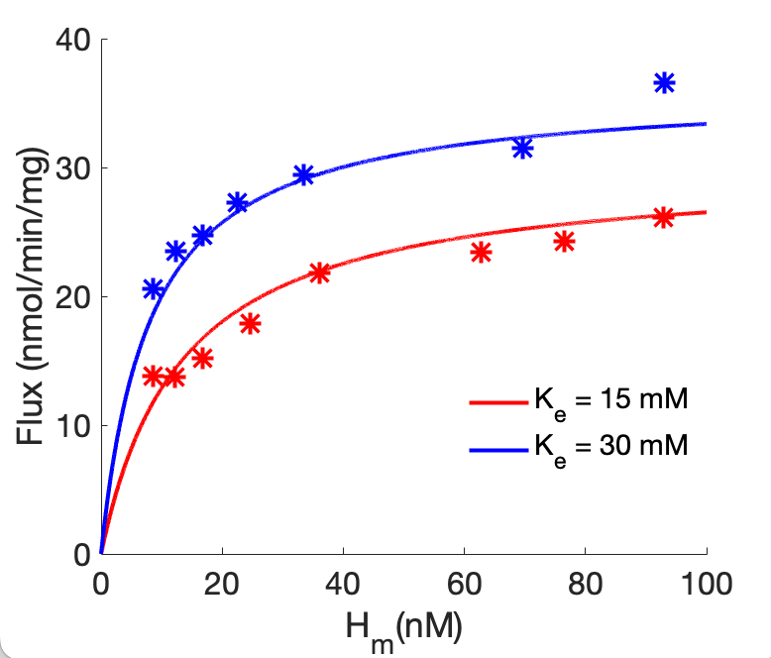
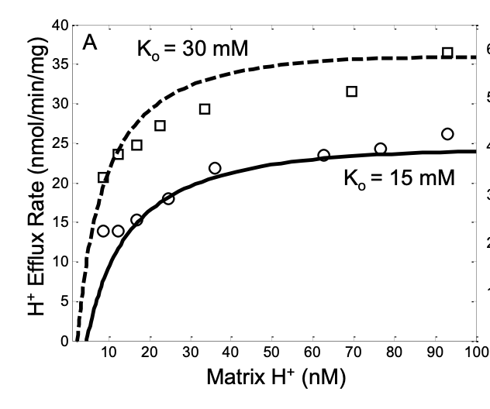

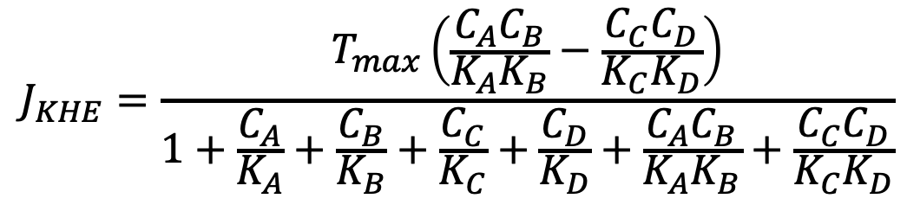
$$K_{m}^{+}+H_{e}^{+}⇌K_{e}^{+}+H_{m}^{+}$$
$$K_{m}^{+}=A, H_{e}^{+}=B, K_{e}^{+}=C, H_{m}^{+}=D$$
$$J_{KHE}=\frac{T_{max}\left(\frac{C_{A}C_{B}}{K_{A}K_{B}}−\frac{C_{C}C_{D}}{K_{C}K_{D}}\right)}{1+\frac{C_{A}}{K_{A}}+\frac{C_{B}}{K_{B}}+\frac{C_{C}}{K_{C}}+\frac{C_{D}}{K_{D}}+\frac{C_{A}C_{B}}{K_{A}K_{B}}+\frac{C_{C}C_{D}}{K_{C}K_{D}}}$$
K_{A} = K_{C} = 7.4968377e-03
K_{B} = K_{D} = 8.3126531e-11
T_{max} = 4.5080887e-05

Slide 2
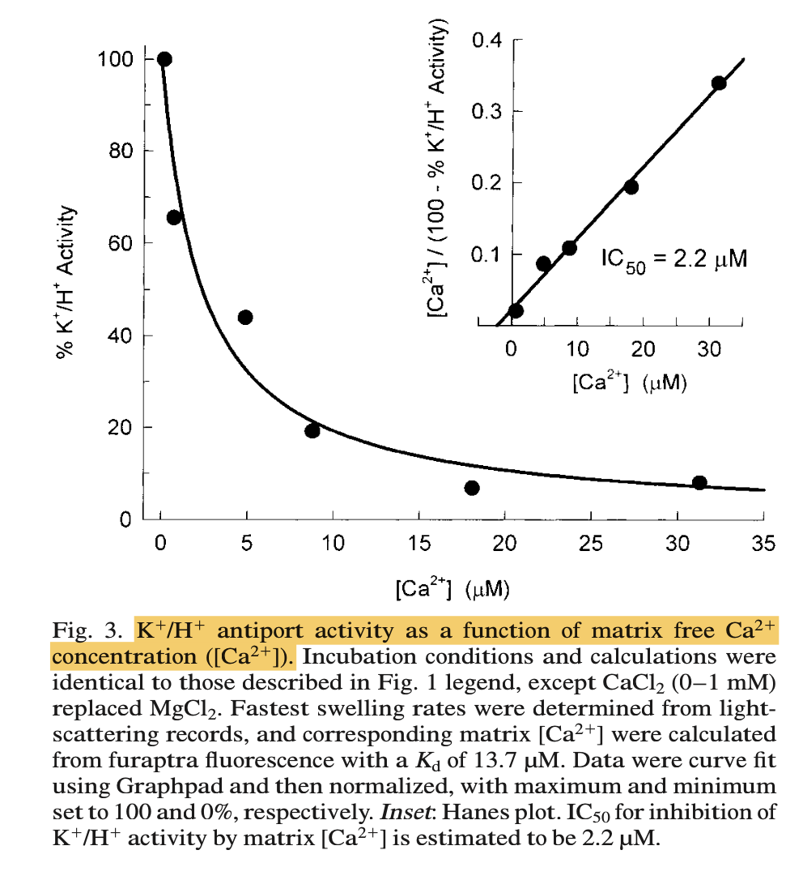
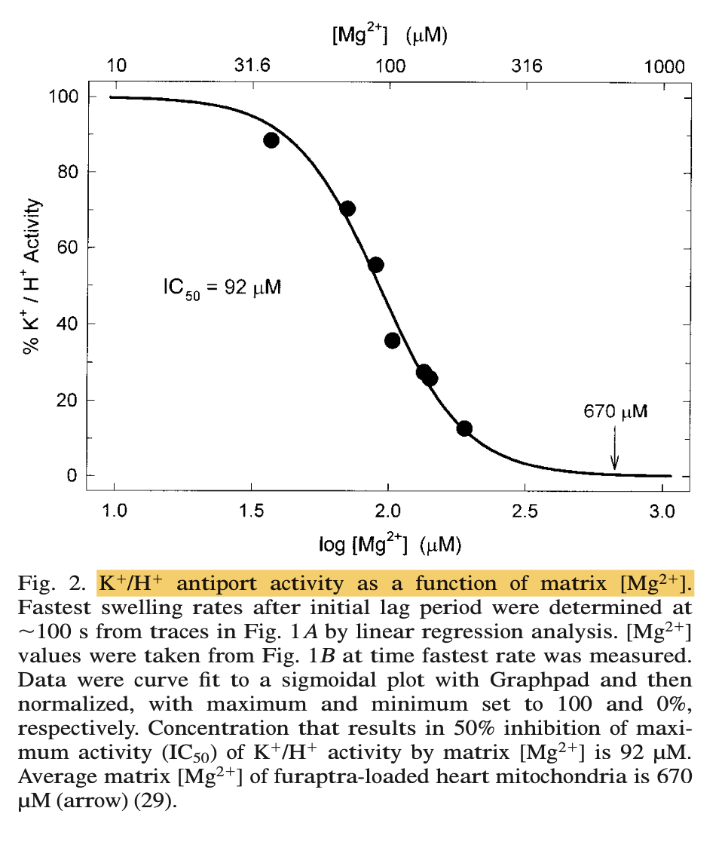

Slide 3
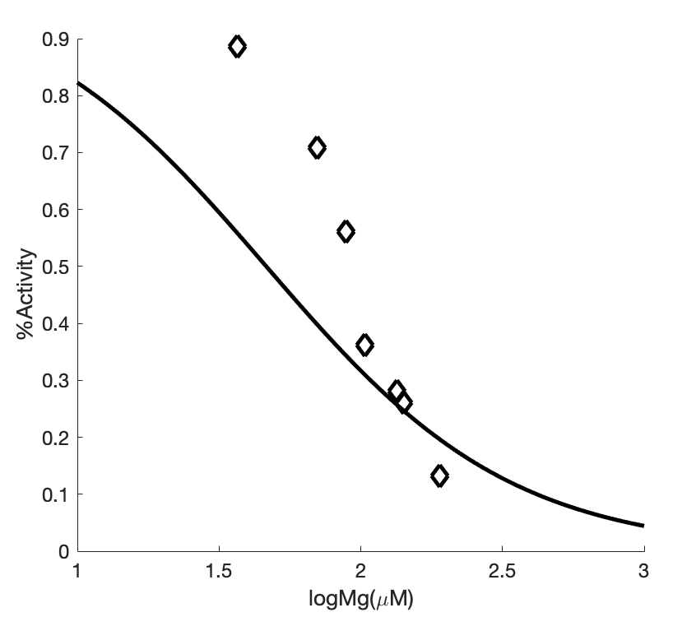
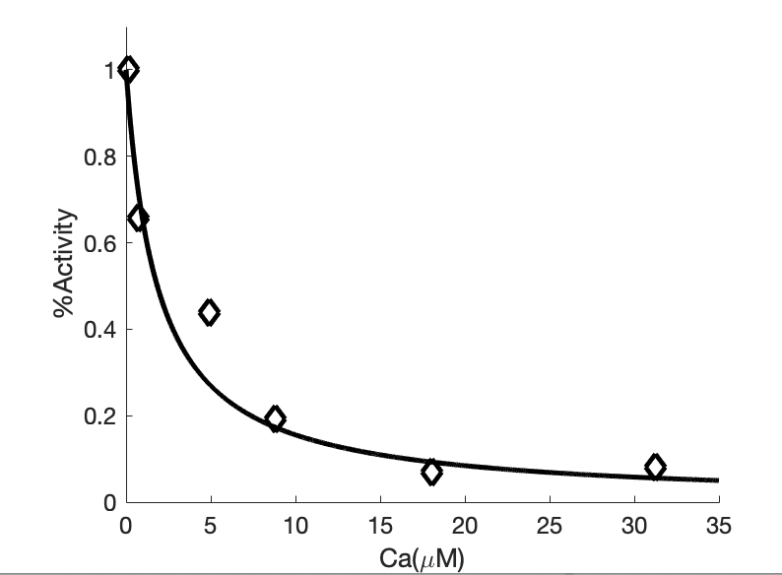
1.8430172e-06
4.6427077e-05

