Slide 1
POSIX THREADS & OPENMP
Avinash Reddy Penugonda
Sai Chinmayananda Korlimarla
Darshil Hirpara

Slide 2
Outline
Part I (by Avinash)
Thread & Process Basics
POSIX Threads API
Thread Management & Synchronization techniques
Part II (by Sai)
OPENMP API
Part III (by Darshil)
POSIX Threads Vs OPENMP Vs MPI
Examples

Slide 3
What is a Thread?
OS view: A thread is an independent stream of instructions that can be scheduled to run by the OS.
Each one has its own, independent control flow
Threads are powerful. As with most powerful tools, if they are not used appropriately thread programming may be inefficient.
Software developer view: a thread can be considered as a “procedure” that runs independently from the main program.
Sequential program: a single stream of instructions in a program.
Multi-threaded program: a program with multiple streams
Multiple threads are needed to use multiple cores/CPUs

Slide 4
Process
Process is an instance of a computer program that is being executed.
Example: Web browser, Microsoft Office etc.
Each processes may contain multiple threads of execution that execute concurrently
If a process dies, it kills all the threads associated with it
Process are used for more heavyweight tasks whereas threads are used for small tasks
Threads within a process share same memory space whereas different process do not.

Slide 5
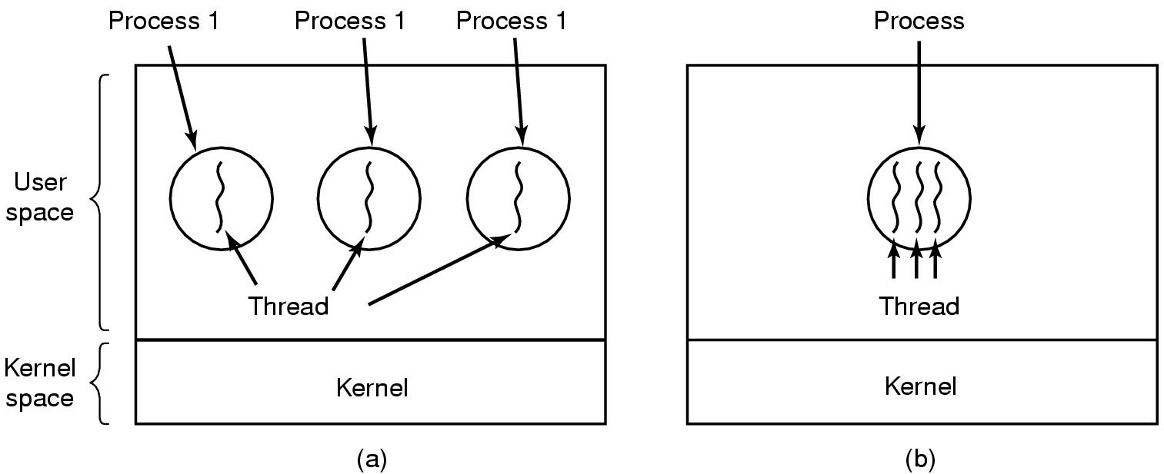
The Thread Model
(a) Three processes each with one thread
(b) One process with three threads

Slide 6
Why is Threading required?
Leverage Multi-core processors and used in client-server model of computing
Computer games
each thread controls the movement of an object.
Scientific simulations
Hurricane movement simulation: each thread simulates the hurricane in a small domain.
Molecular dynamic: each thread simulates a subset of particulars.
Web server
Each thread handles a connection.

Slide 7
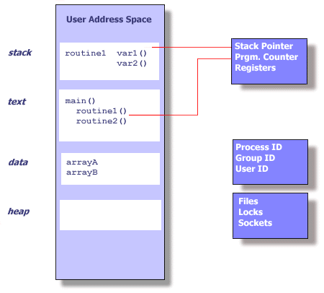
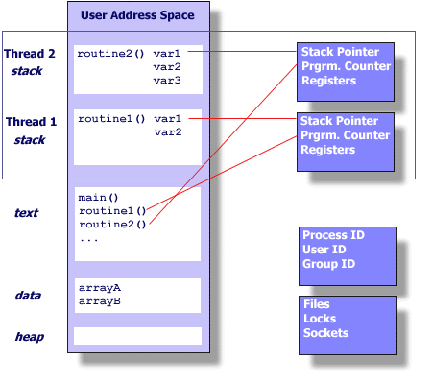
Process Vs Thread
Courtesy of Lawrence Livermore National Lab http://www.llnl.gov/computing/tutorials/pthreads/

Slide 8
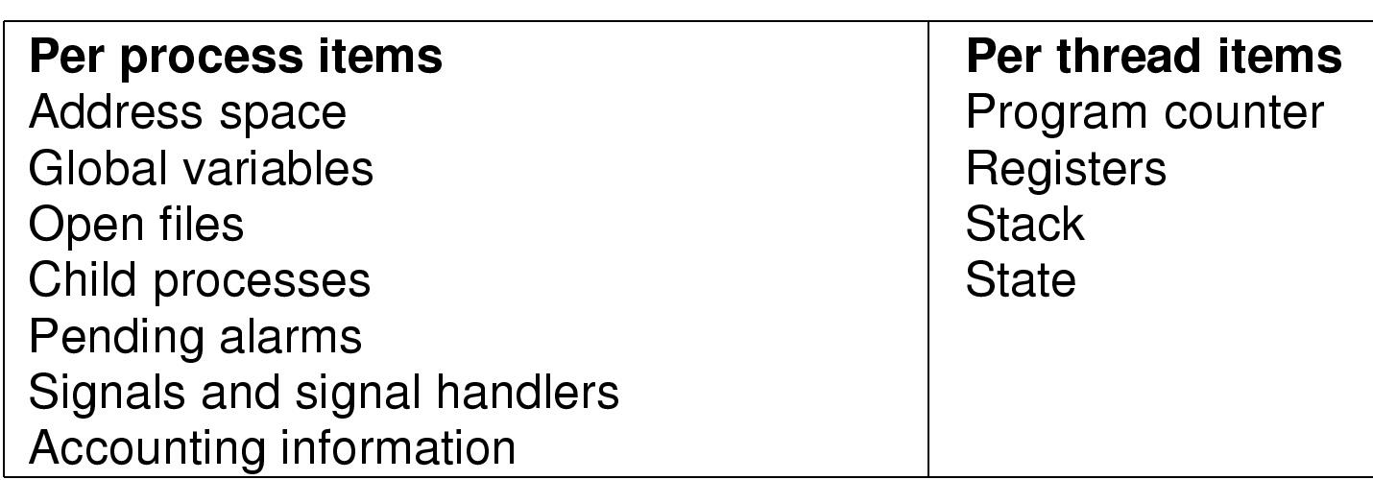
Per process vs per thread items
Each thread maintains
Stack, Registers, Scheduling properties (e.g. priority)
Set of pending and blocked signals (to allow different react differently to signals)
Thread specific data

Slide 9
Advantages of Threads
Light-weight
Lower overhead for thread creation
Lower Context Switching Overhead
Fewer OS resources
Shared State
Don’t need IPC-like mechanism to communicate between threads of same process

Slide 10
Disadvantages of Threads
Shared State!
Global variables are shared between threads. Accidental changes can be fatal.
Many library functions are not thread-safe
Library Functions that return pointers to static internal memory. E.g. gethostbyname()
Lack of robustness
Crash in one thread will crash the entire process.

Slide 11
Real life example
Google Chrome browser
Multi-process Architecture --Uses one process per tab, plugin and extension
Memory intensive
Each process has its own memory
Stable even if a plugin crashes
Speed
Secure
Mozilla Firefox browser
Single process architecture --Uses multiple thread of one process for all the tabs
Not memory intensive
All the threads share the same memory
Not stable as one plugin can crash the entire browser
Relatively slow
Not secure
Good news: Multi-process architecture is in beta version and will be rolling out in future releases.

Slide 12
The POSIX Threads API
Many thread models emerged: Solaris threads, win-32 threads
For UNIX systems, implementations of threads that adhere to the IEEE POSIX 1003.1c standard are Pthreads.
API specifies the rules for thread creation and synchronization.
Simply a collection of C functions defined in the pthread.h header/include file.
One of the undergraduates from UB implemented a object-oriented version of the Pthreads called Zthreads.

Slide 13
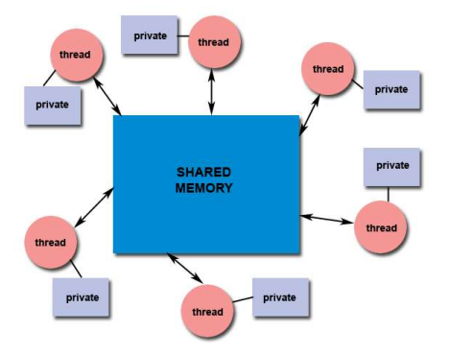
Pthreads Shared Memory Model:

Slide 14
Designing Pthreads Programs
Pthreads are best used with programs that can be organized into discrete, independent tasks which can execute concurrently.
Example: different tabs in a browser
Common models for threaded programs:
Manager/Worker: manager assigns work to other threads, the workers. Manager handles input and hands out the work to the other tasks.
Pipeline: task is broken into a series of suboperations, each handled in series but concurrently, by a different thread.

Slide 15
Pthread API Subroutines
Thread management: Routines that work directly on threads - creating, detaching, joining, etc. They also include functions to set/query thread attributes (joinable, scheduling etc.)
Mutexes: Routines that deal with synchronization, called a "mutex", which is an abbreviation for "mutual exclusion". Mutex functions provide for creating, destroying, locking and unlocking mutexes. These are supplemented by mutex attribute functions that set or modify attributes associated with mutexes.
Condition variables: Routines that address communications between threads that share a mutex. Based upon programmer specified conditions. This group includes functions to create, destroy, wait and signal based upon specified variable values. Functions to set/query condition variable attributes are also included.
Synchronization: Routines that manage read/write locks and barriers.

Slide 16
The Pthreads API naming convention
Routine Prefix | Function
Pthread_ | General pthread
Pthread_attr_ | Thread attributes
Pthread_mutex_ | mutex
Pthread_mutexattr | Mutex attributes
Pthread_cond_ | Condition variables
Pthread_condaddr | Conditional variable attributes
Pthread_key_ | Thread specific data keys

Slide 17
Thread management primitives-- Creating Threads
Prototype:
int pthread_create(pthread_t *tid, const pthread_attr_t *tattr, void*(*start_routine)(void *), void *arg);
tid: an unsigned long integer that indicates a threads id
tattr: attributes of the thread – usually NULL
start_routine: the name of the function the thread starts executing
arg: the argument to be passed to the start routine – only one
after this function gets executed, a new thread has been created and is executing the function indicated by start_routine

Slide 18
Waiting for a Thread
Prototype:
int pthread_join(thread_t tid, void **status);
tid: identification of the thread to wait for
status: the exit status of the terminating thread – can be NULL
the thread that calls this function blocks its own execution until the thread indicated by tid terminates its execution
finishes the function it started with or
issues a pthread_exit() command – more on this in a minute

Slide 19
Example
thrd 0
thrd 1
create_thread()
start of printMsg()
end of printMsg()
end of program
Note: thrd 0 is the function that contains main() – only one main() per program

Slide 20
Exiting a Thread
Pthreads exist in user space and are seen by the kernel as a single process
if one issues and exit() system call, all the threads are terminated by the OS
if the main() function exits, all of the other threads are terminated
To have a thread exit, use pthread_exit()
Prototype:
void pthread_exit(void *status);
status: the exit status of the thread – passed to the status variable in the pthread_join() function of a thread waiting for this one

Slide 21
Pthread Example
#include <pthread.h>
#include <stdio.h>
#define NUM_THREADS 5
void *PrintHello(void *threadid) {
int tid; tid = (int)threadid;
printf("Hello World! It's me, thread #%d!\n", tid);
pthread_exit(NULL); }
int main (int argc, char *argv[]) {
pthread_t threads[NUM_THREADS];
int rc, t;
for(t=0; t<NUM_THREADS; t++){
printf("In main: creating thread %d\n", t);
rc = pthread_create(&threads[t], NULL, PrintHello, (void *)t);
if (rc){
printf("ERROR; return code from pthread_create() is %d\n", rc);
exit(-1);
}}
pthread_exit(NULL);
}

Slide 22
Pthread Example - Output
In main: creating thread 0
In main: creating thread 1
Hello World! It's me, thread #0!
In main: creating thread 2
Hello World! It's me, thread #1!
Hello World! It's me, thread #2!
In main: creating thread 3
In main: creating thread 4
Hello World! It's me, thread #3!
Hello World! It's me, thread #4!

Slide 23
Synchronization problems
Problems when multiple threads share a common address space
THREAD 1 THREAD 2
a = data; b = data;
a++; b--;
data = a; data = b;
Variable ‘data’ is accessed and modified in both threads (race – condition).

Slide 24
Thread synchronization primitives-- Mutex Locks
Apply locks to eliminate race conditions from multi-threaded application.
A Mutex lock is created like a normal variable
pthread_mutex_p mutex;
Mutexes must be initialized before being used
a mutex can only be initialized once
prototype:
int pthread_mutex_init(pthread_mutex_t *mp, const pthread_mutexattr_t *mattr);
mp: a pointer to the mutex lock to be initialized
mattr: attributes of the mutex – usually NULL

Slide 25
Locking a Mutex
To insure mutual exclusion to a critical section, a thread should lock a mutex
when locking function is called, it does not return until the current thread owns the lock
if multiple threads try to gain lock at the same time, the return order is based on priority of the threads
higher priorities return first
no guarantees about ordering between same priority threads
prototype:
int pthread_mutex_lock(pthread_mutex_t *mp);
mp: mutex to lock

Slide 26
Unlocking a Mutex
When a thread is finished within the critical section, it needs to release the mutex
calling the unlock function releases the lock
then, any threads waiting for the lock compete to get it
very important to remember to release mutex
prototype:
int pthread_mutex_unlock(pthread_mutex_t *mp);
mp: mutex to unlock

Slide 27
Condition Variables (CV)
Condition variables allow a thread to block until a specific condition becomes true
recall that a blocked process cannot be run
doesn’t waste CPU cycles
blocked thread goes to wait queue for condition
When the condition becomes true, some other thread signals the blocked thread(s)

Slide 28
Creation of a Condition Variable (CV)
A CV is created like a normal variable
pthread_cond_t condition;
CVs must be initialized before being used
a CV can only be initialized once
prototype:
int pthread_cond_init(pthread_cond_t *cv, const pthread_condattr_t *cattr);
cv: a pointer to the conditon variable to be initialized
cattr: attributes of the condition variable – usually NULL

Slide 29
Blocking on CV
A wait call is used to block a thread on a CV
puts the thread on a wait queue until it gets signaled that the condition is true
even after signal, condition may still not be true!
blocked thread does not compete for CPU
the wait call should occur under the protection of a mutex
this mutex is automatically released by the wait call
the mutex is automatically reclaimed on return from wait call
prototype:
int pthread_cond_wait(pthread_cond_t *cv,pthread_mutex_t *mutex);
cv: condition variable to block on
mutex: the mutex to release while waiting

Slide 30
Signaling a Condition
A signal call is used to “wake up” a single thread waiting on a condition
multiple threads may be waiting and there is no guarantee as to which one wakes up first
thread to wake up does not actually wake until the lock indicated by the wait call becomes available
int pthread_cond_signal(pthread_cond_t *cv);
cv: condition variable to signal on

Slide 31
Conclusion:
Pthreads is a very low-level API for working with threads. Thus, you have extremely fine-grained control over thread management (create/join/etc), mutexes, and so on. It's fairly bare-bones.
Improve system performance than single threaded program.
Reduce system overhead as creating two threads uses less memory when compared to separate processes.
Intraprocess (Inter-thread) communication is more efficient than interprocess communication.
Exploit potential parallelism

Slide 32
OpenMP

Slide 33
OpenMP
What is OpenMP
An API that may be used to explicitly direct multi-threaded, shared memory parallelism
Abbreviation for Open Multi-Processing
Comprised of three main API components
Compiler Directives
Runtime Library Routines
Environment Variables

Slide 34
History of OpenMP
OpenMP standard started in 1997, it is led by OpenMP Architecture Review Board (ARB)
Members of ARB include:
Compac/Digital
Intel Corporation
IBM
KAI
Silicon Graphics
Sun microsystems
US department of Enrgy ASIC program

Slide 35
Goals of OpenMP
Standardization
Provide a standard among shared memory architectures/platforms
Lean and Mean
Establish a simple set of directives for programming shared machines
Ease of Use
Provide capability to incrementally parallelize a serial program
Portability
API is specified for C\C++\Fortran
Major platforms have been implemented including Unix/Linux and Windows

Slide 36
OpenMP Programming Model
OpenMP is designed for multi-processors/cores, shared memory models (Memory models can be UMA or NUMA)
All threads have access to same global shared memory. Shared data is accessible by all threads.
Each thread has a private memory which can by accessed by it only
Data transfer is transparent to the programmer
Synchronization is mostly implicit
Programming model is an Explicit thread based parallelism model. It follows the Fork-Join model for thread management

Slide 37
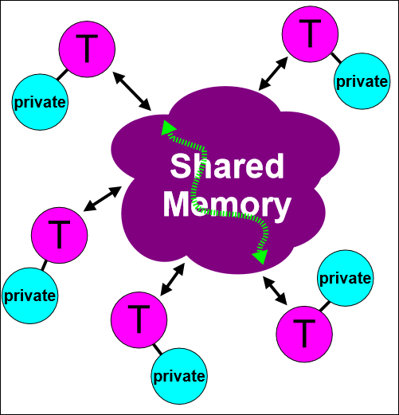
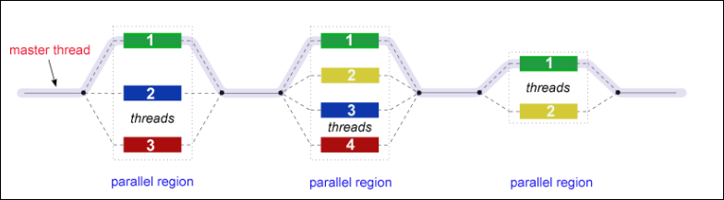
OpenMP Programming Model

Slide 38
Open MP API Overview
Has three components:
Compiler Directives
Run time Library Routines
Environment Variables
Compiler Directives:
These appear as comments in the source code and are considered by compilers when an appropriate compiler flag is raised
OpenMP compiler directives are used for
Creating a parallel region
Serializing a section of code
Distributing loop iterations
Dividing Blocks of code among iterations
Example: #pragma omp parallel default(shared) private(var1,var2)

Slide 39
Open MP API Overview
Run-time Libray Routines:
The API has a ever growing numberof run-time library routines
These routines are used for
Setting and querying number of threads
Finding the thread-id of the thread
Setting the dynamic threads feature
Setting and querying nested parrallelism
Example:
#include <omp.h>
Int threads = omp_get_num_threads();
Omp_set_num_threads(omp_num_procs);

Slide 40
Open MP API Overview
Environment Variables:
OpenMP provides several environment variables for controlling the execution of parallel code at run time
These environment variables are used to control things such as
Setting the Number of threads
Specifying how the loop iterations are divided
Binding threads to processors
Enable/Disable nested parallelism
Managing thread stack size/wait policy
Example:
setenv OMP_NUM_THREADS 8
OMP_STACKSIZE, OMP_WAIT_POLICY (active passive),OMP_PROC_BIND (T/F)

Slide 41
Open MP API Overview
OpenMP team = Master + workers
A parallel region is a block of code executed by all threads
Master thread has id 0
Parallel regions can be nested, but support is implementation dependent
If clause can be sued to guard the parallel region
Work sharing constructs divides the execution of the enclosed code region among master and worker threads

Slide 42
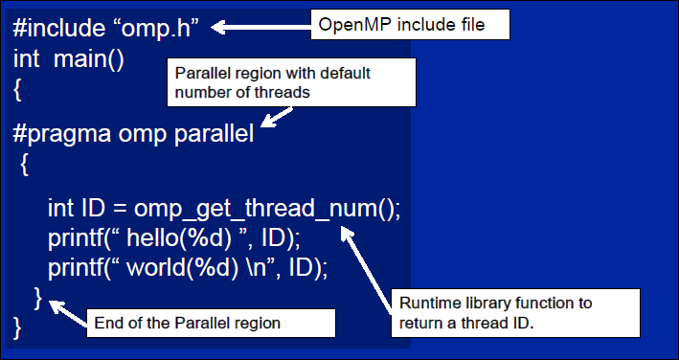
Open MP Example

Slide 43
Parallel Region construct
#pragma omp parallel clause if(scalar exression)
private (list)
shared(list)
default(none, shared, private)
firstprivate(list)
lastprivate(list)
reduction(operator:list) // + - * & ! && !!
copyin(list)
num_threads (integer-expression)
{
//this is executed in parallel
} //implied barrier

Slide 44
Data Sharing Attributes
In OpenMP program data needs to be labelled as either shared or private
Shared
Only one Instance of the data will exist
All threads can read/write the data simultaneously unless protected explicitly
All changes are visible to all threads (not necessarily immediately)
Unintended sharing of data may cause race condition
Synchronization of data is needed for the above case
Private
Each thread has a copy of the data
Access is available only to the thread that owns it

Slide 45
Parallel Region construct
Example:
#pragma omp parallel if(size > threshold) private (i) shared(a) default(shared)\ reduction(+:sum) num_threads (4)
{ #pragma omp for
for (i=0;i<n;i++)
{
sum += a[i] ;
}
} //implied barrier
//Sum has the accumulated sum from the 4 threads

Slide 46
Work sharing constructs
#pragma omp parallel for [clauses]
{
//for loop to be parallalized
}
Clauses: private, shared, firstprivate, lastprivate, reduction, ordered, nowait, schedule
Ordered: in order execution of code (i before i+1)
Schedule: (static, dynamic, guided, auto,runtime)
Collapse (number of nested loops)

Slide 47
Work sharing constructs
#pragma omp parallel sections
{
#pragma omp parallel section
code block 1
#pragma omp parallel section
code block 2
}
Clauses: private, shared, firstprivate, lastprivate, reduction, nowait

Slide 48
Work sharing constructs
#pragma omp single (private, firstprivate, nowait)
{
code block
}
Ideally suited for I/O operations or initializations
Only one thread can pick up the code block
#pragma omp master
Similar to single, but the code block is executed by the master thread alone

Slide 49
Combined Parallel work sharing constructs
For conveniences of the programmer the following work constraints are available
#pragma omp parallel for
#pragma omp parallel sections
Identical to a parallel section followed by these work sharing constructs

Slide 50
Critical and atomic constructs
#pragma omp critical
{
code block
}
Only one thread can pick up the code block at a time
Useful to avoid race conditions. Not scalable in some cases
#pragma omp atomic {statement}
Similar to critical, but only for load, store operations

Slide 51
Synchronization
#pragma omp barrier
Explicit barrier
Threads wait here till all threads have reached the barrier
Useful to prevent race conditions
master construct has no implicit barrier since other threads just skip it
For, single, section and parallel have an implicit barrier.
Implicit barrier can be removed by using nowait clause in for, single and section

Slide 52
OpenMP Tasks
#pragma omp task
Tasks are independent units of work
Tasks are composed of code to execute, data environment and ICV(internal control variables)
Threads perform work of each task.
Runtime decides when a task is executed
Need an explicit barrier to tell where all tasks need to end
Barrier or taskwait constructs can be used
Have potential to parallelize irregular patterns and recursive function call

Slide 53
OpenMP Memory consistency
OpenMP follows a variant of weak consistency
Can not reorder S ops with R or W ops
Flush:
Flush is seen as a sequence point at which a thread can see a consistent view of memory with respect to all thread visible variables (flush set = flush(list))
#pragma omp flush (list)
Forces data to memory so other threads can see the updated values
Implied for barrier, paralled (entry/exit), critical (entry,exit), ordered(entry,exit)
For (exit), sections(exit), single(exit)
Not implied if a nowait clause is implemented

Slide 54
Further reading resources on Open MP
http://www.openmp.org/resources/tutorials-articles/
https://computing.llnl.gov/tutorials/openMP/

Slide 55
Pthreads Vs OpenMP Vs MPI

Slide 56
Pthreads Vs OpenMP
pThreads
OpenMP
POSIX standard
Library functions
Explicit fork and join
Explicit synchronization
Explicit locks
Often used in “operational” environment
Often used for M:N applications -many short tasks for a few processors
Industry Standard
Compiler assist: • Directives (Fortran) • Pragmas (C, C++)
Explicit fork and join
Implicit synchronization
Implicit locks
Often used in data analysis
Often used for 1:1 applications - one task per processor

Slide 57
Sample Problem
Executing sum_st 1000 times
void sum_st(int *A, int *B, int *C){
int end = 10000000;
for(int i = 0; i < end; i++)
A[i] = B[i] + C[i];
}

Slide 58
Pthread Solution Parallelizing the loop such that different iterations can run in parallel.
struct params {
int *A;
int *B;
int *C;
int tid;
int size;
int nthreads;
};
void *compute_parallel(void *_p){
params *p = (params*) _p;
int tid = p->tid;
int chunk_size = (p->size / p->nthreads);
int start = tid * chunk_size;
int end = start + chunk_size;
for(int i = start; i < end; i++) p->A[i] = p->B[i] + p->C[i];
return 0;
}
void sum_mt(int *A, int *B, int *C){
int nthreads = 4;
int size = 10000000;
pthread_t threads[nthreads]; //array to hold thread information
params *thread_params = (params*) malloc(nthreads * sizeof(params));
for(int i = 0; i < nthreads; i++){
thread_params[i].A = A;
thread_params[i].B = B;
thread_params[i].C = C;
thread_params[i].tid = i;
thread_params[i].size = size;
thread_params[i].nthreads = nthreads;
pthread_create(&threads[i], NULL, compute_parallel, (void*) &thread_params[i]);
}
for(int i = 0; i < nthreads; i++){
pthread_join(threads[i], NULL);
}
free(thread_params);
}

Slide 59
Explanation
pthread_create: This is the function that spawns new threads. It takes the starting address of the new thread as its third argument and an input to the new thread as its fourth and last argument. The new thread is spawned when pthread_create is called.
pthread_join: This function makes the master thread (which spawned the threads) wait for the spawned child threads. It is called once for each spawned thread.
struct params Since pthread_create allows only one input argument to be passed to the thread, the input parameters are bundled into a struct called params and a pointer to the bundle is the thread’s input argument.
The function compute_parallel: pthread library requires that thread code should be in a separate function and cannot be inline. This requirement made the existence of the function compute_parallel necessary. Compute parallel takes six input parameters bundled in a single struct. Each thread first determines which portion of the array it needs to work on and then performs the operations. Note: in order to keep the code clean, I assume that the number of iterations is always a multiple of the number of threads

Slide 60
Open MP Solution
Open MP performs code-to-code transformations and also links libraries optimized for common parallel programming constructs.
The programmer annotates the code using pragmas and the compiler converts the code into parallel code.
To parallelize the same loop with Open MP, you can simply add a pragma before the loop as follows:
#pragma omp parallel for(private(i) shared(A, B, C) )
for(int i = 0; i < 10000000; i++)
A[i] = B[i] + C[i];
Upon encountering the pragma, the OpenMP compiler does the code transformation we did manually when using pthreads.

Slide 61
SIMILARITIES AND DIFFERENCES OpenMP AND MPI
OpenMP
MPI
OpenMP are hooked with compiler so with gnu compiler and with Intel compiler one have specific implementation. User is at liberty with changing compiler but not with openmp implementation.
OpenMP support C,C++ and FORTRAN
OpenMP target only shared memory system
Thread based Parallelism
No such overheads, as thread can share variables
Available from different vendor and can be compiled in desired platform with desired compiler. One can use any of MPI API i.e MPICH, OpenMPI or other
OpenMP support C,C++ and FORTRAN
MPI target both distributed as well shared memory system
Process and Thread based Parallelism
There are overheads associated with transferring message from one process to another

Slide 62
Contd
OpenMP
MPI
In OpenMP , threads have both private as well shared variable
Data racing is inherent in OpenMP model
Need to add omp.h and then can directly compile code with compiler option -fopenmp in Linux environment
Process in MPI has private variable only, no shared variable
Data racing not there if not using any thread in the process
Compilation of MPI program require
1. Adding header file : #include "mpi.h"
2. compiler as:(in linux )
mpic++ mpi.cxx -o mpiExe

Slide 63
Sample Program – Hello World!
OpenMP
MPI
#include <omp.h>
#include <stdio.h>
#include <stdlib.h>
int main (int argc, char *argv[])
{
int nthreads, tid;
/* Fork a team of threads giving them their own copies of variables */
#pragma omp parallel private(nthreads, tid)
{
/* Obtain thread number */
tid = omp_get_thread_num();
printf("Hello World from thread = %d\n", tid);
/* Only master thread does this */
if (tid == 0)
{
nthreads = omp_get_num_threads();
printf("Number of threads = %d\n", nthreads);
}
} /* All threads join master thread and disband */
}
#include <iostream>
#include <mpi.h>
using namespace std;
int main(int argc,char** argv)
{
int myid, numprocs;
MPI_Init(&argc,&argv);
MPI_Comm_size(MPI_COMM_WORLD,&numprocs);
MPI_Comm_rank(MPI_COMM_WORLD,&myid);
/* output my rank */
cout<<"Hello from "<<myid<<endl;
MPI_Finalize();
}

Slide 64
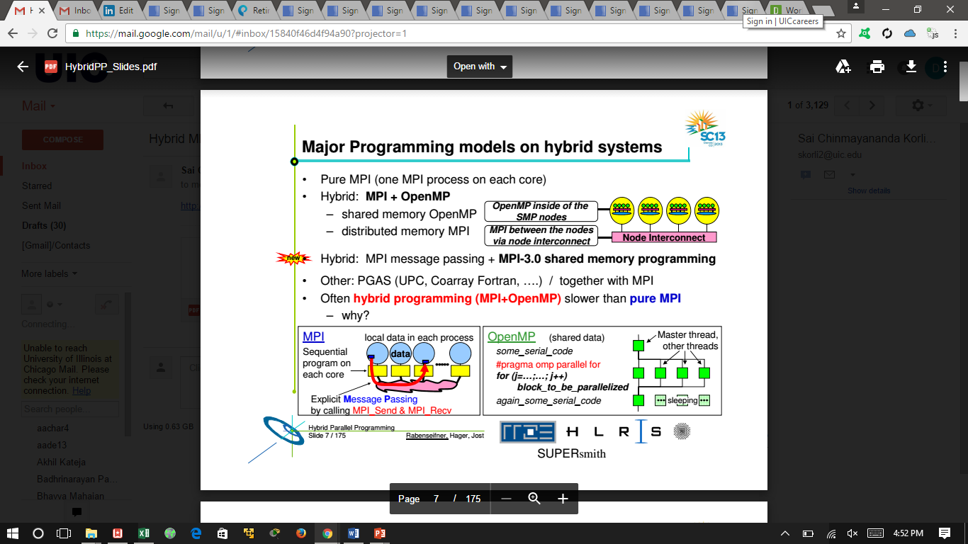
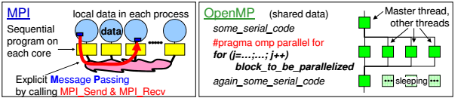
Hybrid MPI
Pure MPI(One MPI process per core)
Hybrid: MPI + OpenMP
- shared memory OpenMP
- distributed memory MPI

Slide 65
Conclusion
Open MP just makes it easier to write parallel code by hiding the ugly syntax. It does NOT help you in finding parallelism or figuring out the dependencies. Both of these are still the programmer’s burden.
Open MP has several advanced features which you can be used for more complex loops.
Open MP is not general enough to be used for all kinds of parallelism. It is best equipped with pragmas for loop-level parallelism often found in compute intensive workloads. pthreads is universal and can be used for any type of parallelism, e.g., transactional workloads like the MySQL database. Thus, pthreads will continue to prevail because of such workloads.

Slide 66
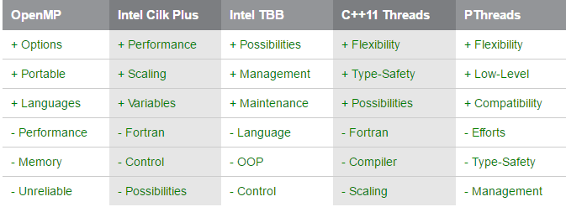
Additional Parallel Processing Platforms

Slide 67
Summary
If we need total control what is happening then Pthreads might be the best choices.
A good cross-platform solution with less overhead and fewer integrated possibilities would be OpenMP.
OpenMP provides quite fast fork and join functions, which enables applications to stay sequential most of the time and only fork in time-critical sections.
On the other hand using very low level functions provided by Pthreads will certainly result in applications that do mostly independent work but with very custom and flexible synchronization points.

Slide 68
Thank you!! Queries??

