Slide 1

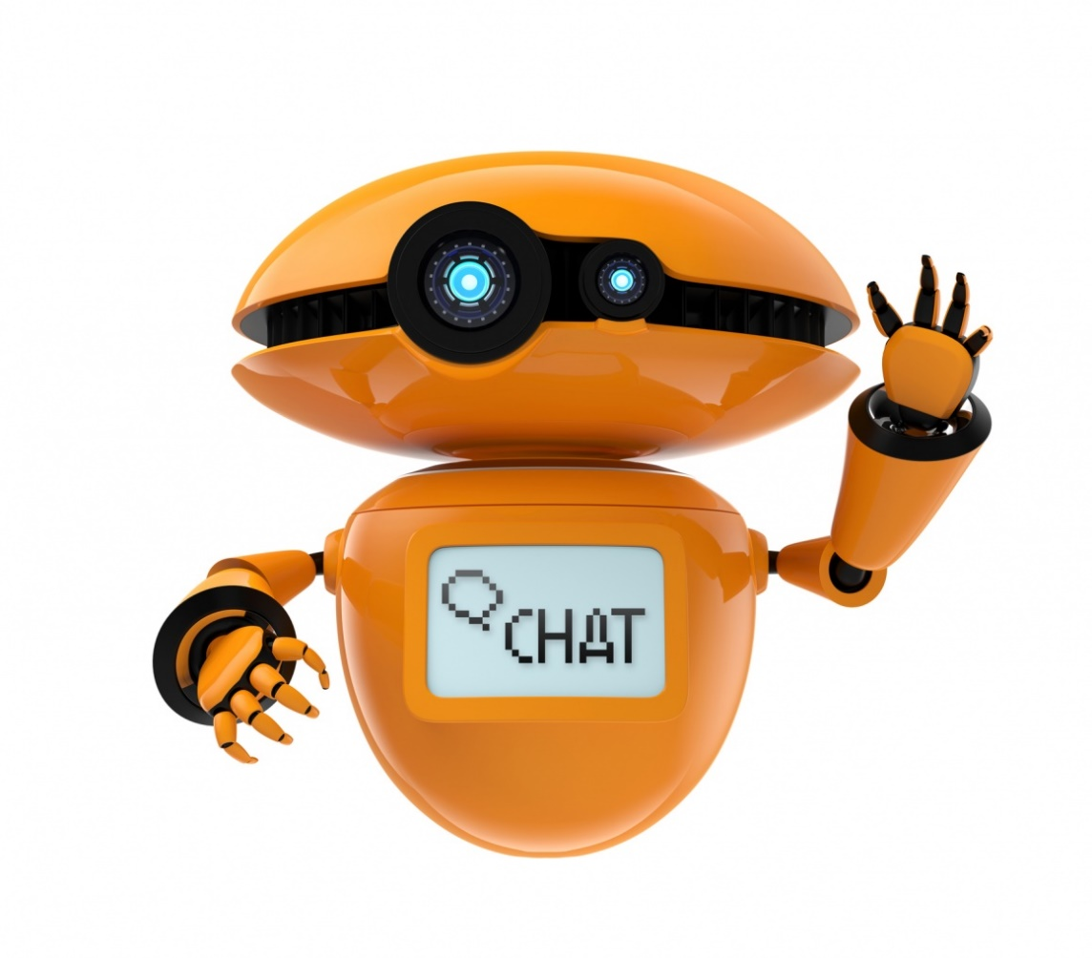
MSIS- CIS 5850 Chatbot Presentation
Project Team
Ambika Sharma
Vatsal Pancholi
Mayur Patil
Rashmi Pareek

Slide 2


Agenda
Project Goals & Vision
Project Team Members
Research & Development
Chatbot Process Creation Overview
Setup & Installation
Triggers & Authoring Canvas Improvements Flowcharts
FAQ’s

Slide 3
Project Goals & Vision
Primary Goal: Developing an expert system for college enquiry desk using a power app based Chatbot through AI technology & virtual assistance transmitting natural language to the servers
Target Group
Needs
Product
Product Goals
Primarily focused on college students
Live text discussions on course contents
Get relevant information's on the important deadlines for under graduates and graduates
College Chatbot
Resolve students queries immediately
24/7 student service
3

Slide 4
Research & Development
Chatbot Implementation Model
PHASES
Survey
Research
Testing & Deployment
KEY ACTIVITIES | Based on feedback we collected most FAQs from students | Research multiple suitable frameworks/platforms to identify most popular and free versions for Chatbot creations Bot framework (paid) Visual Studio (paid) Power App (free) | Setting up & Installing necessary software
DELIVERABLES | Created survey document and documented all feedback | Power App based Chatbot | Created the test data Created multiple workflows based on FAQ’s Test Chatbot with live users
4

Slide 5
Chatbot process creation overview
Phase 1
Phase 2
Phase 3
Created Power virtual agent under supported browsers & selected generic name
Created a topic, a dialog tree specifying how the bot responds to a user’s question
Added the trigger phrases for the selected topics
Tested the content in real time
Published the bot on demo website & invite team members to do the same
Analyzed & optimized the performance of the bot
Published the bot and selected a channel Microsoft Teams

Slide 6
Setup & Installation
Go to https://aka.ms/TryPVA under supported browsers
Try Preview and sign in using college e-mail address
Choose the name of the bot
Create a topic & trigger phrases
Create & Test content
Publish on demo website and perform testing
Publish on Microsoft Teams

Slide 7
Trigger & Authoring Canvas Improvements Flowcharts

Slide 8
FAQ’s

Slide 9

Q&A

