Slide 1

Akara Logistics Solutions
Transforming Supply Chains with Speed, Transparency & Trust.
Notes:
Brief intro, thank audience, set expectation for logistics transformation story.

Slide 2
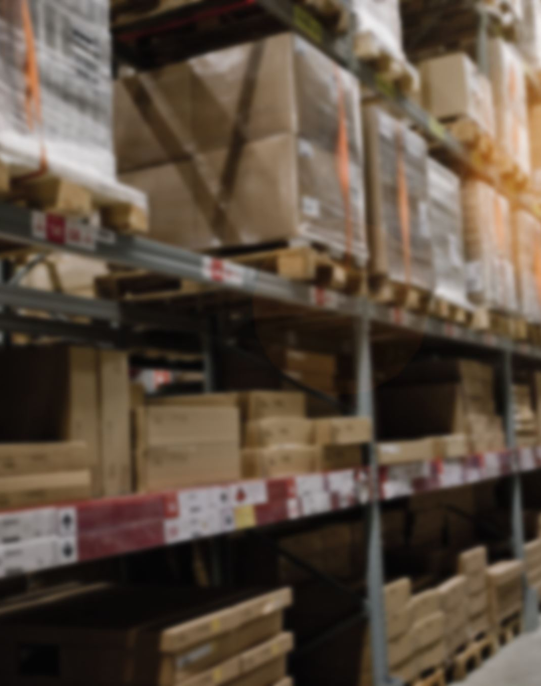

About Akara
Our Mission — To be the most trusted logistics partner worldwide
Our Values — Integrity, Innovation, Accountability, Respect, Sustainability
How We Work — Customer-centric, consistent, and sustainable operations
Notes:
Global logistics company focused on trust and innovation.
Mission: become the most trusted supply-chain partner worldwide.
Values: integrity, innovation, accountability, respect, sustainability.
Playbook keeps every team aligned to these principles.
These aren’t slogans — they guide daily decisions.

Slide 3

The Challenge
Fragmented Systems → limited visibility, inconsistent data
Unreliable Delivery Networks → missed timelines, higher costs
Scaling Under Pressure → operational inefficiencies, dissatisfied customers
Notes:
Businesses face pressure for faster, more transparent logistics.
Fragmented systems and unreliable networks drive up costs.
Limited visibility hurts customer trust and growth.
The challenge: connect every piece of the supply chain.
Sets up the need for a smarter, unified solution.

Slide 4

The Solution
Integrate for Impact – Build a logistics strategy centered on visibility, efficiency, and reliability.
Power with Data – Leverage real-time insights and automation to boost performance and control costs.
Unify the Network – Connect warehouse to last mile through intelligent, transparent processes.
Notes:
To overcome these challenges, organizations need connected systems, data-driven visibility, and operational unity.
The best logistics strategies do three things:
they integrate for impact
they power decisions with data
and they unify the entire network from warehouse to last mile.
This approach defines truly modern logistics - making operations efficient, transparent, and strategically aligned with business goals.

Slide 5

Akara’s Offering
End-to-End Solutions - Freight forwarding, warehousing, last-mile delivery, and real-time tracking all in one.
Smart & Transparent - Advanced analytics and automation for full visibility, faster decisions, and reliable results.
Proven Performance:
95% on-time delivery
99% inventory accuracy
4.5+ customer satisfaction
Notes:
Akara brings these principles to life through fully integrated, end-to-end solutions. This means managing freight forwarding, warehousing, last-mile delivery, and real-time tracking - all within a single, connected system.
We consistently deliver strong results, including 95% on-time deliveries, 99% inventory accuracy, and customer satisfaction scores above 4.5.
These outcomes are powered by our platform ecosystem – Akara Suite, FleetTrack, WarePro, and CRM 360 - which provides advanced analytics, automation, and full visibility to drive faster, smarter, and more reliable operations.

Slide 6

Success Stories
30% improvement in delivery accuracy
25% reduction in warehouse processing time
CRM-driven insights improving customer retention
Notes:
FMCG client improved delivery accuracy by 30 %.
Manufacturing client cut warehouse time 25 %.
CRM 360 boosted engagement and retention.
Data-driven results prove the impact.

Slide 7

Akara vs the Competition
Capability | Akara | Others
Proprietary tech stack | ✅ | ❌
Real-time Tracking | ✅ | ⚠️ Partial
Compliance & safety | ✅ | ⚠️ Inconsistent
Notes:
Proprietary tech stack = more control and reliability.
Real-time tracking and automation reduce disruptions.
Competitors depend on third-party tools — we don’t.
Clients choose Akara for speed, trust, and innovation.

Slide 8

Pricing Approach
Flexible pricing tailored to shipment volume, warehousing needs, and integration scope.
Contact our team for a custom quote aligned with your logistics goals.
Notes:
Flexible, needs-based pricing for every client.
Factors: shipment volume, warehousing, tech integration.
Pay only for what you need — request a tailored quote.

Slide 9

Next Steps
🗓️ Schedule a discovery call
💻 Request a platform demo
✉️ Email sales@akara.com
Notes:
Schedule a discovery call or demo.
Visit akara.com or email sales@akara.com.
Let’s start transforming your logistics today.

