Slide 1
MD-gated dendritic plasticity: progress update
Since 15 Oct: a full audit of the model, then new experiments on what MD gating actually buys
Raghav · PI meeting 2026-11-02 · Model A (spiking, Brian 2)
Notes:
Thanks for making time. Since our meeting on 15 October I did two things.
First, before building anything bigger, I audited every result in the model end to end. That audit corrected some of what I showed you last time, and I'll be upfront about which conclusions changed.
Second, with the corrected model I ran new experiments on what MD gating actually buys us when contexts share inputs, and when contexts keep alternating.
At the end there's one new model issue I found today that I'd like your steer on.
Roughly 10 minutes, then discussion.

Slide 2
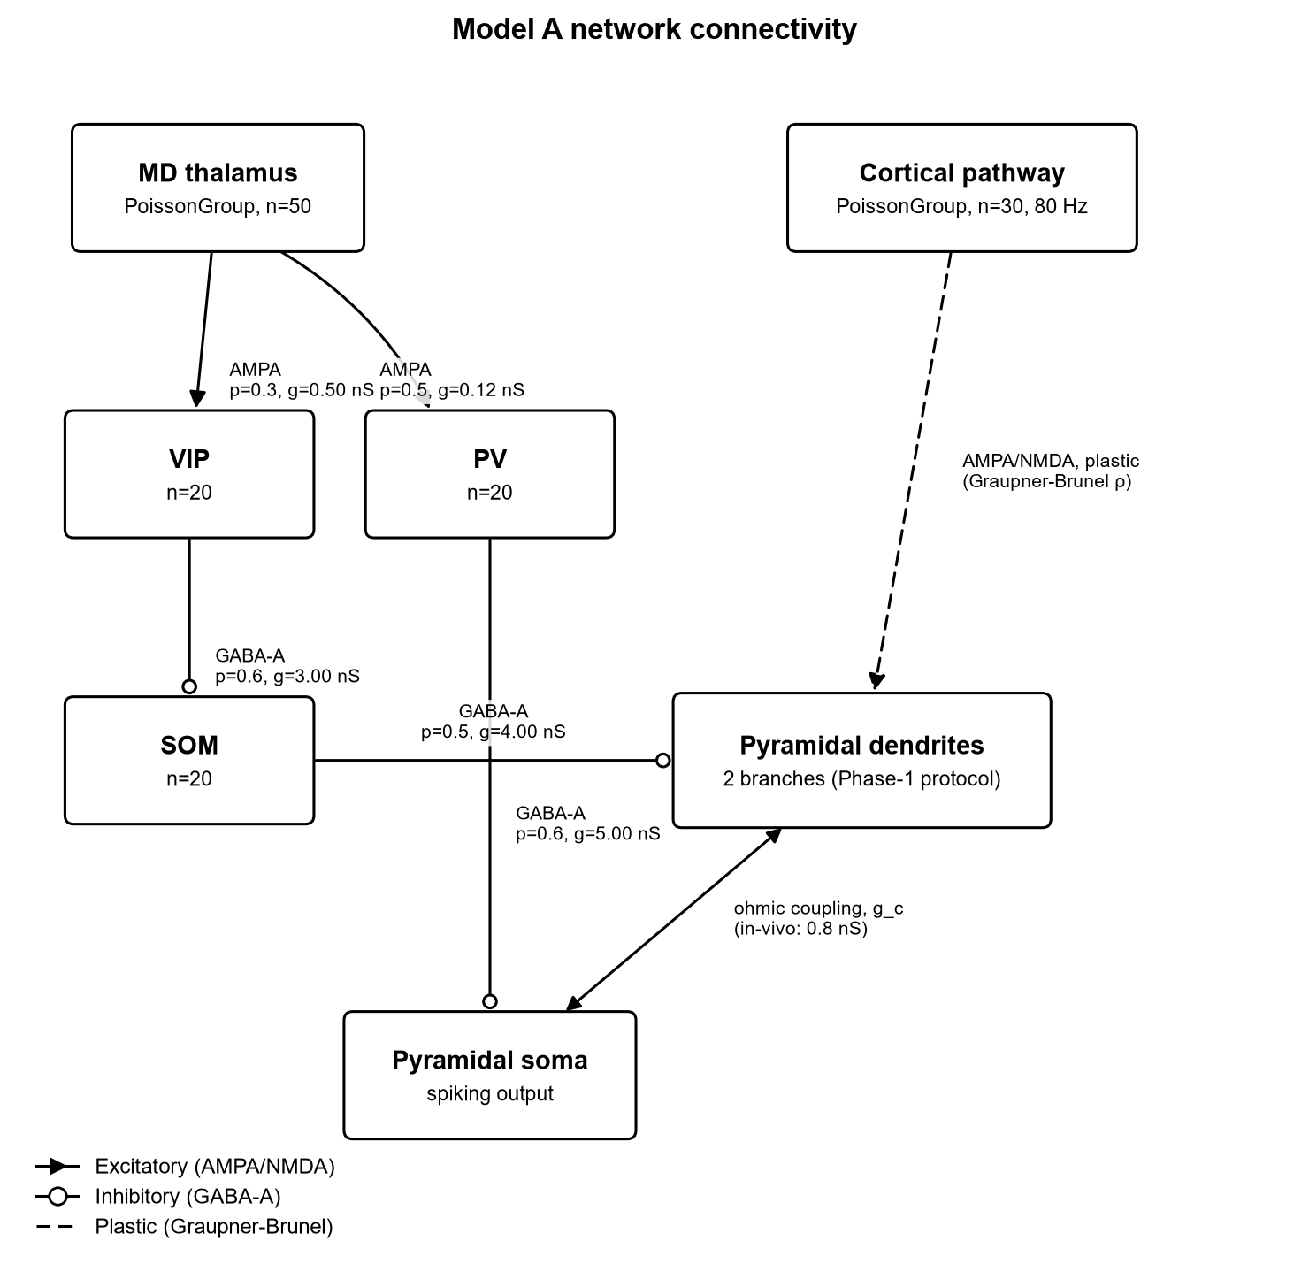
Recap: the question and the model
Hypothesis
MD thalamus selects which dendritic branch of a PFC pyramidal cell may learn, so different contexts write onto different branches instead of overwriting each other.
Model
• Yang, Murray & Wang 2016: 2-branch pyramidal cell, SOM→dendrite gating, calcium-based (Graupner–Brunel) plasticity
• Zhang et al. 2025: MD→VIP→SOM (disinhibition) and MD→PV (somatic gain)
• Readout: learned weight ρ on the free vs the inhibited branch
Notes:
Quick reminder of the question. The hypothesis is that the MD thalamus acts as a controller that selects which dendritic branch of a prefrontal pyramidal neuron is allowed to learn. If different contexts write onto different branches, they shouldn't overwrite each other.
The model grafts two papers together. From Yang, Murray and Wang 2016 we take the single neuron: a soma and two dendritic branches, SOM interneurons that inhibit a branch, and a calcium-based plasticity rule. If a branch is inhibited, its calcium stays low and it can't potentiate. From Zhang et al. 2025 we take the MD wiring: MD excites VIP, VIP inhibits SOM, so MD disinhibits a branch. MD also excites PV, which inhibits the soma.
The readout throughout is the learned synaptic weight, rho, on the free branch versus the inhibited branch.

Slide 3
Since last meeting
Audited every result before building further; fixed 8 problems
1 · Audit
• 8 problems found and fixed, with regression tests
• Some conclusions from 15 Oct changed (next slides)
• Compiled coupling: same results, ~2× faster
2 · Calibration
• PV interneurons recalibrated: 7 Hz at rest, graded with MD
• Balanced, fluctuation-driven soma: PV now scales firing gradually
• Tested: MD→PV does not protect memories
3 · New experiments
• Overlapping inputs between contexts
• Repeated A/B alternation
• Recall test started: exposed a model issue (NMDA not plastic)
Notes:
Three blocks of work.
One: the audit. I found and fixed eight problems, each with a regression test. Some of them changed conclusions from last time — I'll go through those next. I also compiled the soma–dendrite coupling, which gives identical results about twice as fast.
Two: calibration. The PV interneurons were firing unrealistically. They're now recalibrated: about 7 Hz at rest and graded with MD input. I also gave the soma a balanced, fluctuation-driven drive, so PV inhibition scales firing gradually instead of switching it off. With that I could test whether MD→PV protects memories. It doesn't.
Three: new experiments — overlapping inputs, repeated alternation, and a recall test. The recall test exposed a model issue, which is the last results slide.

Slide 4
Audit: what changed from 15 Oct
Earlier claim | What the audit found | Now
Model needs ~2× Yang SOM rate (20–30 Hz) | All SOM cells spiked in lockstep (identical initial voltages) | Desynchronised: gating threshold 13–15 Hz; 25 Hz → 20/20 seeds
MD switches context | In earlier runs MD never chose a branch (gating was hard-wired) | New circuit: MD_k → VIP_k → SOM_k → branch k
Branch gating prevents forgetting | Missing control: retention comes from input sparsity alone | Gating alone: 32–38% retained; inputs alone: 100%
Validation V1 matches Yang | V1 was circular (compared the model to itself) | Measured: matches without inhibition; shunts less than Yang under inhibition
Simulation step 0.02 ms | Network actually ran at 0.1 ms | Checked: results dt-converged
Full write-up: docs/AUDIT_2026-11-01.md · tests: tests/test_audit_fixes.py
Notes:
This is the most important slide for comparing with last time.
Row one: last time I said the model needs about twice Yang's SOM firing rate to gate. The audit found that all SOM cells started from identical voltages, so they spiked in perfect lockstep. Once desynchronised, the gating threshold drops to 13–15 Hz, and at 25 Hz all 20 seeds gate. So the rate gap was an artefact, and the seed failures I explained as a population-size effect were also mostly the lockstep.
Row two: in all earlier runs MD was effectively off and which branch got inhibited was hard-wired. MD never chose a branch. I built a new circuit where each MD channel drives its own VIP→SOM channel onto its own branch. MD now genuinely selects the branch.
Row three: the forgetting result was missing a control — next slide.
Row four: one validation compared the model to its own equations, so it was circular. The measured dendrite matches Yang without inhibition but is shunted less by inhibition.
Row five: the network ran at 0.1 ms rather than the stated 0.02 ms. I checked that the results are converged at that step, so nothing changes, but it's now documented.

Slide 5
Forgetting: retention comes from input sparsity, not gating
Context A × 8 epochs then context B × 8; 5 seeds
Condition | A retained
Gating + idle inputs silent | 100%
Idle inputs silent only | 100%
Gating only (inputs active) | 32–38%
Neither | 100%, but no selectivity
Interpretation
• A silent synapse does not change, so silencing the idle context’s inputs is enough to keep its memory
• Inhibiting a branch whose inputs are still active pushes calcium into the LTD band and erases it
• MD→PV (lowering somatic firing and bAPs) does not rescue this: the erasing LTD is NMDA-driven (retention 0.37–0.39)
Notes:
Last time I showed 100% retention and attributed it to branch gating. The audit added the missing controls.
Context A for 8 epochs, then context B for 8, five seeds. If both gating and silent idle inputs are present: 100%. Silent idle inputs alone, no gating: also 100%. Gating alone, with the old context's inputs still active: only 32–38% retained. Neither: 100% retained, but no selectivity at all.
The interpretation is simple. A synapse that isn't active doesn't change, so silencing the idle context's inputs is what preserves the memory. Inhibiting a branch whose inputs are still active actually pushes its calcium into the depression band and erases the memory.
I also tested whether MD→PV could help, by lowering somatic firing and therefore back-propagating calcium. It doesn't: retention stays 0.37–0.39, because the erasing depression is driven by the branch's own NMDA calcium.
So MD's demonstrated role is choosing which branch learns, not protecting what was learned.

Slide 6
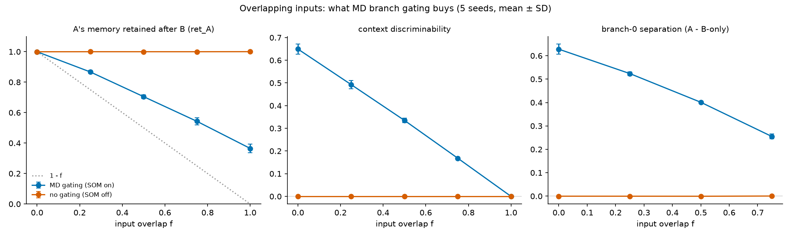
Overlapping inputs: separation costs retention
A and B share a fraction f of their 20 inputs; every input synapses on both branches; 50 runs
Condition | Memory of A kept | Can tell A from B
No gating | 100% at every f | 0 (even at f = 0)
MD gating | ≈ 1 − 0.6·f | ≈ 0.65·(1 − f)
Notes:
Real contexts share inputs, so the next question was what gating buys when they overlap.
Here patterns A and B share a fraction f of their 20 inputs, and every input has a synapse on both branches, so only MD decides where a pattern is stored. A for 8 epochs, then B for 8; MD gating on or off; five overlap levels, five seeds — 50 runs. I wrote the predictions before running, and the extreme cases reproduce the earlier audit numbers.
Without gating, retention is perfect at every overlap, but the cell cannot tell A from B at all — even with zero overlap — because both branches learn both patterns.
With MD gating, inputs unique to A are kept exactly. Shared inputs lose about 60%, because during B they're active on A's gated branch. So retention falls as one minus 0.6 f, and discriminability is about 0.65 times one minus f.
Takeaway: MD gating is the only source of context separation in this model, and the overlap sets the exchange rate between separation and retention.

Slide 7
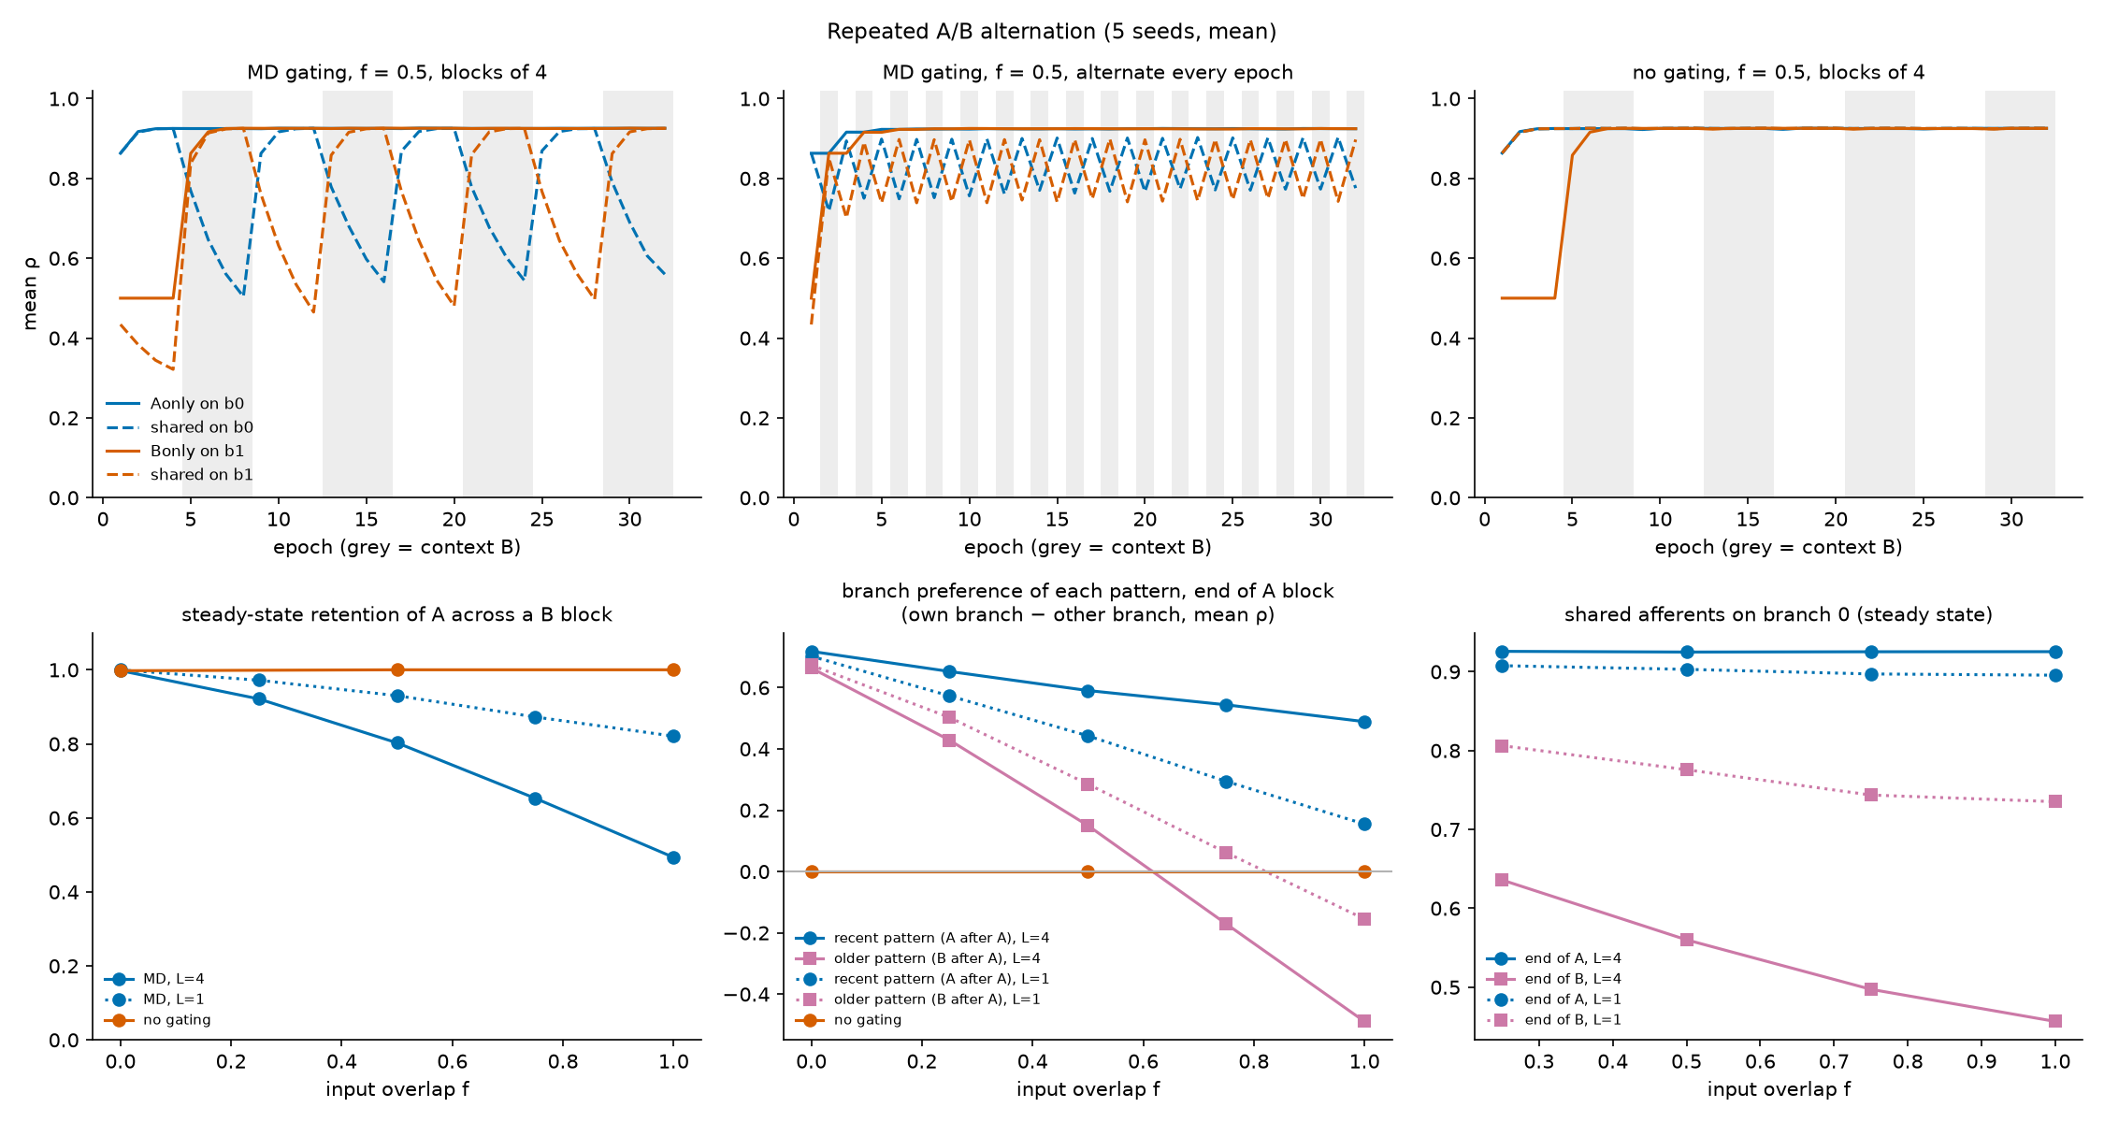
Repeated A/B alternation: forgetting becomes recency
32 epochs, blocks of 4 or alternating every epoch; 65 runs
• Loss is cyclic, not cumulative: fast LTP restores shared synapses on every return
• Shared inputs side with the most recent context’s branch
• Long blocks + high overlap: the older pattern prefers the wrong branch (−0.49 at f = 1)
• Frequent switching keeps both usable (A kept 82–97% vs 49–92%) but separates less
Notes:
Contexts recur, so next I alternated A and B repeatedly: 32 epochs, either in blocks of 4 or switching every epoch. 65 runs including a no-gating control.
Top left shows a typical run. The dashed lines are shared inputs: they drop during the other context's block, then recover within one or two epochs when their own context returns. Potentiation is fast and saturating; depression on a gated branch is slow. So loss is cyclic, not cumulative.
The cost moves from forgetting to recency. Shared inputs always side with whichever context ran last. Bottom middle: with long blocks and high overlap, the older pattern actually prefers the wrong branch — down to −0.49 at full overlap.
Switching every epoch keeps both contexts more usable — 82–97% retained versus 49–92% — but with less separation.
A methods note: my original summed discriminability metric hid this, because shared inputs cancel in it. I added a per-pattern branch preference that reveals it.

Slide 8
New issue: learning cannot change branch output
Recall test, learning frozen (smoke test)
Recall condition | Branch response
MD cue for the context | Cued branch plateaus (~−10 mV), even with all weights = 0
No cue (SOM baseline) | Never plateaus; weights shift V only −68 → −59 mV
No SOM inhibition | Both branches plateau, even with weights = 0
Cause
• Our model: learning scales a small AMPA conductance (0.4 nS); NMDA, which makes the plateaus, is fixed at 2.5 nS
• Yang 2016: inputs are NMDA-only, and learning scales the NMDA conductance (w × 2.5 nS, w from 0 to 3)
• An earlier deliberate choice to avoid a runaway loop; it means the learned weights have no functional effect
Plan: Yang’s NMDA-plastic version as an option, check stability, rerun the key results
Notes:
All results so far are at the level of synaptic weights. So I started a recall test: freeze learning, present A or B, and measure each branch's response. A quick smoke test showed a problem.
With the MD cue for a context, the cued branch goes into an NMDA plateau — even if all its weights are zero. With no cue, SOM keeps both branches below plateau, and the learned weights only shift the voltage by about 9 mV. With SOM removed, both branches plateau, again with zero weights. So learning never decides which branch responds.
The cause: in our model the learned weight scales only a small AMPA conductance, 0.4 nS. The NMDA conductance that produces the plateaus is fixed at 2.5 nS. In Yang 2016, inputs are NMDA-only and the learned weight scales the NMDA conductance directly, from 0 to 3 times 2.5 nS. Our version was an earlier deliberate choice to avoid a runaway loop, but it means the weights have no functional effect.
My plan: add Yang's NMDA-plastic version as an option, check whether it's stable — in Yang the weights are bounded, so the runaway may not happen — and rerun the key experiments. About 1.5–2 hours if stable, a few more hours if it needs recalibration.

Slide 9
Where we are and next steps
Established
• MD selects which branch learns (via VIP→SOM)
• Retention comes from input sparsity; MD gating alone erases
• With shared inputs: gating = separation, paid in retention
• Under alternation: a recency-weighted branch code
Next
• Make NMDA plastic (Yang-faithful) and rerun the key experiments
• Functional recall test with learning frozen
• Then scale to a network (Phase 4)
• Open: Yang’s 10 Hz needs ~1.5× gGABA (our dendrite shunts less) — refit or accept?
Notes:
To summarise where we are.
Established: MD selects which branch learns, through VIP→SOM. Retention comes from input sparsity; gating alone erases. With shared inputs, gating buys separation and pays for it in retention. And under repeated alternation, the branch code is weighted toward the most recent context.
Next: make NMDA plastic as in Yang and rerun the key experiments; then the functional recall test; then scale to a network.
Two things I'd like your input on. First, do you agree with switching to Yang's NMDA-plastic weights, given it changes the core model? Second, our dendrite is shunted less by inhibition than Yang's fit, so reaching Yang's 10 Hz SOM regime needs about 1.5 times his inhibitory conductance. Should I refit the dendrite, or accept that and document it?
One more housekeeping note: this work is on a branch and isn't pushed to GitHub yet.

Slide 10
In progress: Yang-faithful NMDA-plastic synapses
Option implemented today; first check running now
What changed (opt-in setting)
• NMDA conductance = w × 2.5 nS (w = 3ρ, 0 to 7.5 nS), in the current and its calcium
• AMPA input off (Yang: NMDA-only); start at w = 1 as in Yang
• Default unchanged: old results stay bit-identical
Running now: experiments/nmda_plastic_check.py
• 12 runs: old vs Yang synapse × 2 protocols × 3 seeds
• Protocol: context A × 8 epochs then B × 8 (3 s each)
• Check 1: no runaway (weights bounded, branches not stuck in plateau)
• Check 2: gating still works (free branch potentiates, inhibited one does not)
• Check 3: retention, inputs always on vs context-specific
• Then: rerun overlap, alternation, and the recall test
# synapse equations (context_circuit.py)
before: I_NMDA = -gNMDA·s·(V-E)·mg
now: I_NMDA = -w·gNMDA·s·(V-E)·mg
calcium: dc/dt ∝ w·gNMDA·s·mg·(E-V)
run_context_protocol(..., nmda_plastic=True)
First results (3 seeds):
Stable, no runaway · gating ratio ≈ 3 (old ≈ 4)
Retention, inputs always on: 0.43 / 0.59 / 0.98 (old 0.35–0.40)
Notes:
This is what I started right after finding the issue. The change is small in code but big for the model: the learned weight now scales the NMDA conductance, exactly as in Yang 2016, both in the NMDA current and in the calcium it produces. AMPA input is switched off to match Yang's NMDA-only inputs, and synapses start at w = 1, Yang's 2.5 nS.
It's an opt-in setting, so every result I've shown today is still reproducible exactly.
The first check is running now: 12 short runs comparing the old and new synapse on the same protocol. The main risk is the runaway loop that motivated the original choice — stronger NMDA, more depolarisation, more calcium, more potentiation. In Yang the weight is bounded at w = 3, so it may be fine. I'm also checking that gating still works and what happens to retention.
If it's stable, the overlap, alternation and recall experiments rerun in about an hour. If it isn't, it needs recalibrating, which is a few hours more.
First results just came in (3 seeds each). The new synapse is stable: no runaway, weights stay at or below 0.93, the same ceiling as before. Gating still works: after context A the free branch is at 0.93 and the inhibited branch stays near 0.30, a ratio of about 3, versus about 4 with the old synapse. With context-specific inputs, retention is still 100%. With inputs always on, retention is 0.43, 0.59 and 0.98 across the three seeds, versus 0.35–0.40 with the old synapse — so the NMDA-plastic version may protect memories partly, but it is very seed-dependent and needs more seeds before I'd claim anything.

