Slide 1
Thalamocortical Gating Model
Results summary - what we replicated, what broke, what we fixed. Compiled from the project's real result figures, in the order things happened.

Slide 2
What we set out to do
• Question: can MD thalamus control WHICH dendritic branch of a pyramidal neuron
• is allowed to learn - so different contexts write onto different branches?
•
• Built by combining two papers that don't talk to each other:
• Yang, Murray & Wang 2016 - the gating mechanism (dendrite + calcium + plasticity),
• no thalamus.
• Zhang et al. 2025 - the MD thalamus wiring (MD -> PV, MD -> VIP), no dendrites,
• no plasticity.
•
• Canonical model ("Model A"): 1 soma, 2 dendritic branches, 20 of each
• interneuron type (PV / SOM / VIP), Brian 2 spiking simulation.

Slide 3
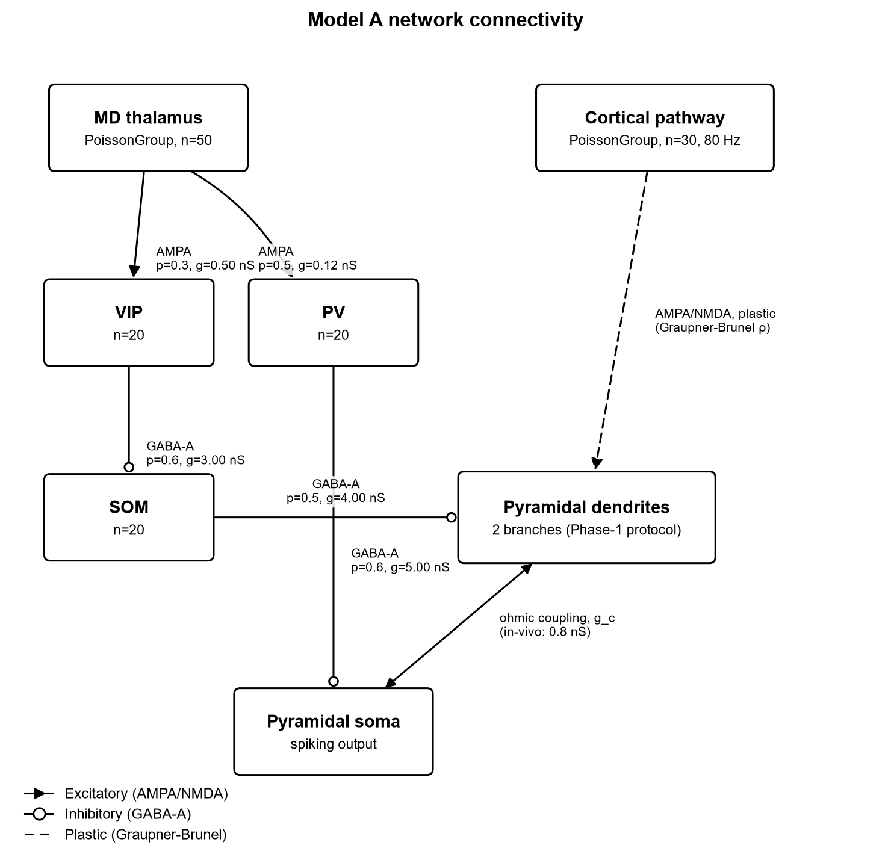
Model architecture
Model A connectivity.
MD thalamus (Poisson input) drives PV and VIP.
VIP inhibits SOM (disinhibition).
SOM inhibits one dendritic branch only.
PV inhibits the soma.
Weights / probabilities read directly
from model/parameters.py.

Slide 4
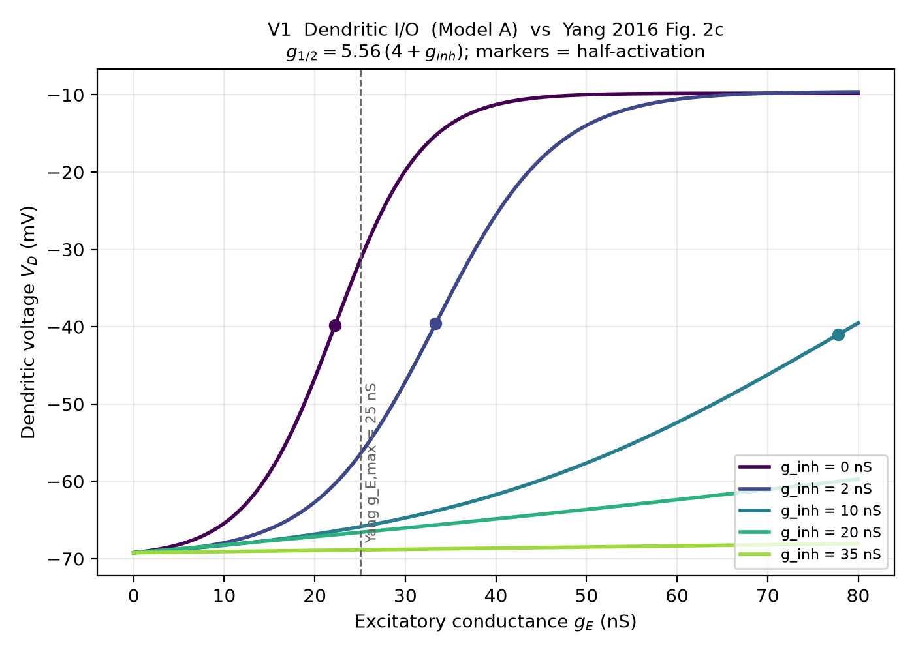
Bug 1 + Bug 2 fix - validation
Bug 1: coupling constant was 4.0 nS,
should have been Yang's 0.8 nS.
-> soma fired at 201 Hz instead of ~10 Hz.
Bug 2: calcium model wasn't Yang's leaky
integral - old version capped at 1.328,
below LTP threshold (2.78). LTP impossible.
After both fixes, measured dendritic
half-activation vs. Yang's own formula
g(1/2) = 5.56 x (4 + g_inh):
22.24 / 33.36 / 77.83 / 133.42 / 216.81 nS
matches Yang's formula to the digit
at all 5 inhibition levels.

Slide 5
Bug 1 + Bug 2 - sanity check number
• Free branch rho = 0.78
• Inhibited branch rho = 0.02
• (seed 42, exc = 80 Hz, post = 10 Hz, coupling = 0.8 nS)
•
• First working separation between the two branches after both fixes.
•
• Caveat found later: this specific ratio was inflated by a separate,
• then-undiscovered bug (the 346x plasticity-timescale bug - next section).
• The dendritic I/O match on the previous slide is the cleaner check,
• since it does not depend on the plasticity equation at all.

Slide 6
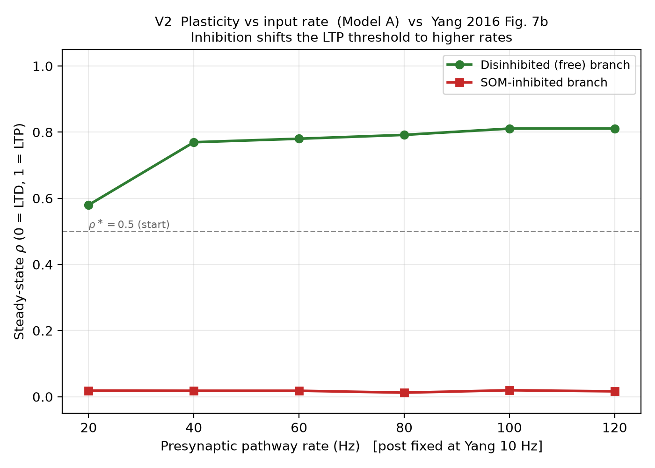
V2 - LTP threshold shifts with rate (Yang Fig. 7b)
Presynaptic rate (Hz):
20 40 60 80 100 120
Free branch rho:
0.58 0.77 0.78 0.79 0.81 0.81
Inhibited branch rho:
stays ~0.012-0.020 across the whole range
Free branch potentiates more as rate rises;
inhibited branch never does, at any rate.

Slide 7
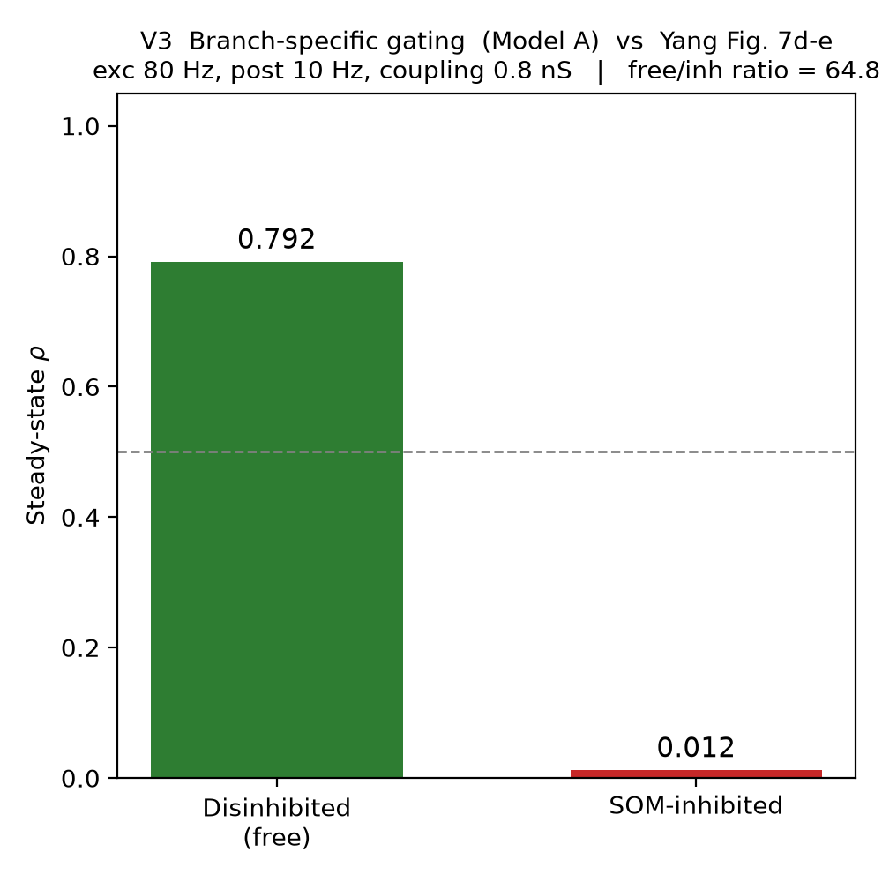
V3 - gating at Yang's own operating point
exc = 80 Hz, post = 10 Hz
(Yang's own stated operating point)
Free branch rho = 0.792
Inhibited branch rho = 0.012
Ratio = 64.83
(One of 3 different measurements of the
same nominal number that didn't agree with
each other - flagged, not hidden - see
Progress_Report.docx Section 2.2.)

Slide 8
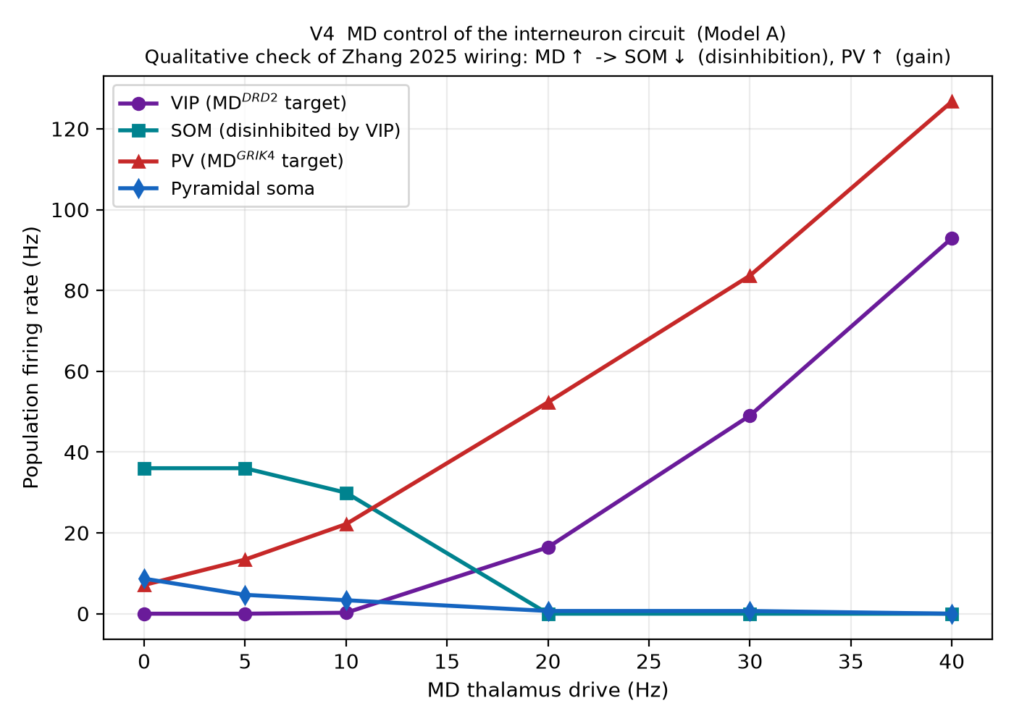
V4 - does MD control the interneurons the way Zhang says?
MD drive (Hz): 0 5 10 20 30 40
PV rate (Hz): 7.1 13.4 22.2 52.3 83.7 126.7
SOM rate (Hz): 36.0 36.0 29.9 0.0 0.0 0.0
VIP rate (Hz): 0.0 0.0 0.2 16.4 49.0 92.9
As MD rises, VIP rises and suppresses SOM
(36 -> 0 Hz) - disinhibition works as Zhang's
wiring predicts. PV rises in parallel
(separate gain-control arm).
Qualitative check only - we borrow Zhang's
wiring labels, not his trained behavior.

Slide 9
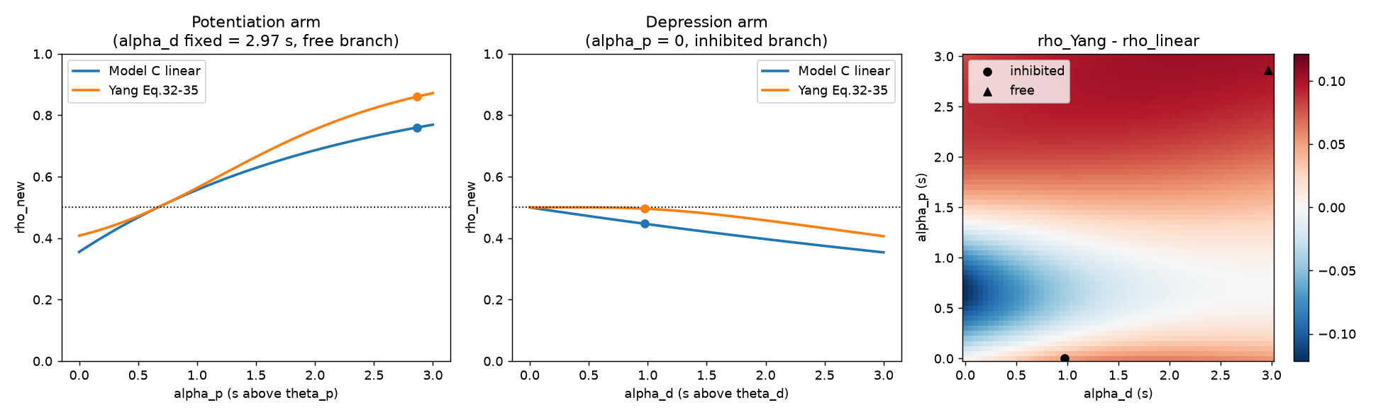
The 346x plasticity-timescale bug
tau = 346.36 s (Yang's own published time
constant) - but the project's ODE only
divided part of the equation by tau.
Ratio of what was written vs. correct: 346.
Form rho_inhib rho_free ratio
As-committed 0.018 0.779 42.76
Canonical(fixed) 0.424 0.638 1.51
(both at T = 3 seconds)
Canonical form run for 300 s (~1.7 hrs
wall-clock): oscillated 1.49-2.83,
never converged. Motivated switching to
Yang's actual closed-form equation instead
of patching this ODE further.

Slide 10
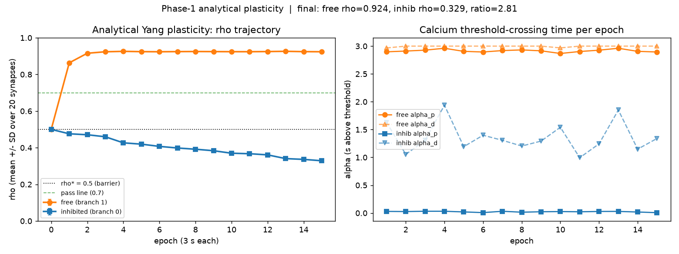
Multi-epoch result with Yang's real equation
Yang's closed-form epoch update
(his Eqs. 32-35), not a continuous ODE.
epoch: 0 1 2 3 5 8 15
free rho: .50 .86 .92 .92 .92 .93 .92
inhib rho:.50 .48 .47 .46 .42 .39 .33
Final ratio = 2.81
Much lower than the old 42.76 headline -
because 42.76 was never real (previous slide).
This number is honest.

Slide 11
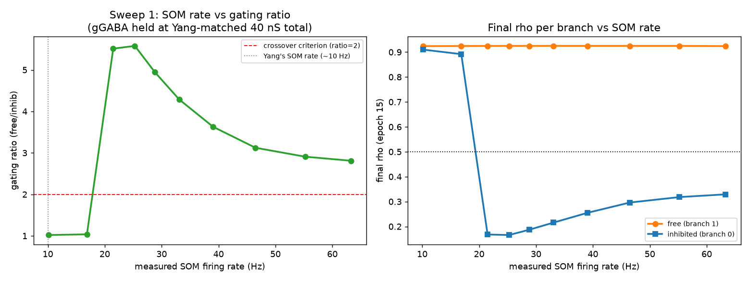
Sweep 1 - SOM firing rate (this is where 25 Hz comes from)
gGABA held fixed at Yang-matched 40 nS.
SOM rate (Hz): 10 17 21 25 29 33 39 46 55 63
ratio: 1.0 1.0 5.5 5.6 5.0 4.3 3.6 3.1 2.9 2.8
Sharp STEP between 17 and 21 Hz, not gradual.
Peak ratio 5.58 at 25.3 Hz.
Ratio then DECLINES past the peak -
more SOM drive is not always better.

Slide 12
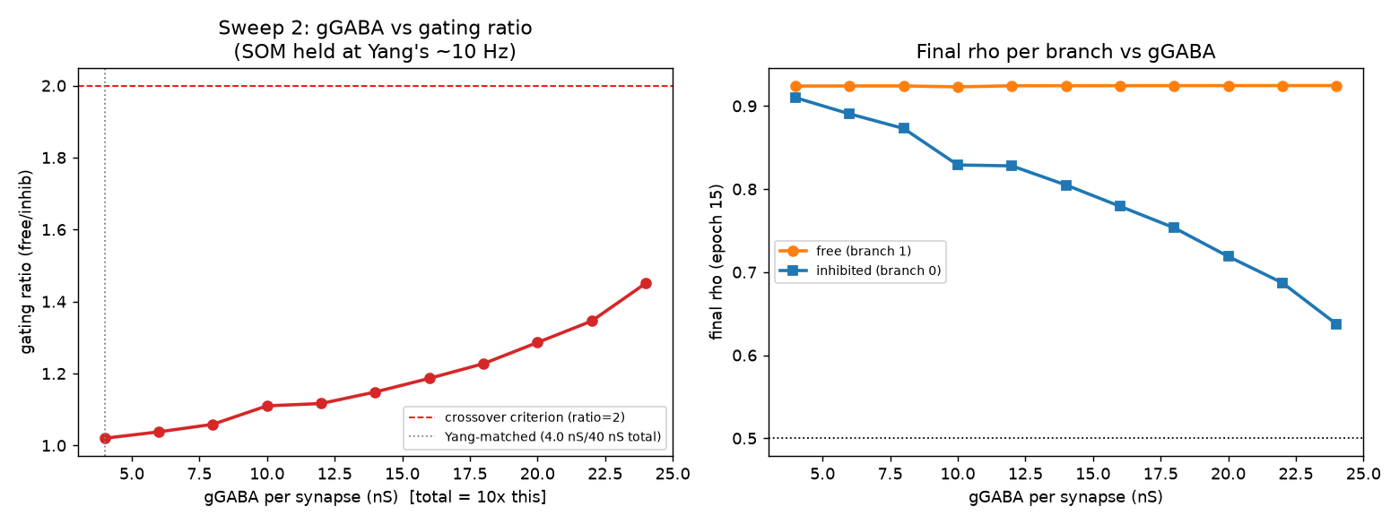
Sweep 2 - GABA conductance amount (this one failed)
SOM held at Yang's own ~10.15 Hz.
gGABA per synapse swept 4 -> 24 nS.
Ratio only climbs from 1.02 to 1.45,
even at 6x Yang's own conductance spec.
Never reaches the ratio = 2 pass line.
Conclusion: it's SOM's RATE / TIMING that
matters for gating, not the total amount
of inhibitory conductance.

Slide 13
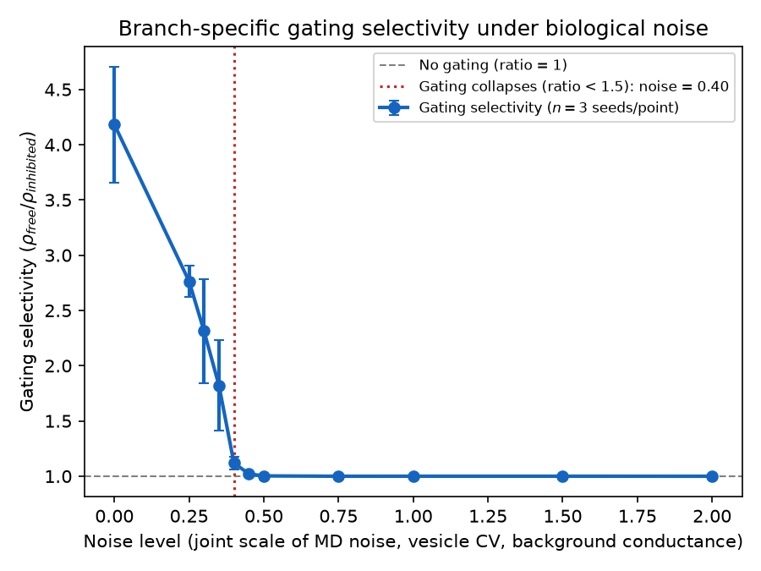
Noise robustness
How much biological noise can gating
tolerate before it stops working?
3 noise sources scaled together:
MD noise input, vesicle-release variance,
SOM/VIP background fluctuation.
Gating degrades gradually, then collapses
sharply past a breaking-point noise level.
(current baseline: SOM at 30 Hz)

Slide 14
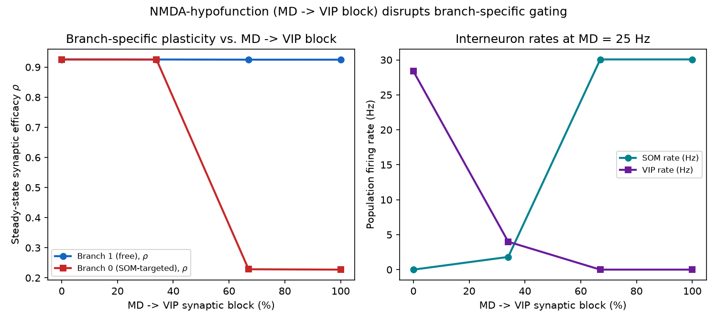
Ketamine / NMDA-hypofunction simulation
Models a standard schizophrenia-dysfunction
circuit disruption: block NMDA on VIP,
i.e. block MD -> VIP synapse (0% -> 100%).
Below ~50% block: MD can still pick which
branch learns.
Above ~50% block: SOM returns to its own
baseline rate, permanently shuts its
branch - MD's signal no longer matters.
Reading: loss of CONTROL over learning,
not a general shutdown of learning.

Slide 15
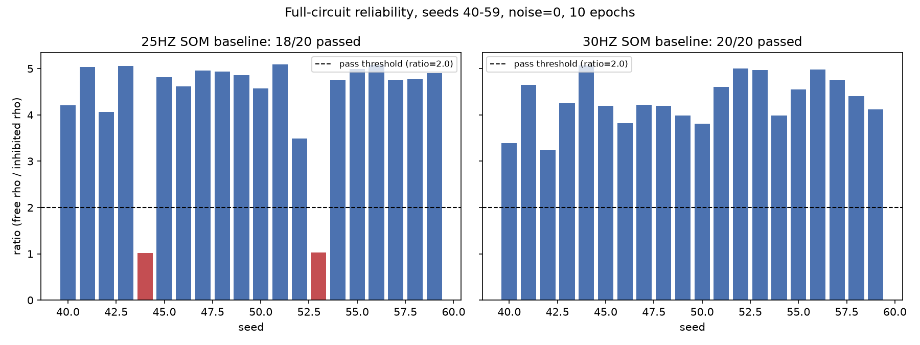
Reliability check: does 25 Hz actually hold up?
20 seeds (40-59), full circuit, noise = 0.
25 Hz: 18 / 20 seeds pass
(seeds 44 and 53 both fail,
ratio ~1.02 - a real ~10% failure
rate, not a fluke)
30 Hz: 20 / 20 seeds pass
(ratios 3.25 - 5.07)
Result: SOM baseline relocked to 30 Hz.
This is the current committed default.

Slide 16
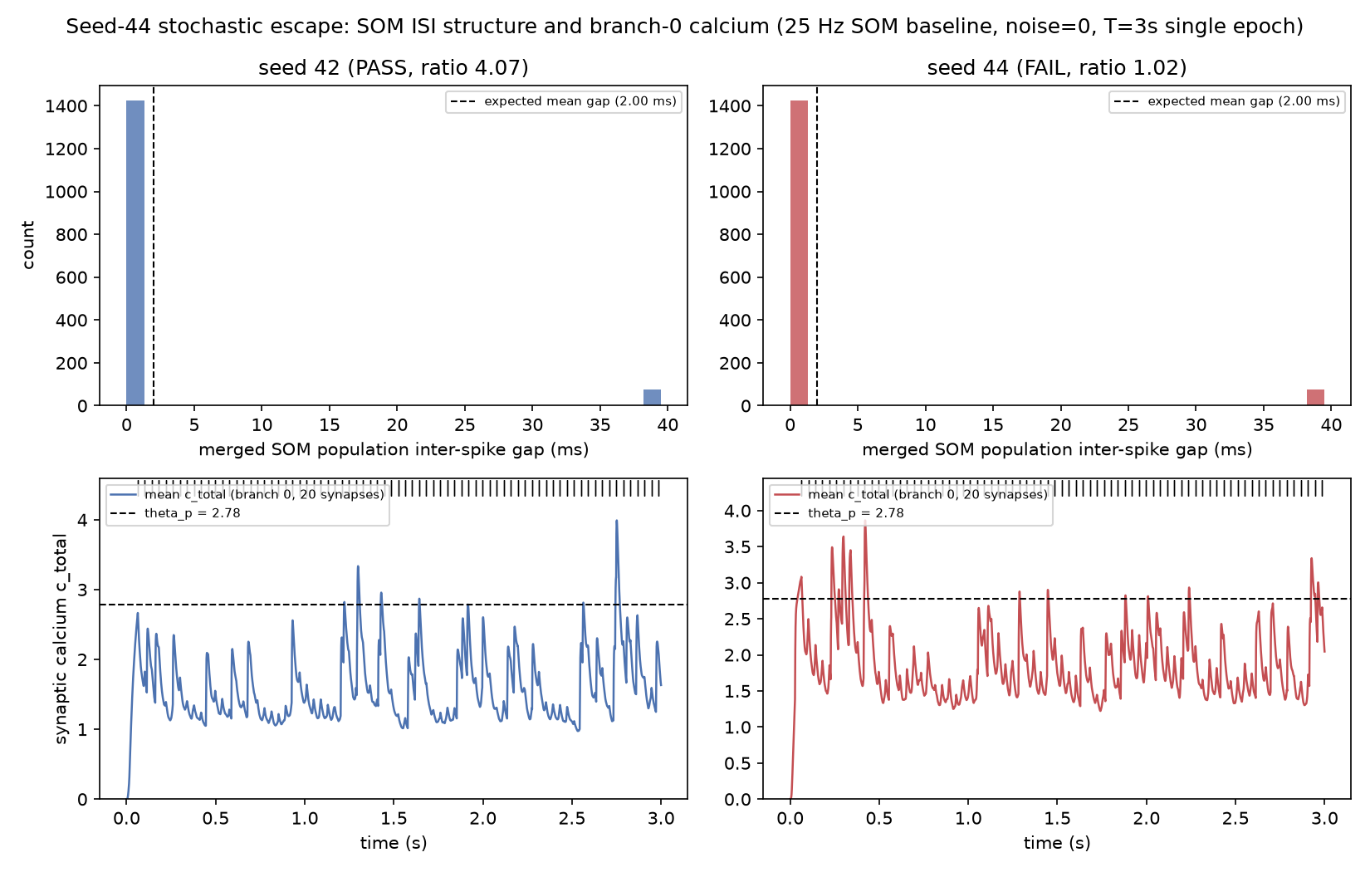
What actually differs in a failing seed?
Seed 42 (pass, ratio 4.07) vs.
seed 44 (fail, ratio 1.02), both at 25 Hz.
SOM inter-spike-gap histograms:
statistically indistinguishable between
the two seeds - the clean "SOM got an
unlucky gap" story does NOT show up here.
What DOES differ: seed 44's calcium trace
sits higher and crosses the LTP threshold
more persistently through the run.
Honest status: escape is real, mechanism
only partially characterized - not a
single isolated cause yet.

Slide 17
Where things stand right now
• Model: Model A (Brian 2), SOM baseline = 30 Hz, Yang's real Eqs. 32-35 plasticity.
• Reliability at current baseline: 20/20 seeds, full circuit, noise = 0.
•
• Still open:
• - Seed-44-style escape mechanism: real, not fully isolated to one cause.
• - Phase-1 headline ratio: 3 different measurements (43 / 64.8 / 42.76) never
• fully reconciled - flagged, not resolved.
• - Reproducibility (Test 5): same seed gives different output. Still undiagnosed.
• - Network scale: still 1 soma / 2 branches / 20 interneurons, not Yang's ~3000 neurons.
• - Models B and C (NumPy prototypes): still plasticity-inert, not repaired or retired.

