Slide 1
Replicating Yang (2016) Supplementary Figures 1 & 2
Paper panels (left) vs. our model's replication (right). Panels relevant to our gating model first, then panels generated only to validate Yang's modelling choices.

Slide 2
Part 1 — Panels relevant to our gating model
(the dendritic NMDA-plateau mechanism our model is built on)

Slide 3
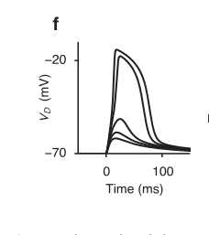
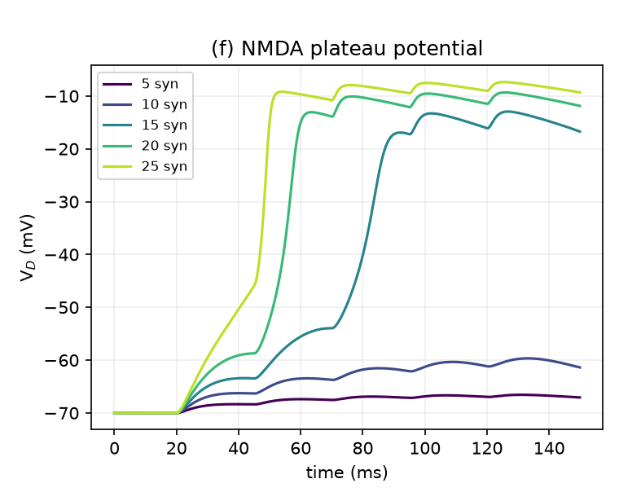
NMDA plateau potential (Supp Fig. 1f)
Yang 2016 (paper)
Our model
The dendrite jumps sharply to a plateau (~-10 mV) once enough NMDA synapses activate (here ≥15). This regenerative nonlinearity is exactly what our model's dendritic branches rely on.

Slide 4
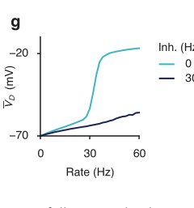
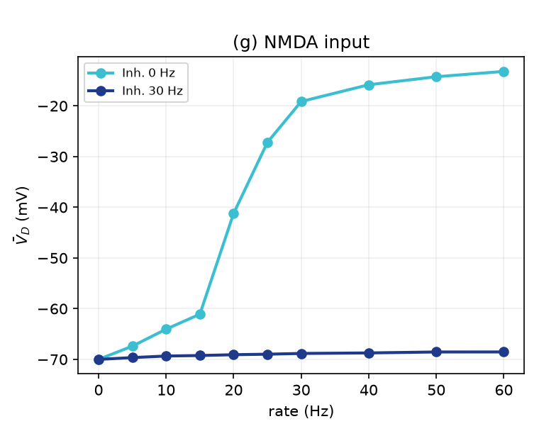
NMDA input gated by inhibition (Supp Fig. 1g)
Yang 2016 (paper)
Our model
Mean dendritic voltage vs input rate: a sharp threshold at ~25-30 Hz that 30 Hz inhibition completely suppresses. This IS our gating mechanism — SOM inhibition shutting a dendritic branch.

Slide 5
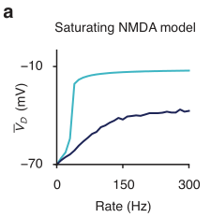
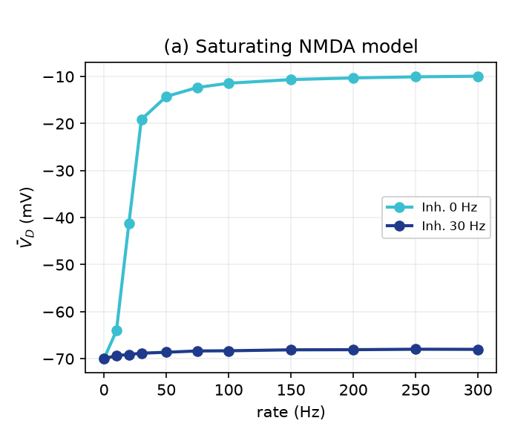
Saturating NMDA enables strong inhibitory control (Supp Fig. 2a)
Yang 2016 (paper)
Our model
With saturating NMDA, modest inhibition holds the branch down across all input rates (the inhibited curve never reaches the disinhibited one) — why gating is robust in our model.

Slide 6
Part 2 — Panels generated only to validate Yang's modelling choices
(our model does not use AMPA or non-saturating NMDA; shown for completeness)

Slide 7
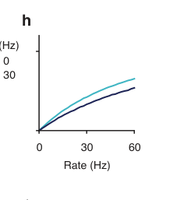
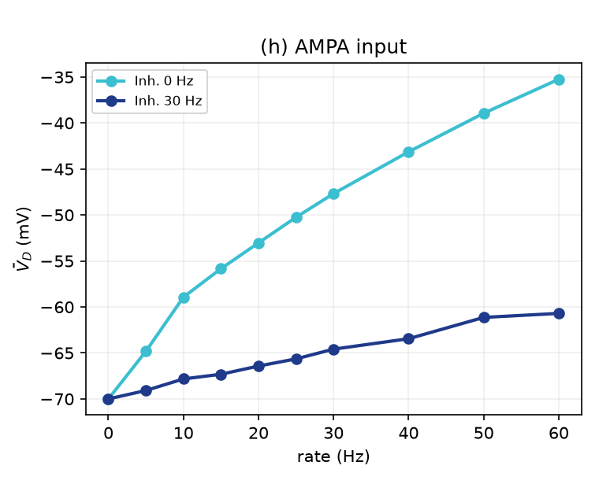
AMPA input is barely gated (Supp Fig. 1h)
Yang 2016 (paper)
Our model
AMPAR-driven input is roughly linear and only weakly affected by inhibition — validating Yang's (and our) choice to use NMDA-only excitation for gateable dendrites.

Slide 8
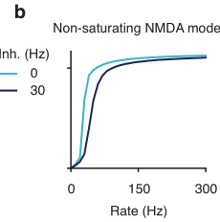
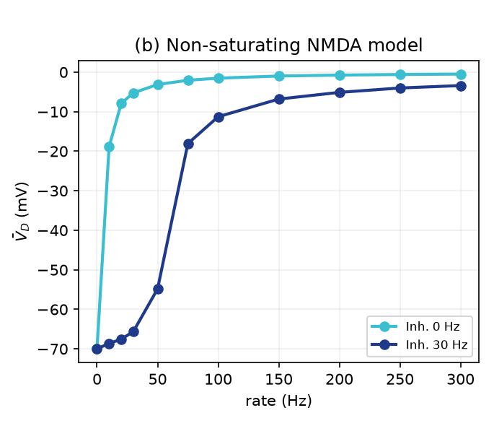
Non-saturating NMDA loses inhibitory control (Supp Fig. 2b)
Yang 2016 (paper)
Our model
A control: without NMDA saturation the inhibited curve climbs back up at high rates, so inhibition can no longer gate. Confirms saturation is essential.

Slide 9
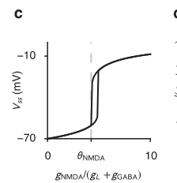
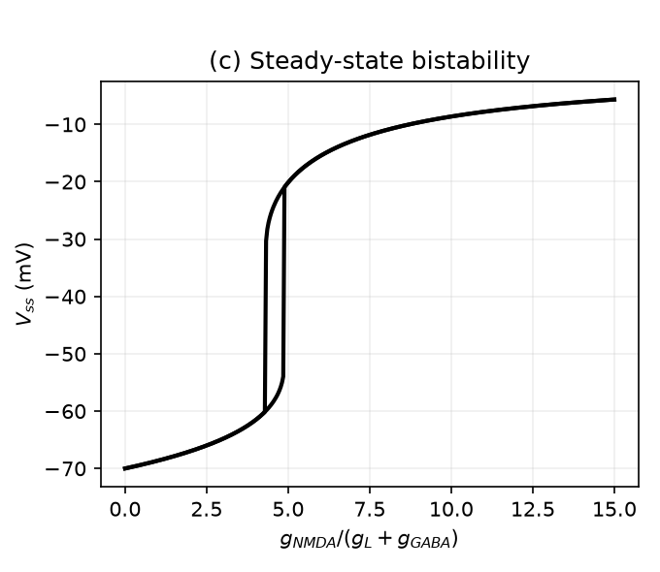
Steady-state bistability (Supp Fig. 2c)
Yang 2016 (paper)
Our model
Steady-state voltage jumps sharply at a threshold θ_NMDA in the effective input g_NMDA/(g_L+g_GABA) — the theoretical basis of the plateau switch.

Slide 10
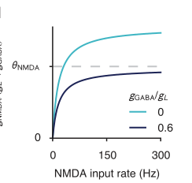
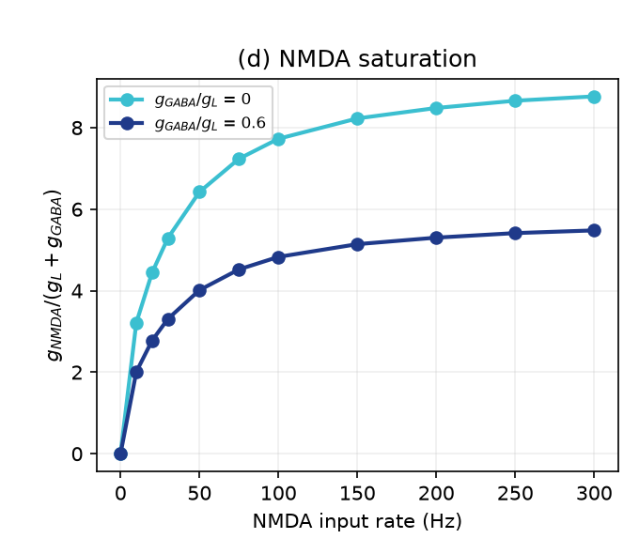
NMDA conductance saturation (Supp Fig. 2d)
Yang 2016 (paper)
Our model
The effective NMDA input saturates with rate; adding inhibition (g_GABA/g_L = 0.6) lowers the saturated value toward the plateau threshold. Theory panel underpinning gating.

